Slide 1
Final Project Defense
Student Performance Factors Analysis
Subject: Data Science with Python & SQL (ADY201m)
Dataset: StudentPerformanceFactors.csv (n = 6,607)
Key Highlights:
• Complete 10-Step Data Science Methodology (SQL + Python)
• Non-destructive SQL Data Cleaning (CTE & Window Functions)
• Exploratory Data Analysis (EDA) & IQR Outlier Detection
• Statistical Testing (ANOVA / T-test) & Linear Regression
FPT UNIVERSITY
DATA SCIENCE METHODOLOGY
10-Step SQL & Python
Analytics Pipeline
6,607 Student Records
16 Attributes
14 SQL Queries & EDA

Slide 2
00
AGENDA
Presentation Outline
01. Business Understanding & Approach
• Steps 1–2: Problem formulation, analytical questions, SQL + Python methodology.
02. Data Requirements & Collection
• Steps 3–4: 6,607 records, 16 columns, rowid key generation, initial SQL queries.
03. Data Quality & SQL/Python Cleaning
• Steps 5–6: Handling missing values (Unknown) and out-of-range score (101 -> NULL).
04. Exploratory Data Analysis (EDA)
• Distribution of Exam_Score, scatter fits, and Pearson correlation matrix.
05. Categorical Factors & Demographics
• Violin/Box plots across family, school, peer, gender, and school type.
06. SQL Rule-Based Modeling (Step 7)
• CASE WHEN study tiers, RANK() OVER window function, Motivation × Parent matrix.
07. ANOVA Testing & Linear Regression
• Hypothesis testing (8/10 significant factors) and multivariate regression (R² = 85.8%).
08. Evaluation, Deployment & Feedback
• Steps 8–10: SQL JOIN cohort evaluation, CSV/DB export, and policy recommendations.

Slide 3
01
STEPS 1 & 2 — METHODOLOGY
Business Understanding & Analytic Approach
Step 1: Business Understanding (Problem)
• Educational institutions need to identify which study behaviors and socioeconomic contexts accompany high or low Exam_Score.
• Goal: Prioritize academic advising and resource support for at-risk student groups.
• Focus on associative patterns and actionable cohort benchmarks rather than causal claims.
Core Analytical Questions
• Q1: What is the average exam score (67.23) and overall data quality profile?
• Q2: How do scores differ across weekly study-hour tiers (<=10h to >30h) and attendance brackets (<70% to 90–100%)?
• Q3: How do motivation, parental involvement, parental education, and extracurriculars interact?
Step 2: SQL Analytic Approach
• Data quality audit: COUNT, GROUP BY HAVING, NULL/empty checks, and range validation.
• Non-destructive cleaning via CTE (WITH standardized AS) & ROW_NUMBER() deduplication.
• Rule-based cohort modeling using CASE WHEN, RANK() OVER, SUM() OVER, and CROSS/INNER JOIN.
Step 2: Python Statistical & ML Approach
• Pandas & NumPy pipeline to cross-verify 100% of SQL cleaning and group aggregations.
• Exploratory Data Analysis (EDA) with Matplotlib/Seaborn and IQR outlier detection.
• Parametric hypothesis testing (One-way ANOVA, T-test) and Multivariate Linear Regression.
Combining SQL relational querying with Python statistical modeling ensures 100% reproducibility.

Slide 4
02
STEPS 3 & 4 — DATA PIPELINE
Data Requirements & SQL Data Collection
Step 3: Dataset Architecture (6,607 × 16)
• Source: StudentPerformanceFactors.csv (6,607 rows, 16 columns).
• Primary Key Generation: Raw CSV has no ID column -> generated student_id = rowid (1 to 6,607).
• Target Variable: Exam_Score (0–100 scale).
• 5 Numeric Predictors: Hours_Studied, Attendance, Previous_Scores, Sleep_Hours, Physical_Activity.
• 10 Categorical Predictors: Parental_Involvement, Access_to_Resources, Motivation_Level, Family_Income, Teacher_Quality, Peer_Influence, Parental_Education_Level, Extracurricular_Activities, School_Type, Gender.
School_Type | Gender | Students | Avg Exam Score
Private | Female | 843 | 67.30
Private | Male | 1,166 | 67.28
Public | Female | 1,950 | 67.22
Public | Male | 2,648 | 67.21
Step 4: Initial SQL Retrieval Findings
• Query 4.1 (Top 10 students with Attendance >= 90%): Uncovered student_id = 1526 with Exam_Score = 101, immediately signaling the need for domain validation in Step 5.
• Query 4.2 (School_Type × Gender): Public schools represent 69.6% of records (4,598 students) vs. Private (30.4%, 2,009 students); mean scores are nearly identical (~67.2–67.3).
• Verified with Pandas groupby: 100% match across all 4 subgroups.
SQLite table raw_students preserves the exact original CSV for auditability before cleaning.

Slide 5
03
STEPS 5 & 6 — DATA CLEANING
Data Quality Audit & SQL/Python Cleaning
Quality Metric | Before (Raw) | After (Clean SQL/Py)
Total Records | 6,607 | 6,607 (student_id 1..6607)
Duplicate Rows | 0 | 0 (ROW_NUMBER rn = 1)
Missing Teacher_Quality | 78 (1.18%) | 0 (78 -> 'Unknown')
Missing Parental_Education | 90 (1.36%) | 0 (90 -> 'Unknown')
Exam_Score > 100 (Invalid) | 1 (id=1526, score=101) | 0 (1 -> NULL, n=6,606 valid)
Valid Mean Exam_Score | 67.236 | 67.231
5 Golden Rules of Step 6 Cleaning
• 1. Generate primary key student_id = rowid.
• 2. Standardize column names to snake_case and TRIM() text.
• 3. Never fabricate exam scores: out-of-range Exam_Score = 101 is flagged as NULL rather than capped to 100.
• 4. Map missing categorical entries to 'Unknown' via COALESCE(NULLIF(TRIM(col), ''), 'Unknown').
• 5. Execute cleaning in new table students_clean_sql & DataFrame clean_py without altering raw_students.
Reconciliation Verification (SQLite vs. Pandas)
• All automated assertions passed: len(clean_sql) == len(clean_py) == 6,607 | mean(exam_score) == 67.231 | Unknown counts (78 & 90) match 100%.
Non-destructive data preparation ensures full transparency and prevents artificial bias.

Slide 6
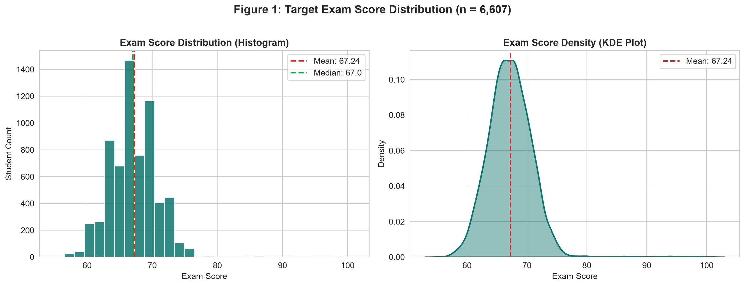
04
EXPLORATORY DATA ANALYSIS
Exam Score Distribution & Outlier Audit
Key Distributional Insights
• Mean = 67.24 | Median = 67.0 | Std = 3.89.
• IQR = 4.0 (Q1 = 65.0, Q3 = 69.0): 50% of students score between 65 and 69.
• Right-skewed distribution (Skewness = 1.645, Kurtosis = 10.575) driven by high achievers scoring 76–100.
• IQR Outliers: Hours_Studied has 43 outliers (0.65%), Exam_Score has 104 high-achieving outliers (1.57%); Attendance, Sleep_Hours, Previous_Scores, and Physical_Activity have 0% outliers.
Predictor variables are symmetrically distributed, while Exam_Score exhibits a high-achieving right tail.

Slide 7
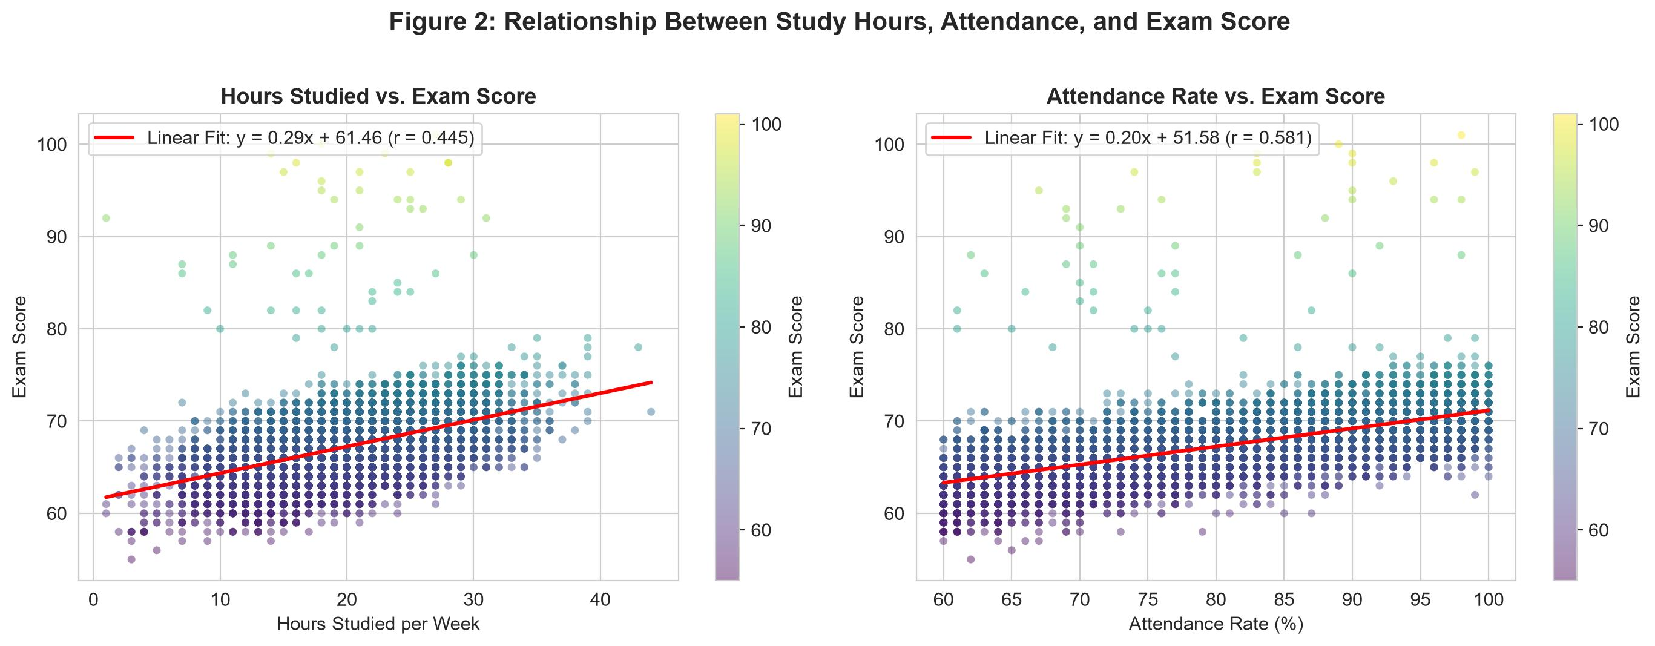
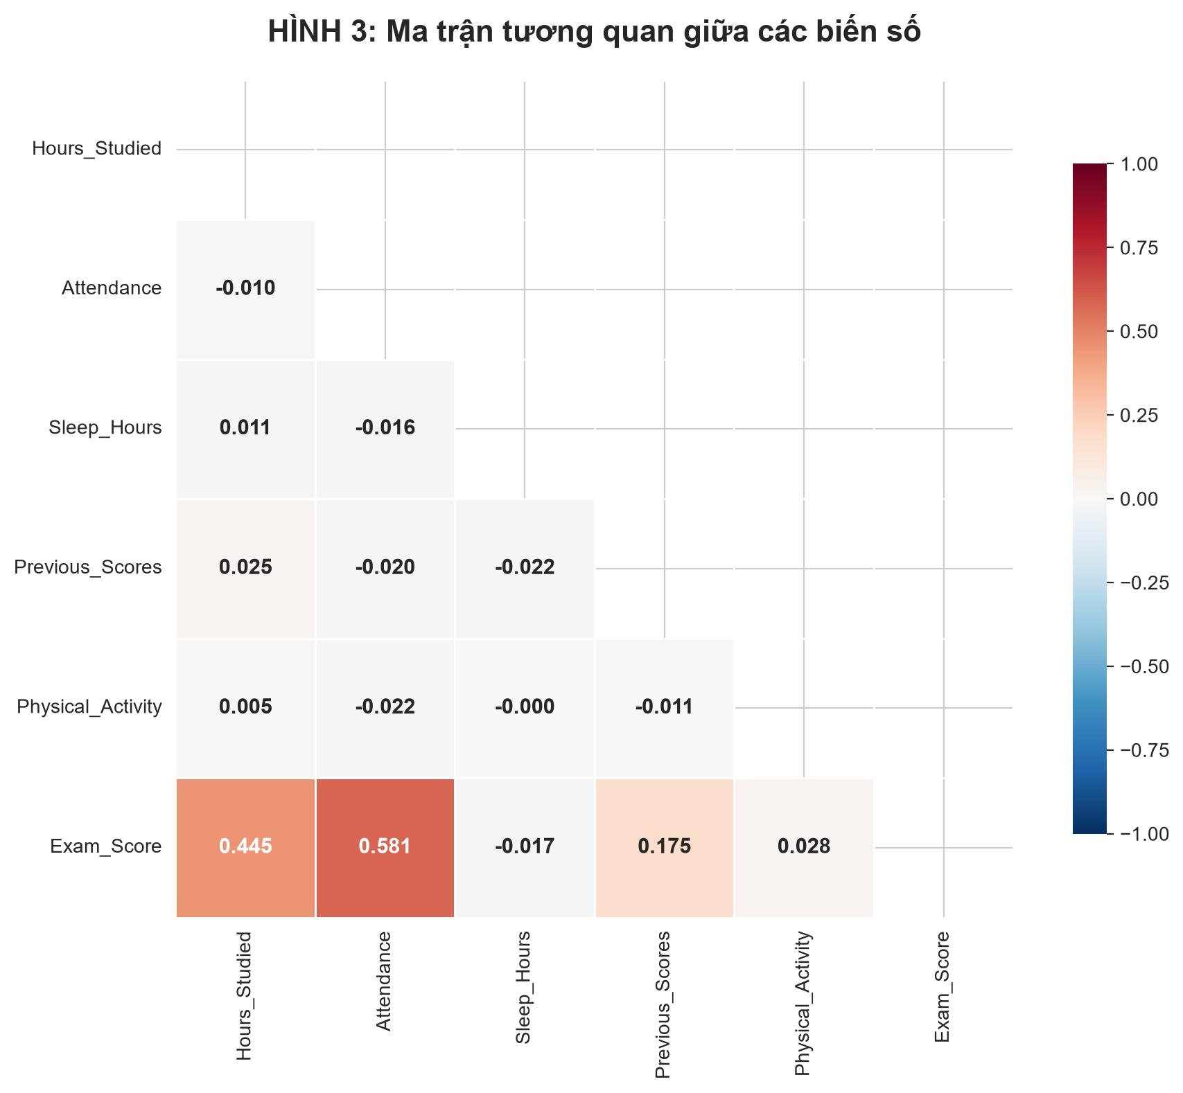
05
EXPLORATORY DATA ANALYSIS
Key Numerical Drivers & Correlation Matrix
Pearson Correlation Summary (r with Exam_Score)
• 1. Attendance (r = +0.581, strong positive): Each +10% attendance corresponds to +1.98 exam score points (y = 0.20x + 51.59).
• 2. Hours_Studied (r = +0.445, moderate-strong positive): Each +10 study hours/week adds +2.90 exam score points (y = 0.29x + 61.46).
• 3. Previous_Scores (r = +0.175, weak positive) | Physical_Activity (r = +0.028, negligible) | Sleep_Hours (r = -0.017, negligible).
Attendance and weekly study hours are the two dominant numerical drivers of student exam performance.

Slide 8
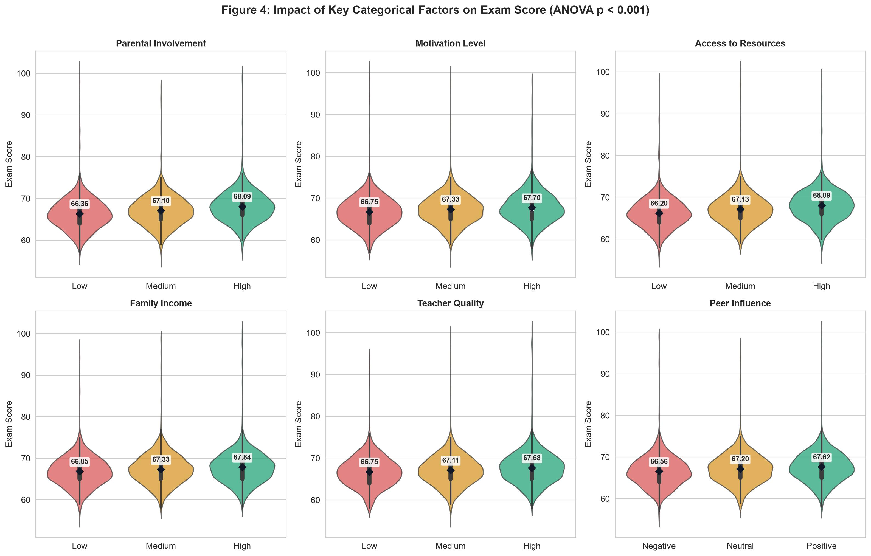
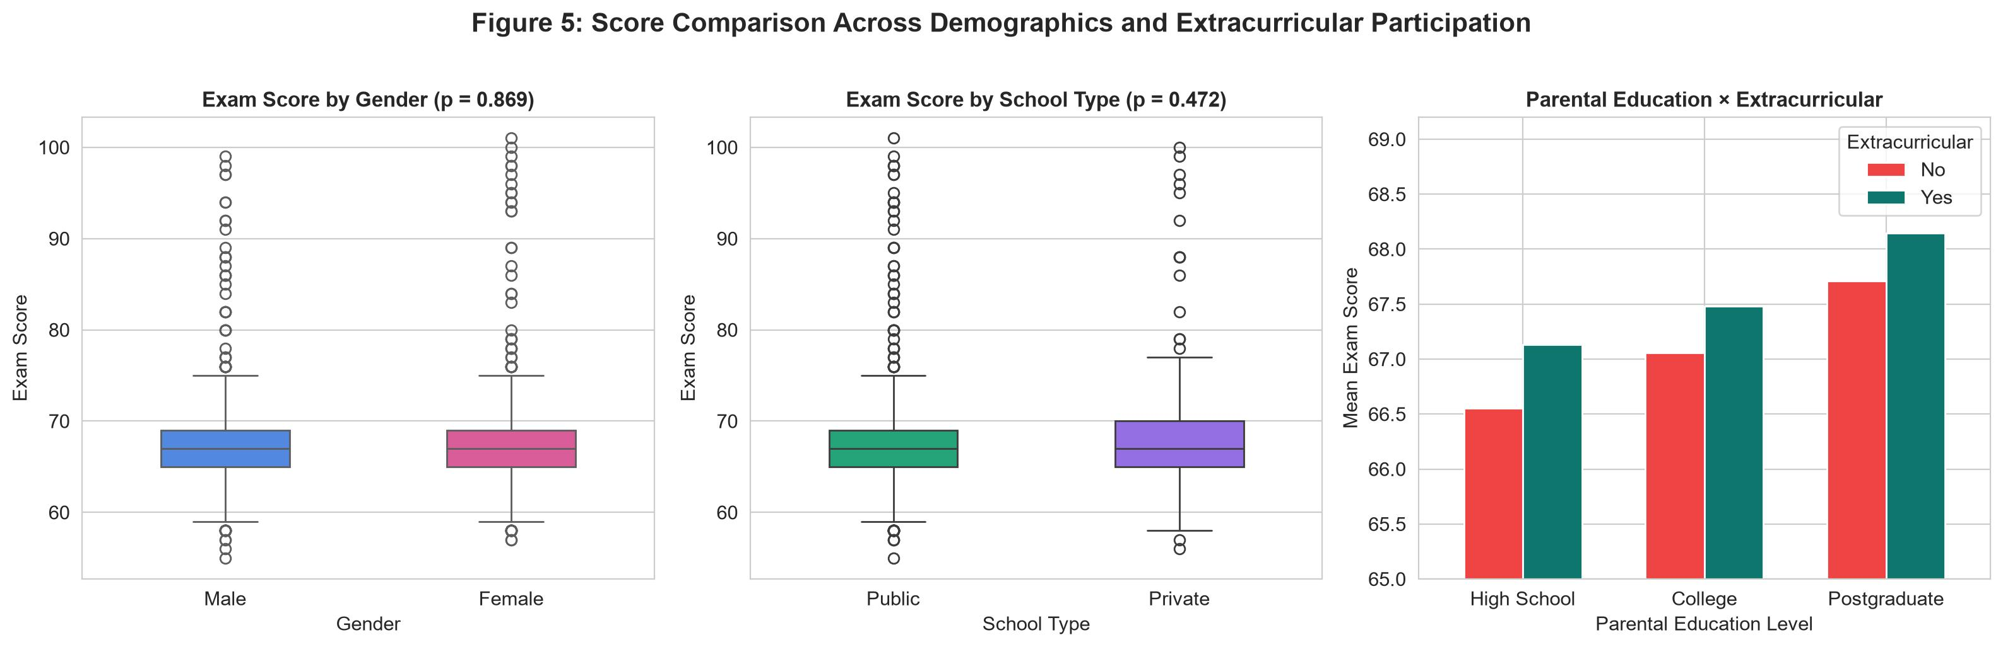
06
EXPLORATORY DATA ANALYSIS
Impact of Categorical & Demographic Factors
Categorical Group Comparisons
• Access_to_Resources: High (68.09) vs. Low (66.20) -> Diff = +1.89 pts.
• Parental_Involvement: High (68.09) vs. Low (66.36) -> Diff = +1.73 pts.
• Parental_Education: Postgraduate (67.97) vs. High School (66.89) -> +1.08 pts.
• Peer_Influence: Positive (67.62) vs. Negative (66.56) -> +1.06 pts.
• Gender (67.24 vs 67.23) & School_Type (67.29 vs 67.21): No meaningful difference.
Supportive home environments, school resources, and positive peer networks consistently elevate student scores.

Slide 9
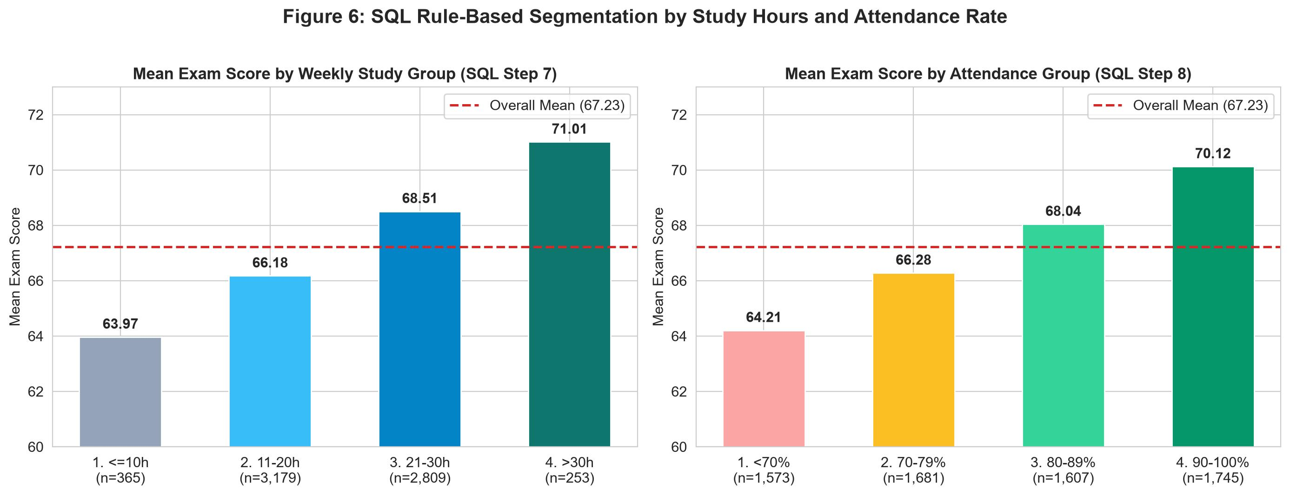
07
STEPS 7 & 8 — SQL MODELING
SQL Rule-Based Segmentation (Study & Attendance)
Study Group | Count | Avg Score | Diff | Rank
1. <=10h | 365 | 63.97 | -3.26 | 4
2. 11-20h | 3,179 | 66.18 | -1.05 | 3
3. 21-30h | 2,809 | 68.51 | +1.28 | 2
4. >30h | 253 | 71.01 | +3.78 | 1
Attendance Tier | Students | Avg Score | vs. <70%
1. < 70% | 1,573 | 64.21 | Baseline
2. 70 - 79% | 1,681 | 66.28 | +2.07
3. 80 - 89% | 1,607 | 68.04 | +3.83
4. 90 - 100% | 1,745 | 70.12 | +5.91
SQL Window Function & Segmentation Insights
• Students studying >30h/week score 71.01 on average (+7.04 pts higher than <=10h/week), even though average attendance (~79–80%) is nearly identical across study groups.
• Students with 90–100% attendance average 70.12 (+5.91 pts vs. <70%; n = 6,606 valid scores, excl. 1 NULL).
SQL CASE WHEN, CTEs, and RANK() OVER provide crystal-clear cohort benchmarks verified by Python.

Slide 10
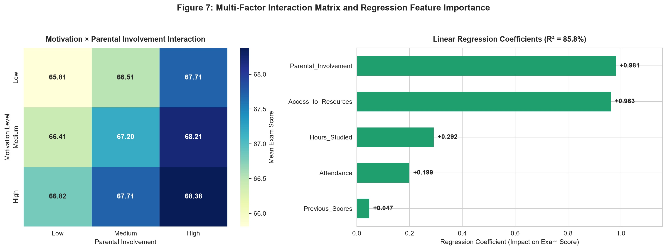
08
STATISTICAL & ML MODELING
ANOVA Hypothesis Testing & Linear Regression
Variable | Test | Stat | p-value
Access_to_Resources | ANOVA | 98.00 | < 0.001
Parental_Involvement | ANOVA | 84.49 | < 0.001
Parental_Education | ANOVA | 36.43 | < 0.001
Peer_Influence | ANOVA | 34.05 | < 0.001
Family_Income | ANOVA | 29.79 | < 0.001
Motivation_Level | ANOVA | 25.72 | < 0.001
Teacher_Quality | ANOVA | 19.64 | < 0.001
Extracurricular | T-test | -5.24 | < 0.001
School_Type | T-test | 0.72 | 0.472 (NS)
Gender | T-test | 0.17 | 0.869 (NS)
Interaction Effect & Regression Performance
• High Motivation × High Parental Involvement yields 68.38 vs. 65.81 for Low × Low (+2.57 pts).
• Linear Regression (5 key predictors, IQR [59, 75] outlier filter) achieves R² = 85.8% (up from 60.8% initially).
8 of 10 categorical factors are statistically significant (p < 0.001); Gender and School Type are not.

Slide 11
09
STEPS 8, 9 & 10 — WRAP-UP
SQL JOIN Evaluation, Deployment & Conclusion
Parental Education | Extracurricular | Students | Avg Score | Diff
Postgraduate | Yes | 774 | 68.15 | +0.92
Postgraduate | No | 531 | 67.71 | +0.48
College | Yes | 1,208 | 67.48 | +0.25
High School | Yes | 1,906 | 67.11 | -0.12
College | No | 781 | 67.06 | -0.17
High School | No | 1,317 | 66.55 | -0.68
Step 10: Feedback & Strategic Recommendations
• 1. Data Governance: Keep non-destructive cleaning; verify anomalous record student_id = 1526 (Exam_Score = 101) with exam office.
• 2. Early Warning System: Prioritize academic intervention for students with Attendance < 75% or Hours_Studied <= 10h/week.
• 3. Family-School Partnership: Engage parents through regular progress reports, as High Parental Involvement + High Motivation adds +2.57 pts.
• 4. Resource Equity: Provide learning resources and extracurricular opportunities to low-income students to close the achievement gap.
Step 9: Deployment Deliverables
• SQLite DB: student_analysis.db (raw_students, students_clean_sql, students_clean_python).
• Standalone SQL: TruyVan_LamSach_PhanTich.sql (14 queries).
• Cleaned CSVs: student_performance_cleaned_sql.csv, student_performance_cleaned_python.csv, analysis_study_groups.csv.
Thank You for Listening! — Q&A Session (Data Science with Python & SQL - ADY201m)

