Slide 1
Systems Inspired by the Brain
A Brain Built From Atomic Switches Can Learn

Slide 2
Problem:
Today’s circuits are inefficient
Limits exist to miniaturization and efficiency
Moore’s Law: “the observation that the number of transistors in a dense integrated circuit doubles approximately every two years”
Rate currently slowing to a halt

Slide 3

Why The Brain?
The Brain - tremendously energy efficiency
Power consumption: one 20-watt light bulb
K computer - supercomputer in Kobe, Japan
Power consumption: 10,000 light bulbs
Took 40 minutes to simulate a second of 1% of human brain activity

Slide 4

Solution
Create systems that mimic the brain’s structure
Typically neural networks
Different approach taken at the California NanoSystems Institute @ UCLA
Researches Adam Steig and Jim Gimzewski
“Inspired by the brain to generate the properties that enable to brain to do what it does”

Slide 5
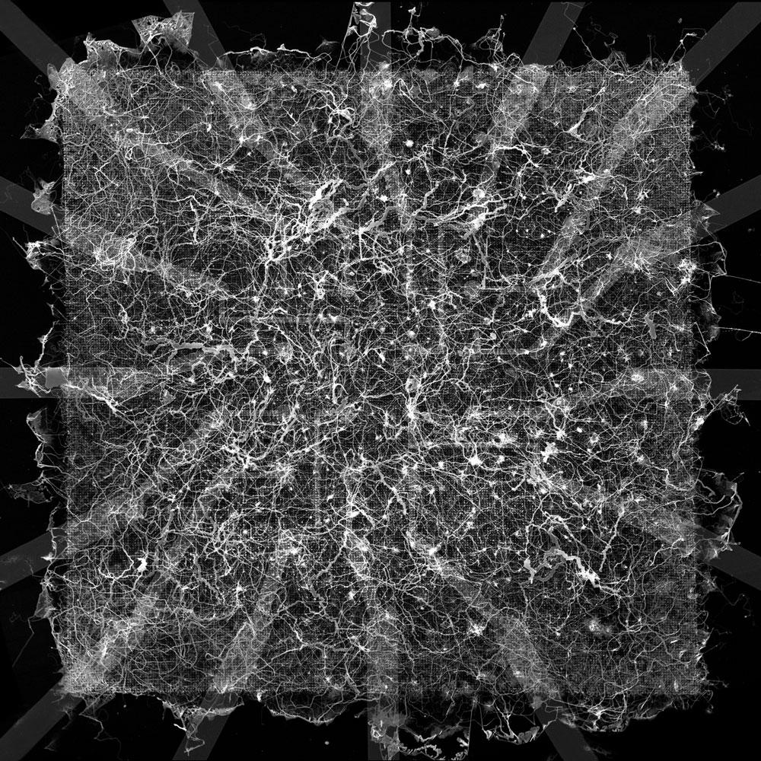
What is it?
2mm by 2mm mesh of nanowires
Connected with artificial synapses
Atomic Switches

Slide 6
Atomic Switches
Nanoscale circuit element
Behavior observed to be synapse-like
Controlled using ions
Several types

Slide 7
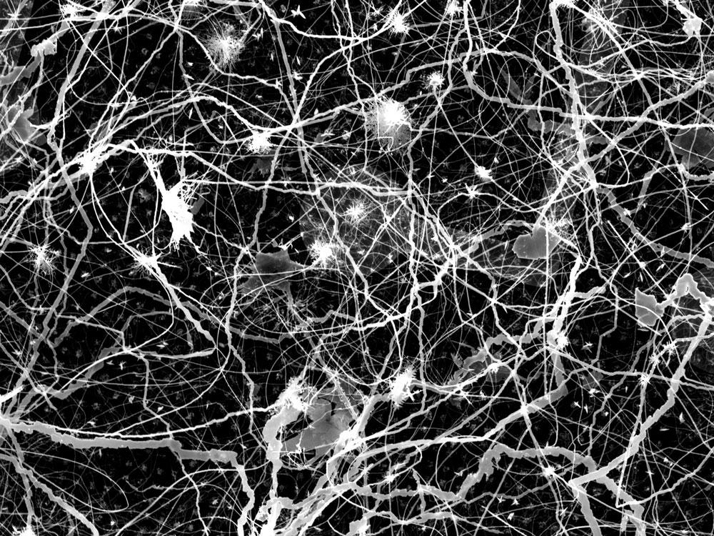
Similarities to the Brain
Disorganized structure
Ability to learn
Power-Law behavior
“Criticality” is possible
State between order and chaos indicating maximum efficiency has been achieved
Ability to create a “sleeping” state in system

Slide 8
Benefits
Able to perform simple learning and logic operations
Clean out unwanted noise from signals
Switches are able to
Remember their history
Interact with each other
No need for software
Training
Fast
Doesn’t separate processing and memory

Slide 9
Possible Applications
Voice or Image Recognition
Due to its ability to clean out unwanted noise from signals
Align structural complexity of system with that which is being modeled
Reservoir Computing

Slide 10
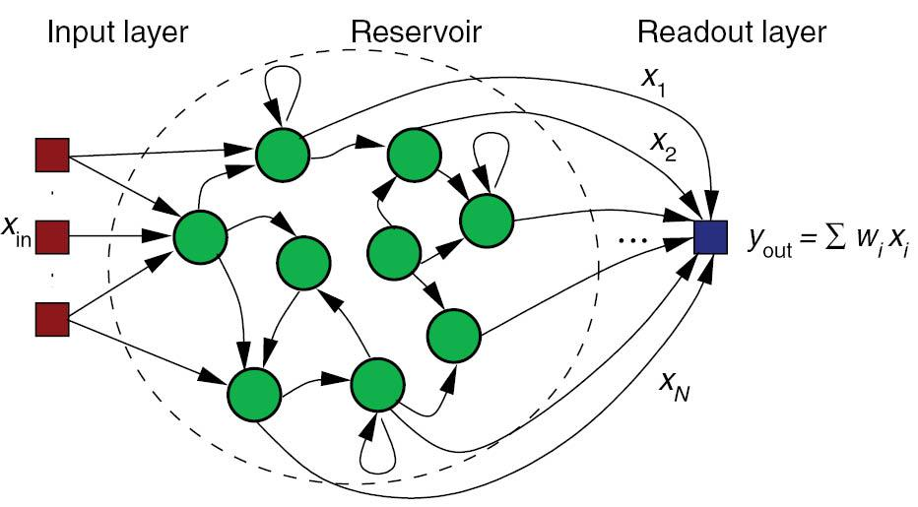
Reservoir Computing
Extension of neural networks
Machine Learning
AI
Input is fed into a “reservoir”
“Readout” mechanism looks at the reservoir and gives corresponding output
In this case:
One input → many different outputs (“reservoir”)
Combined to create desired computation

Slide 11
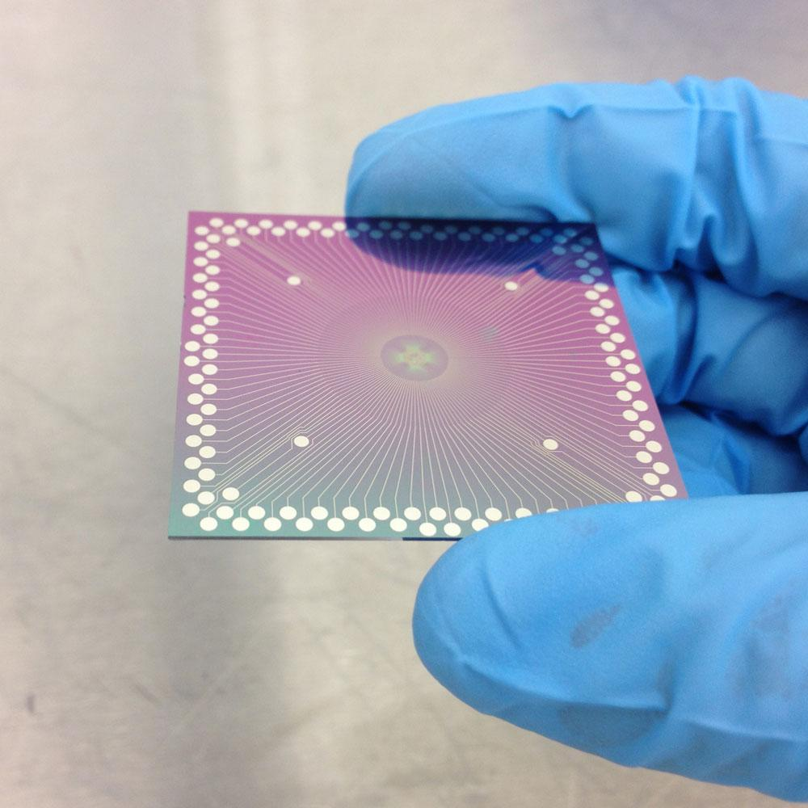
Challenges
Finding the right inputs and outputs
Encoding these inputs and outputs
Training the device
Relatively new technology

Slide 12
Works Cited
[1] Bubnoff, Andreas von. “A Brain Built From Atomic Switches Can Learn.” Quanta Magazine, Quanta Magazine, 20 Sept. 2017, www.quantamagazine.org/a-brain-built-from-atomic-switches-can-learn-20170920/.
[2] “Moore's law.” Wikipedia, Wikimedia Foundation, 1 Nov. 2017, en.wikipedia.org/wiki/Moore%27s_law.
[3] Simonite, Tom. “The foundation of the computing industry's innovation is faltering. What can replace it?” MIT Technology Review, MIT Technology Review, 6 Feb. 2017, www.technologyreview.com/s/601441/moores-law-is-dead-now-what/.
[4] “Atomic Switch Networks for Cognitive Technology.” International Center for Materials Nanoarchitectonics(WPI-MANA), International Center for Materials Nanoarchitectonics(WPI-MANA), 1 Aug. 2014, www.nims.go.jp/mana/research/highlights/vol17.html.
[5] “Reservoir computing.” Wikipedia, Wikimedia Foundation, 28 Aug. 2017, en.wikipedia.org/wiki/Reservoir_computing.

