Slide 1
Sampling
false result as new neg
Feature Extraction
pos
Boost Training
neg
Trained Model

Slide 2
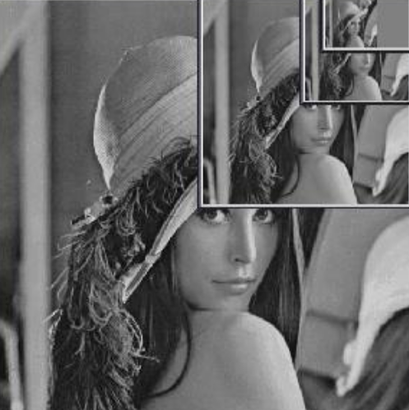
Feature Extraction
Trained Model
get score and labeling

