Slide 1
Meta-learning in movement prediction problem of aperiodic time-series data
Nguyen Bao Long – 2210434
Supervisor: Ryo Maezono

Slide 2
Table of Contents
Introduction
Related Work
Proposed Method
Experiment
Result & Discussion

Slide 3
Introduction
What is our motivation?
What is the problem we are trying to solve?

Slide 4
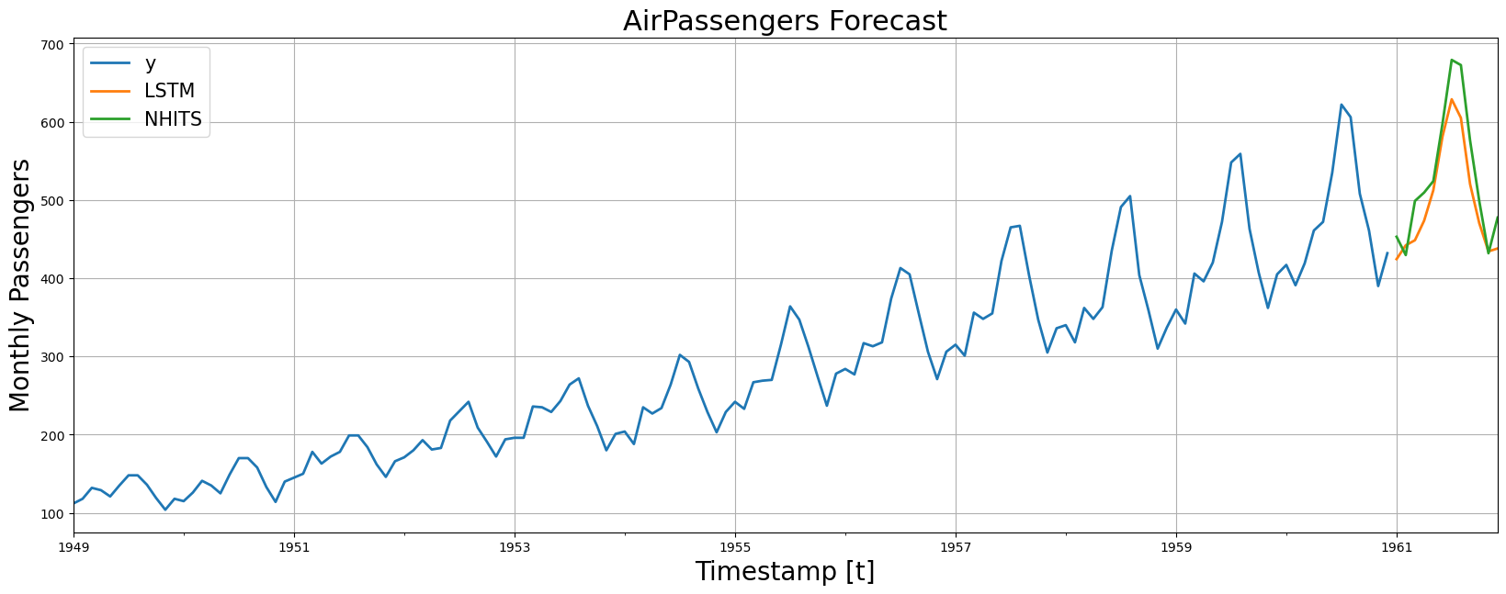
What is our motivation?
Periodic data, such as Electricity Transformer Temperature, Air Passengers,...
Easy to forecast future, even in long horizon forecasting
Air passenger forecast ¹

Slide 5
What is our motivation?
Aperiodic data, such as Foreign exchange (FX), stock price,...
Hard to forecast future, even in movement prediction of the next timestamp.
Exchange rate between Swiss Franc and New Zealand Dollar

Slide 6
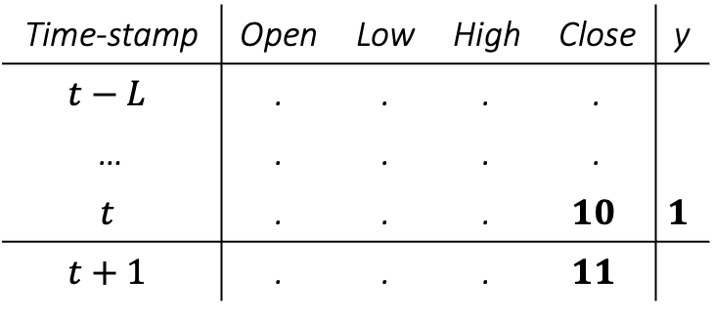
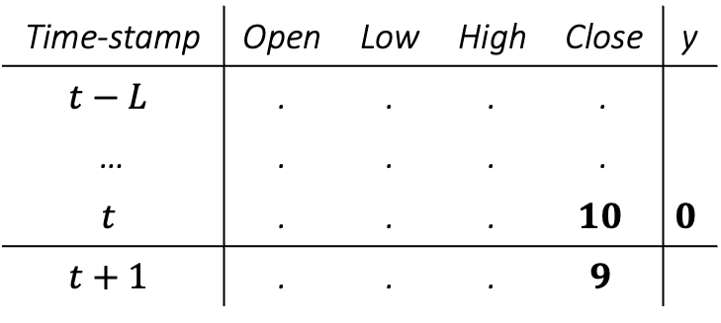
What is the problem we are trying to solve?
Time-stamp | Open | Low | High | Close | y
$$t−L$$ | . | . | . | .
… | . | . | . | .
$$t$$ | . | . | . | $$10$$ | $$1$$
$$t+1$$ | . | . | . | $$11$$
Time-stamp | Open | Low | High | Close | y
$$t−L$$ | . | . | . | .
… | . | . | . | .
$$t$$ | . | . | . | $$10$$ | $$0$$
$$t+1$$ | . | . | . | $$9$$
Exchange rate between Swiss Franc and New Zealand Dollar

Slide 7
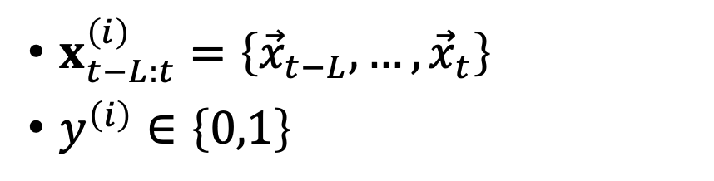
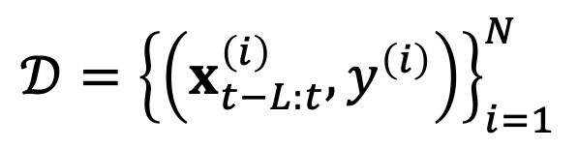
What is the problem we are trying to solve?
Time-stamp | Open | Low | High | Close | y
$$t−L$$ | . | . | . | .
… | . | . | . | .
$$t$$ | . | . | . | $$10$$ | $$1$$
$$t+1$$ | . | . | . | $$11$$
Movement prediction problem of aperiodic time-series data
$$𝒟={\left\{\left(x_{t−L:t}^{\left(i\right)},y^{\left(i\right)}\right)\right\}}_{i=1}^{N}$$
Time-stamp | Open | Low | High | Close | y
$$t−L$$ | . | . | . | .
… | . | . | . | .
$$t$$ | . | . | . | $$10$$ | $$0$$
$$t+1$$ | . | . | . | $$9$$
$x_{t−L:t}^{\left(i\right)}=\left\{{\vec{x}}_{t−L}, …,{\vec{x}}_{t}\right\}$
$y^{\left(i\right)}∈\left\{0,1\right\}$

Slide 8
Related Work
How do researchers approach this problem?
Any advantages/disadvantages?

Slide 9
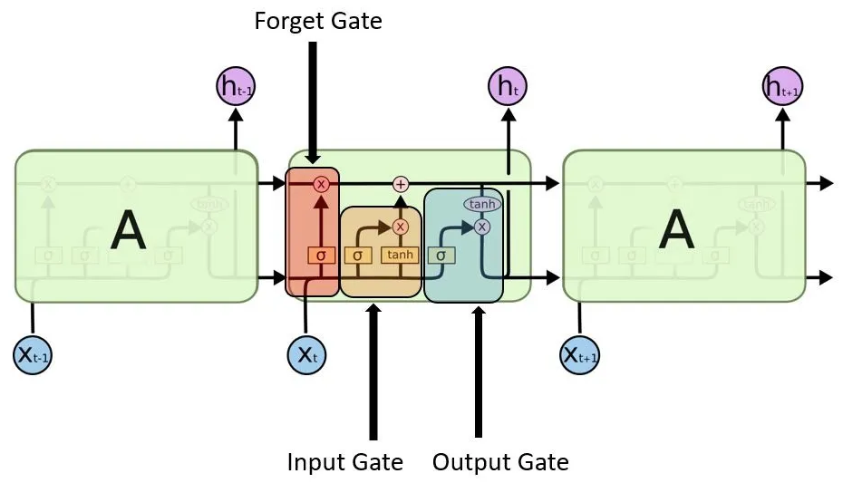
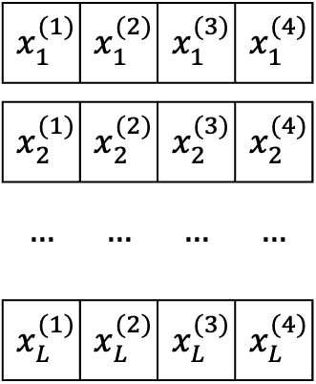

Feature extraction using LSTM
Capture long short-dependencies in data by forget-update mechanism
$$x_{1}^{(1)}$$ | $$x_{1}^{(2)}$$ | $$x_{1}^{(3)}$$ | $$x_{1}^{(4)}$$
$$x_{2}^{(1)}$$ | $$x_{2}^{(2)}$$ | $$x_{2}^{(3)}$$ | $$x_{2}^{(4)}$$
$$…$$ | $$…$$ | $$…$$ | $$…$$
$$x_{L}^{(1)}$$ | $$x_{L}^{(2)}$$ | $$x_{L}^{(3)}$$ | $$x_{L}^{(4)}$$
$$h$$
LSTM architecture
LSTM extractor

Slide 10
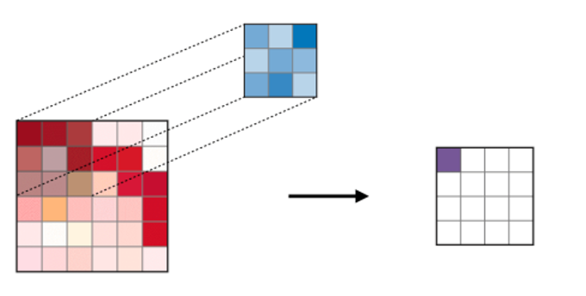
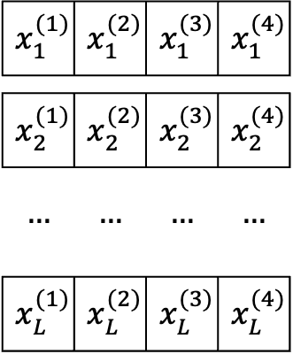


Feature extraction using CNN
Capture local feature in data by kernel-mechanism
$$kernel$$
$$x_{1}^{(1)}$$ | $$x_{1}^{(2)}$$ | $$x_{1}^{(3)}$$ | $$x_{1}^{(4)}$$
$$x_{2}^{(1)}$$ | $$x_{2}^{(2)}$$ | $$x_{2}^{(3)}$$ | $$x_{2}^{(4)}$$
$$…$$ | $$…$$ | $$…$$ | $$…$$
$$x_{L}^{(1)}$$ | $$x_{L}^{(2)}$$ | $$x_{L}^{(3)}$$ | $$x_{L}^{(4)}$$
$$h$$
Convolution operator
CNN extractor

Slide 11
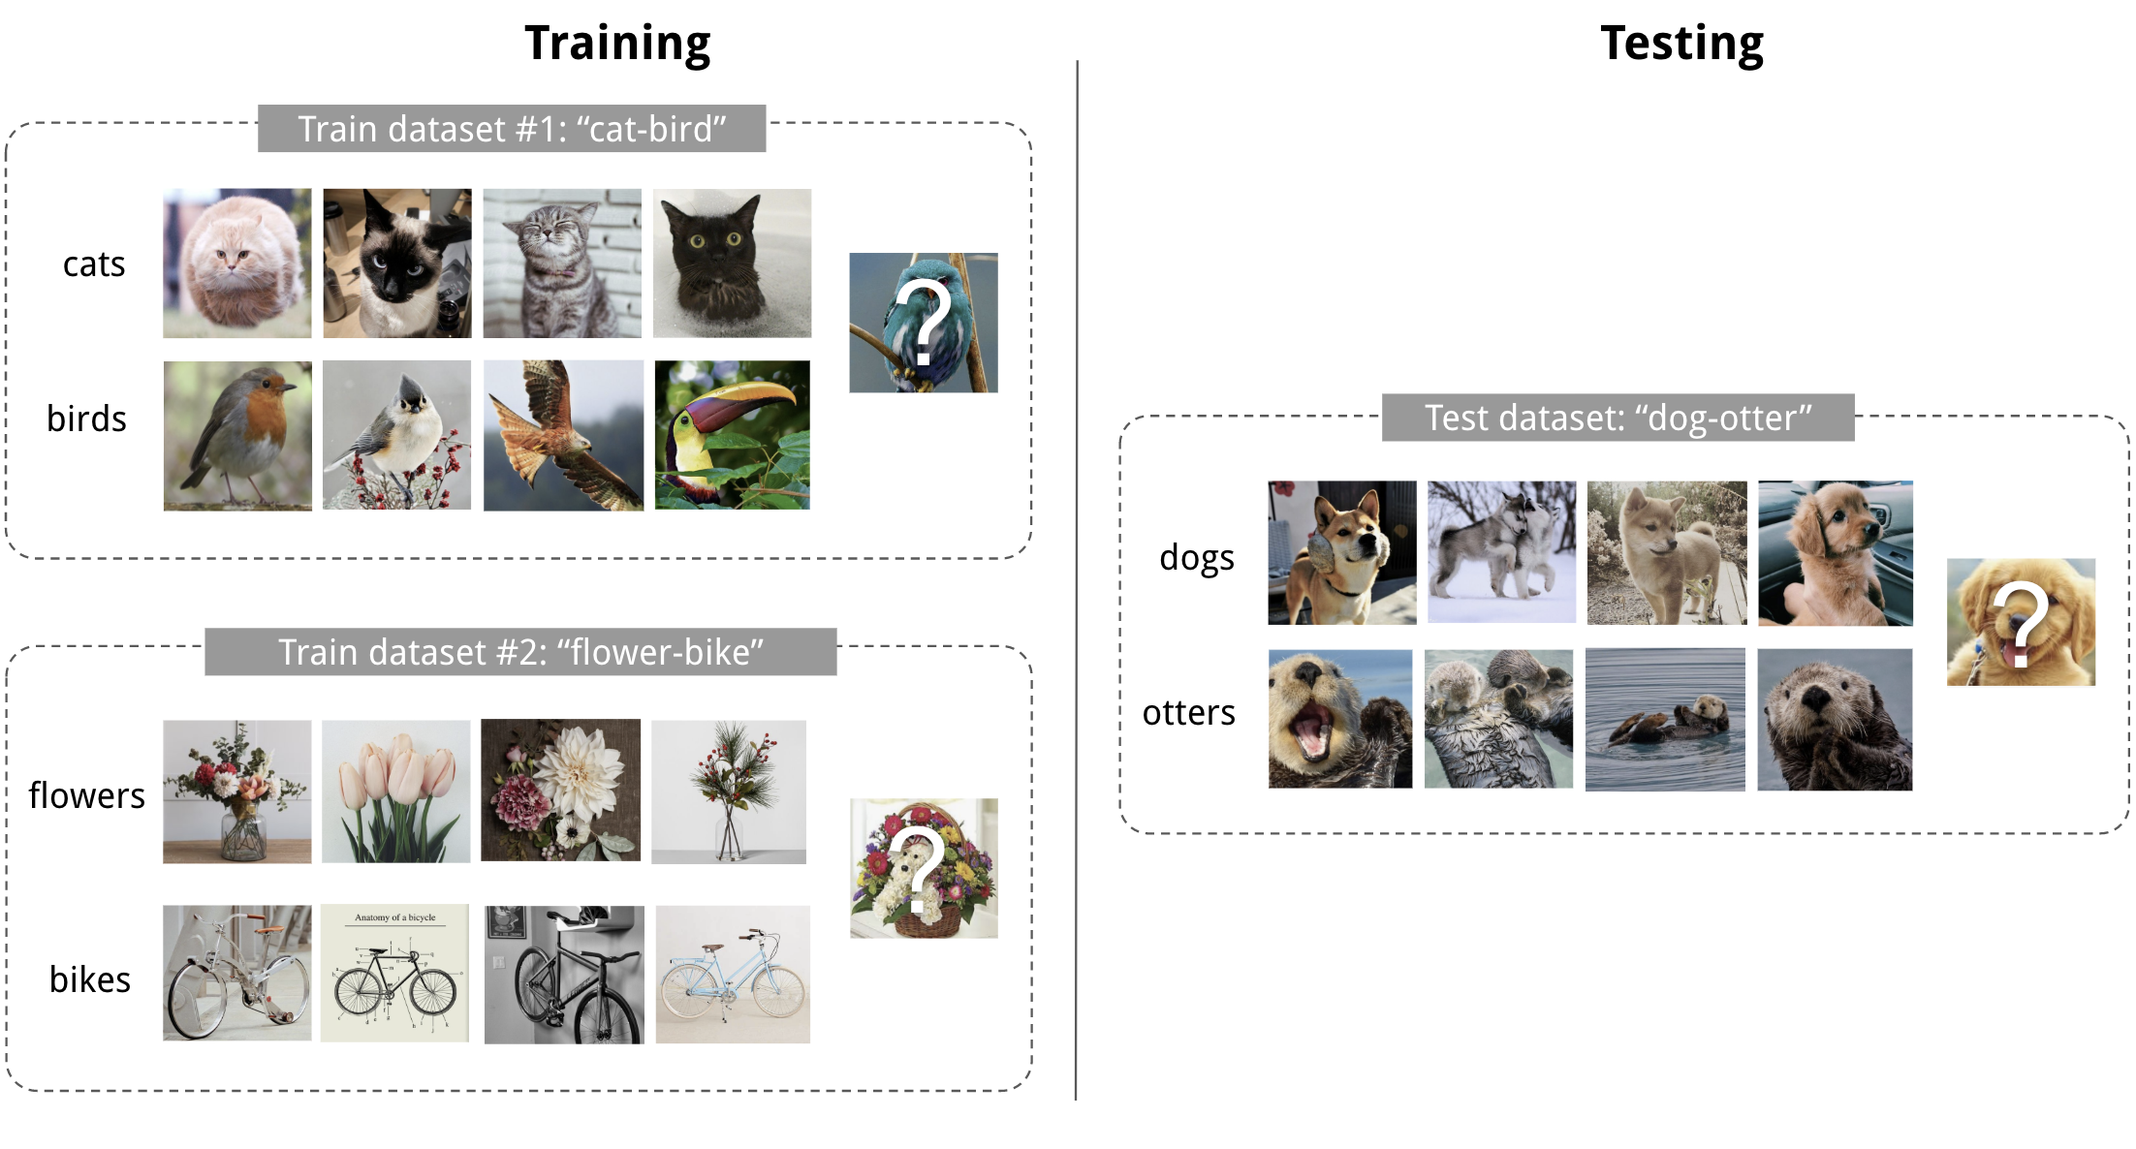
Fast adapt using Meta-learning
Meta-train on a set of tasks
After meta-training, model has the ability to fast adapt to new task
Meta-test on a set of new tasks
Meta-learning objective

Slide 12
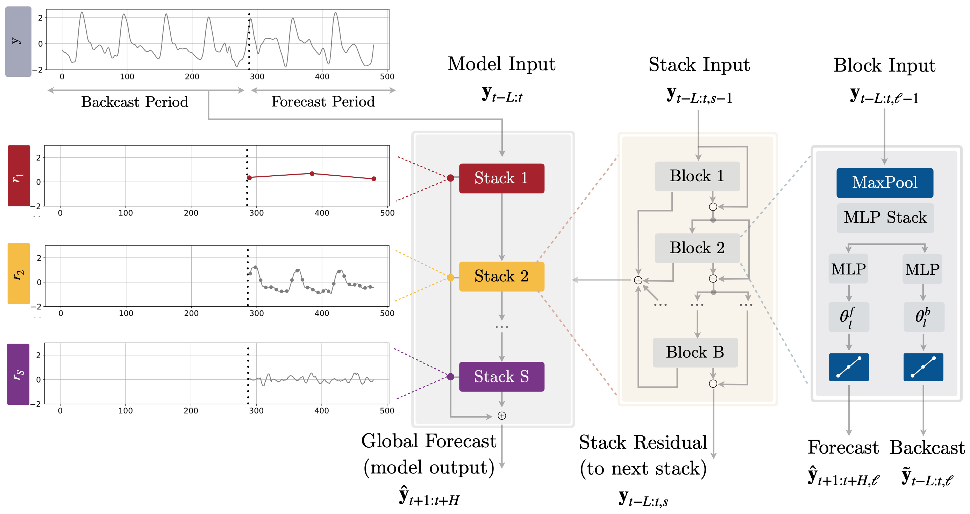
Long horizon prediction using NHITS
NHITS architecture – State of the art model in 2023 in forecast tasks

Slide 13
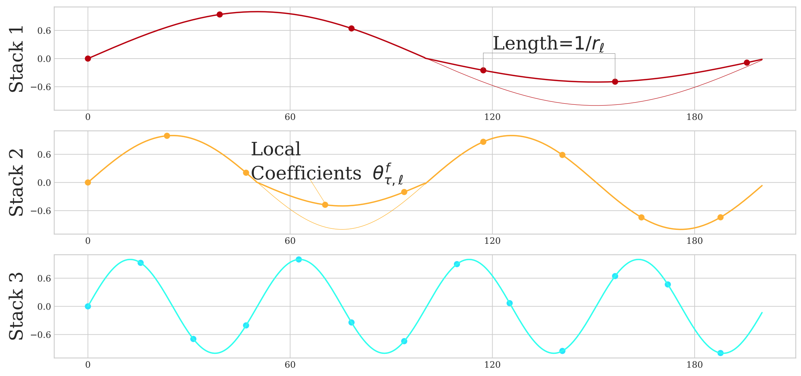
Long horizon prediction using NHITS
NHITS goal: Decompose input signal into frequency bands

Slide 14
Proposed Method
What kind of features are extracted?
How do we aggregate these features?

Slide 15
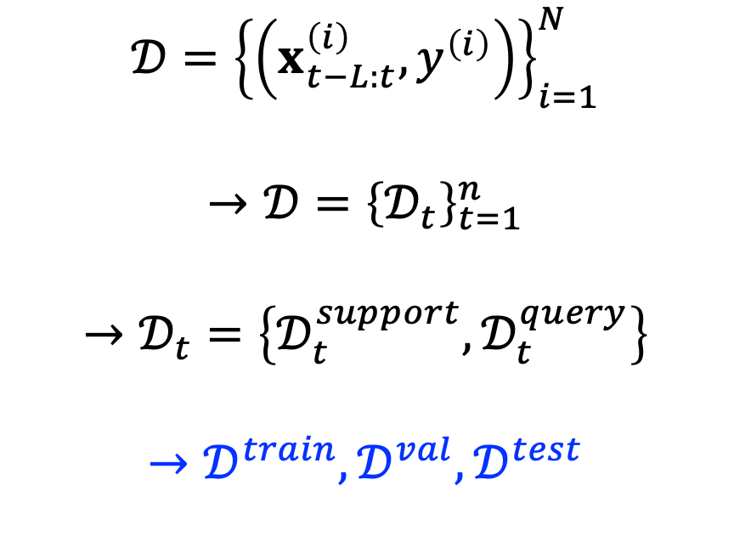

Data preparation
Conventional machine learning
Meta-learning
$$𝒟={\left\{\left(x_{t−L:t}^{\left(i\right)},y^{\left(i\right)}\right)\right\}}_{i=1}^{N}$$
$$→𝒟^{train},𝒟^{val}, 𝒟^{test}$$
$$𝒟={\left\{\left(x_{t−L:t}^{\left(i\right)},y^{\left(i\right)}\right)\right\}}_{i=1}^{N}$$
$$→𝒟={\left\{𝒟_{t}\right\}}_{t=1}^{n}$$
$$→𝒟_{t}=\left\{𝒟_{t}^{support},𝒟_{t}^{query}\right\}$$
$$→𝒟^{train},𝒟^{val}, 𝒟^{test}$$

Slide 16
What kind of features are extracted?
We aggregate LSTM feature and CNN feature for training
Purpose: Extract long-term dependency + highlight localized feature
Training process of LSTM+CNN, LSTM, CNN on 2600 samples

Slide 17
What kind of features are extracted?
We aggregate LSTM feature and CNN feature for training
Purpose: Extract long-term dependency + highlight localized feature
But even that …
Validating process of LSTM+CNN, LSTM, CNN on 2600 samples

Slide 18
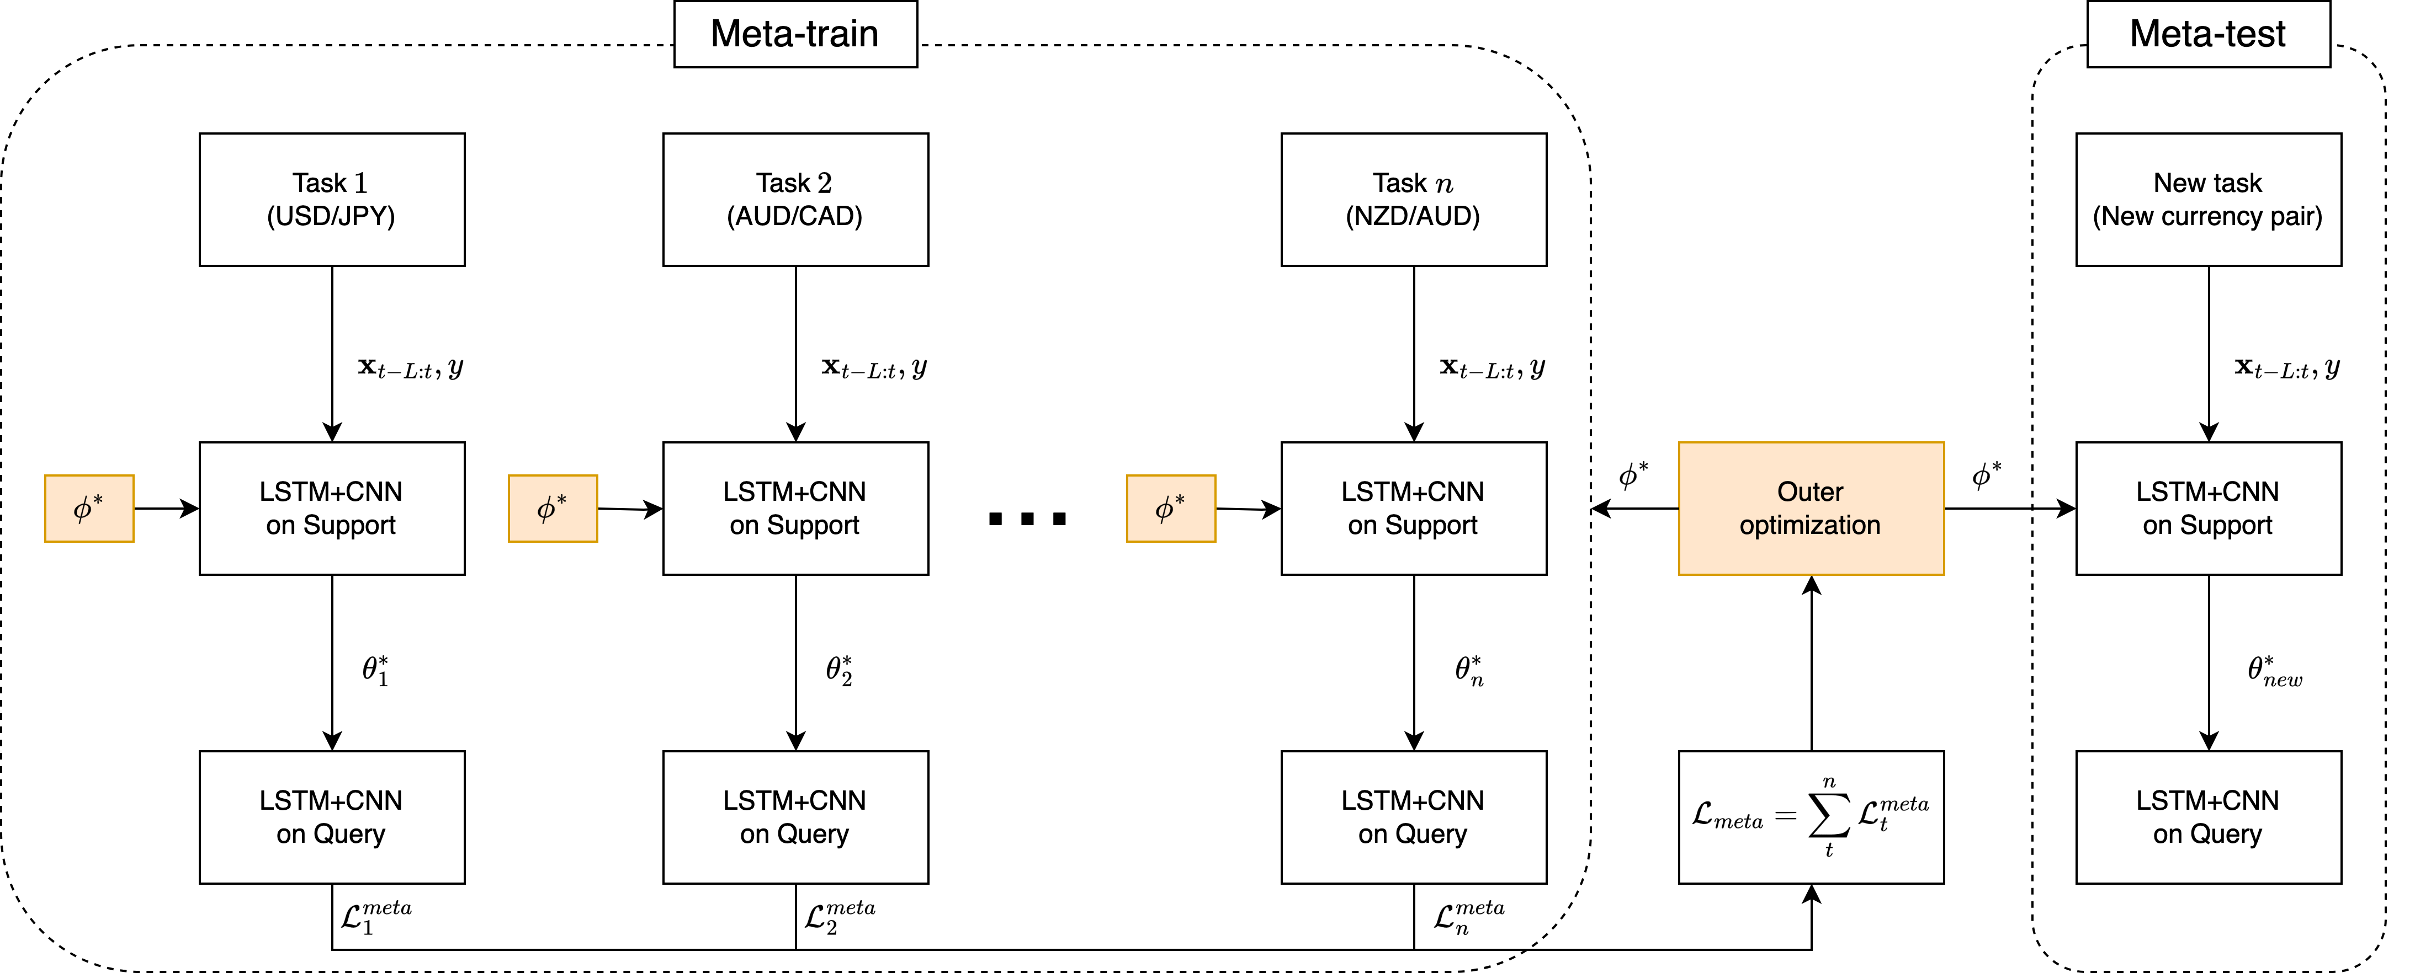
That’s why we need to synthesize models
Proposed method architecture

Slide 19
Experiment
How do we evaluate our method?

Slide 20
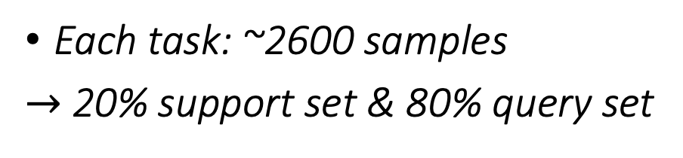
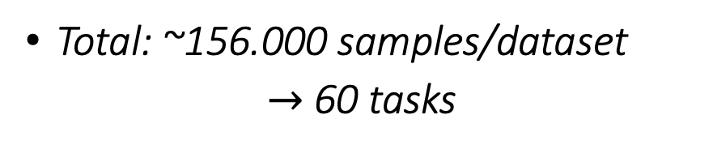
How do we evaluate our method?
We use 2 FX datasets
USD/JPY
2000 – 2024, hourly
This dataset is divided into 60 parts
Total: ~156.000 samples/dataset
$→$ 60 tasks
30 tasks for meta-training
15 tasks for meta-validating
15 tasks for meta-testing
multi-fx
2014– 2024, daily
60 currency pairs, ~2600 samples/pair
Each task: ~2600 samples
$→$ 20% support set & 80% query set

Slide 21
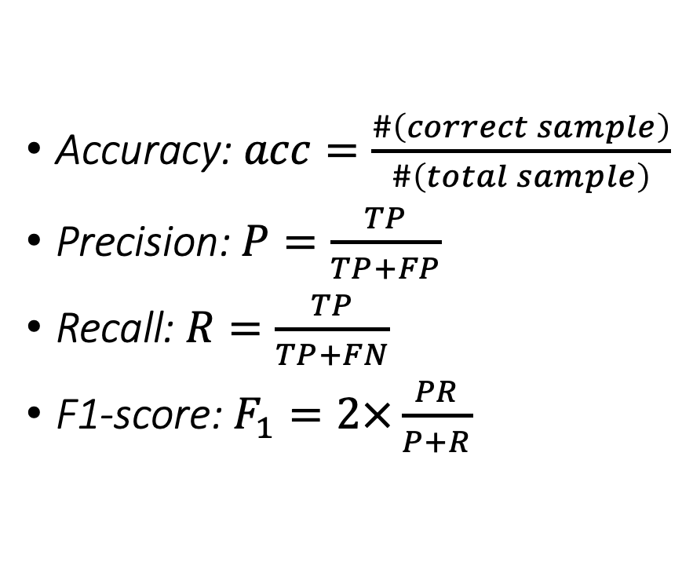
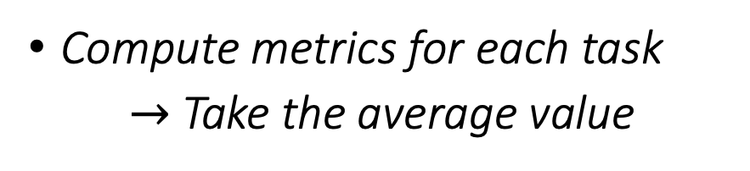
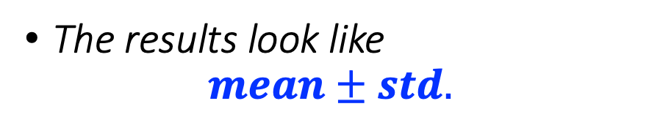
How do we evaluate our method?
Macro Classification Metric
Accuracy: $acc=\frac{\#\left(correct sample\right)}{\#\left(total sample\right)}$
Precision: $P=\frac{TP}{TP+FP}$
Recall: $R=\frac{TP}{TP+FN}$
F1-score: $F_{1}=2×\frac{PR}{P+R}$
Compute metrics for each task
$→$ Take the average value
The results look like
$$mean±std.$$

Slide 22
Result & Discussion
Compare to state of the art model
Why it works?

Slide 23
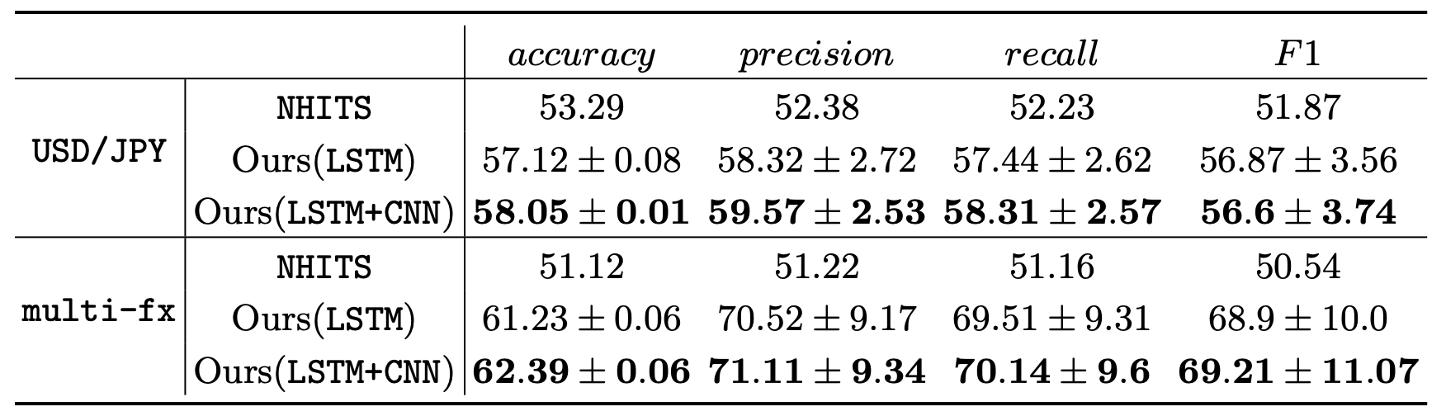
Outperform NHITS
We use LSTM and LSTM+CNN as our feature extractors
Compare the result with NHITS – state of the art model in 2023

Slide 24
Adaptability
Fast adaptability means
Fast convergence
High accuracy
Meta-model using LSTM+CNN have a fast adaptability
Fast adaptability of LSTM+CNN

Slide 25
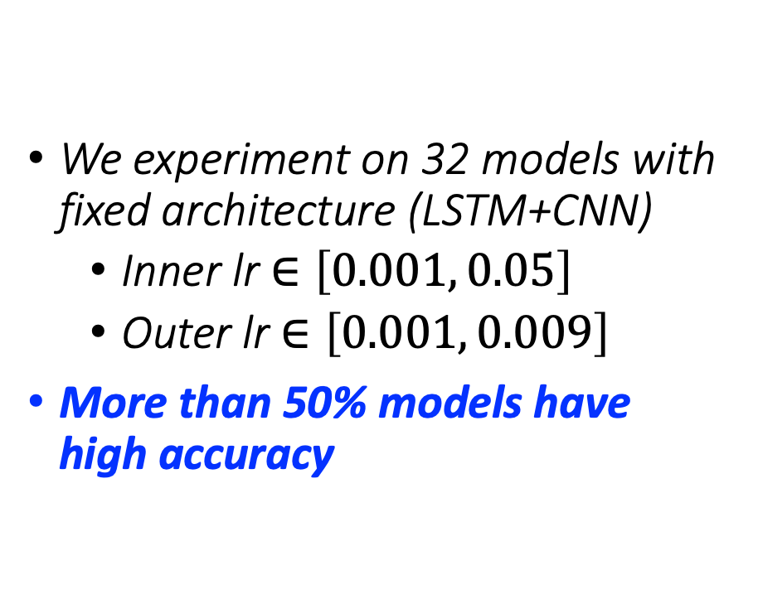
Hyper-parameter dependence
We experiment on 32 models with fixed architecture (LSTM+CNN)
Inner lr $∈\left[0.001, 0.05\right]$
Outer lr $∈\left[0.001, 0.009\right]$
More than 50% models have high accuracy
LSTM+CNN reduces hyper-parameters dependence

Slide 26
Thank you/Q&A

