Slide 1
MANAGEMENT OF DEVICE
Final Project
Professor: Jahan Ghofraniha
Course: CS 157A, Fall 2022
Section: 01
Team member:
Quan Le
Bao Nguyen

Slide 2
INTRODUCTION
Copiers, printers, scanners and fax machines are indispensable office equipment for the operation of a company.
They are also popular devices for individuals with printing and paperless storage needs. High-end printing equipment needs periodic maintenance, replacement of spare parts and consumables to ensure print quality.
"Management Of Device" is a software to manage the devices being used by customers in order to improve the quality of repair and maintenance services for customers.

Slide 3
Requirement
BACKEND (SERVER)
NODEJS 6.0
EXPRESS
CORS
BODY-PARSER
MYSQL2
FRONTEND (CLIENT)
HTML/CSS
BOOTSTRAP
JAVASCRIPT
AXIOS
REACT ROUTERS
DOM
MDB-UI KIT
DATABASE SCHEMA
AWS HOST
WORKBENCH SQL (VISUAL DATABASE DESIGN TOOL)

Slide 4
Conceptual
Design
There are 6 entities: Department, Customers, Employees, Machines, Models, and States.
3rd Normalization
Five relationships
States to Customers: 1 to many
Departments to Employees: 1 to many
Customers to Machines: 1 to many
Employees to Machines: 1 to many
Models to Machines: 1 to many

Slide 5
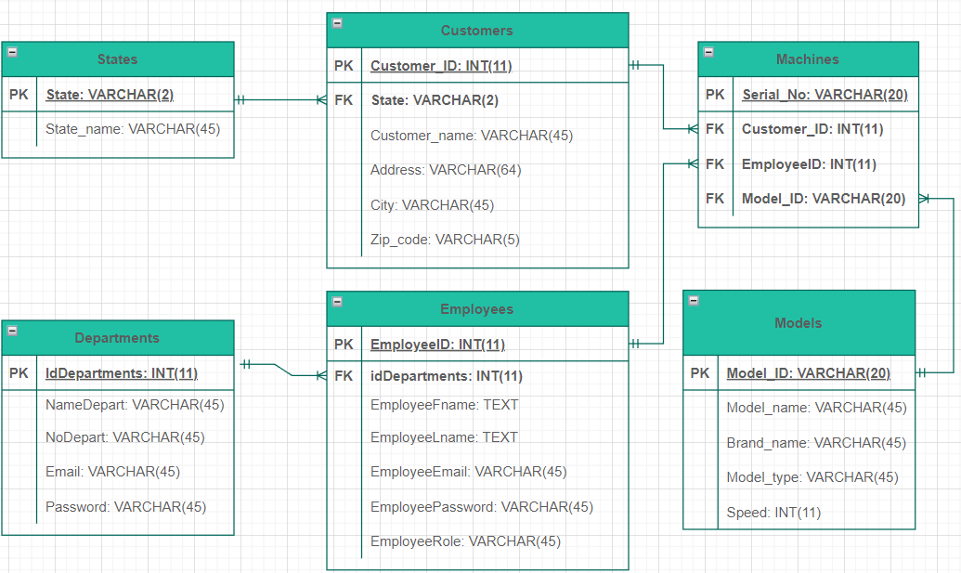
Logical
Model

Slide 6
Physical Design
CREATE TABLE States ( state VARCHAR(2) NOT NULL PRIMARY KEY, state_name VARCHAR(45) NOT NULL);
CREATE TABLE Departments (idDepartment INT(11) NOT NULL PRIMARY KEY AUTO_INCREMENT, nameDepart VARCHAR(45) NOT NULL, noDepart VARCHAR(45), email VARCHAR(45) NOT NULL, password VARCHAR(45) NOT NULL);
CREATE TABLE Employees (employeeID INT(11) NOT NULL PRIMARY KEY AUTO_INCREMENT, employeeFname TEXT NOT NULL, employeeLname TEXT NOT NULL, employeeEmail VARCHAR(45) NOT NULL, employeePassword VARCHAR(45) NOT NULL, employeeRole VARCHAR(45) NOT NULL, idDepartments INT(11) NOT NULL, FOREIGN KEY (idDepartments) REFERENCES Departments(idDepartments) ON UPDATE CASCADE);
CREATE TABLE Models (model_ID VARCHAR(20) NOT NULL PRIMARY KEY, model_name VARCHAR(45) NOT NULL, brand_name VARCHAR(45) NOT NULL, model_type VARCHAR(45) NOT NULL, speed INT(11) NOT NULL);
CREATE TABLE Customers (customer_ID INT(11) NOT NULL PRIMARY KEY AUTO_INCREMENT, customer_name VARCHAR(45) NOT NULL, address VARCHAR(64) NOT NULL, city VARCHAR(45) NOT NULL, state VARCHAR(2) NOT NULL, zip_code VARCHAR(5) NOT NULL, FOREIGN KEY (state) REFERENCES States(state) ON UPDATE CASCADE);
CREATE TABLE Machines (serial_no VARCHAR(30) NOT NULL PRIMARY KEY, customer_ID INT(11) NOT NULL, employeeID INT(11) NOT NULL, model_ID VARCHAR(20) NOT NULL, FOREIGN KEY (customer_ID) REFERENCES Customers(customer_ID) ON DELETE CASCADE ON UPDATE CASCADE, FOREIGN KEY (employeeID) REFERENCES Employees(employeeID) ON UPDATE CASCADE, FOREIGN KEY (model_ID) REFERENCES Models(model_ID) ON UPDATE CASCADE);

Slide 7
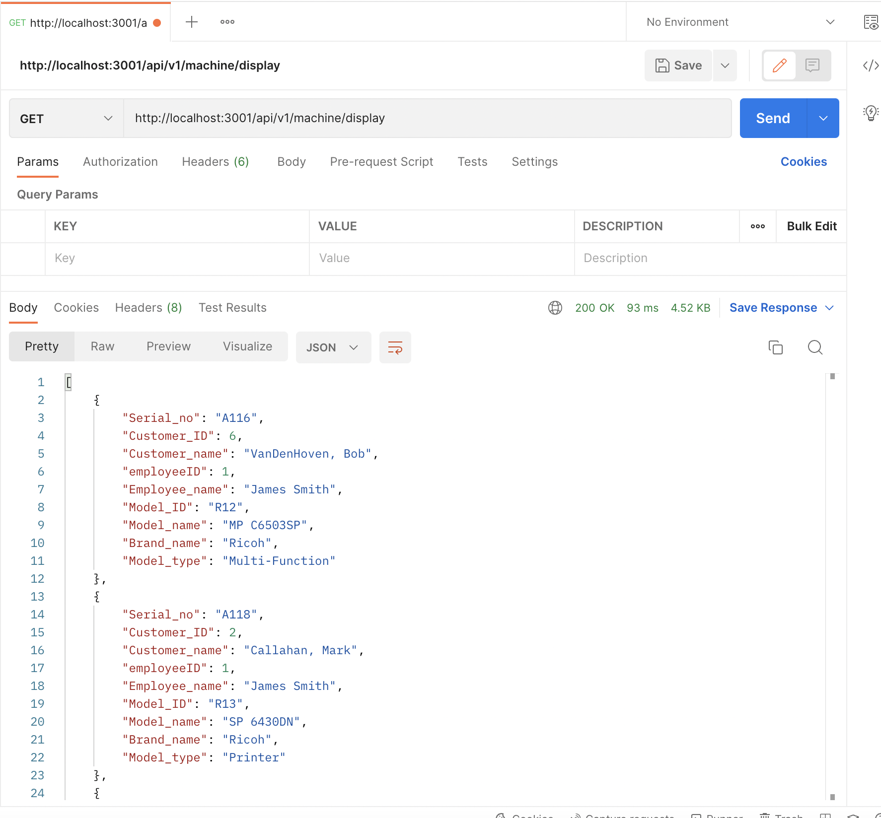
Testing REST API
Use Postman test API

Slide 8
Demo
https://drive.google.com/file/d/12iCyckiTq_L-Ny0gE6EV6OH_AKBeDg0P/view?usp=share_link
Notes:
Next, Bao and Lam will perform the demo

Slide 9





Communication Tool and Usage
Discord
Github
Zoom
Google Drive

Slide 10
Project Meetings
General Project Team Meeting
Purpose: Overall progress report from the Manager. Collaborate with team, brainstorm, discuss and share ideas and issues within team.
Frequency and Duration:
Weekly
15-20 minutes
Date/Time and Location of Meeting:
Online/Remote
Meeting Rules:
Each team member must attend this meeting in person.
Each team member is responsible for staying updated on the team progress/activities.

Slide 11
Project Meetings Contd…
Developers Team Meeting
Purpose: To meet with the development team to share progress and discuss coding related issues and ideas.
Frequency and Duration:
Once or twice a week
30-45 minutes
Date/Time and Location of Meeting:
Online/Remote
Meeting Rules:
Only Dev. Team members required to attend.
Meeting will be held remotely on zoom.

Slide 12
Tracking Processing Project Tool
Microsoft Excel/Google Spreadsheets
Github/Git

Slide 13
Software Development Tool
VS Code
React
SQL
Bootstrap, Figma
Github/Git

Slide 14
REFERENCES
https://getbootstrap.com/docs/5.2/getting-started/introduction/
https://mdbootstrap.com/docs/react/

Slide 15
Thank you for your time

