Slide 1
WOMAN WITH OUTSTANDING ACHIEVEMENT

Slide 2


Slide 3
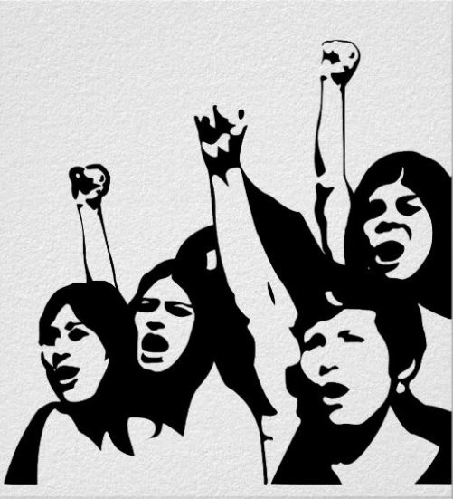
today
achievements
Eradicate prejudice
Without women, the world would not be as perfect as it is, so the role of women in society is that no one can deny and we can easily see that by the change of time, women's status has been placed in the right place they deserve.

Slide 4
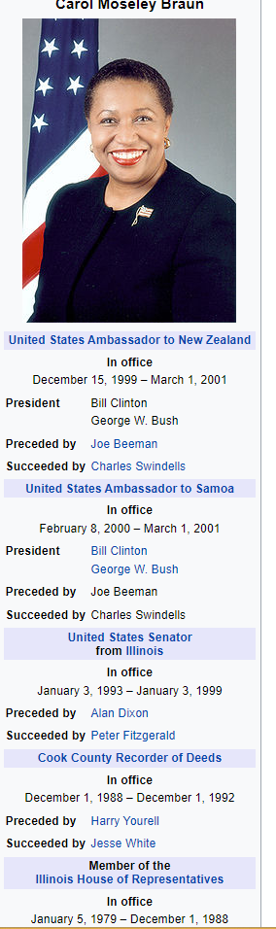
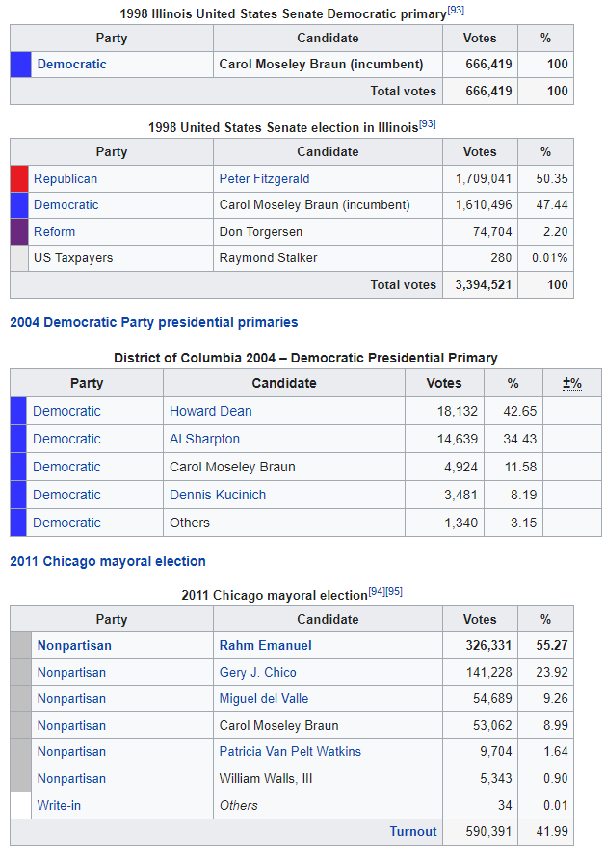
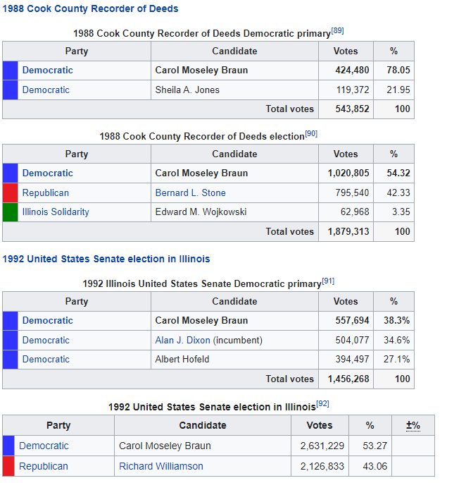
Despite her reputation as a liberal Democrat, Moseley Braun possessed something of a centrist record on economic issues. She voted for the 1993 budget package and against the welfare reform laws passed in 1996, but on many other matters she was more conservative.
Women were not allowed to wear pants on the U.S. Senate floor until 1993.^{[24][25]} In 1993, Senators Moseley Braun and Barbara Mikulski wore pants onto the floor in defiance of the rule. Soon after, female support staff followed their example. Later that year, the rule was amended by Senate Sergeant-at-Arms Martha Pope to allow women to wear pants on the floor so long as they also wore jackets.^{[24][25]}

Slide 5
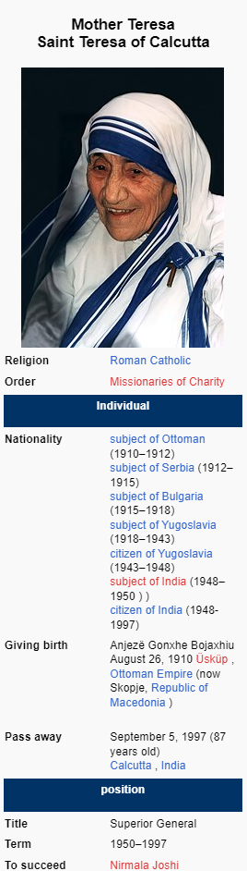
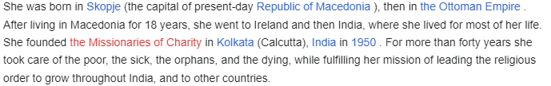

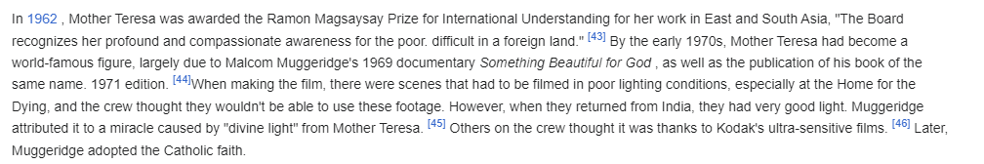

Slide 6
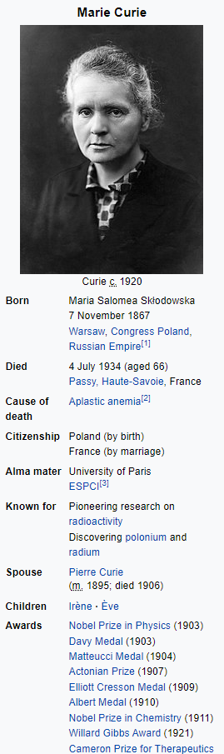
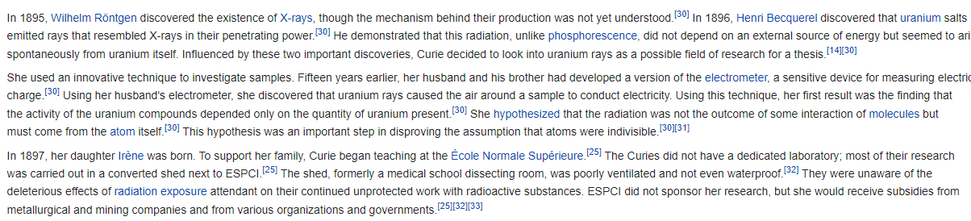
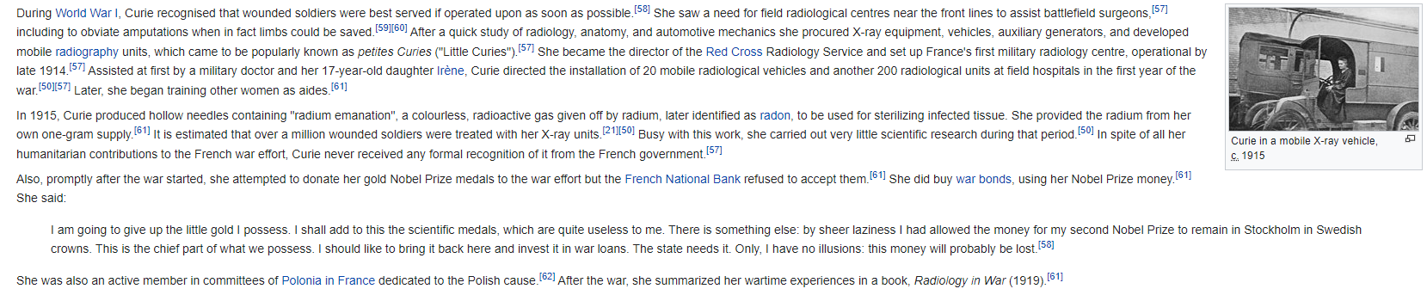

Slide 7
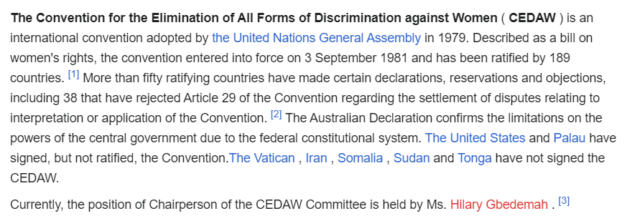
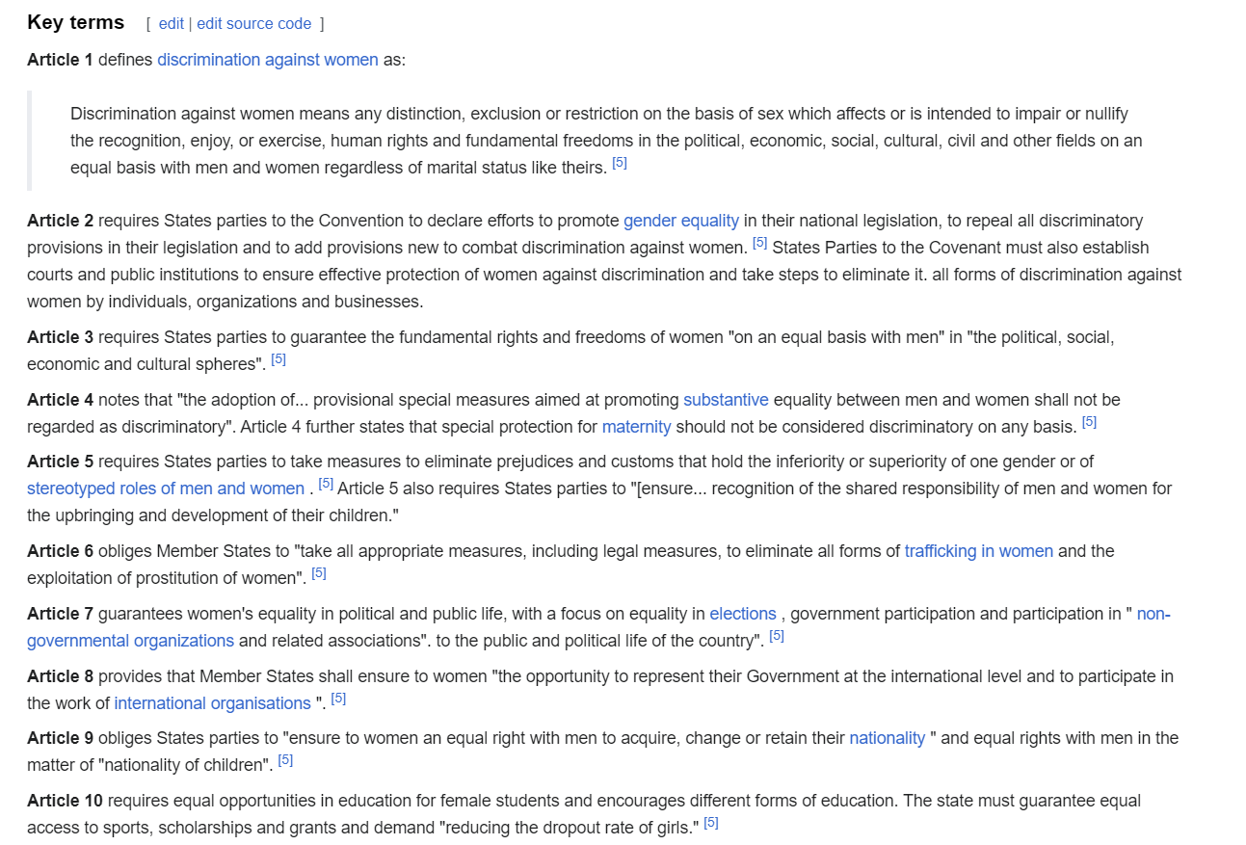
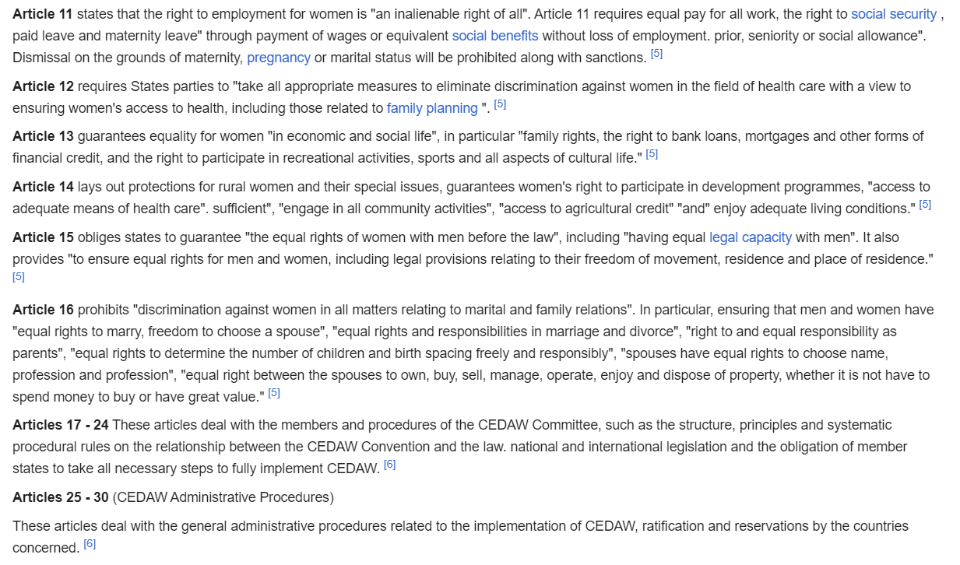
Công ước xóa bỏ mọi hình thức phân biệt đối xử với phụ nữ

