Slide 1

Library Management System
By: Bao Phuc Nguyen

Slide 2
Introduction
What is the Library Management System?
- The Library Management System is a Java-based application with an intuitive GUI.
- It manages books, borrow records, librarians, and customers efficiently.
- Built using Java Swing for the user interface and MySQL for the database.

Slide 3
Features
- View All Books: Displays a table of all books in the library.
- Add/Remove Books: Allows easy management of the library's inventory.
- Change Book Status: Updates the status of books (Available/Borrowed).
- Manage Borrow Records: Add or remove borrowing records.
- Librarian Management: View, add, or remove librarians.
- Customer Management: View, add, or remove customers.

Slide 4
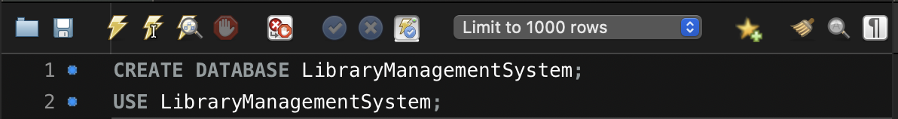
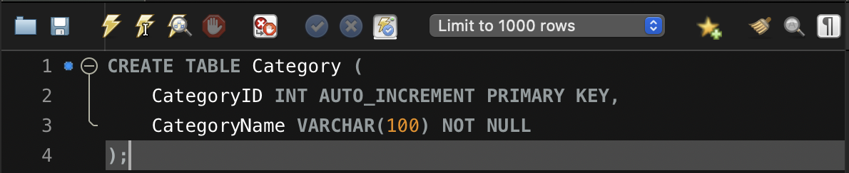
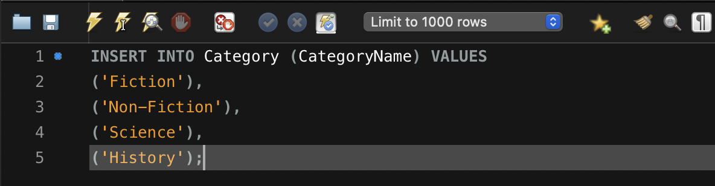
Create Tables

Slide 5
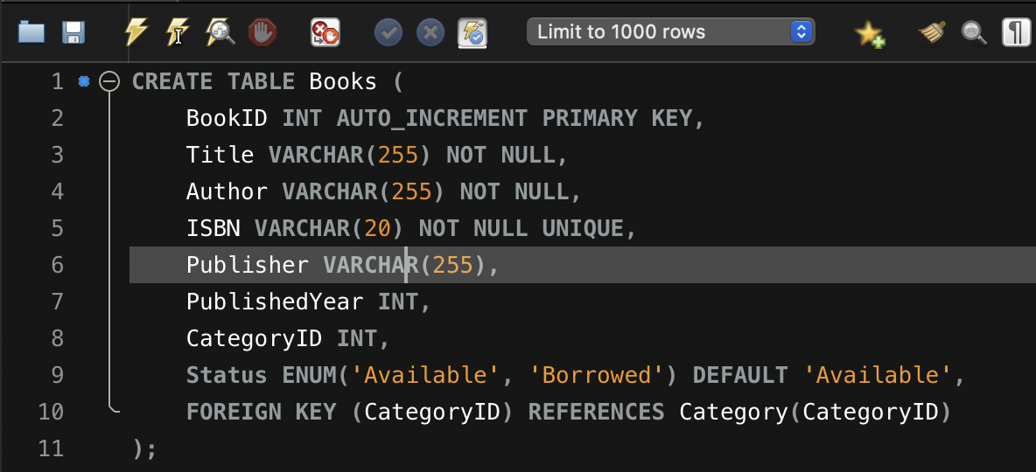
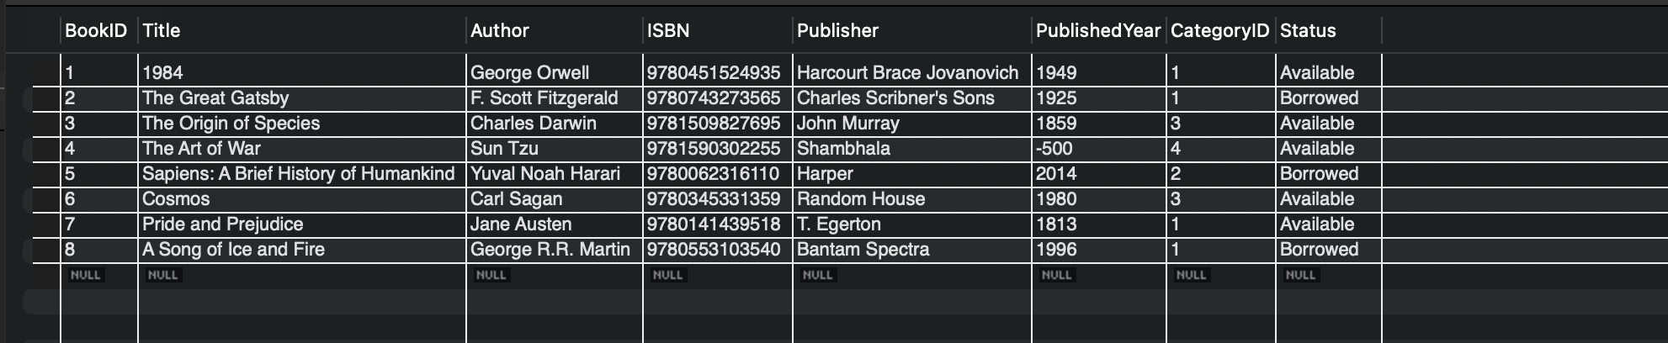
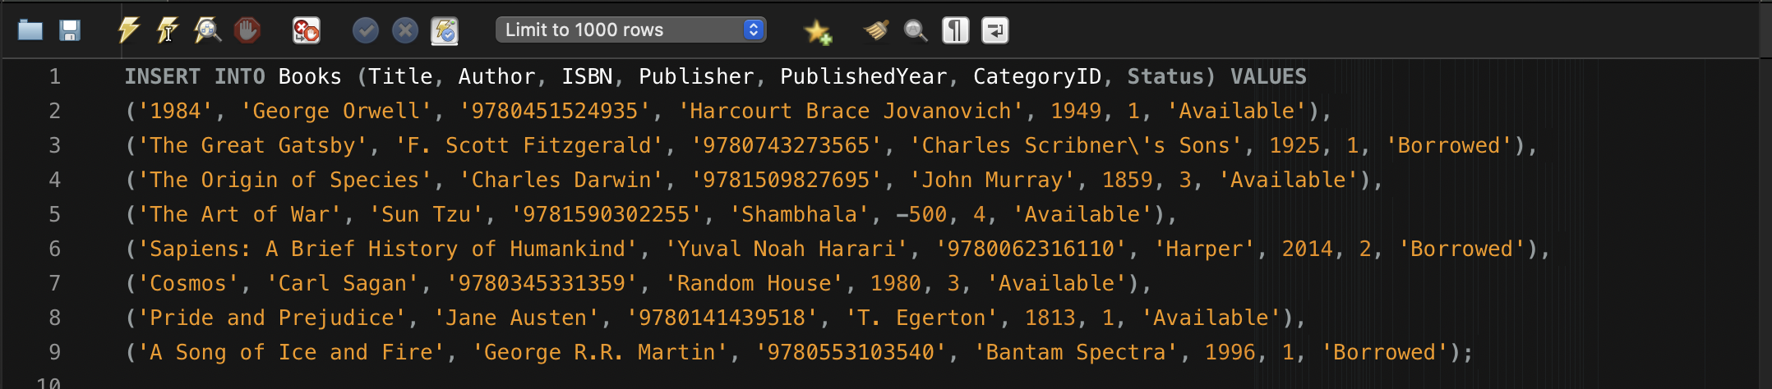
Books Tables

Slide 6
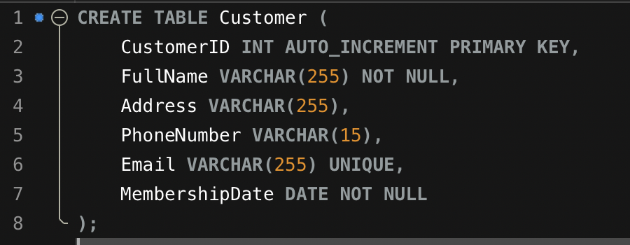
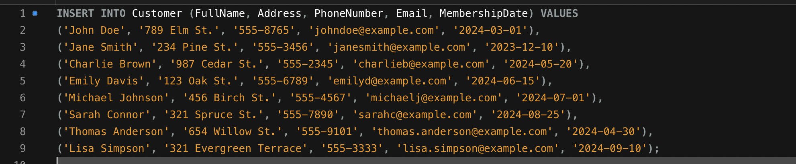
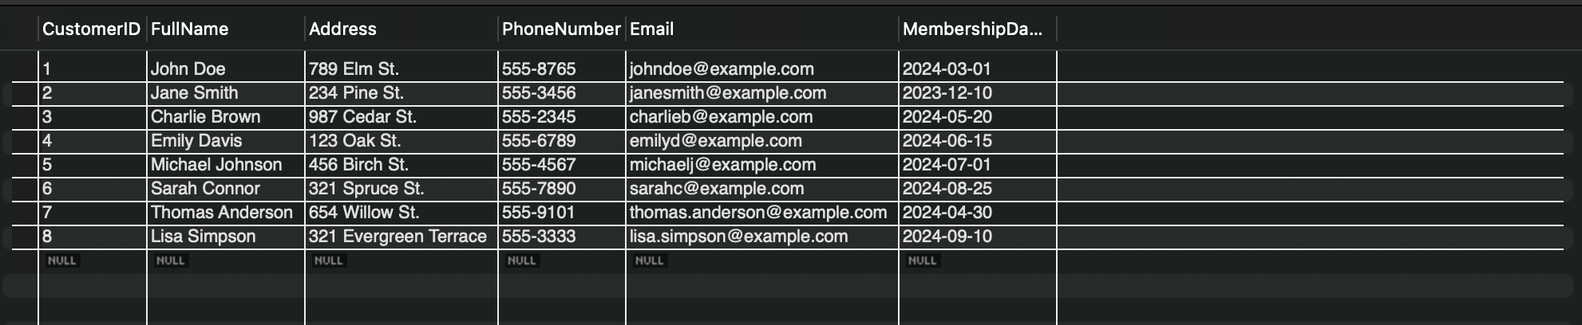
Customer Tables

Slide 7
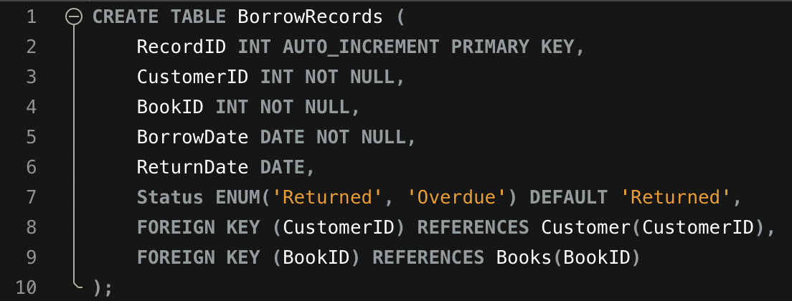
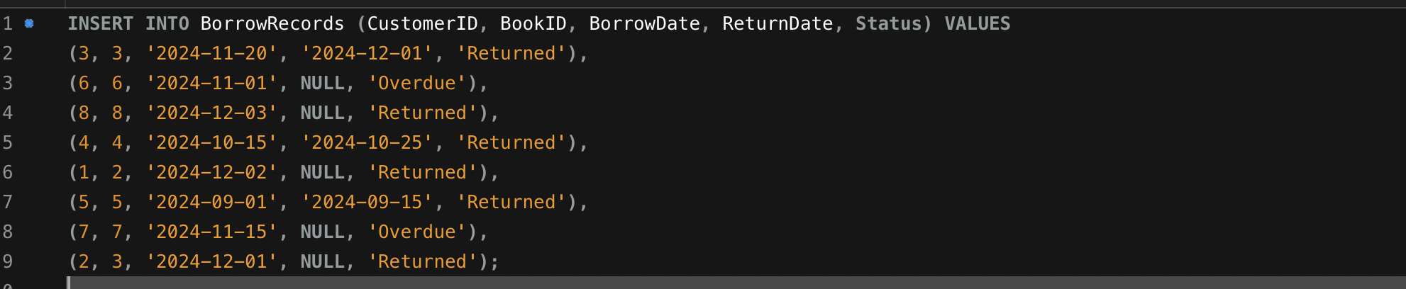
BorrowRecord Tables

Slide 8
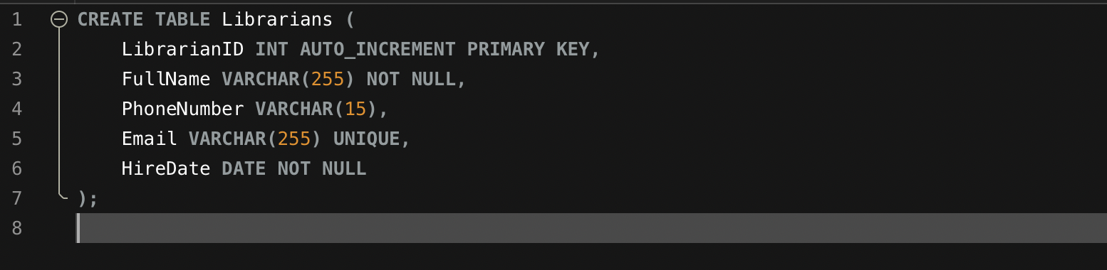
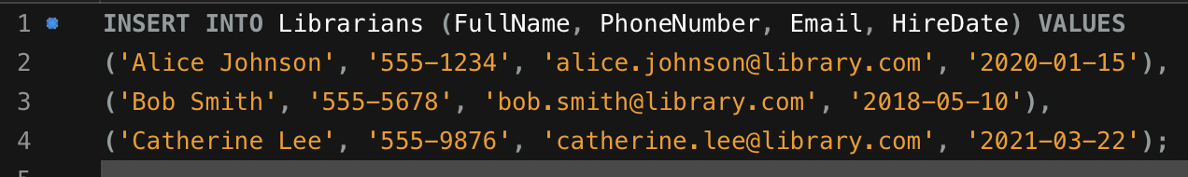
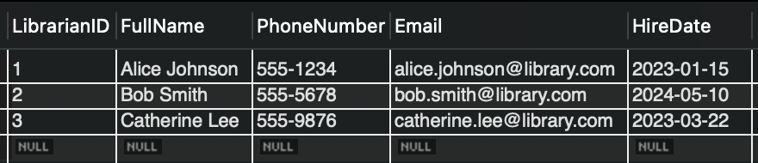
Librarian Tables

Slide 9
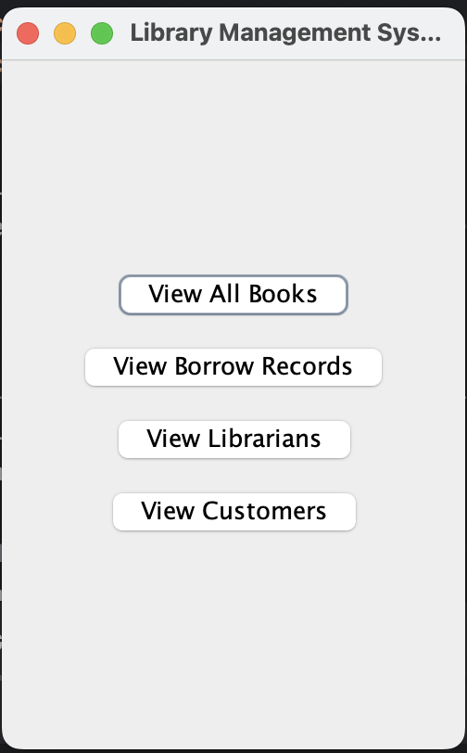
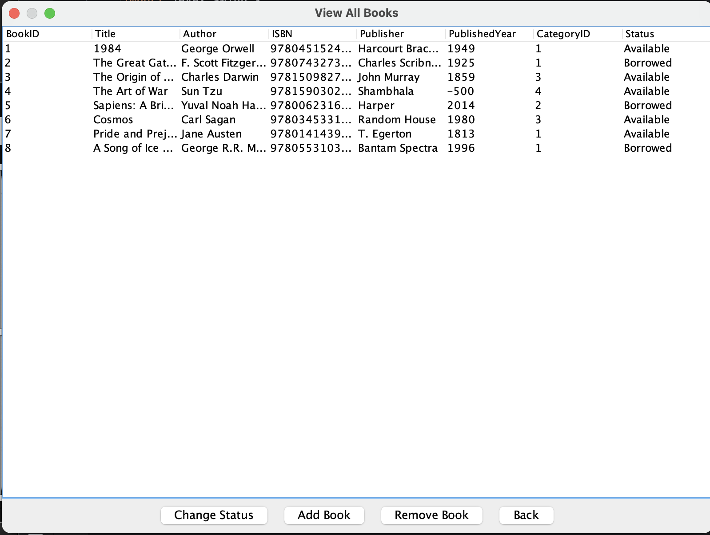
GUI

Slide 10
DEMO
TIME

