Slide 1
Analyze a testing case
CUSTOMORE
Nguyen Dinh Quoc Bao

Slide 2
Project analysis slide 2
AGENDA
CHALLENGE AND DATA
ANALYSIS
SOLUTION

Slide 3
Project analysis slide 3
CHALLENGE AND DATA
Challenge: 10Bils+ VND for gross revenue in July. Provide a concrete action plan to achieve KPI in August (20B VND for gross revenue)
Data:
Historical sales performance data - Order (11 columns, 61728 rows)
Traffic source performance data - Traffic (10 columns, 197 rows)
Tools: Python and Google research

Slide 4
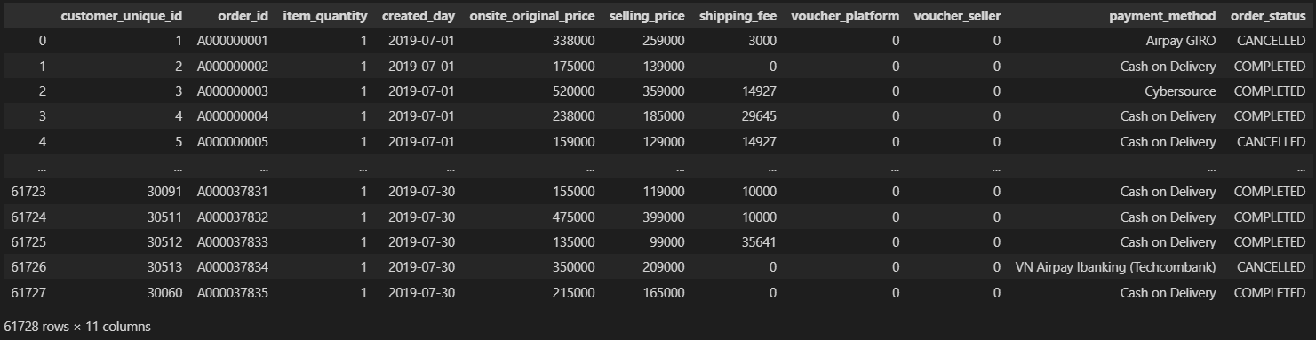
Project analysis slide 4
1. Historical sales performance data
Describe: Historical sales performance data from internal Order Management System
Size: 61728 rows x 11 columns

Slide 5
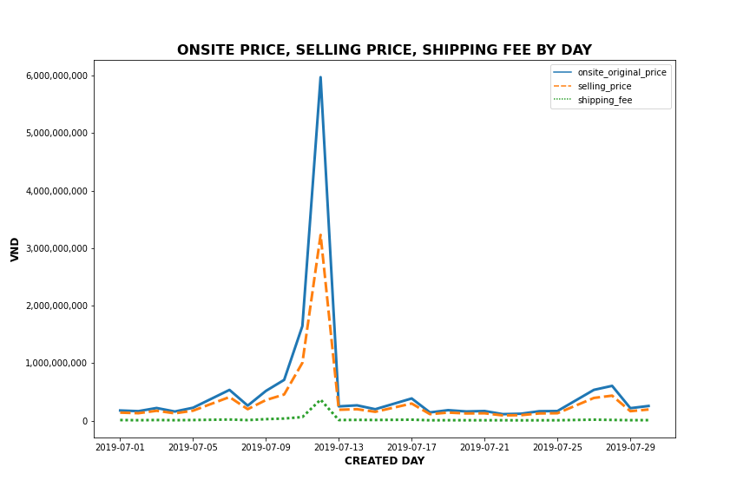
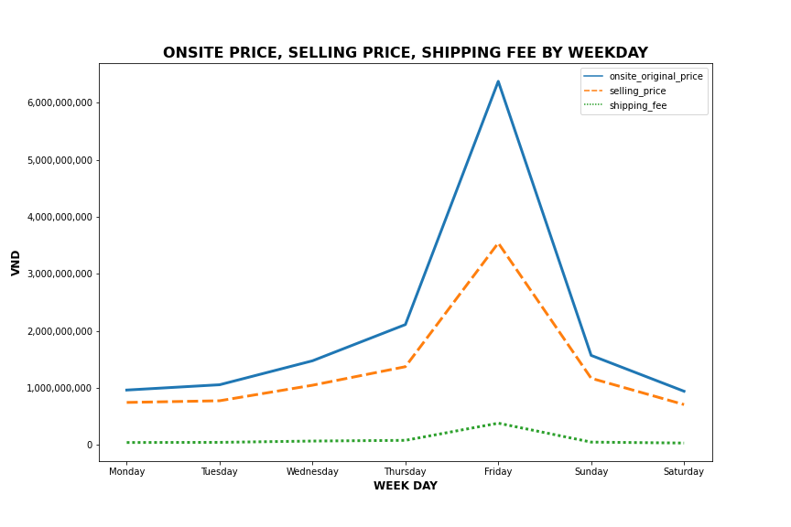
Project analysis slide 4
1. Historical sales performance data
Insight: By visualizing the price, we can see that revenue on 2019-07-12 and Friday are higher than the rest
Solution: Organize sales campaign on 09, 10, 11, 12, 13 or every Friday in next month

Slide 6
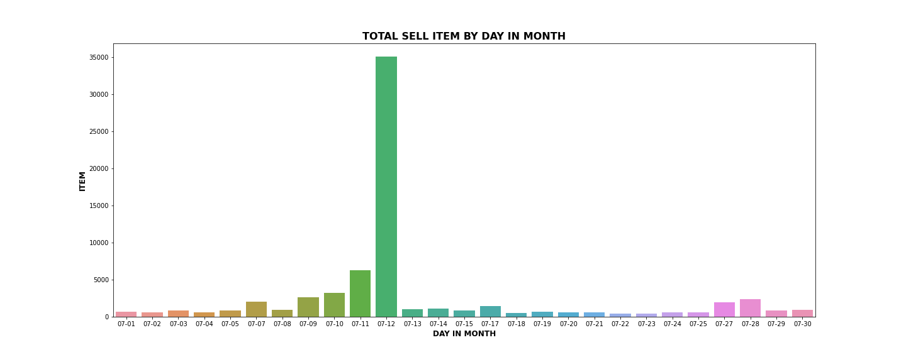
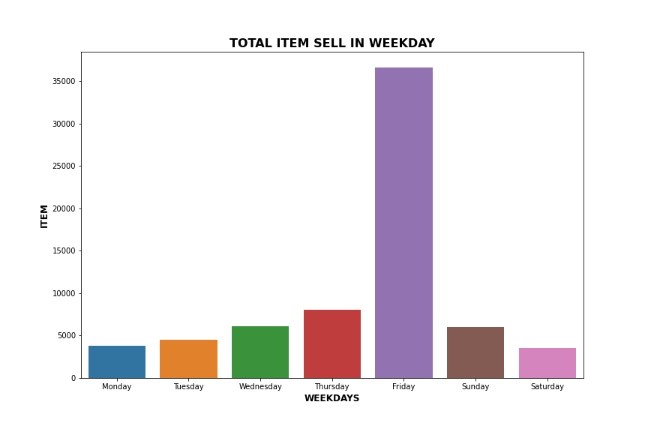
Project analysis slide 4
1. Historical sales performance data
Insight: As same as the price, total items sold on 2019-07-13 and Friday are higher than on the other days
Solution: Organize sales campaign on these days or every Friday in next month

Slide 7
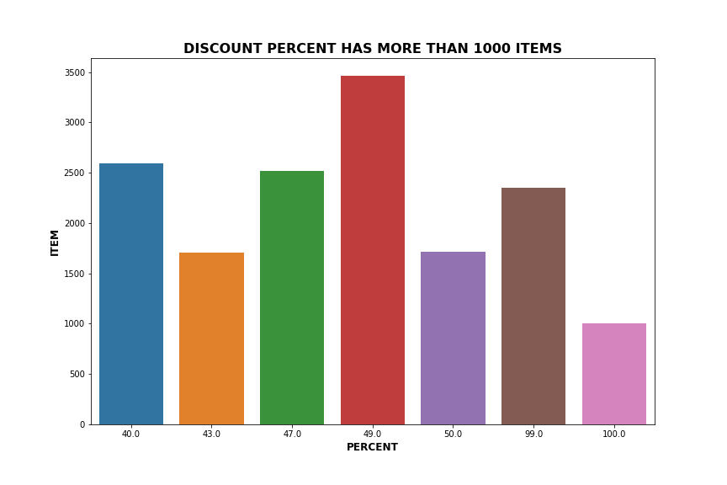
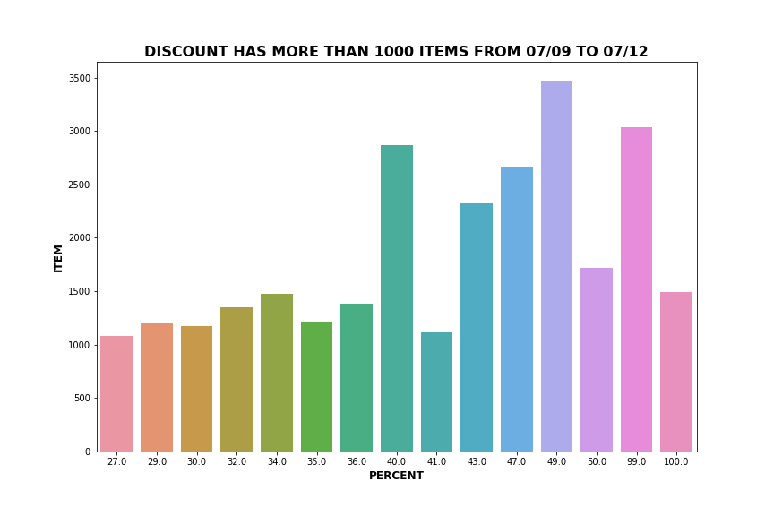
Project analysis slide 4
1. Historical sales performance data
Insight: Voucher with discount 40%, 49% and 99% can increase purchasing ability
Solution: More voucher with discount 40%, 49% on sales campaign

Slide 8
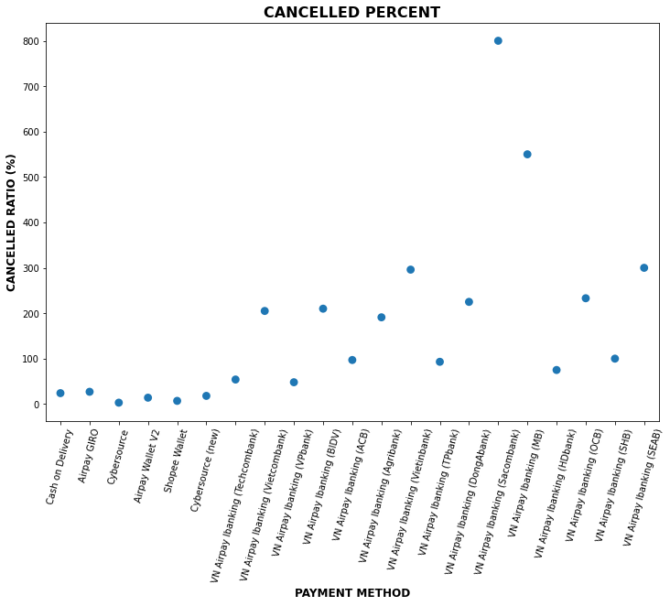
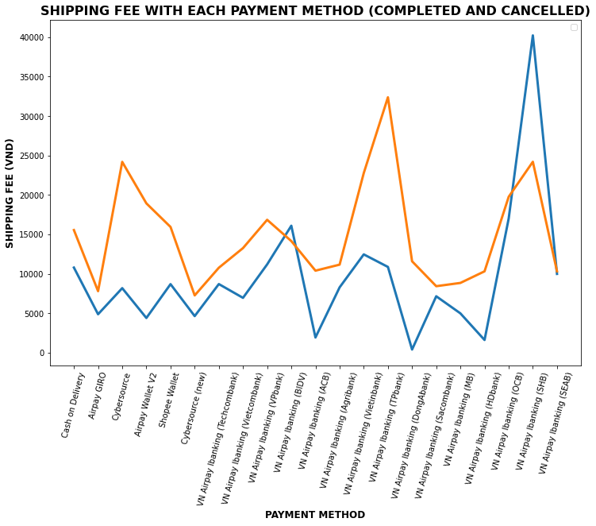
Project analysis slide 4
1. Historical sales performance data
Insight: VN Airpay Ibanking has a high cancelled ratio (from 50% to 800%). Meanwhile, another payment method has cancelled ratio is low (under 27%). Mean shipping fees of Cash on Delivery and Airpay GIRO are also low.
Solution: Increase shipping voucher for Cash on Delivery, Airpay GIRO payment method

Slide 9
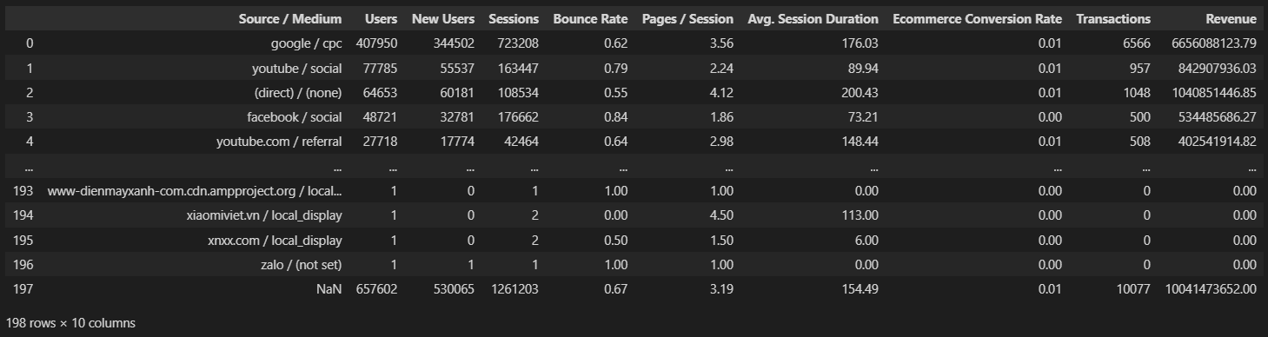
Project analysis slide 4
2. Traffic source performance data
Describe: Traffic source performance data from Google Analytics
Size: 197 rows x 10 columns

Slide 10
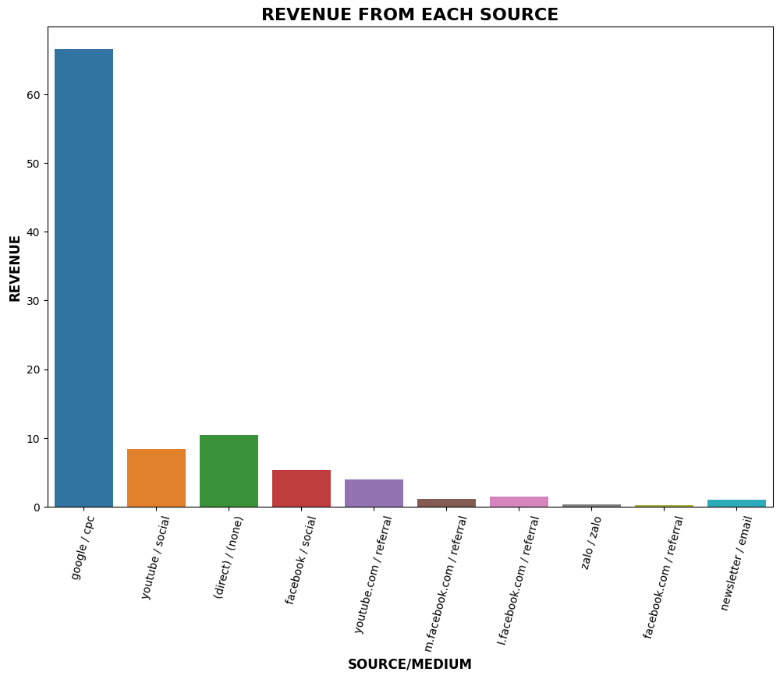
Project analysis slide 4
2. Traffic source performance data
Insight: Revenue (>20Mils VND) comes from Google, Youtube, and Facebook
Solution: Increase advertisement on these sources

Slide 11
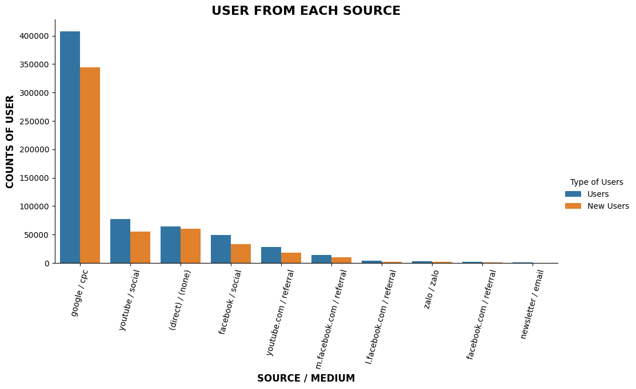
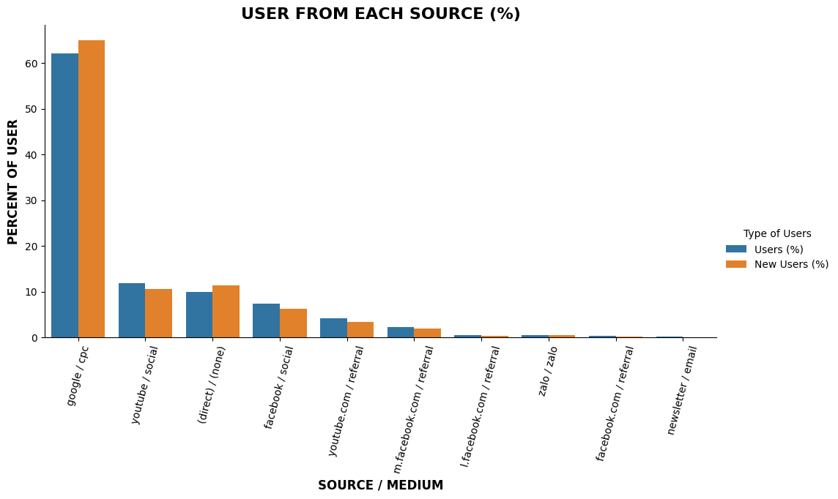
Project analysis slide 4
2. Traffic source performance data
Insight: Most users are from Google/ CPC (60%). In July, new users from Google/ CPC and Direct percent are higher than the total user ratio
Solution: Continuing advertisement on Google CPC. Increase ads on Youtube Social and Facebook Social

Slide 12
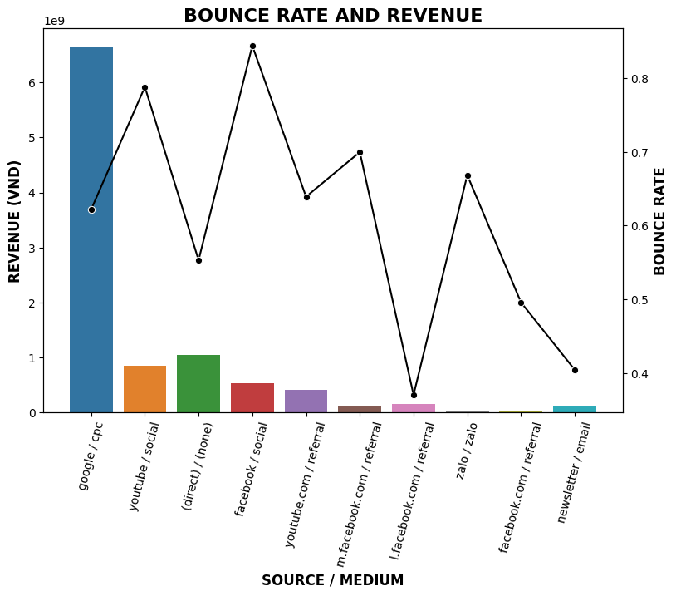
Project analysis slide 4
2. Traffic source performance data
Insight: Youtube/ Social and Facebook/ Social has bounce rate really bad (at 0.8)
Meanwhile l.facebook.com/ Referral and Newsletter/ Email has good Bounce Rate (at 0.4)
Most revenue comes from Google/ CPC and its bounce rate is about 0.62
Solution: Improve content marketing to attract users

Slide 13
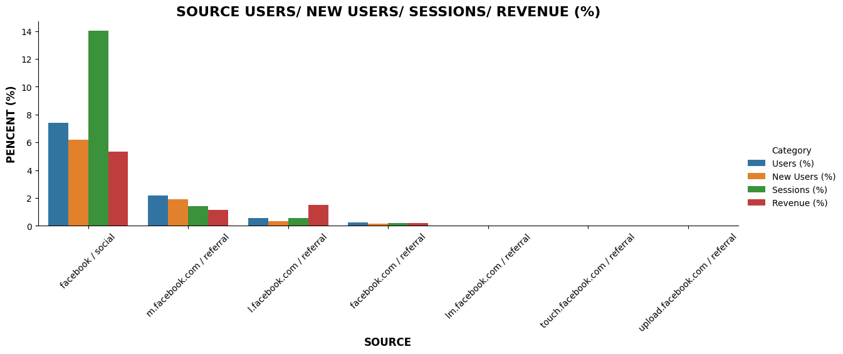
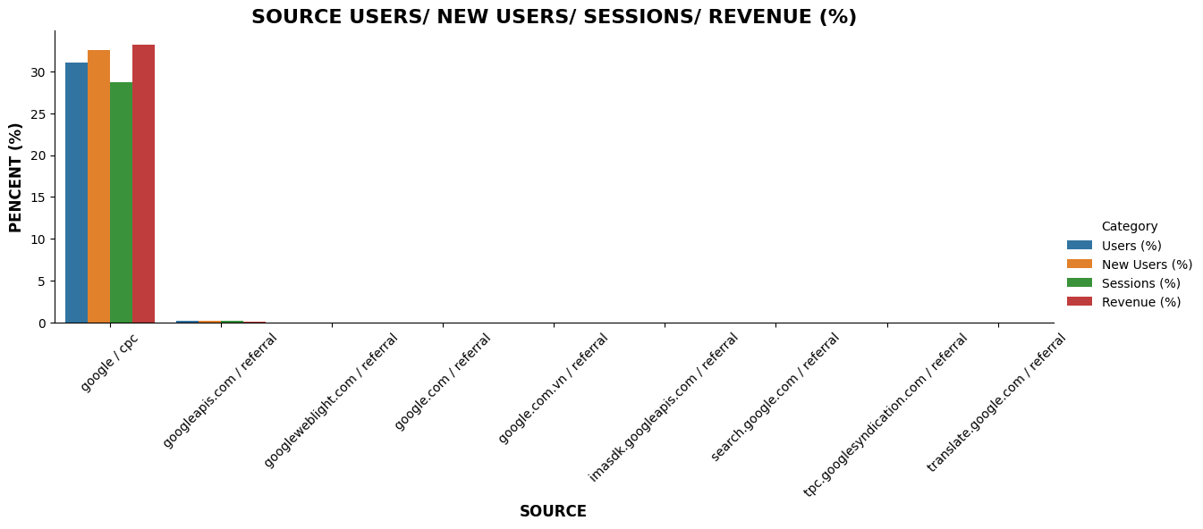
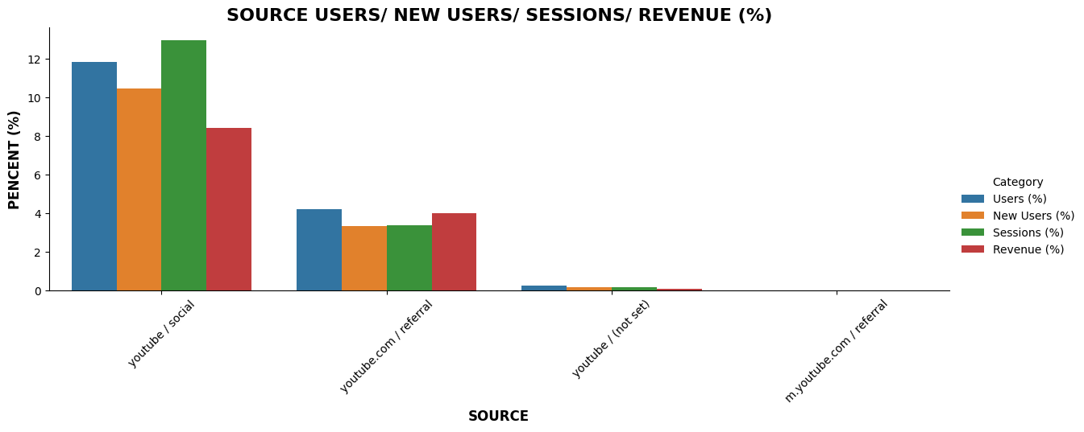
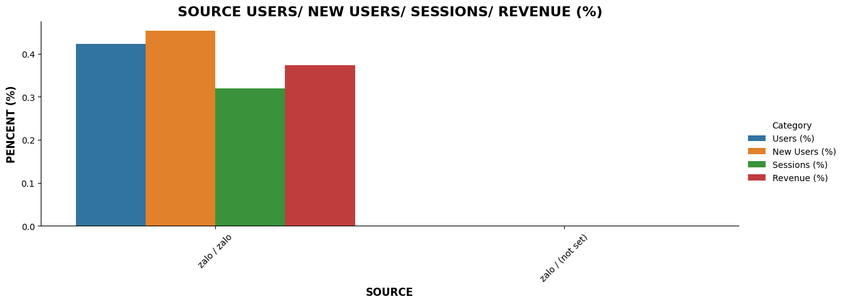
Project analysis slide 4
2. Traffic source performance data
Insight: While Facebook and Youtube Revenue come from Social platform, most of Google revenue comes from CPC
Facebook’s Session account for 15% of total session but revenue is only more than 5%
Solution: Improve ads on Youtube/ Social and Facebook/ Social. Build more customers’ beliefs on Facebook/ Social by updating content, ads, and website

Slide 14
Project analysis slide 3
SOLUTION
Solution: Organize sales campaigns
Time: From day 10 to 15 and every Friday in next month
Voucher: More voucher with discount 40%, 49%
Shipping: Increase shipping voucher for Cash on Delivery, Airpay GIRO payment method
Before sales campaign:
Increase advertisement on Google, Youtube and Facbook: Continuing advertisement on Google CPC. Increase ads on Youtube Social and Facebook Social
Improve content marketing to attract users
Build more customers’ beliefs on Facebook/ Social by updating content, ads, and website

Slide 15
Thank You

