Slide 2
Status update Hard Carbon Synthesis & Characterisation for Sodium-Ion Anodes 10 ECTS: 18-05 / 31-07-2026 Nihat Sahin Peter Curran Johan Hjelm
Joao Maria De Sacadura Botte Corte-Real (195687)

Slide 3
Joao Materials: Multi-stage Pyrolysis
 | Material ID | Pyrolysis |  |  |  | Mass in-out (g) | Yield % | Battery test | XRD | XRF | N2-BET | Raman
 | MMB1A |  |  |  |  |  |  | Coin cell → | +
26-05-2026 NS | MMB1_6A | → 600 °C | 180 °C/h | 2h | N2 (50%) | → 10. 0015 → 6.8485 | 68.47% | Coin cell → | +
04-06-2026 JM+NS | MMB1_7A | → 700 °C | 180 °C/h | 2h | N2 (50%) | →10.0972 →6.7481 | 66.83%
27-05-2026 JM+NS | MMB1_8A | → 800 °C | 180 °C/h | 2h | N2 (50%) | →10.0002 →6.5844 | 65.84% | Coin cell → | +
01-06-2026 JM+NS | MMB1_9A | → 900 °C | 180 °C/h | 2h | N2 (50%) | →10.0087 →6.4991 | 64.93%
28-05-2026 JM+NS | MMB1_10A | → 1000 °C | 180 °C/h | 2h | N2 (50%) | →10.0095 →6.3498 | 63.43% | Coin cell → | +
01-06-2026 JM+NS | MMB1_12A | → 1200 °C | 180 °C/h | 2h | N2 (50%) | →10.0062 →6.2284 | 62.24% | Coin cell → | +
29-06-2026 NS | MMB1_12A-1C/min | → 1200 °C | 60 °C/h | 2h | N2 (50%) | →10.0015 →6.3281 | 63.27% |  | +
xx-06-2026 JM+NS | MMB1_12A 10C/min | → 1200 °C | 600 °C/h | 2h | N2 (50%) | → → | -
02-05-2026 NS | MMB1_13A | → 1300 °C | 180 °C/h | 2h | N2 (50%) | →10.0125 →6.1867g | 61.85%
Materials
Completed
Processing
To be done
Batteries
→ Slurry
→ Coating
→ Coin cell

Slide 4
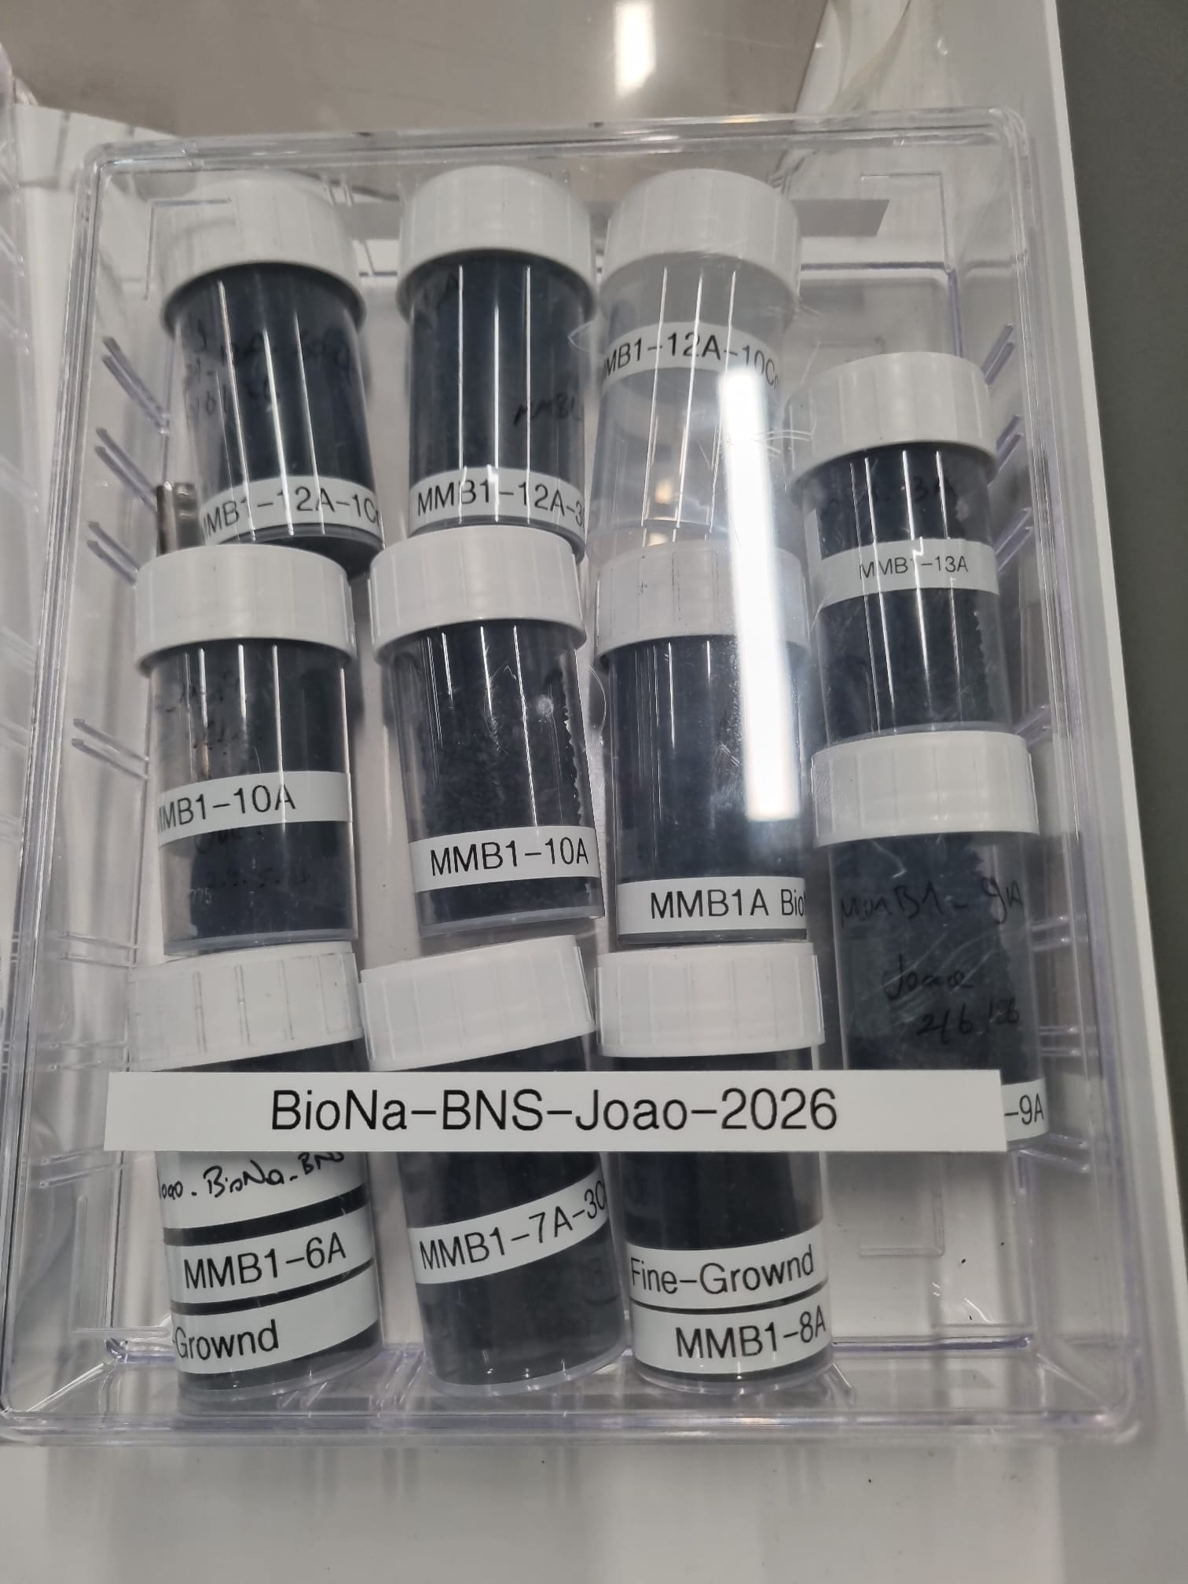
BioNa MMB1A materials
Biochar pyrolysis completed in the Furnace Lab.
XRD analysis done.
Slurry prepared using MMB1-10A
The powder needs further grinding to achieve a finer particle size.
Coating and calendering completed.
The XRD raw data have been uploaded to the BioNa Teams. To examine the results, you can find them under MMB1A in the General Results folder.
Please focus on the literature review of coin cell assembly and testing parameters.
https://doi.org/10.1021/acs.energyfuels.5c04452
https://doi.org/10.1016/j.cej.2025.161953
https://doi.org/10.1016/j.mattod.2018.12.040

