Slide 1




Machine Learning for
Tract Segmentation in dMRI Data
Bao Nguyen
NeuroInformatics Laboratory (NILab)
Trento, January 2013

Slide 2
Contents
Introduction
State of the art (SoA)
Problem statement
Preliminary results
Conclusion and Future works

Slide 3
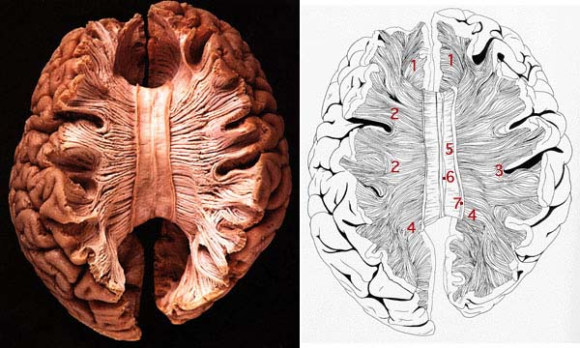
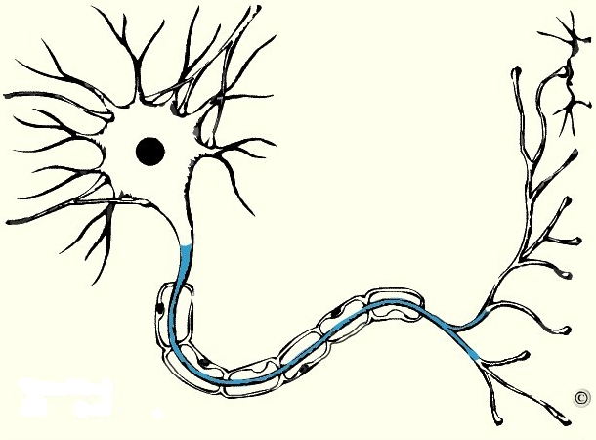
White matter
white matter
grey matter
dMRI technique
(diffusion Magnetic Resonance Imaging) in vivo (not invasive)
Denis Le Bihan, 1984
Axon
Number: ~ 10¹² axons
Size: ~ 2-20µm
Introduction SoA Problem Preliminary results Conclusion

Slide 4
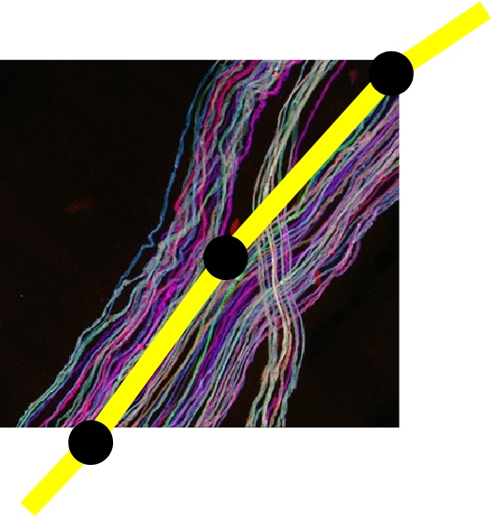
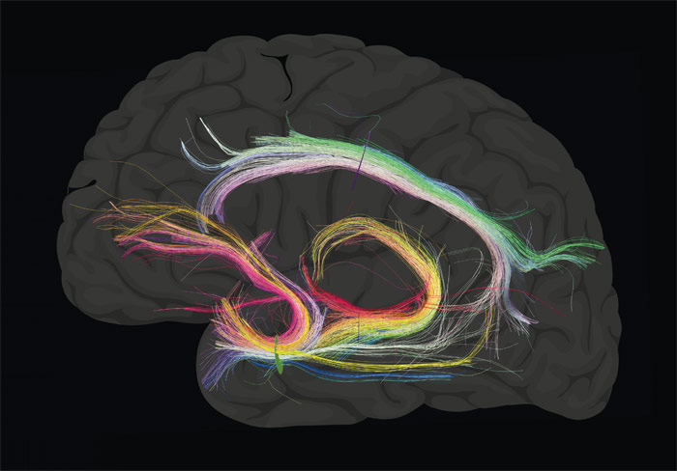
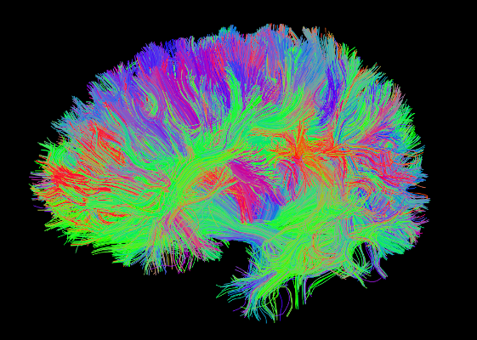
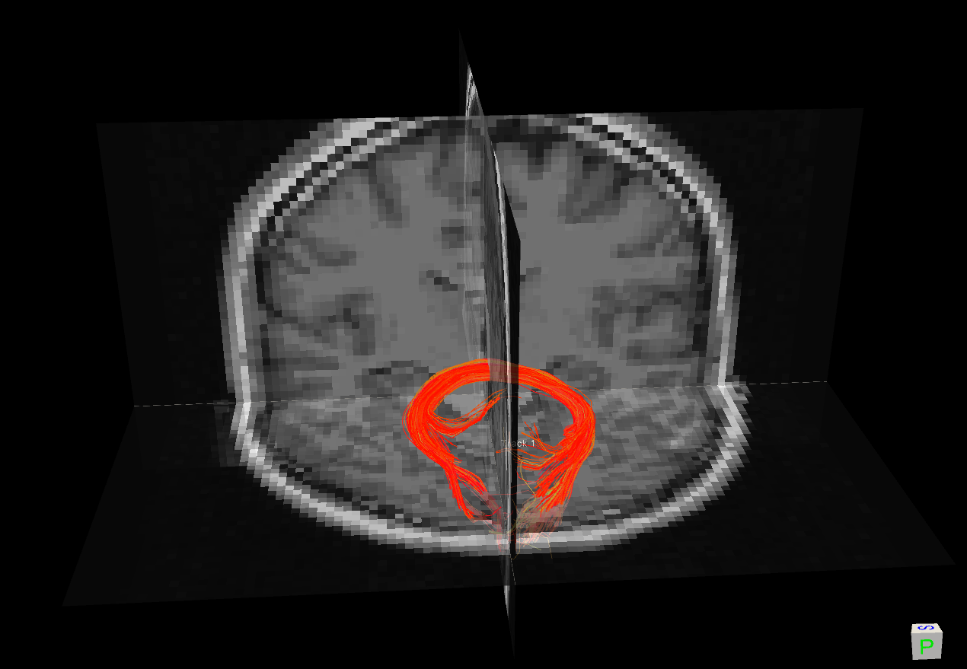
Streamline & Tractography
  Streamline: a polyline representating thousands of axons. (fiber, track)
  Bundle: a group of
  'close' streamlines
Tract: the real anatomical
group of axons.
Tractography: presentation of whole brain by streamlines.
Introduction SoA Problem Preliminary results Conclusion

Slide 5
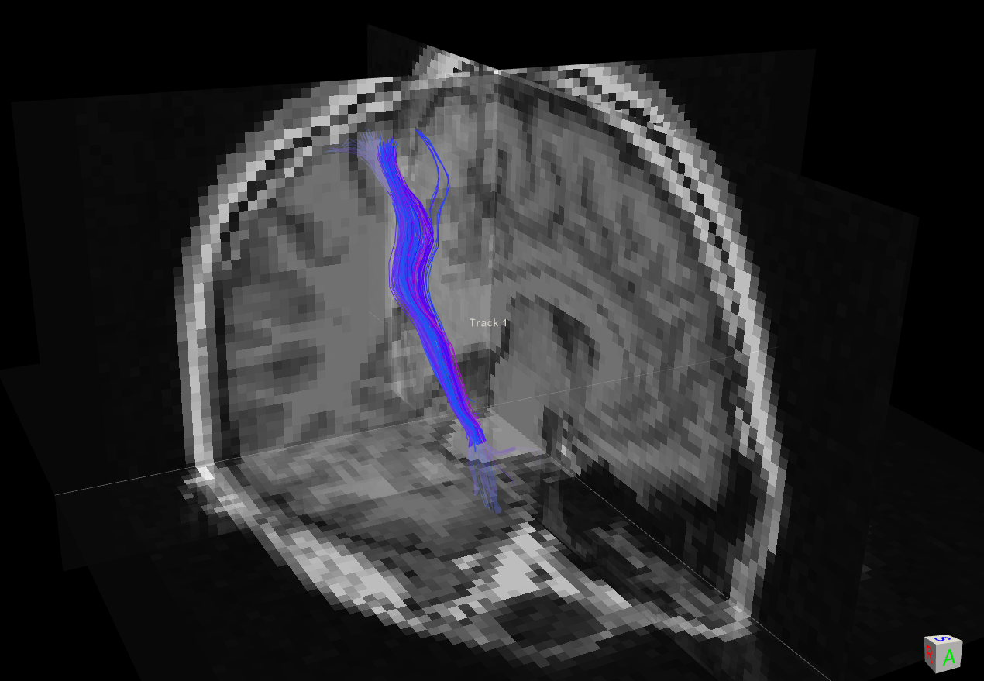
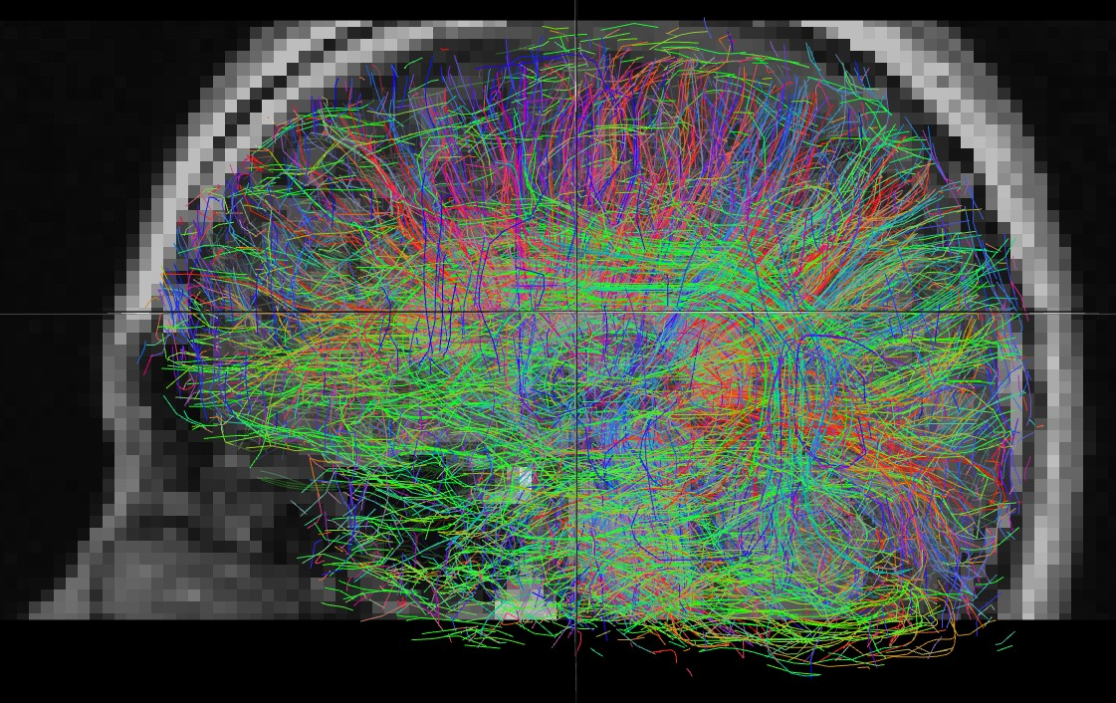
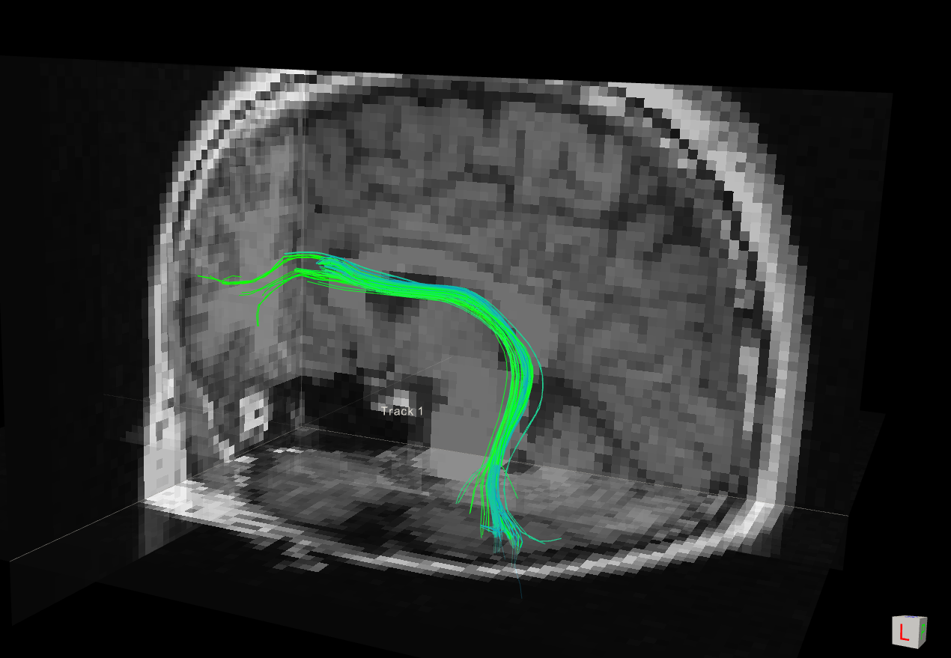
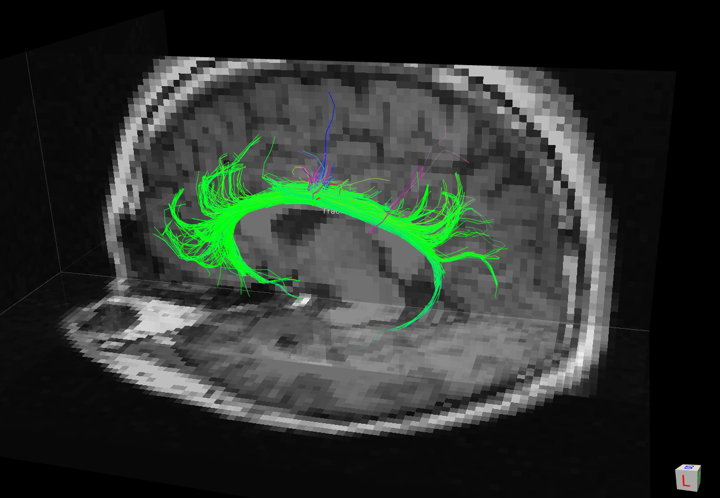
Tractography Segmentation
Corticol
Spnial Tract (CST)
Arcuate Fasciculus
Tract (AFT)
Tractography
Group streamlines belonging
to a common anatomical area
into one segmentation
Cingulum
Tract
(CGT)
Introduction SoA Problem Preliminary results Conclusion

Slide 6
Tract segmentation approaches
Atlas based
ROI based
(region of interest)
Unsupervised
tractography
tract(s)
Supervised
Introduction SoA Problem Preliminary results Conclusion

Slide 7
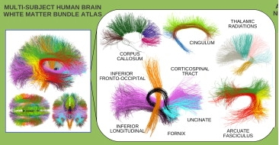

Atlas based Tract Segmentation
O'Donnell et al., 2007
  Pros
    No pairwise distance calculation
    Relate to anatomy
  Cons
    Whole brain, not target tract
    Brain variety → co-registration problem
clustering
(nearest neighbor)
tractography
tract(s)
Introduction SoA Problem Preliminary results Conclusion

Slide 8
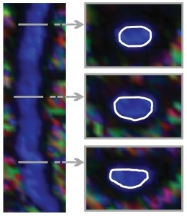
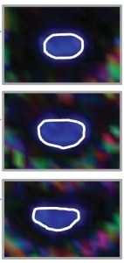
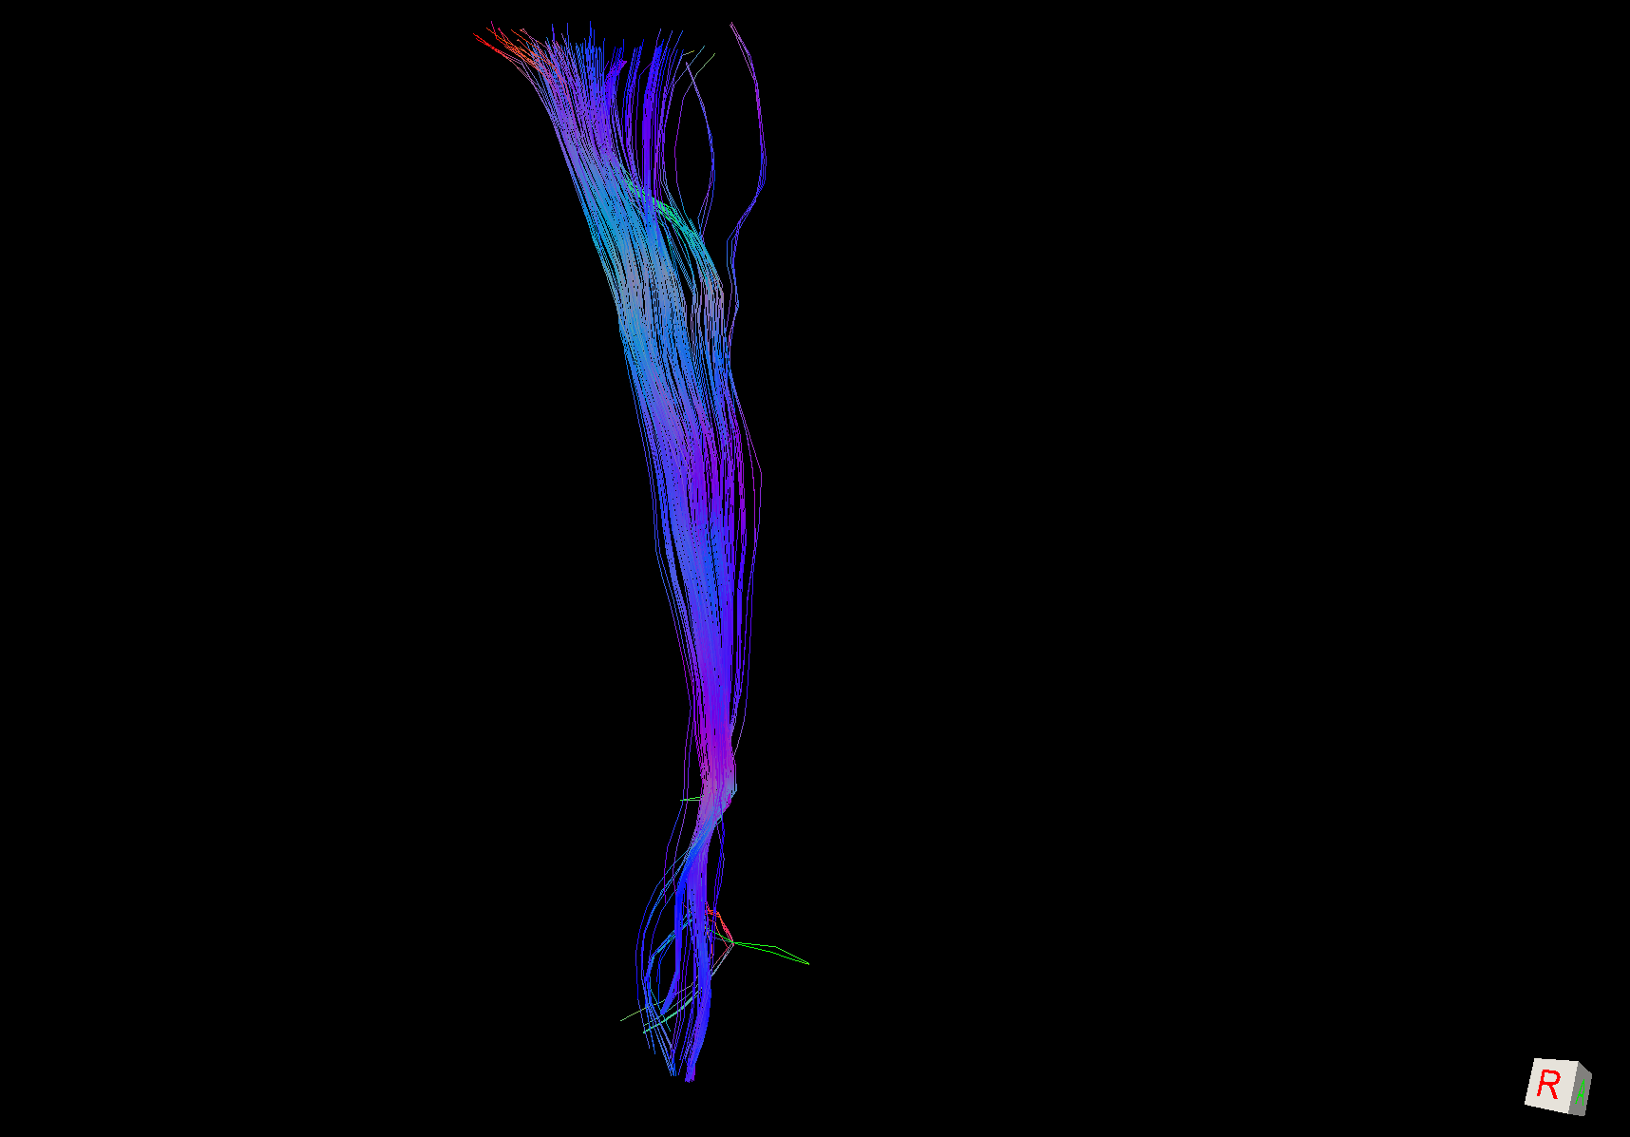
ROI based Tract Segmentation
(ROI:Region of Interest)
Wakana et al., 2007
  Pros
    No pairwise distance calculate
    Relate to anatomy (indirect)
    Target tract
  Cons
    Prior knowledge of tracjectory
    Work on well characterized tracts
    Co-registration
ROIs are drawn
tract
tractography
Introduction SoA Problem Preliminary results Conclusion

Slide 9
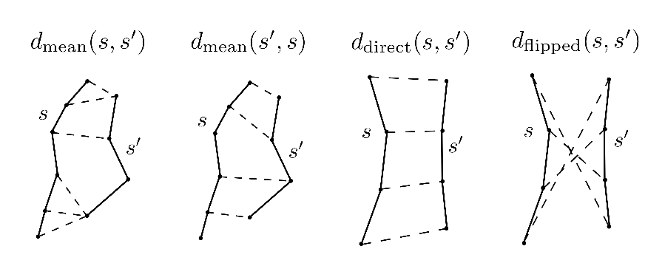
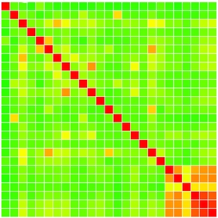
Unsupervised Tract Segmentation
Wang et al., 2011
Streamlines distance
  Pros
    No co-registration
  Cons
    Calculate pairwaise distance
    Whole brain not target tract
    Not relate to anatomy
    Number of cluster
Clustering algorithm
(agglomerative, k-means, etc.)
similarity matrix
tract(s)
Introduction SoA Problem Preliminary results Conclusion

Slide 10
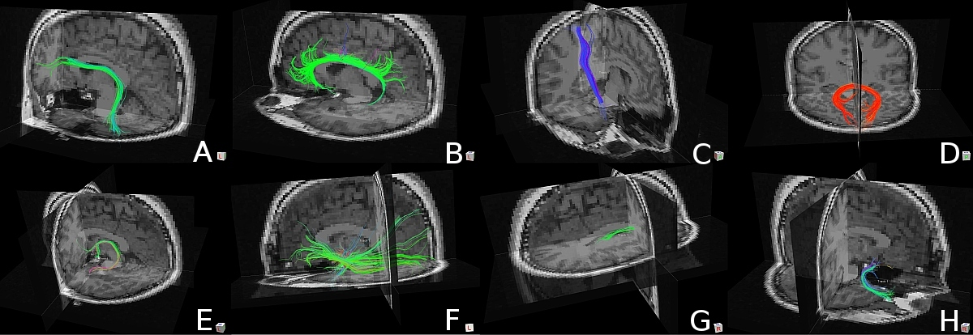
Supervised Tract Segmentation
Olivetti et al., 2011
  Pros
    Target tract
    Relate to anatomy
  Cons
    Calculate pairwise distance
    Brain variety → co-registration problem
    Ground truth data
Classifier
(Ada Boost, SVM, ect)
tractography
tract(s)
Introduction SoA Problem Preliminary results Conclusion

Slide 11
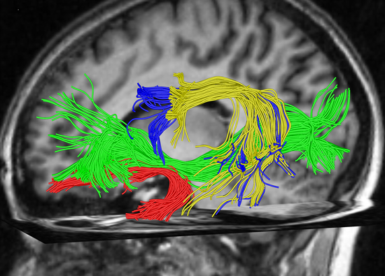
New strategy: BOI - Bundle of Interest
Focus directly on which
bundle (cluster of streamlines)
that user wants to work on
Approach | ROI | BOI
Anatomy related | Yes (indirect) | Yes
Visualization | No | Yes
Interaction | No | Yes
No prior knowledge of trajectory | No | Yes
Introduction SoA Problem Preliminary results Conclusion

Slide 12
Goals
Challenges
Machine Learning (ML)
Improve the support of ML for tract segmentation
overcome disadvantages of Atlas, ROI
combine both un-supervised and supervised
design an effective method for tract segmentation
Introduction SoA Problem Preliminary results Conclusion

Slide 13
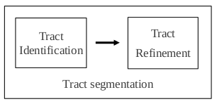
Process design: interactive segmentation
create tract candidate from set of samples
based
on BOI
Remove
streamline
Change
abstraction level
Olivetti et al.,
Supervised segmentation
of fiber tracts, SIMBAD 2011
Add
streamline
Explore
Introduction SoA Problem Preliminary results Conclusion

Slide 14
Interactive tract refinement
Demo of Spaghetti
Introduction SoA Problem Preliminary results Conclusion

Slide 15
Problem statement
Given a set of N objects X = {x₁ , . . , xN}
Traditional partitional clustering: find one partition of X
C = {C1 , . . . , CK } with K ≤ N
Ci ≠ ∅, i ∈[1, . ., K]
∪^{K}i = 1 Ci = X
Ci ∩ Cj = ∅, i, j ∈ [1, . ., K], i ≠ j
where Ci is a cluster of X : Ci = {x^{i}1 , . . , x^{i}j}, j ≤ N
Introduction SoA Problem Preliminary results Conclusion

Slide 16
Interactive clustering
Our approach: find a set of m partitions of X
P = { P1 , . . . , Pm }
where Pi is one partition of X : Pi = {C^{i}1 , . . , C^{i}d_{i}}
Pi represents the ith abstraction level of X
constraint γ: ∀i ∈[1,m-1], Pi ¹ Pi+1 (”nested in”)
Denoted as a triple ⟨ X,P,γ⟩
Introduction SoA Problem Preliminary results Conclusion

Slide 17
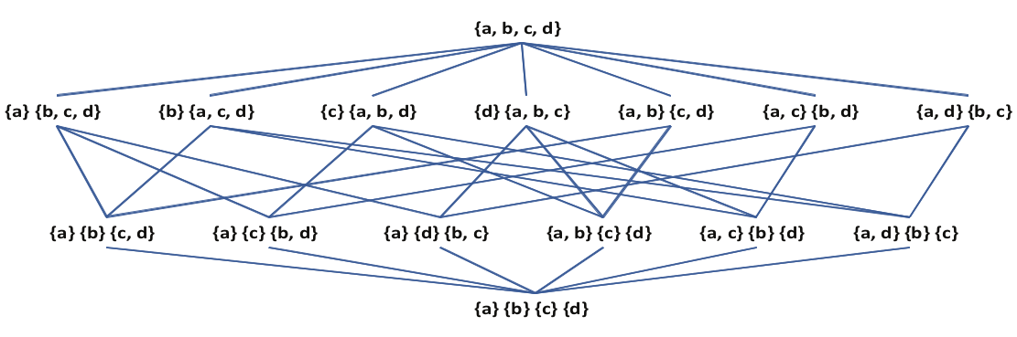
Interactive clustering: partial order relation
Vega-Pons et al., 2011
PX : set of all possible partitions of X
Over P X , a partial order relation ¹ (”nested in”)
∀Pa,Pb ∈PX , Pa ¹ Pb ↔ ∀ C^{b}i ∈Pb ,∃Cªi₁,..,Cªi_{k} ∈Pa: C^{b}i = ∪^{k}t=1 Cªi_{t}
Hasse diagram of the lattice of
the set of partitions of the set {a,b,c,d}
Introduction SoA Problem Preliminary results Conclusion

Slide 18
Interactive clustering: update partitions
Remove an old object xr.m ∈ X
Add a new object xadd
X = {x₁ . . , xN}
X ' = X \ { x_{r.m} }
X = {x₁ . . , xN}
X ' = X ∪ { xadd }
P = { P1 , . . . , Pm }
P' = { P'1 , . . . , P'm' }
⟨ X ,P,γ ⟩, γ: Pi ¹ Pi+1
⟨ X ',P ',γ '⟩, γ ': P'i ¹ P'i+1
i ∈[1,m-1]
i ∈[1,m'-1]
current partitions
updating partitions
Introduction SoA Problem Preliminary results Conclusion

Slide 19
Interactive clustering: remove object
Removing object xr.m
from all partitions
∀Pi , i ∈[1,..,m],
∀j ∈[1,..,di]:
if xr.m ∈ C^{i}j then
C^{i}j = C^{i}j \ {xr.m},
if C^{i}j = ∅, Pi = Pi \ {C^{i}j}
Examlpe of removing {b}
Introduction SoA Problem Preliminary results Conclusion

Slide 20
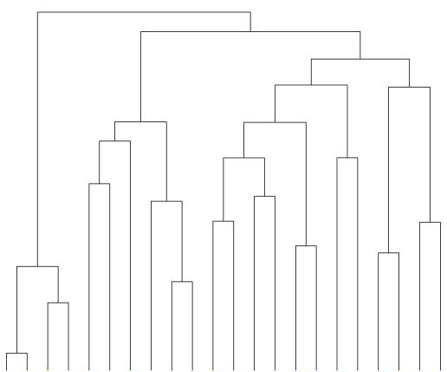
Interactive clustering: add object
xadd
incremental clustering
Introduction SoA Problem Preliminary results Conclusion

Slide 21
Incremental clustering – SoA
Douglas H. Fisher, Knowledge Acquisition Via Incremental Conceptual
Clustering, Machine Learning, Vol. 2, 1987
Arnaud Ribert, Abdel Ennaji, Yves Lecourtier, An Incremental Hierarchical
Clustering, Vision Interface, 1999
Dwi H. Widyantoro & Thomas R. Ioerger, John Chen, An incremental
approach to building a cluster hierarchy, IEEE ICDM, 2002
Chien Y. Chen, Shien C. Hwang, Yen J. Oyang, An incremental hierarchical
data clustering algorithm based on gravity theory, PAKDD 2002
Samer Nassar, Jörg Sander, Corrine Cheng, Incremental and effective data
summarization for dynamic hierarchical clustering, ACM SIGMOD MD 2004
Ibai Gurrutxaga, Olatz Arbelaitz, José I. Martín, et al., SIHC: A Stable
Incremental Hierarchical Clustering Algorithm, ICEIS 2009.
M. Srinivas, C. K. Mohan, Efficient clustering approach using incremental
and hierarchical clustering methods, IJCNN, 2010
Dingding Wang, Tao Li, Document update summarization using incremental
hierarchical clustering, CIKM 2010
Introduction SoA Problem Preliminary results Conclusion

Slide 22
Incremental clustering: critical factors
Complexity
Stability
  Not drammatically change the current dendrogram
  User can assimilate the changes
Data summarization
Introduction SoA Problem Preliminary results Conclusion

Slide 23
Interactive clustering – close solutions
An incremental approach to building a cluster hierarchy
Widyantoro et al., 2002
Nassar et al., 2004
Gurrutxaga et al., 2009
O(N log N) v.s build MST (O( N² log N))
+ not stable structure
Incremental and effective data summarization for dynamic hierarchical clustering
O (m * N) v.s data summarization
SIHC: A Stable Incremental Hierarchical Clustering Algorithm
Keep a stable structure v.s O(N² log N)
Introduction SoA Problem Preliminary results Conclusion

Slide 24
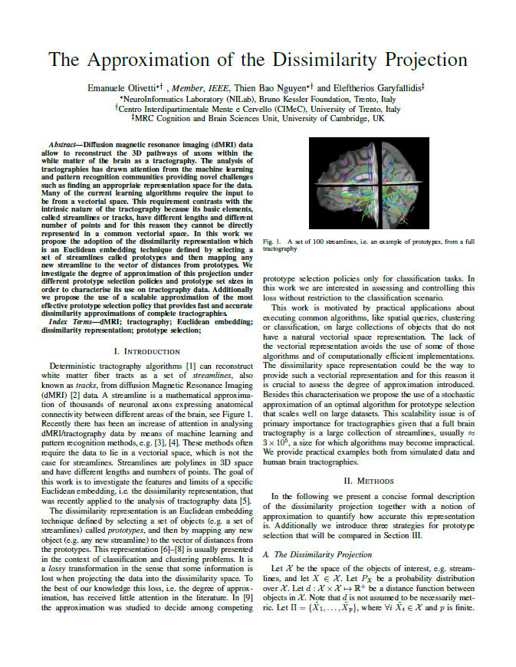

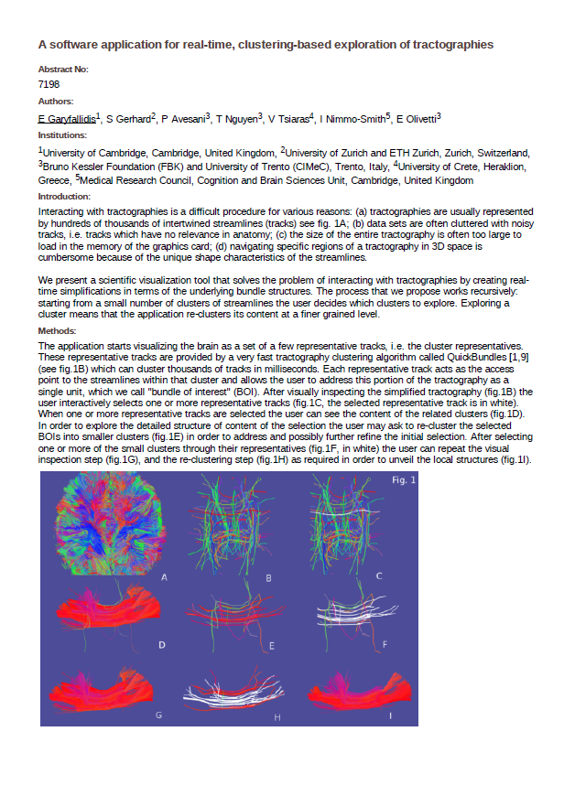

Preliminary Results
(method) Dissimilarity representation
(software/tool) Spaghetti: an interactive visualization
tool for segmentation tractography
(case study) ALS (amyotrophic lateral sclerosis) disease
E. Olivetti, T. B. Nguyen, E. Garyfallidis,
The Approximation of the Dissimilarity Projection,
Pattern Recognition in NeuroImaging, PRNI 2012.
E. Garyfallidis, S. Gerhard, P. Avesani,
T. B. Nguyen, V. Tsiaras, I. N. Smith, E. Olivetti,
A software application for real-time, clustering
based exploration of tractographies, OHBM 2012.
(in preparation)
Introduction SoA Problem Preliminary results Conclusion

Slide 25
Conclusion
Future works
An effective method for tract segmentation:
tract candidate (supervised) and tract refinement (clustering)
An interactive visualization tool for tract segmentation
ALS case study
Implement the modified HAC for tractography
Revise the solution for 'adding object' to partitions
Integerate tract candidate (supervised) into Spaghetti
Introduction SoA Problem Preliminary results Conclusion

Slide 26
Credits
Nivedita Agarwal, S.Chiara Trento Hospital, Italy; University of Utah, USA
Eleftherios Garyfallidis, University of Cambridge, UK; University of Sherbrooke, Canada
Emanuele Olivetti, Fondazione Bruno Kessler, Italy
Paolo Avesani, Fondazione Bruno Kessler, Italy
Luigi Cattaneo, CiMeC, University of Trento, Italy
Francesca Maule, CiMeC, University of Trento, Italy
Introduction SoA Problem Preliminary results Conclusion

Slide 27
Thank you!

Slide 28
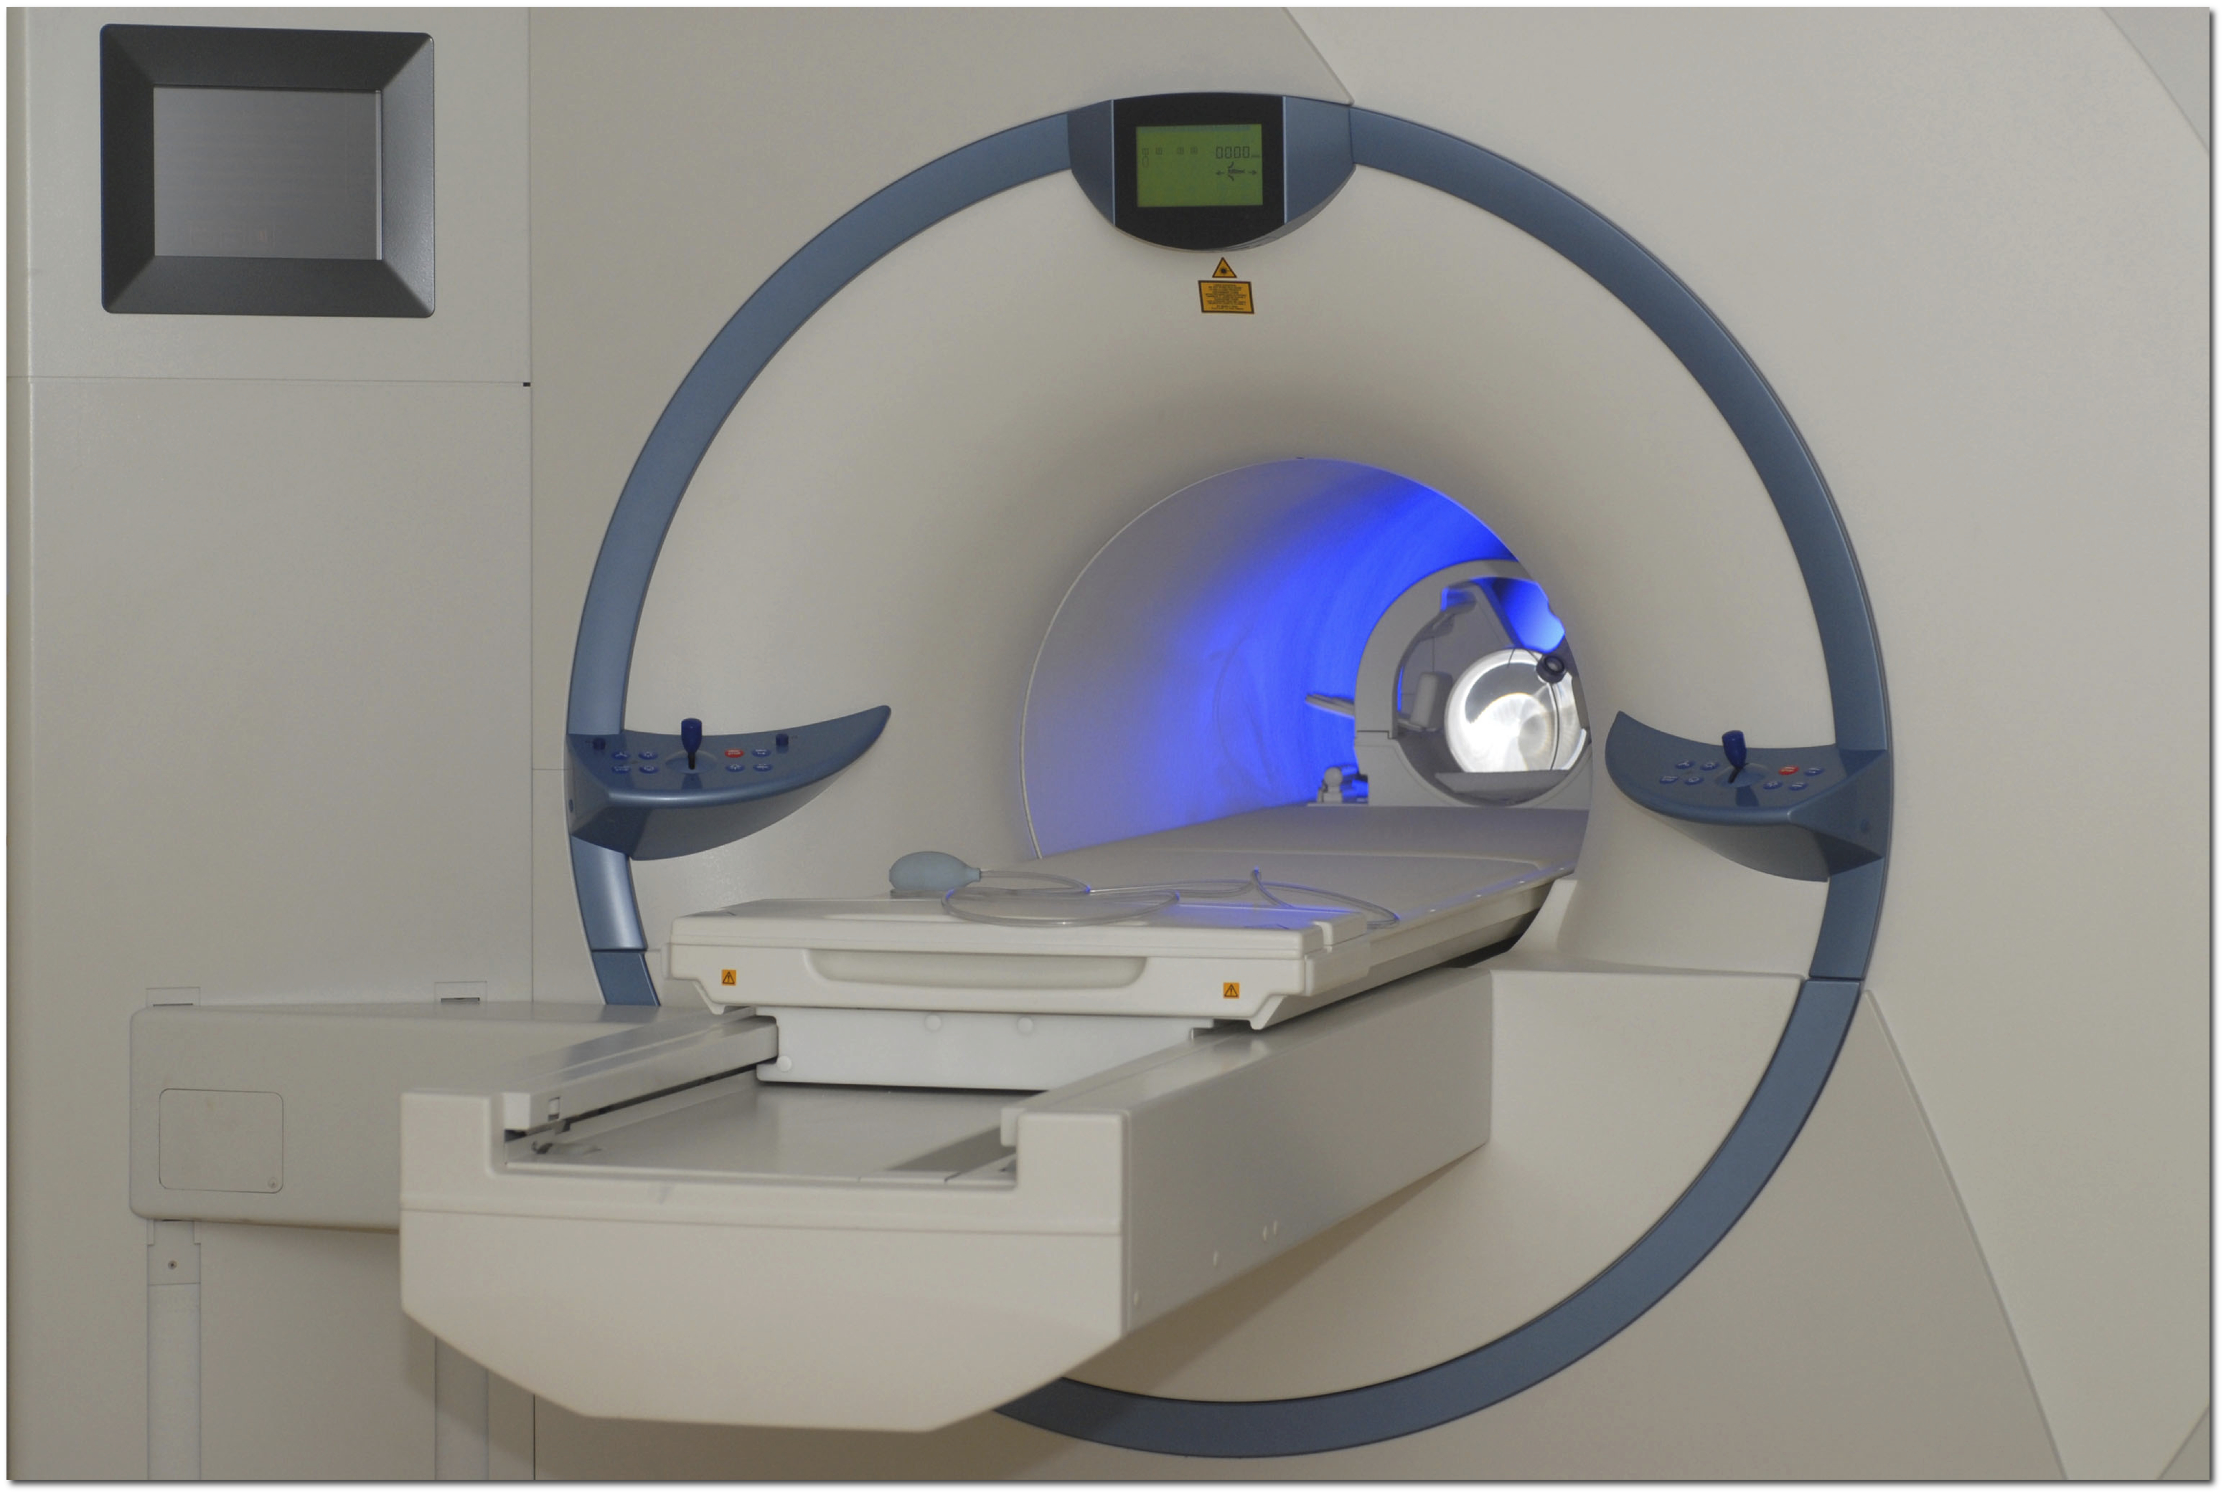
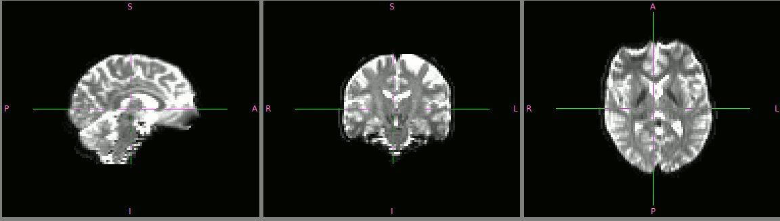
dMRI technique
(diffusion Magnetic Resonance Imaging) in vivo (not invasive)
Denis Le Bihan, 1984
Tractography
in 3D
(*)
Garyfallidis et. al. 2012
(Towards an accurate brain tractography)
MRI images in 3D
Introduction SoA Problem Proposed solution Preliminary results Conclusion

Slide 29
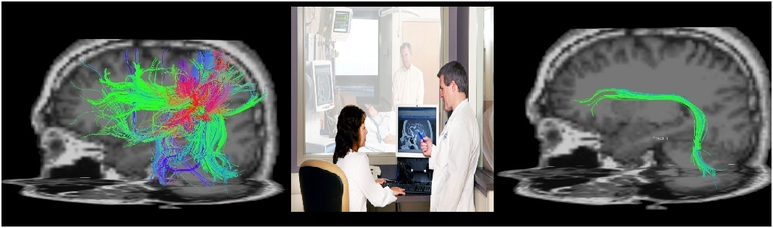
Tract Segmentation: Human Expert
large amount of streamlines
segmentation
difficult and lengthy
anatomical variability
among subjects
Introduction SoA Problem Proposed solution Preliminary results Conclusion

Slide 30

Introduction SoA Problem Proposed solution Preliminary results Conclusion

Slide 31
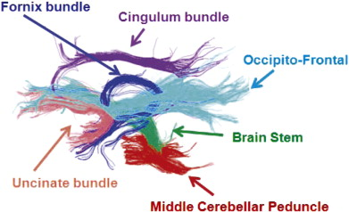
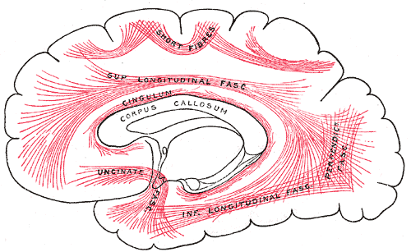
Tractography Segmentation
To group streamlines belonging to a common anatomical area into one segmentation
Introduction SoA Problem Preliminary results Conclusion

Slide 32
Survey of tractography segmentation methods
Approach | Target tract | Anatomy related | No co-registration | No pairwise distance | Visualization/ Interaction
Atlas | No | Yes | No | Yes | No
ROI | Yes (indirect) | Yes (indirect) | No | Yes | No
Unsupervised | No | No | Yes | No (costly) | No
Supervised | Yes | Yes (indirect) | No | Yes | No
pros
con
Introduction SoA Problem Proposed solution Preliminary results Conclusion

Slide 33
Comparison
Approach | Target tract | Related anatomy | No co-registration | No pairwise distance | Visualization \Interaction
Atlas | No | Yes | No | Yes | No
ROI | Yes (indirect) | Yes (indirect) | No | Yes | No
Unsupervised | No | No | Yes | No (costly) | No
Supervised | Yes | Yes (indirect) | No | Yes | No
Ours | Yes | Yes | No(*) | Yes | Yes
Introduction SoA Problem Proposed solution Preliminary results Conclusion

Slide 34
Data representation
Most of learning algorithms assume objects to be in an Euclidean feature space
Issue: streamlines s = {x₁ , . . . , xns}, where x ∈ ℝ³
  The number of points is not the same
  Lengths are different
Find a representation φ of streamline φ : T → ℝ^{d}
minimize lossy : φ = argmin L(φ ⁻¹(s))
Introduction SoA Problem Proposed solution Preliminary results Conclusion

Slide 35
Notations
Streamline: a polyline s = {x₁ , . . . , xns}, where x ∈ ℝ³
Tractography: a set of n streamlines T = {s₁ , . . , sn}
Taget tract: Ttarget ⊂ T
Introduction SoA Problem Proposed solution Preliminary results Conclusion

Slide 36
Tract identification
Supervised Learning
(*)Olivetti et al., 2011
Tract candidate
Given a class-labeled sample E = {(s1 , y1), . ., (sN, yN)},
with yi = 0 if yi ∈Ttarget; yi = 1 otherwise.
Learn classifier ƒ from E by minimizing the loss
function L: ƒ = argmin L(ƒ'(s),y)
Tract candidate: Tcandidate = { si | ƒ(si) = 1, ∀si ∈T }
Introduction SoA Problem Proposed solution Preliminary results Conclusion

Slide 37
Interactive tract refinement
Remove
streamline
Change
abstraction level
Add
streamline
Explore
Introduction SoA Problem Proposed solution Preliminary results Conclusion

Slide 38
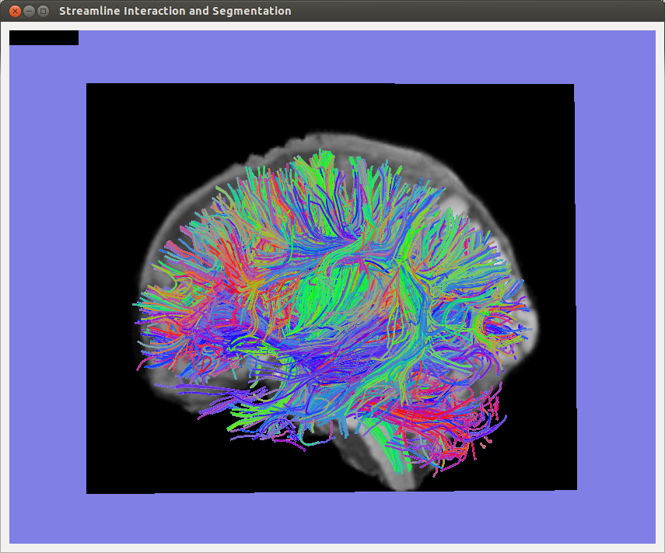
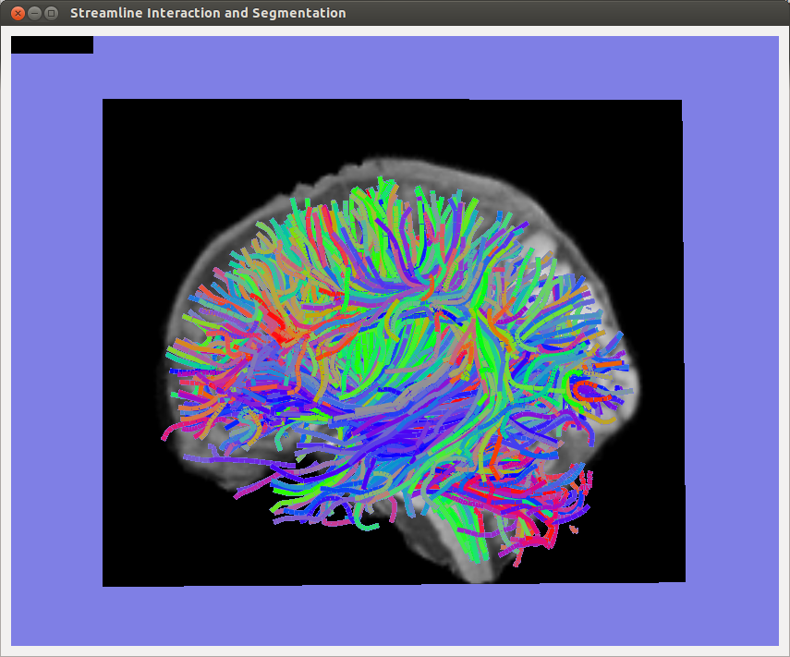
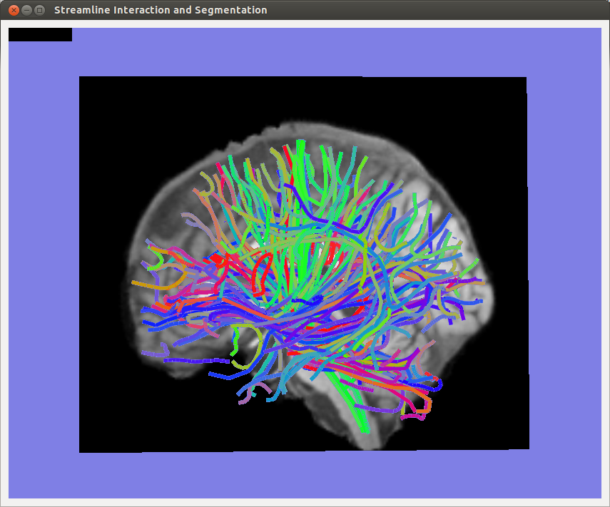
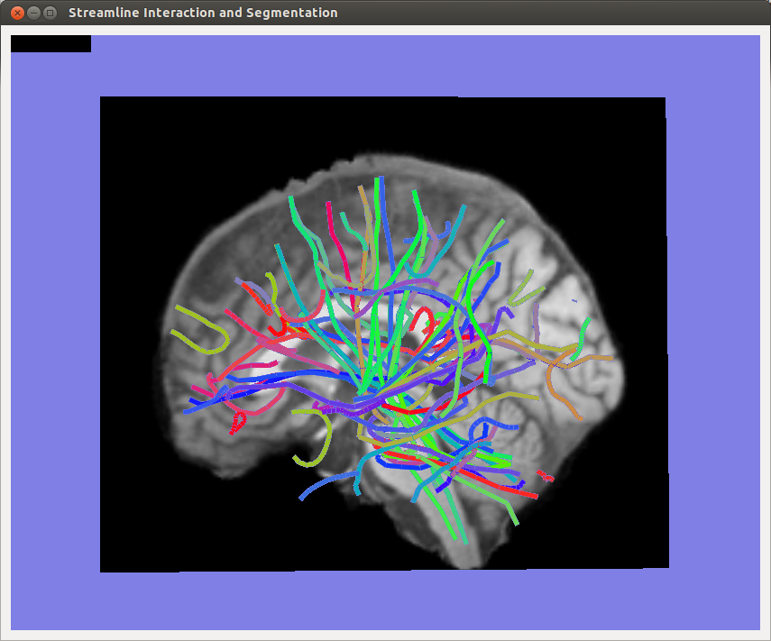
Interactive tract refinement
abstraction level
large ammount of streamlines
difficult to interpret and interact
Cluster in
multiple-level
of abstraction
Introduction SoA Problem Proposed solution Preliminary results Conclusion

Slide 39
Tractography clustering
Given a set of N streamlines T = {s₁ , . . , sN}
Traditional approaches: find one partition of T
C = {C1 , . . . , CK } with K ≤ N
with Ci is a cluster of T : Ci = {s^{i}1 , . . , s^{i}j}, j ≤ N
Ci ≠ ∅, i = 1, . . , K
∪^{K}i = 1 Ci = T
Introduction SoA Problem Proposed solution Preliminary results Conclusion

Slide 40
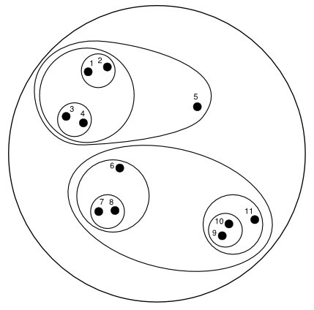
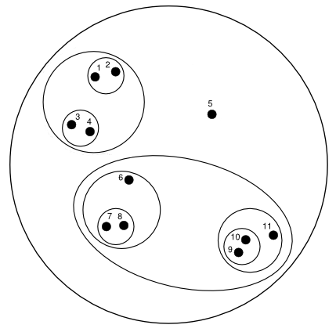
Interactive tractography clustering
∀Pi , Pj , i > j, (C^{j}k ⊆ C^{i}l) ∨ (C^{j}k ∩ C^{i}l = ∅)
l ∈[1,..,di],
k ∈[1,..,dj]
C
A
B
Introduction SoA Problem Proposed solution Preliminary results Conclusion

Slide 41
Neighbor checking
Given a distance measure d(sa,sb) on whole tractography ΤΒ
neighbor(T,θ) = {s | d(s,st) ≤ θ, ∀ st ∈T, s ∈ΤΒ, s ≠ st}
Add streamline sa ∈ neighbor(T,θ) to T ???
  The current viewing partition is Pi
  Cclose(sa,Pi) is the cluster in Pi closest to sa:
  dmin(Pi) is the min distance between two clusters of Pi
  Cclose(sa,Pi) = argmin (d(sa,C^{i}k)), ∀ C^{i}k ∈Pi
  dmin(Pi) = argmin (d(C^{i}k,C^{i}l)),∀ C^{i}l,C^{i}k∈Pi, k ≠ l
Introduction SoA Problem Proposed solution Preliminary results Conclusion

Slide 42
Neighbor checking – add streamline
Case 1: d(sa,Cclose(sa,Pi)) > dmin(Pi)
  sa becomes a new cluster: P'i = Pi ∪ {sa}
  <P',T ',γ2> where γ2 is the constraint as:
γ2 : ∀ j ∈[1, .., i], ∃C'^{j}k ∈ P'j : C'^{j}k = { sa }
Case 2: d(sa,Cclose(sa,Pi)) ≤ dmin(Pi)
  sa is merged into Cclose(sa,Pi): Cclose(sa,Pi) = Cclose(sa,Pi) ∪ {sa}
  <P',T ',γ3> where γ3 is the constraint as:
γ3 : ∀ j ∈[i, .., m], ∃C'^{j}k ∈ P'j : (Cclose(sa,Pi) ∪ {sa}) ⊆ C'^{j}k
Introduction SoA Problem Proposed solution Preliminary results Conclusion

Slide 43
Neighbor checking
Given a distance measure d(sa,sb) on whole tractography ΤΒ
neighbor(T,θ) = {s | d(s,st) ≤ θ, ∀ st ∈T, s ∈ΤΒ, s ≠ st}
Add streamline sa ∈ neighbor(T,θ) to T ???
  The current viewing partition is Pi
  Cclose(sa,Pi) is the cluster in Pi closest to sa:
  dmin(Pi) is the min distance between two clusters of Pi
  Cclose(sa,Pi) = argmin (d(sa,C^{i}k)), ∀ C^{i}k ∈Pi
  dmin(Pi) = argmin (d(C^{i}k,C^{i}l)),∀ C^{i}l,C^{i}k∈Pi, k ≠ l
Introduction SoA Problem Proposed solution Preliminary results Conclusion

Slide 44
Neighbor checking – add streamline
Case 1: d(sa,Cclose(sa,Pi)) > dmin(Pi)
  sa becomes a new cluster: P'i = Pi ∪ {sa}
  <P',T ',γ2> where γ2 is the constraint as:
γ2 : ∀ j ∈[1, .., i], ∃C'^{j}k ∈ P'j : C'^{j}k = { sa }
Case 2: d(sa,Cclose(sa,Pi)) ≤ dmin(Pi)
  sa is merged into Cclose(sa,Pi): Cclose(sa,Pi) = Cclose(sa,Pi) ∪ {sa}
  <P',T ',γ3> where γ3 is the constraint as:
γ3 : ∀ j ∈[i, .., m], ∃C'^{j}k ∈ P'j : (Cclose(sa,Pi) ∪ {sa}) ⊆ C'^{j}k
Introduction SoA Problem Proposed solution Preliminary results Conclusion

Slide 45
Interactive clustering: add new object
Current viewing abstraction level is ith
C(x, Pi): cluster in parition Pi having object x
  All upper partitions
γ1' : ∀ j ∈[i, .., m], ∀ x ∈ X :
C(x,P'i) = C(xadd,P'i) → C(x,P'j) = C(xadd,P'j)
  All lower partitions
γ2' : ∀ k ∈[1, .., i−1], ∀ x ∈ X :
C(x,P'i) ≠ C(xadd,P'i) → C(x,P'k) ≠ C(xadd,P'k)
Introduction SoA Problem Proposed solution Preliminary results Conclusion

Slide 46

Dissimilarity approximation for tractography
Given a tractography of n streamlines T = {s₁ , . ., sn}
Chose a set of prototype: Π = {t₁ ,..., td}, ∀i t_{i} ∈ T, d ≤ n
Dissimilarity representation:
φ : T → ℝ^{d}
φΠ^{d}(s) = [d(s,t1),…, d(s,td)]
Good representation
ρ far from zero and close to 1
Prototype policy
Random
FFT (farthest first travel)
SFF (subset farther first)
Introduction SoA Problem Proposed solution Preliminary results Conclusion

Slide 47
Hierarchical clustering
Johnson, 1967
Find m partitions of X : P = {P1,..., Pm}, Pi ¹ Pi+1, i ∈[1,m-1]
Algorithm
Assign each xi to one cluster
Merge two closest clusters
Compute distances
Repeat until all in one cluster
level of abstraction
N objects
Introduction SoA Problem Proposed solution Preliminary results Conclusion

Slide 48
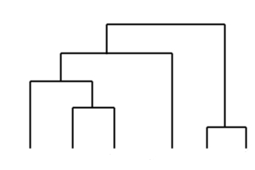
Interactive clustering: add object
Widyantoro et al., 2002
Gurrutxaga et al., 2009
Denote δmax as the maximum distance in cluster Ci
δmax(Ci) = max {d(x,x')}, ∀x,x'∈Ci, x≠x'
Find the closet cluster of xadd in P1: Cclose(xadd,P1)
Start from the direct parent of Cclose(xadd,P1):
Ccrt = Cclose(xadd,P1).parent
If (Ccrt = ∅) ∨ (d(xadd, Ccrt) < δmax(Ccrt))
  Merge: Ccrt = Ccrt ∪ {sa}
  Stop
Ccrt = Ccrt.parent, goto step 3
Start from here
Cclose xadd
Introduction SoA Problem Proposed solution Preliminary results Conclusion

Slide 49
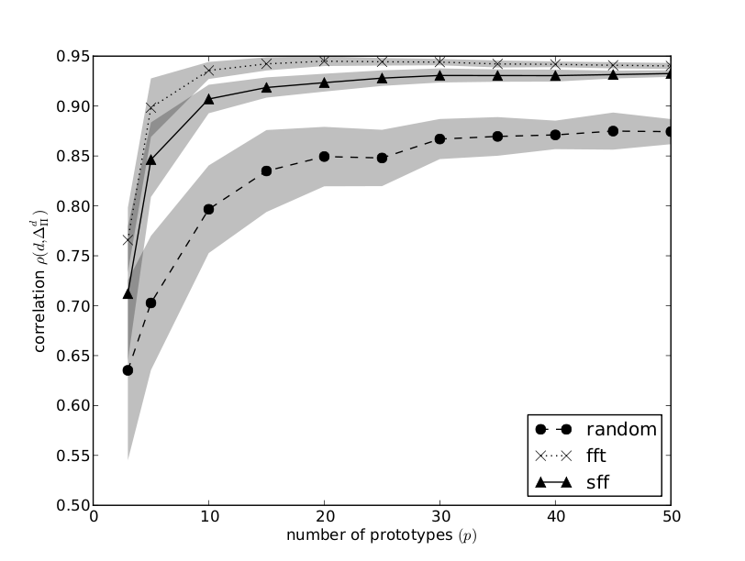
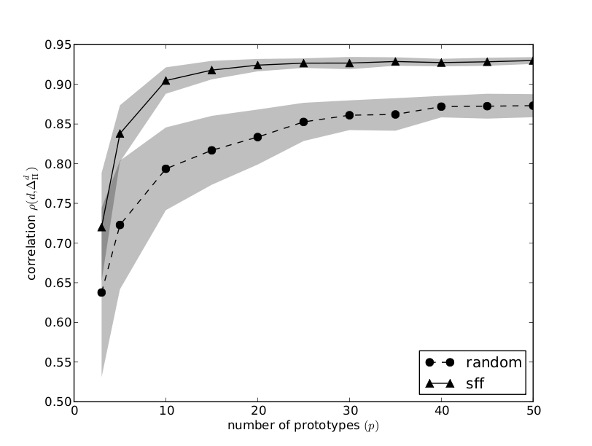
(dis)Similarity approximation for tractography
FFT: < 1secs, SFF: 2 secs (one iteration)
FFT: 15mins, SFF: 2 secs (one iteration)
Tractography of 10³ streamlines
Tractography of 3x10⁵ streamlines
E. Olivetti, T. B. Nguyen, E. Garyfallidis, The Approximation of the Dissimilarity Projection, PRNI 2012.
Introduction SoA Problem Proposed solution Preliminary results Conclusion

Slide 50
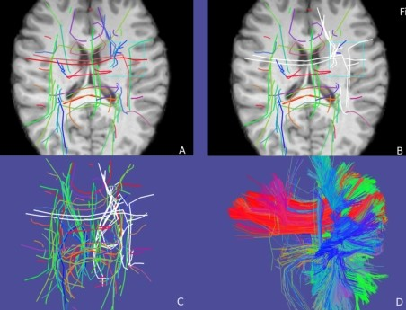
Spaghetti
An interactive visualization tool for segmentation tractography
Rotate, hide, select, explore, zoom, ''cluster'', etc
E. Garyfallidis, S. Gerhard, P. Avesani, T. B. Nguyen, V. Tsiaras, I. N. Smith, and E. Olivetti, A software
application for real-time, clustering-based exploration of tractographies, OHBM 2012.
Introduction SoA Problem Proposed solution Preliminary results Conclusion

Slide 51
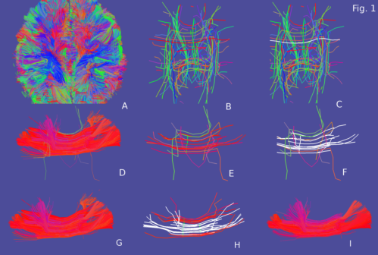
Spaghetti
Refinement, not support the tract candidate step
''cluster'' – recluster, not change partition
E. Garyfallidis, S. Gerhard, P. Avesani, T. B. Nguyen, V. Tsiaras, I. N. Smith, and E. Olivetti, A software
application for real-time, clustering-based exploration of tractographies, OHBM 2012.
Introduction SoA Problem Proposed solution Preliminary results Conclusion

Slide 52
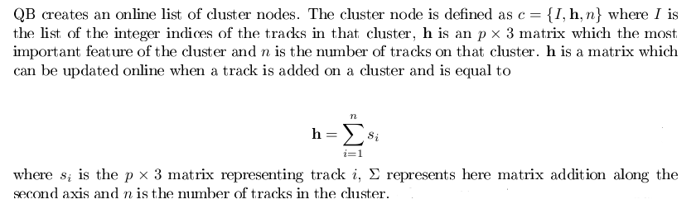
QuickBundles
- Trajectory clustering algorithm
- Inspired from BIRCH
- Linear time O(N)
- Online
- Low Memory Usage
- Simplifies Tractographies
- Every track belongs to one cluster only
-Useful for a huge number of applications

Slide 53
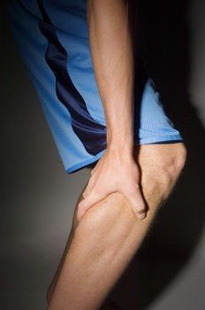
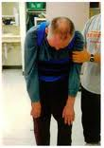
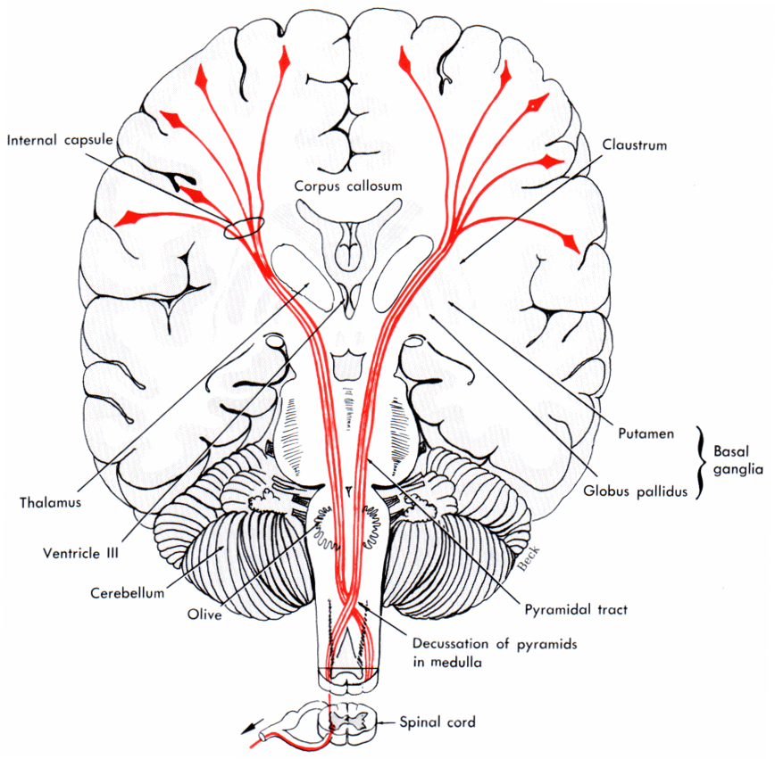
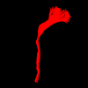
Case study: ALS disease
Aim: CST difference between healthy and ALS
(Amyotrophic Lateral Sclerosis) diseased brains
Based on tractography approach
Cortical spinal tract
(CST)
CST segmentation
using Spaghetti
ALS disease
Introduction SoA Problem Proposed solution Preliminary results Conclusion

Slide 54
Case study: ALS disease
Dataset: 12 subjects + 12 controls
Features: streamline number, length, volume, density,
FA (fractional anisotrophy), MD (mean diffusion)
Features | Left |  | Right
 | t-score | p-value | t-score | p-value
Number | -0.9002843 | 0.3777187 | -4.1417273 | 0.0004268
Mean length | -1.0671294 | 0.2974843 | 0.1987283 | 0.8443004
Volumn | 0.6123652 | 0.5465741 | -3.2843068 | 0.0033857
Density | -1.5767140 | 0.1291333 | -3.5359672 | 0.0018566
Mean FA | -0.9798571 | 0.3378099 | -0.1985348 | 0.8444499
Mean MD | -0.0132796 | 0.9895244 | -0.0856670 | 0.9325060
Introduction SoA Problem Proposed solution Preliminary results Conclusion

Slide 55
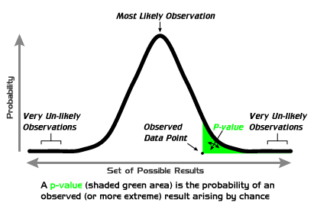
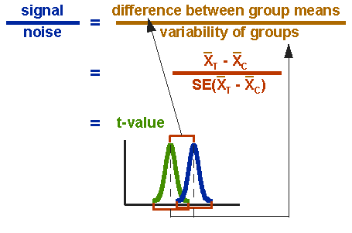

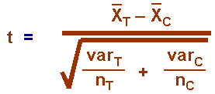
t-test
t-score
p-value
p-value is the probability of obtaining a test statistic as the one that was actually observed, given the null hypothesis is true
Introduction SoA Problem Proposed solution Preliminary results Conclusion

Slide 56
Incremental clustering – SoA
Two strategies:
Incremental clustering algorithm (cat.1)
  directly handle dynamic changes (hard)
  find place and do update on the dendrogram
  NP problem
Incremental data summarization (cat.2)
  compress the data incrementally
  apply standard clustering algorithm subsequently
  exploit a wide range of current clustering algorithms
  application driven
Introduction SoA Problem Proposed solution Preliminary results Conclusion

Slide 57
Incremental clustering
Knowledge Acquisition
Via Incremental
Conceptual Clustering
Fisher et al., 1987 (cat.1)
  COBWEB: an incremental hierarchical clustering
  Node: probabilistic concept that summarizes the
  attribute-value distributions of all objects under the node
  Top down strategy
  At each node: chose action get the best clustering quality.
  Action: Insert, Create, Merge, Split
  Quality: CU (Category Utility)
  Only consider normal distribution
  Complexity: O(N * AVB2 logK)
  where B : branching factor(2-5), A : attributes,
  V : average number of values), K : number of classes/node
  Each node: pairs (attribute, value)
Introduction SoA Problem Proposed solution Preliminary results Conclusion

Slide 58
Incremental clustering
Ribert et al., 1999 (cat.1)
  Complexity: O(N³)
  ROI – region of influence
  Obtain the same tree as the HAC on the union of the
  initial dataset and the new case
  Considerably reduce memory usage
An Incremental Hierarchical Clustering
An incremental approach to building a cluster hierarchy
Widyantoro et al., 2002 (cat.1)
  O(N log N) (not inluce ”update MST”) → O (N² log N)
  Find place: closest – MST (minimum spanning tree)
  Restructure: based on ''density'' property
  Little sensative to input ordering
Introduction SoA Problem Proposed solution Preliminary results Conclusion

Slide 59
Incremental clustering (con't)
An incremental hierarchical data clustering algorithm based on gravity theory
Chen et al., 2002 (cat.1 + cat.2)
  GRACE: build a dendrogram, O(N²)
  (gravity-based agglomerative hierarchical clustering)
  From dendrogram, generate the tentative dendrogram
  Insertion: O(N) (or O(N²) in the worst case)
    Belong to leaf node → insert (cat. 1)
    No: in outlier buffer → exceed threshold, reapply GRACE (cat.2)
  No deletion
  Not sensative to input ordering
  O(N³) ( or O(N⁴) in the worst case)
Introduction SoA Problem Proposed solution Preliminary results Conclusion

Slide 60
Incremental clustering
Incremental and effective data summarization for dynamic hierarchical clustering
Nassar et al., 2004 (cat.2)
  Domain: KDD (knowledge discorvery in database)
  Create dendrogram:
    Random s seed points
    Compress data: create s ''data bubbles”
    B = (rep, n, extent, nnDist)
    Run hierarchical clustering on s ”bubles”
  Update: measure 'bubble' quality
  → reassign points among ”bubbles”
  Rerun clustering algorithm when the number of seed changes
  O (s * N)
Introduction SoA Problem Proposed solution Preliminary results Conclusion

Slide 61
Incremental clustering (con't)
SIHC: A Stable Incremental Hierarchical Clustering Algorithm
Gurrutxaga et al., 2009 (cat. 1)
  Complexity: O(N² log N)
  Top-down strategy
  Each node: height
  Place: height(current node) < distance(new object, current node)
    Insert into current node
    Else: update height and travese the nearest child node
  No deletions
  Little sensative to input ordering
  Keep the original structure
Introduction SoA Problem Proposed solution Preliminary results Conclusion

Slide 62
Incremental clustering (con't)
Efficient clustering approach using incremental and hierarchical clustering methods
Srinivas et al., 2010 (not incremental)
  Two phases: LC and HAC
  LC (leader clustering): create m sub-clusters
    Complexity: best – O(N) or worst - O(N² )
    Similar to QB (QuickBundle)
  HAC (hierarchical allogmerative clustering)
    Complexity : O(m² log m)
    Bottom-up strategy
  Similarity measurement: cohesion or joinability of two clusters
Introduction SoA Problem Proposed solution Preliminary results Conclusion

Slide 63
Incremental clustering (con't)
Document update summarization using incremental hierarchical clustering
Wang et al., 2010 (cat.1)
  Two phases: summarization and clustering
  Summarization: create sentence matrix of input document
    Sentence: a set of pairs (term, frequency)
  Clustering: COBWEB
    Not normal distribution, but Katz distribution (word occurence)
  Similar to original COBWEB, only use different distribution
Introduction SoA Problem Proposed solution Preliminary results Conclusion

Slide 64
Interactive clustering – challenges
Intuitive display of both the hierarchy and the
instances at the same time
Maintain the history of operations
Provide a stable structure of the dendrogram
  Not drammatically change the previous one
  User can assimilate the changes
At an acceptable computational cost
Introduction SoA Problem Proposed solution Preliminary results Conclusion

Slide 65
Interactive clustering – close solutions
An incremental approach to building a cluster hierarchy
Widyantoro et al., 2002 (cat.1)
Gurrutxaga et al., 2009 (cat. 1)
Nassar et al., 2004 (cat.2)
O( N log N) v.s build MST (O( N² log N))
+ not stable structure
SIHC: A Stable Incremental Hierarchical Clustering Algorithm
Keep a stable structure v.s O(N² log N)
Incremental and effective data summarization for dynamic hierarchical clustering
O (m * N) v.s data summarization
Introduction SoA Problem Proposed solution Preliminary results Conclusion

Slide 66
Incremental clustering (con't)
Incremental hierarchical clustering of text documents (good)
Sahoo et al., 2006 (cat. 1)
  ..............., O(N²)
  (gravity-based agglomerative hierarchical clustering)
  From dendrogram, generate tentative dendrogram
  Insertion: O(N) (or O(N²) in the worst case)
    Belong to leaf node → insert (cat. 1)
    No: put in outlier buffer →exceed threshold, reapply GRACE (cat. 2)
  Not sensative to input ordering
Introduction SoA Problem Proposed solution Preliminary results Conclusion

