Slide 1




Machine learning for tract segmentation in dMRI data
Bao Nguyen
NeuroInformatics Laboratory (NILab)
Trento, January 2013

Slide 2
Contents
Introduction
State of the art (SoA)
Problem statement
Proposed solution
Preliminary results
Conclusion and Future works

Slide 3
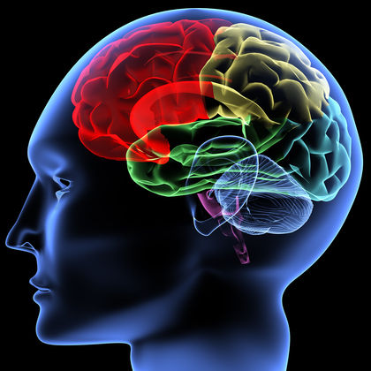
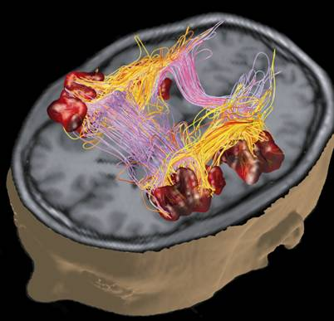
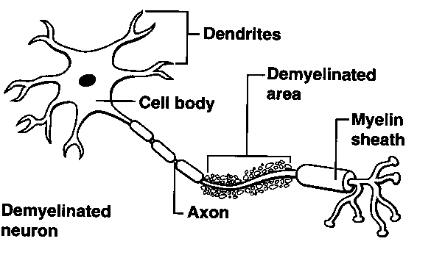
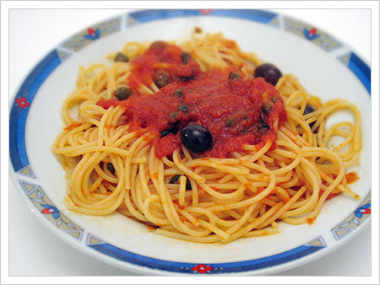
Axons
Number: ~ 10¹² axons
Size: ~ 2-20µm
Introduction SoA Problem Proposed solution Preliminary results Conclusion

Slide 4
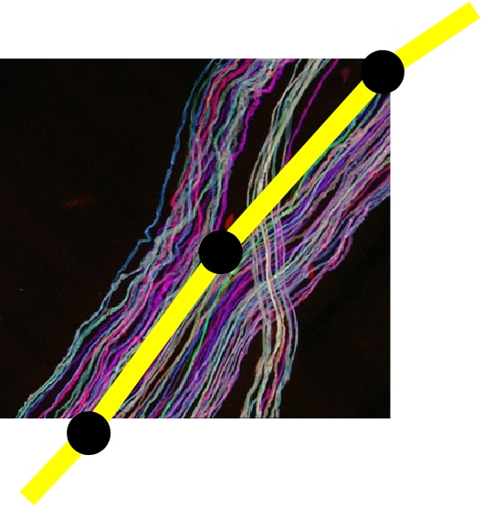
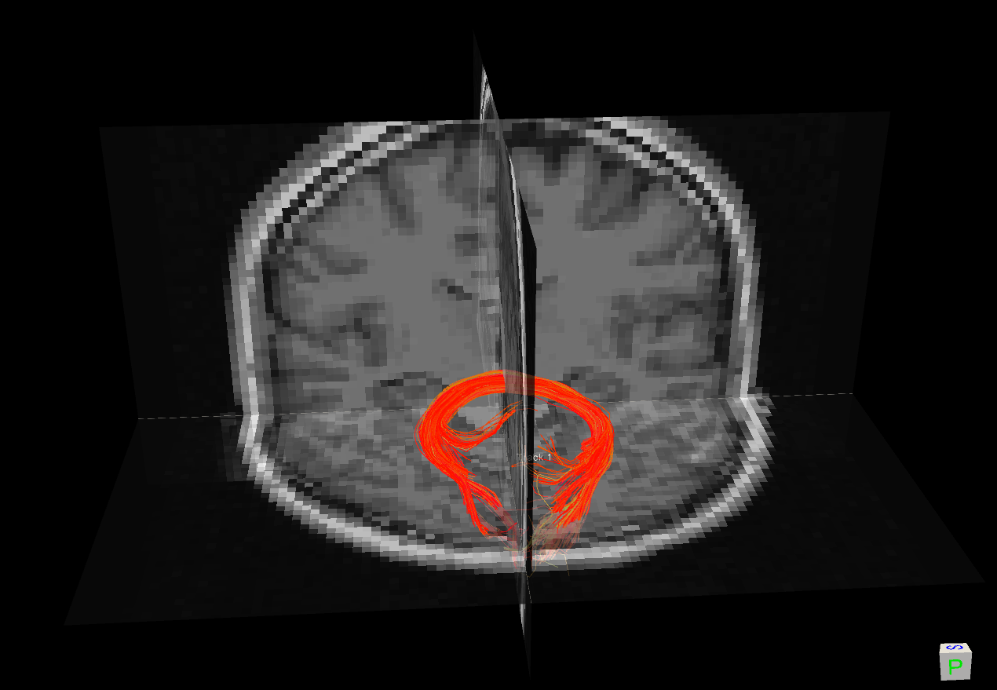
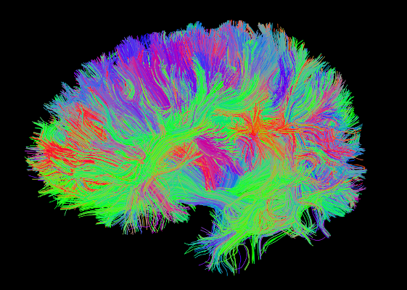
Streamline & Tractography
  Streamline: a polyline representating thousands of axons. (fiber, track)
  Bundle: a group of
  'close' streamlines
Tractography: presentation of whole brain by streamlines.
Tract: the real anatomical group of axons.
Introduction SoA Problem Proposed solution Preliminary results Conclusion

Slide 5
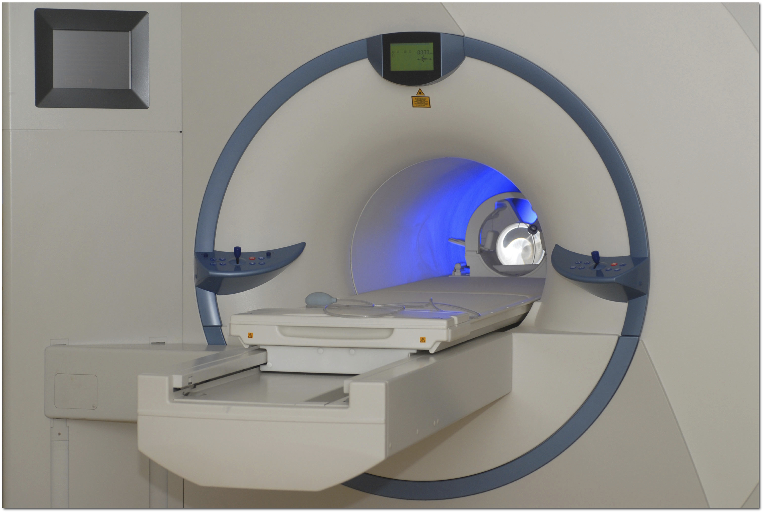
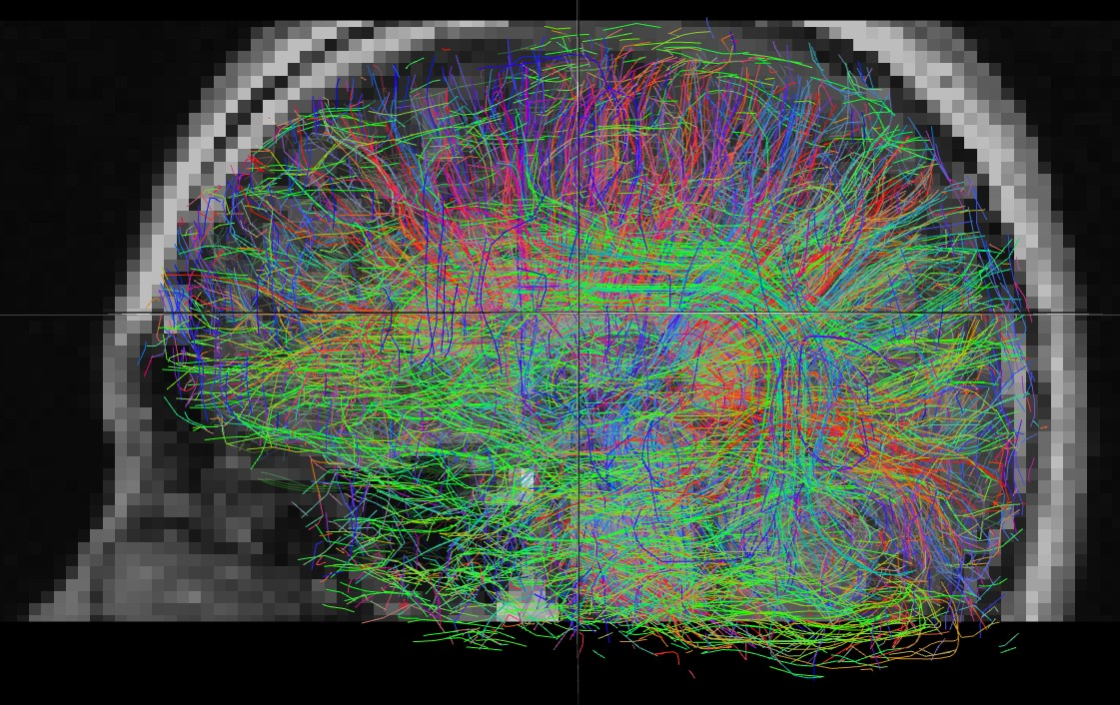
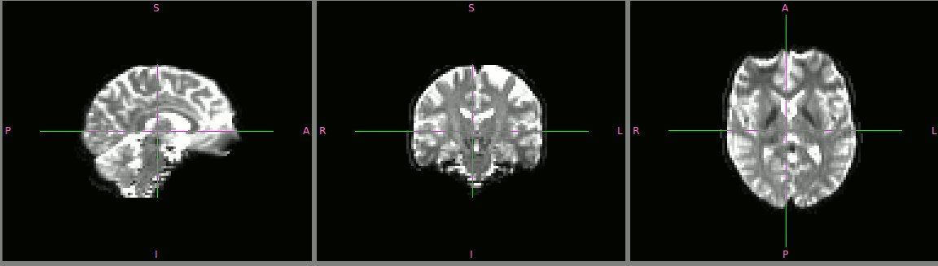
dMRI technique
(diffusion Magnetic Resonance Imaging) in vivo (not invasive)
Denis Le Bihan, 1984
Tractography
in 3D
(*)
Garyfallidis et. al. 2012
(Towards an accurate brain tractography)
MRI images in 3D
Introduction SoA Problem Proposed solution Preliminary results Conclusion

Slide 6
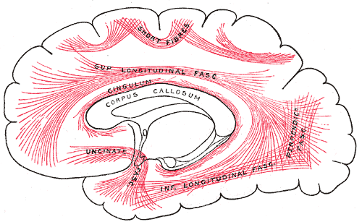
Tractography Segmentation
To group streamlines belonging to a common anatomical area into one segmentation
Introduction SoA Problem Proposed solution Preliminary results Conclusion

Slide 7
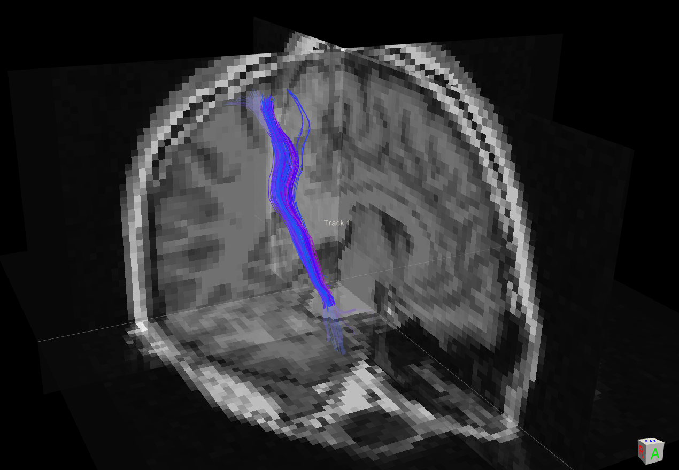
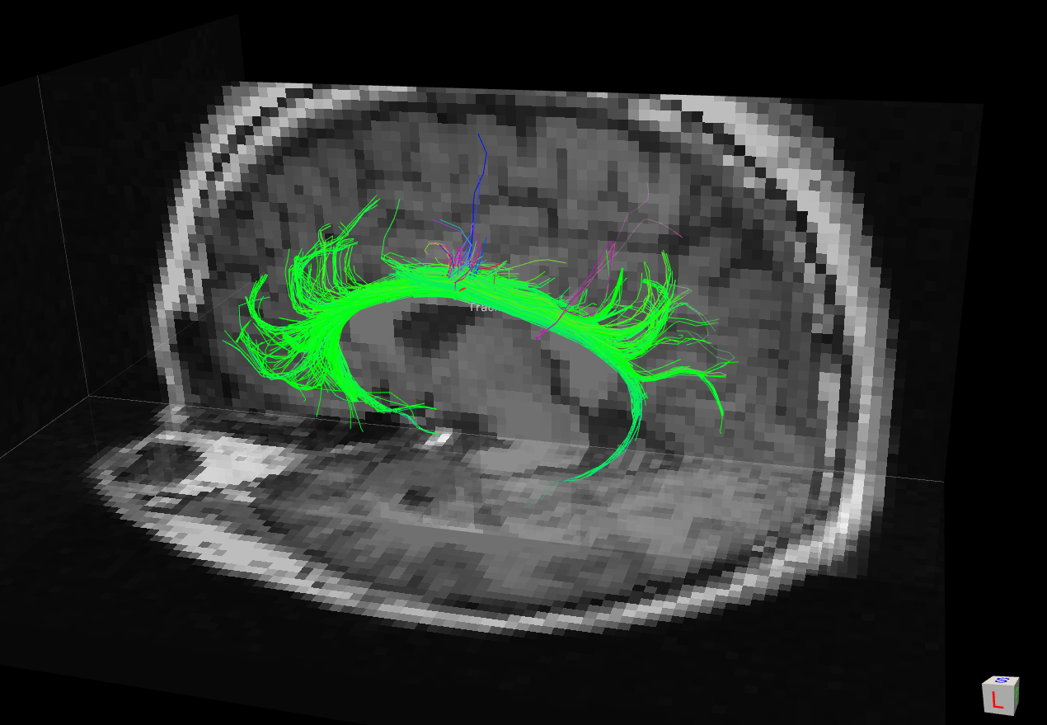
Corticol
Spnial Tract (CST)
Forceps
Major Tract (FMT)
Tractography
Cingulum
Tract
(CGT)
Example of
tractography segmentation
Introduction SoA Problem Proposed solution Preliminary results Conclusion

Slide 8
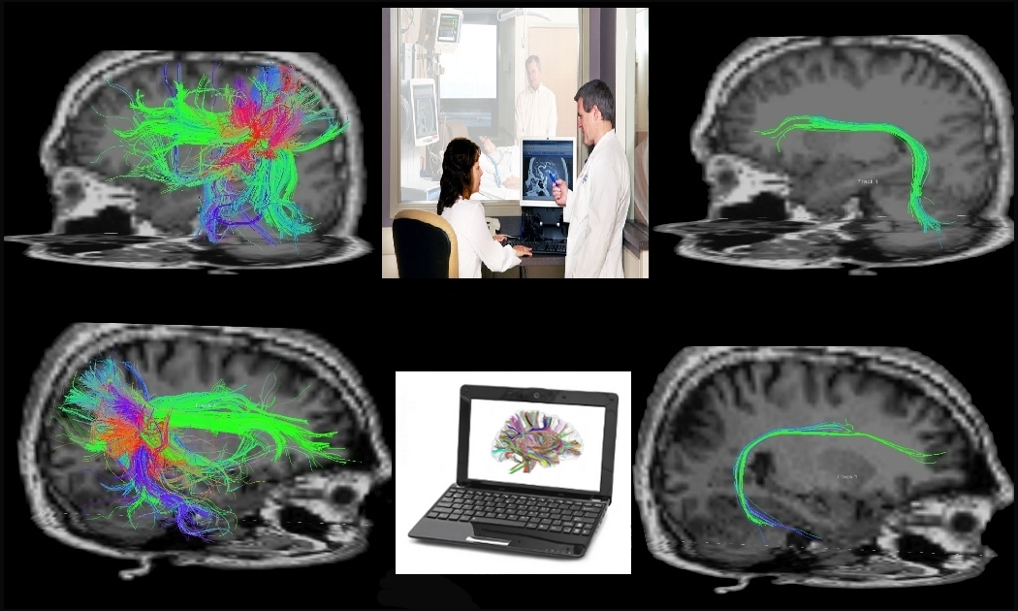
Introduction SoA Problem Proposed solution Preliminary results Conclusion

Slide 9
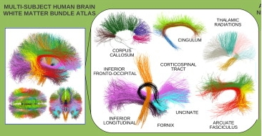
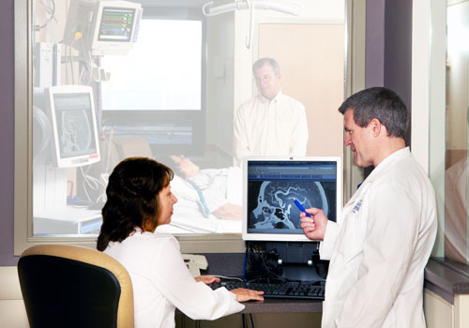
Atlas based Tract Segmentation
O'Donnell et al., 2007
brain
variety
co-registration
problem
clustering
(nearest neighbor)
whole brain
tractography
tract(s)
Introduction SoA Problem Proposed solution Preliminary results Conclusion

Slide 10
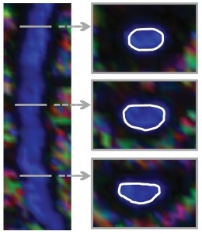
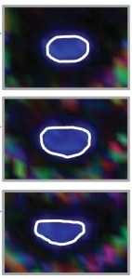
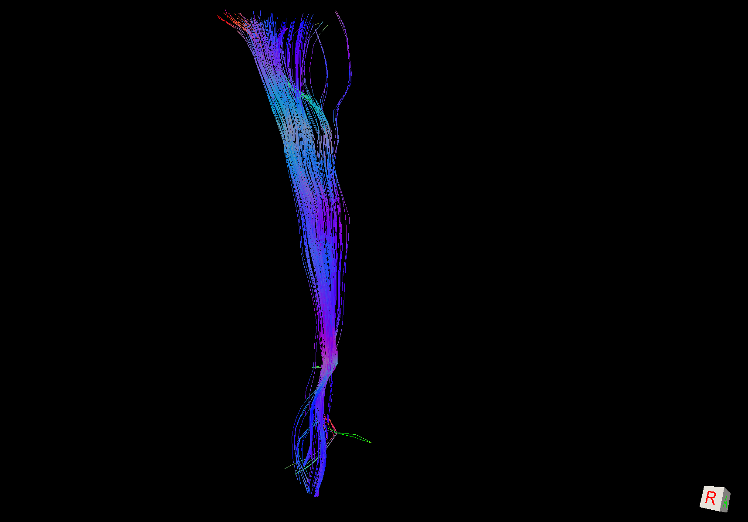
ROI based Tract Segmentation
(ROI:Region of Interest)
Wakana et al., 2007
ROIs are drawn
prior knowledge of trajectory
well characterized tracts
tract
tractography
Introduction SoA Problem Proposed solution Preliminary results Conclusion

Slide 11
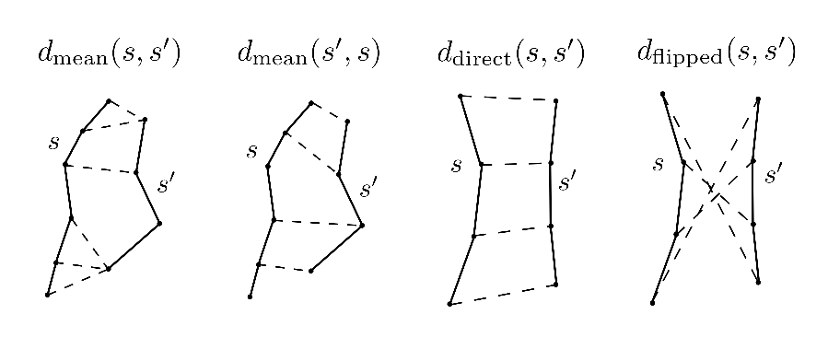
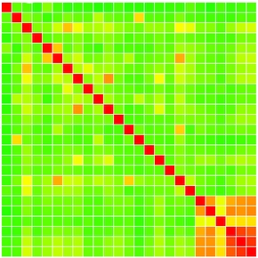
Unsupervised Tract Segmentation
Wang et al., 2011
Streamlines distance
cluster number
pairwise distance
Clustering algorithm
(agglomerative, k-means, etc.)
whole brain
similarity matrix
tract(s)
Introduction SoA Problem Proposed solution Preliminary results Conclusion

Slide 12
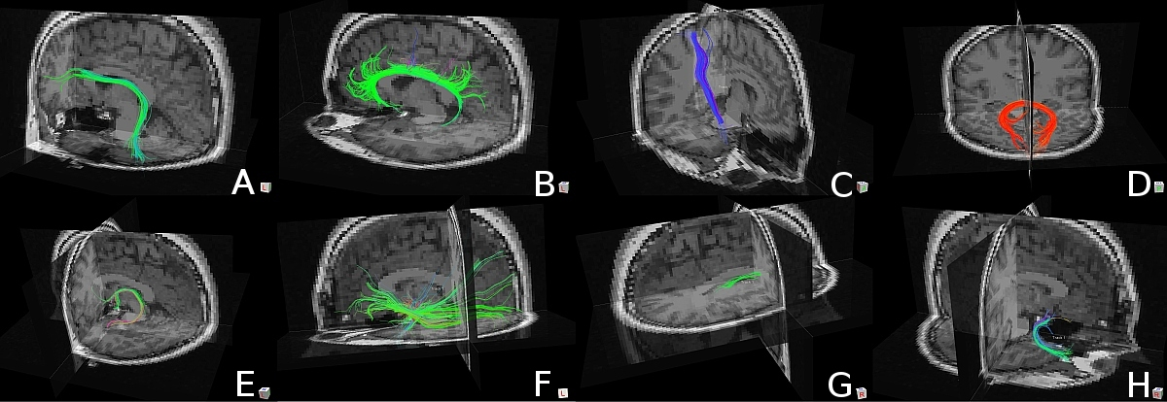
Supervised Tract Segmentation
Olivetti et al., 2011
groundtruth data
Classifier
(Ada Boost, SVM, ect)
refinement
of expert
tractography
tract(s)
Introduction SoA Problem Proposed solution Preliminary results Conclusion

Slide 13
Survey of tractography segmentation methods
Approach | Target tract / Whole brain | Related anatomy | Co-registration | Pairwise distance | Visualization/Interaction
Atlas | WB | Yes | Yes | No | No
ROI | TT (indirect) | Yes (indirect) | Yes | No | No
Unsupervised | WB | No | No | Yes (costly) | No
Supervised | TT | Yes (indirect) | Yes | No | No
pros
con
Introduction SoA Problem Proposed solution Preliminary results Conclusion

Slide 14
Goals
Challenges
Machine Learning (ML)
Improve the support of ML for tract segmentation
design an effective method for tract segmentation
overcome disadvantages of Atlas, ROI
combine both un-supervised and supervised
Introduction SoA Problem Proposed solution Preliminary results Conclusion

Slide 15
Comparison
Approach | Target tract / Whole brain | Related anatomy | Co-registration | Pairwise distance | Visualization/Interaction
Atlas | WB | Yes | Yes | No | No
ROI | TT (indirect) | Yes (indirect) | Yes | No | No
Unsupervised | WB | No | No | Yes (costly) | No
Supervised | TT | Yes (indirect) | Yes | No | No
Ours | TT | Yes | Yes(*) | No | Yes
Introduction SoA Problem Proposed solution Preliminary results Conclusion

Slide 16
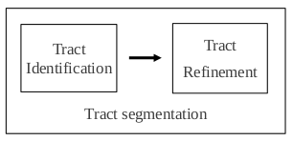
Process design: interactive segmenation
Create tract candidate from set of samples
Remove
streamline
Change
abstraction level
Olivetti et al.,
Supervised segmentation
of fiber tracts, SIMBAD 2011
Add
streamline
Explore
based
on BOI
Introduction SoA Problem Proposed solution Preliminary results Conclusion

Slide 17
BOI - bunble of interest
Focus dirrectly on which bundle (cluster of streamlines)
that user wants to work on
Related to anatomy
Easy to visualize and to interact
Approach | ROI | BOI
Anatomy related | Yes (indirect) | Yes
Visualization | No | Yes
Interaction | No | Yes
Prior knowledge of trajectory | Yes | No
Introduction SoA Problem Proposed solution Preliminary results Conclusion

Slide 18
Interactive tract refinement
Demo of Spaghetti
Introduction SoA Problem Proposed solution Preliminary results Conclusion

Slide 19
Problem statement
Given a set of N objects X = {x₁ , . . , xN}
Traditional clustering: find one partition of X
C = {C1 , . . . , CK } with K ≤ N
with Ci is a cluster of X : Ci = {x^{i}1 , . . , x^{i}j}, j ≤ N
Ci ≠ ∅, i = 1, . . , K
∪^{K}i = 1 Ci = X
Introduction SoA Problem Proposed solution Preliminary results Conclusion

Slide 20
Interactive clustering
Our approach: find a set m partitions of X
P = { P1 , . . . , Pm }
where Pi is one partition of X : Pi = {C^{i}1 , . . , C^{i}d_{i}}
Pi represents the ith abstraction level of X
constraint γ: ∀i ∈[1,m-1], Pi ¹ Pi+1 (”nested in”)
Denoted as a triple ⟨P, X ,γ⟩
Introduction SoA Problem Proposed solution Preliminary results Conclusion

Slide 21
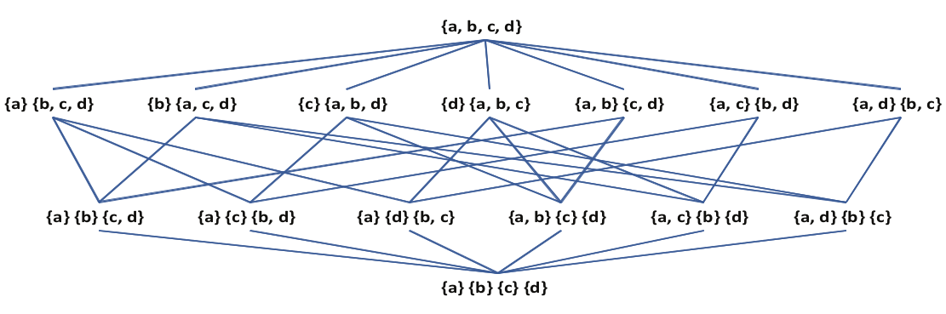
Interactive clustering: partial order relation
PX : set of all possible partitions of X
Over P X , a partial order relation ¹ (”nested in”)
∀Pa ,Pb ∈PX , Pa ¹ Pb ↔ ∀ C^{b}i ∈Pb ,∃Cªi₁,..,Cªi_{k} ∈Pa: C^{b}i = ∪^{k}t=1 Cªi_{t}
Hasse diagram of the lattice of
the set of partitions of the set {a,b,c,d}
Introduction SoA Problem Proposed solution Preliminary results Conclusion

Slide 22
Interactive clustering: update partitions
Remove an old object xr.m ∈ X
Add a new object xadd
X = {x₁ . . , xN}
X ' = X \ { x_{r.m} }
X = {x₁ . . , xN}
X ' = X ∪ { xadd }
P = { P1 , . . . , Pm }
P' = { P'1 , . . . , P'm }
⟨P, X ,γ⟩, γ: Pi ¹ Pi+1
⟨P', X ',γ'⟩, γ': P'i ¹ P'i+1
i ∈[1,m-1]
i ∈[1,m-1]
current partitions
updating partitions
Introduction SoA Problem Proposed solution Preliminary results Conclusion

Slide 23
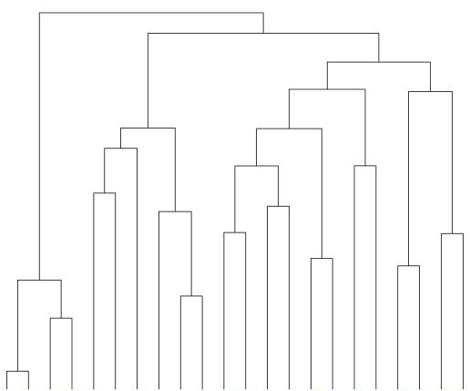
Hierarchical clustering
Find m partitions of X : P = {P1,..., Pm}, Pi ¹ Pi+1, i ∈[1,m-1]
Algorithm
Assign each si to one cluster
Merge two closest clusters
Compute distances
Repeat until all in one cluster
level of abstraction
N objects
Introduction SoA Problem Proposed solution Preliminary results Conclusion

Slide 24
Interactive clustering: remove object
Removing object xr.m
from all partitions
∀Pi , i ∈[1,..,m],
∀j ∈[1,..,di]:
if xr.m ∈ C^{i}j then
C^{i}j = C^{i}j \ {xr.m},
if C^{i}j = ∅, Pi = Pi \ {C^{i}j}
Examlpe of removing {b}
Introduction SoA Problem Proposed solution Preliminary results Conclusion

Slide 25
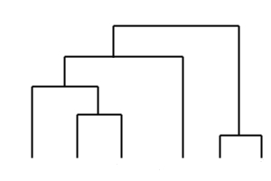
Interactive clustering: add object
Denote δmax as the maximum distance in cluster Ci
δmax(Ci) = max {d(x,x')}, ∀x,x'∈Ci, x≠x'
Find the closet cluster of xadd in P1: Cclose(xadd,P1)
Start from the direct parent of Cclose(xadd,P1):
Ccrt = Cclose(xadd,P1).parent
If (Ccrt = ∅) ∨ (d(xadd, Ccrt) < δmax(Ccrt))
  Merge: Ccrt = Ccrt ∪ {sa}
  Stop
Ccrt = Ccrt.parent
Start from here
Cclose xadd
Introduction SoA Problem Proposed solution Preliminary results Conclusion

Slide 26
Preliminary Results
(method) Dissimilarity representation
(software/tool) Spaghetti: an interactive visualization
tool for segmentation tractography
(case study) ALS (amyotrophy lateral sclerosis) disease
E. Olivetti, T. B. Nguyen, E. Garyfallidis, The Approximation of the Dissimilarity Projection,
Pattern Recognition in NeuroImaging, PRNI 2012.
E. Garyfallidis, S. Gerhard, P. Avesani, T. B. Nguyen, V. Tsiaras, I. N. Smith, and E. Olivetti,
A software application for real-time, clustering-based exploration of tractographies, OHBM 2012.
Introduction SoA Problem Proposed solution Preliminary results Conclusion

Slide 27
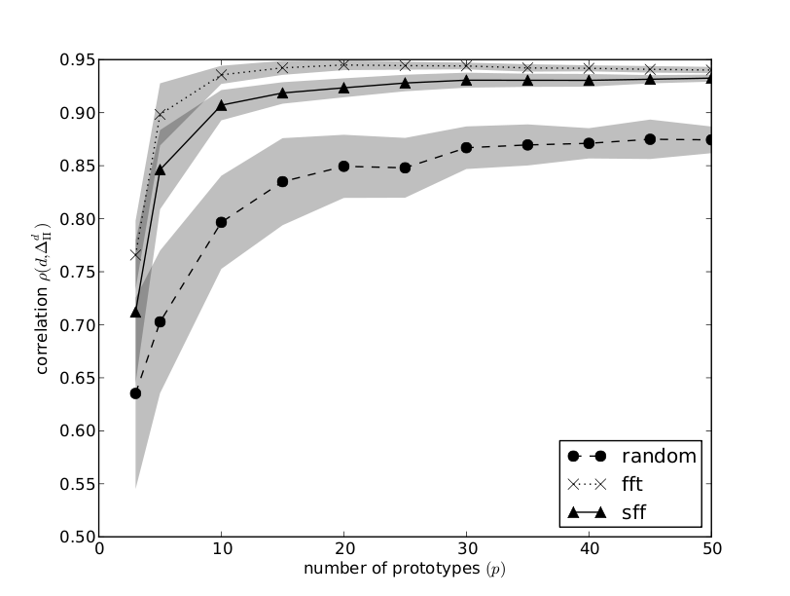
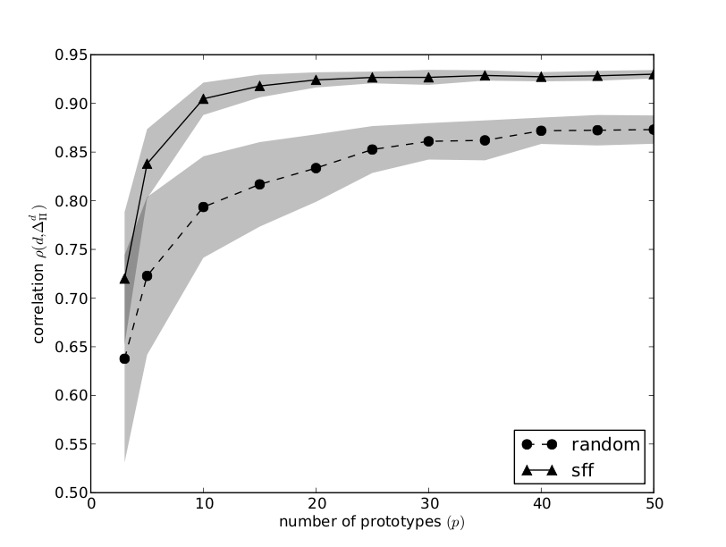
(dis)Similarity approximation for tractography
FFT: < 1secs, SFF: 2 secs (one iteration)
FFT: 15mins, SFF: 2 secs (one iteration)
Tractography of 10³ streamlines
Tractography of 3x10⁵ streamlines
E. Olivetti, T. B. Nguyen, E. Garyfallidis, The Approximation of the Dissimilarity Projection, PRNI 2012.
Introduction SoA Problem Proposed solution Preliminary results Conclusion

Slide 28
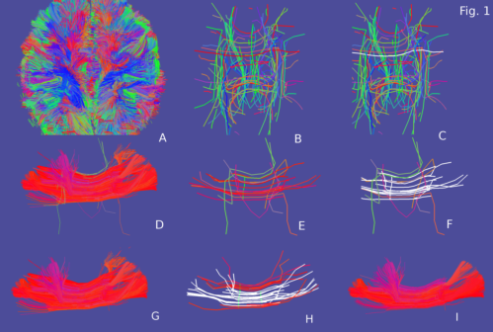
Spaghetti
Refinement, not support the tract candidate step
''cluster'' – recluster, not change partition
E. Garyfallidis, S. Gerhard, P. Avesani, T. B. Nguyen, V. Tsiaras, I. N. Smith, and E. Olivetti, A software
application for real-time, clustering-based exploration of tractographies, OHBM 2012.
Introduction SoA Problem Proposed solution Preliminary results Conclusion

Slide 29
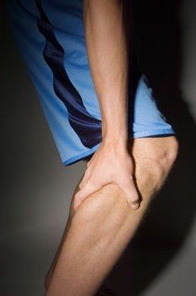
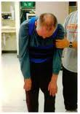
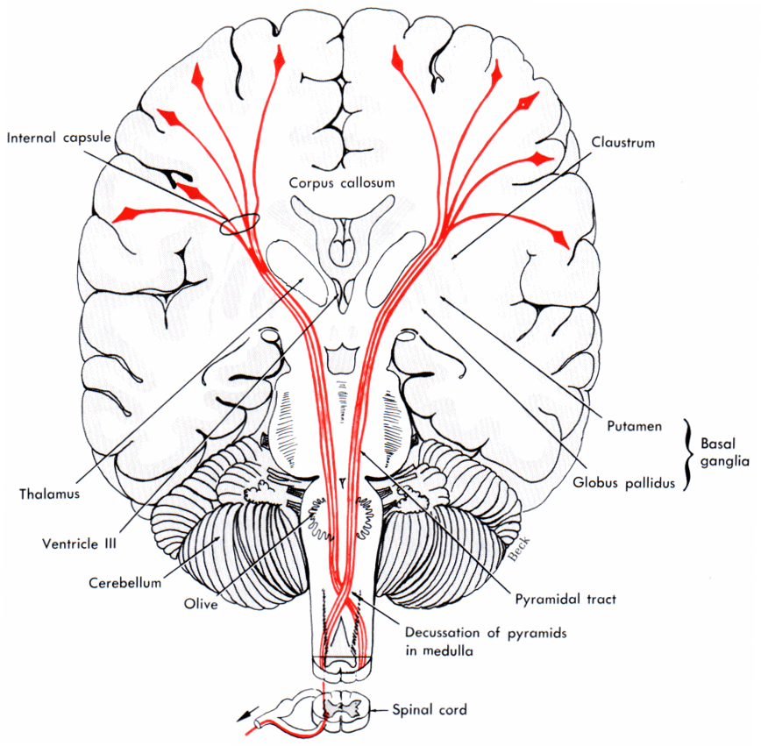
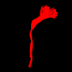
Case study: ALS disease
Aim: the difference of CST between healthy and ALS
(Amyotrophy Lateral Smytrophic) diseased brains
Based on tractography approach
Cortical spinal tract
(CST)
CST segmentation
using Sphagetti
ALS disease
Introduction SoA Problem Proposed solution Preliminary results Conclusion

Slide 30
Conclusion
Future works
An effective method for tract segmentation:
tract candidate (supervised) and tract refinement (clustering)
An interactive visualization tool for tract segmentation
ALS case study
Implement the modified HAC for tractography
Revise the solution for 'adding object' to partitions
Integerate tract candidate (supervised) into Spaghetti
Introduction SoA Problem Proposed solution Preliminary results Conclusion

Slide 31
Credits
Nivedita Agarwal, S.Chiara Trento Hospital, Italy; University of Utah, USA
Eleftherios Garyfallidis, University of Cambridge, UK; University of Sherbrooke, Canada
Emanuele Olivetti, Fondazione Bruno Kessler, Italy
Paolo Avesani, Fondazione Bruno Kessler, Italy
Luigi Cattaneo, CiMeC, University of Trento, Italy
Francesca Maule, CiMeC, University of Trento, Italy
Introduction SoA Problem Proposed solution Preliminary results Conclusion

Slide 32
Thank you!

