Slide 1
Welcome to CS 340
Introduction to Computer Networking

Slide 2
Important
http://networks.cs.northwestern.edu/EECS340-w15/index.htm

Slide 3
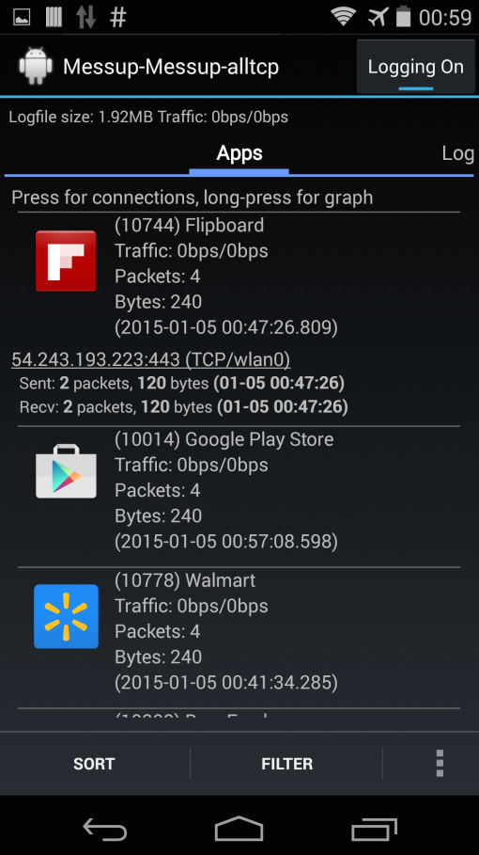
TCP Connection Measurement
(Volunteers for Messup)
Messup (Android app)
  TCP and HTTP performance
  Measurement for Android apps
Android device
  Your own or we provide
  Require root permission
  Install our apk
  Nothing but play with any apps
For more details:
  Contact Ning this week
  ningxia2015@u.northwesten.edu
Download from:
messup.cs.northwestern.edu
Notes:
Messup is an Android app to measurement TCP and HTTP performance from other Android apps.
You can use your Android device, or we can provide. The downloading link is here.
All you need to do is to install our apk, play with other android apps, that is it.
You can learn many details from our app. Award ( for 5 extra credit ?? )
Contact Ning as soon as possible for more details.

Slide 4
Overview
Course Administrative Trivia
Internet Architecture
Network Protocols
Network Edge
A taxonomy of communication networks
Some slides are in courtesy of J. Kurose and K. Ross

Slide 5
Course Overview
Top-down Intro Networking Class
  Application down to physical layer
Topics to Cover
  Overview of Internet architecture, protocols
  Network applications (HTTP, FTP) and programming
  Transport (TCP, UDP), congestion/flow control
  Network (IP), routing, multicast
  Data Link, error handling, LAN, wireless
(Not so) Small Class
  More (or less) attention to each student
Notes:
We will also briefly discuss network security.

Slide 6
People
Instructor
Aleksandar Kuzmanovic (akuzma@northwestern.edu),
Office Hours: Wed. 10am-11 or by appointment, Rm L457, Tech, 2145 Sherian Rd.
TA: Marcel Flores marcel-flores@u.northwestern.edu
Office Hours: Tuesdays 5:00-6:00pm, Ford 2.221
TA: Ning Xia marcel-flores@u.northwestern.edu
Office Hours: Thursdays 5:00-6:00pm, Ford 2.221

Slide 7
Recitations
Recitations: Tuesdays 11:00am-12:00, Tech L221.
Thursdays 11:00am-12:00, Tech L221.
The first one will be on Tuesday 1/13/15.
The second one will be on Thursday 1/15/15.
If you can’t make it on Tuesday, come on Thursday, and vice versa.
There will be ~ 50 seats in each slot.

Slide 8
Prerequisites
A LOT OF WORK – Heavy Projects - but it’s worth!
  Build a TCP stack and a Web server that runs on it
  IP routing
Required: EECS311 (data structures) and EECS213 (Intro to Computer Systems)
Highly Recommended: OS or having some familiarity with Unix systems programming, preferably in C or C++
  Minet is in C++ (News: Minet has been fixed!)
  BUILDING software is 50% of the grade of this class

Slide 9
Project 1
Project 1 out (available at
http://networks.cs.northwestern.edu/EECS340-w15/assignments.htm)
  If you don’t have a TLAB account contact root@eecs.northwestern.edu.
  To enter the TLAB classroom (Tech F-252), contact again root@eecs.northwestern.edu.
  Find partner (groups of 3 preferred)
Due 1/28

Slide 10
Course Materials
Computer Networking: A Top-Down Approach Featuring the Internet, Sixth Edition, James Kurose and Keith Ross, Addison Wesley, 2012
TCP/IP Illustrated, Volume I: The Protocols, Richard Stevens, Addison Wesley
See course webpage and syllabus for other recommended books and references

Slide 11
Grading
Homeworks (4 sets) 10%
Projects 50%
  Web client/server 10%
  TCP stack 25%
  IP routing 15%
Midterm 20%
Final 20%
  Exams in-class, closed-book;
Late policy: 10% each day after the due date
No cheating

Slide 12
Communication
Web page: http://networks.cs.northwestern.edu/EECS340-w15/index.htm
Recitation: Tue and Thu, 11:00am-12, Rm: TBA.
    TA lectures on the homework and projects, and help to prepare the exams.
Newsgroup are available
    See the next page
Send emails to instructor and TA for questions inappropriate in newsgroup

Slide 13
Google Group
Visit: https://groups.google.com/forum/?fromgroups#!forum/eecs340
Apply for membership with your Northwestern email Account.
To send a message to the group, email eecs340@googlegroups.com

Slide 14
Submitting Assignments
All projects and homework should be submitted as zip files to our submission site:
http://yuehuijin.cs.northwestern.edu/
You need to sign up with your netid and email first.
* If there will be any problem with the submission site, please email TAs with your submission.

Slide 15
Overview
Course administrative trivia
Internet Architecture
Network Protocols
Network Edge
A taxonomy of communication networks

Slide 16





What’s the Internet: “nuts and bolts” view
PC
millions of connected computing devices: hosts = end systems
  running network apps
Mobile network
server
Global ISP
wireless
laptop
cellular
handheld
Home network
communication links
  fiber, copper, radio, satellite
  transmission rate = bandwidth
Regional ISP
access
points
Institutional network
wired
links
routers: forward packets (chunks of data)
router

Slide 17
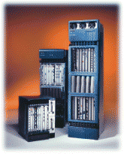
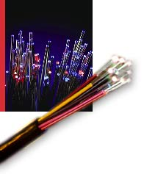
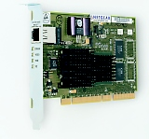
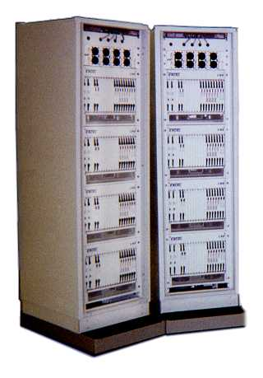
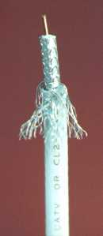
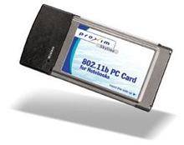
Network Components (Examples)
Links
Interfaces
Switches/routers
Fibers
Ethernet card
Large router
Wireless card
Coaxial Cable
Telephone
switch

Slide 18
What’s the Internet: “nuts and bolts” view
protocols control sending, receiving of msgs
  e.g., TCP, IP, HTTP, Skype, Ethernet
Internet: “network of networks”
  loosely hierarchical
  public Internet versus private intranet
Internet standards
    RFC: Request for comments
    IETF: Internet Engineering Task Force
Mobile network
Global ISP
Home network
Regional ISP
Institutional network

Slide 19
What’s the Internet: a service view
communication infrastructure enables distributed applications:
  Web, VoIP, email, games, e-commerce, file sharing
communication services provided to apps:
  reliable data delivery from source to destination
  “best effort” (unreliable) data delivery

Slide 20

Internet History
1961-1972: Early packet-switching principles
1961: Kleinrock - queueing theory shows effectiveness of packet-switching
1964: Baran - packet-switching in military nets
1967: ARPAnet conceived by Advanced Research Projects Agency
1969: first ARPAnet node operational
1972:
  ARPAnet public demonstration
  NCP (Network Control Protocol) first host-host protocol
  first e-mail program
  ARPAnet has 15 nodes

Slide 21
Internet History
1972-1980: Internetworking, new and proprietary nets
1970: ALOHAnet satellite network in Hawaii
1974: Cerf and Kahn - architecture for interconnecting networks
1976: Ethernet at Xerox PARC
late70’s: proprietary architectures: DECnet, SNA, XNA
late 70’s: switching fixed length packets (ATM precursor)
1979: ARPAnet has 200 nodes
Cerf and Kahn’s internetworking principles:
  minimalism, autonomy - no internal changes required to interconnect networks
  best effort service model
  stateless routers
  decentralized control
define today’s Internet architecture

Slide 22
Internet History
1980-1990: new protocols, a proliferation of networks
1983: deployment of TCP/IP
1982: smtp e-mail protocol defined
1983: DNS defined for name-to-IP-address translation
1985: ftp protocol defined
1988: TCP congestion control
new national networks: Csnet, BITnet, NSFnet, Minitel
100,000 hosts connected to confederation of networks

Slide 23
Internet History
1990, 2000’s: commercialization, the Web, new apps
early 1990’s: ARPAnet decommissioned
1991: NSF lifts restrictions on commercial use of NSFnet (decommissioned, 1995)
early 1990s: Web
  HTML, HTTP: Berners-Lee
  1994: Mosaic, later Netscape
  late 1990’s: commercialization of the Web
late 1990’s – 2000’s:
more killer apps: instant messaging, P2P file sharing
network security to forefront
est. 50 million host, 100 million+ users
backbone links running at Gbps

Slide 24
Internet History
2014:
~950 million hosts
voice, video over IP
P2P applications: BitTorrent (file sharing) Skype (VoIP), PPLive (video)
more applications: YouTube, gaming, Twitter
wireless, mobility

Slide 25
Overview
Course administrative trivia
Internet Architecture
Network Protocols
Network Edge
A taxonomy of communication networks

Slide 26
What’s a protocol?
human protocols:
“what’s the time?”
“I have a question”
introductions
… specific msgs sent
… specific actions taken when msgs received, or other events
network protocols:
machines rather than humans
all communication activity in Internet governed by protocols
protocols define format, order of msgs sent and received among network entities, and actions taken on msg transmission, receipt

Slide 27


What’s a protocol?
a human protocol and a computer network protocol:
Hi
TCP connection
req
Hi
TCP connection
response
Got the
time?
Get http://www.cs.nwu.edu
2:00
<file>
time

Slide 28
Overview
Course administrative trivia
Internet Architecture
Network Protocols
Network Edge
A taxonomy of communication networks

Slide 29
A closer look at network structure:
network edge: applications and hosts
access networks, physical media: wired, wireless communication links
network core:
  interconnected routers
  network of networks

Slide 30
The network edge:
end systems (hosts):
  run application programs
  e.g. Web, email
  at “edge of network”
peer-peer
client/server model
  client host requests, receives service from always-on server
  e.g. Web browser/server; email client/server
client/server
peer-peer model:
  minimal (or no) use of dedicated servers
  e.g. Skype, BitTorrent

Slide 31
Network Edge: Connection-oriented Service
Goal: data transfer between end systems
handshaking: setup (prepare for) data transfer ahead of time
  Hello, hello back human protocol
  set up “state” in two communicating hosts
TCP - Transmission Control Protocol
  Internet’s connection-oriented service
TCP service [RFC 793]
reliable, in-order byte-stream data transfer
  loss: acknowledgements and retransmissions
flow control:
  sender won’t overwhelm receiver
congestion control:
  senders “slow down sending rate” when network congested

Slide 32
Network Edge: Connectionless Service
Goal: data transfer between end systems
  same as before!
UDP - User Datagram Protocol [RFC 768]: Internet’s connectionless service
  unreliable data transfer
  no flow control
  no congestion control
App’s using TCP:
HTTP (Web), FTP (file transfer), Telnet (remote login), SMTP (email)
App’s using UDP:
streaming media, teleconferencing, DNS, Internet telephony

