Slide 1
Final Exam
Wednesday 3/16/2016
Tech L361
3- 5 PM

Slide 2
Link Layer
5.4 Link-Layer Addressing
5.5 Ethernet
5.6 Hubs and switches

Slide 3

Hubs
… physical-layer (“dumb”) repeaters:
  bits coming in one link go out all other links at same rate
  all nodes connected to hub can collide with one another
  no frame buffering
  no CSMA/CD at hub: host NICs detect collisions
twisted pair
hub

Slide 4
Switch
link-layer device: smarter than hubs, take active role
  store, forward Ethernet frames
  examine incoming frame’s MAC address, selectively forward frame to one-or-more outgoing links when frame is to be forwarded on segment, uses CSMA/CD to access segment
transparent
  hosts are unaware of presence of switches
plug-and-play, self-learning
  switches do not need to be configured

Slide 5
Switch: allows multiple simultaneous transmissions
A
hosts have dedicated, direct connection to switch
switches buffer packets
Full duplex
switching: A-to-A’ and B-to-B’ simultaneously, without collisions
  not possible with dumb hub
C’
B
1
2
6
3
5
4
C
B’
A’
switch with six interfaces
(1,2,3,4,5,6)

Slide 6
Switch Table
A
Q: how does switch know that A’ reachable via interface 4, B’ reachable via interface 5?
A: each switch has a switch table, each entry:
  (MAC address of host, interface to reach host, time stamp)
looks like a routing table!
Q: how are entries created, maintained in switch table?
  something like a routing protocol?
C’
B
1
2
6
3
5
4
C
B’
A’
switch with six interfaces
(1,2,3,4,5,6)

Slide 7
Switch: self-learning
Source: A
Dest: A’
A
A A’
switch learns which hosts can be reached through which interfaces
  when frame received, switch “learns” location of sender: incoming LAN segment
  records sender/location pair in switch table
C’
B
1
2
6
3
5
4
C
B’
A’
MAC addr interface TTL
A
1
60
Switch table
(initially empty)

Slide 8
Switch: frame filtering/forwarding
When frame received:
1. record link associated with sending host
2. index switch table using MAC dest address
3. if entry found for destination
then {
if dest on segment from which frame arrived
then drop the frame
else forward the frame on interface indicated
}
else flood
forward on all but the interface
on which the frame arrived

Slide 9
Self-learning, forwarding: example
Source: A
Dest: A’
A
A A’
C’
B
frame destination unknown:
1
2
flood
6
3
A A’
A A’
A A’
A A’
A A’
5
4
destination A location known:
C
selective send
A’ A
B’
A’
MAC addr interface TTL
A
1
60
Switch table
(initially empty)
A’
4
60

Slide 10
Interconnecting switches
switches can be connected together
S₄
S₁
S₃
A
S₂
F
I
B
C
D
E
G
H
Q: sending from A to G - how does S₁ know to forward frame destined to G via S₄ and S₃?
A: self learning! (works exactly the same as in single-switch case!)

Slide 11
Self-learning multi-switch example
Suppose C sends frame to I, I responds to C
1
S₄
S₁
2
S₃
A
S₂
F
I
B
C
D
E
G
H
Q: show switch tables and packet forwarding in S₁, S₂, S₃, S₄

Slide 12
Institutional network
mail server
to external
network
router
web server
IP subnet

Slide 13
Switches vs. Routers
application
transport
network
link
physical
both store-and-forward devices
  routers: network-layer devices (examine network-layer headers)
  switches are link-layer devices (examine link-layer headers)
routers maintain routing tables, implement routing algorithms
switches maintain switch tables, implement filtering, learning algorithms
datagram
frame
link
physical
frame
switch
network
link
physical
datagram
frame
application
transport
network
link
physical

Slide 14
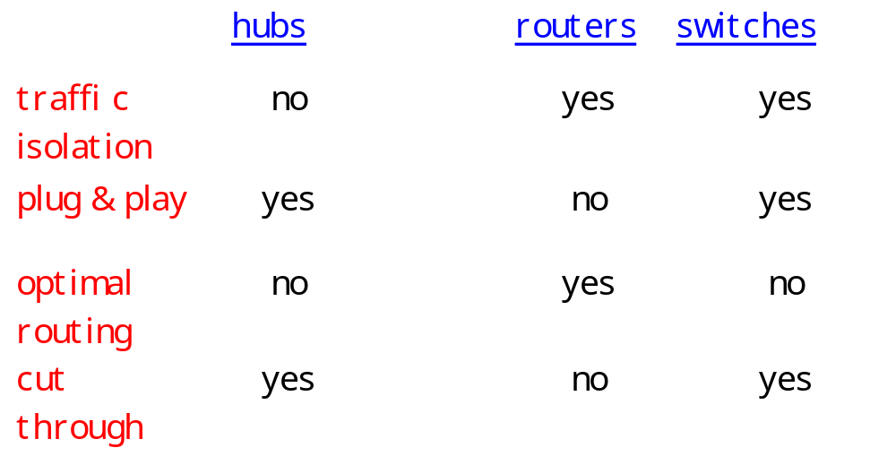
Summary comparison
Notes:
Cut-through switching: frame forwarded from input port to output port without first collecting entire frame.

Slide 15
Chapter 6: Wireless and Mobile Networks
Background:
# wireless (mobile) phone subscribers now exceeds # wired phone subscribers!
computer nets: laptops, smartphones, Internet-enabled phone promise anytime untethered Internet access
two important (but different) challenges
  communication over wireless link
  handling mobile user who changes point of attachment to network

Slide 16
Chapter 6 outline
6.1 Introduction
Wireless
6.2 Wireless links, characteristics
  CDMA
6.3 IEEE 802.11 wireless LANs (“wi-fi”)

Slide 17


Elements of a wireless network
wireless hosts
laptop, smart-phone
run applications
may be stationary (non-mobile) or mobile
  wireless does not always mean mobility
network
infrastructure

Slide 18
Elements of a wireless network
base station
typically connected to wired network
relay - responsible for sending packets between wired network and wireless host(s) in its “area”
  e.g., cell towers or 802.11 access points
network
infrastructure

Slide 19
Elements of a wireless network
wireless link
typically used to connect mobile(s) to base station
multiple access protocol coordinates link access
various data rates, transmission distance
network
infrastructure

Slide 20
Elements of a wireless network
infrastructure mode
base station connects mobiles into wired network
handoff: mobile changes base station providing connection into wired network
network
infrastructure

Slide 21
Elements of a wireless network
Ad hoc mode
no base stations
nodes can only transmit to other nodes within link coverage
nodes organize themselves into a network: route among themselves

Slide 22
Wireless Link Characteristics
Differences from wired link ….
  decreased signal strength: radio signal attenuates as it propagates through matter (path loss)
  interference from other sources: standardized wireless network frequencies (e.g., 2.4 GHz) shared by other devices (e.g., phone);
  multipath propagation: radio signal reflects off objects ground, arriving ad destination at slightly different times
…. make communication across (even a point to point) wireless link much more “difficult”

Slide 23
Wireless network characteristics
Multiple wireless senders and receivers create additional problems (beyond multiple access):
A
B
C
C
A’s signal
strength
C’s signal
strength
B
A
Hidden terminal problem
B, A hear each other
B, C hear each other
A, C can not hear each other
means A, C unaware of their interference at B
space
Signal fading:
B, A hear each other
B, C hear each other
A, C can not hear each other interferring at B

Slide 24
Code Division Multiple Access (CDMA)
used in several wireless broadcast channels (cellular, satellite, etc) standards
unique “code” assigned to each user; i.e., code set partitioning
all users share same frequency, but each user has own “chipping” sequence (i.e., code) to encode data
encoded signal = (original data) X (chipping sequence)
decoding: inner-product of encoded signal and chipping sequence
allows multiple users to “coexist” and transmit simultaneously with minimal interference (if codes are “orthogonal”)

Slide 25
CDMA Encode/Decode
channel output Z_{i,m}
Z_{i,m}= d_{i}.c_{m}
data
bits
d₀ = 1
1
1
1
1
1
d₁ = -1
1
1
1
-
-
-
-
1
-
-
-
1
-
1
1
1
1
1
sender
1
1
slot 1
channel
output
slot 0
channel
output
1
1
1
1
1
code
1
1
-
-
-
1
-
1
1
1
-
-
-
1
-
1
1
1
slot 1
slot 0
M
D_{i} = Σ Z_{i,m}.c_{m}
m=1
M
received
input
1
1
1
1
1
1
1
1
d₀ = 1
-
-
-
-
1
-
-
-
1
-
1
1
1
1
1
1
d₁ = -1
1
slot 1
channel
output
slot 0
channel
output
1
1
1
1
1
code
1
1
-
-
-
1
-
1
1
1
-
-
-
1
-
1
1
1
receiver
slot 1
slot 0

Slide 26

CDMA: two-sender interference

Slide 27
Chapter 6 outline
6.1 Introduction
Wireless
6.2 Wireless links, characteristics
  CDMA
6.3 IEEE 802.11 wireless LANs (“wi-fi”)

Slide 28
IEEE 802.11 Wireless LAN
802.11b
  2.4-5 GHz unlicensed radio spectrum
  up to 11 Mbps
  widely deployed, using base stations
802.11a
  5-6 GHz range
  up to 54 Mbps
802.11g
  2.4-5 GHz range
  up to 54 Mbps
All use CSMA/CA for multiple access
All have base-station and ad-hoc network versions

Slide 29
802.11 LAN architecture
wireless host communicates with base station
  base station = access point (AP)
Basic Service Set (BSS) (aka “cell”) in infrastructure mode contains:
  wireless hosts
  access point (AP): base station
  ad hoc mode: hosts only
Internet
hub, switch
or router
AP
BSS 1
AP
BSS 2

Slide 30
802.11: Channels, association
802.11b: 2.4GHz-2.485GHz spectrum divided into 11 channels at different frequencies
  AP admin chooses frequency for AP
  interference possible: channel can be same as that chosen by neighboring AP!
host: must associate with an AP
  scans channels, listening for beacon frames containing AP’s name (SSID) and MAC address
  selects AP to associate with
  may perform authentication [Chapter 8]
  will typically run DHCP to get IP address in AP’s subnet
Notes:
Ssid --- service set identifier

Slide 31
IEEE 802.11: multiple access
avoid collisions: 2⁺ nodes transmitting at same time
802.11: CSMA - sense before transmitting
  don’t collide with ongoing transmission by other node
802.11: no collision detection!
  difficult to receive (sense collisions) when transmitting due to weak received signals (fading)
  can’t sense all collisions in any case: hidden terminal, fading
  goal: avoid collisions: CSMA/C(ollision)A(voidance)
A
B
C
C
A’s signal
strength
C’s signal
strength
B
A
space

Slide 32
IEEE 802.11 MAC Protocol: CSMA/CA
802.11 sender
1 if sense channel idle for DIFS then
  transmit entire frame (no CD)
2 if sense channel busy then
  start random backoff time
  timer counts down while channel idle
  transmit when timer expires
  if no ACK, increase random backoff interval, repeat 2
802.11 receiver
- if frame received OK
return ACK after SIFS (ACK needed due to hidden terminal problem)
sender
receiver
DIFS
data
SIFS
ACK

Slide 33
Avoiding collisions (more)
idea: allow sender to “reserve” channel rather than random access of data frames: avoid collisions of long data frames
sender first transmits small request-to-send (RTS) packets to BS using CSMA
  RTSs may still collide with each other (but they’re short)
BS broadcasts clear-to-send CTS in response to RTS
RTS heard by all nodes
  sender transmits data frame
  other stations defer transmissions
Avoid data frame collisions completely
using small reservation packets!

Slide 34
Collision Avoidance: RTS-CTS exchange
A
B
AP
RTS(B)
RTS(A)
reservation collision
RTS(A)
CTS(A)
CTS(A)
DATA (A)
defer
time
ACK(A)
ACK(A)

Slide 35
802.11 frame: addressing
2
2
6
6
6
2
6
0 - 2312
4
frame
control
duration
address
1
address
2
address
3
seq
control
address
4
payload
CRC
Address 4: used only in ad hoc mode
Address 1: MAC address
of wireless host or AP
to receive this frame
Address 3: MAC address
of router interface to which AP is attached
Address 2: MAC address
of wireless host or AP
transmitting this frame

Slide 36
802.11 frame: addressing
Internet
H1
R1
router
AP
R1 MAC addr H1 MAC addr
dest. address
source address
802.3 frame
AP MAC addr H1 MAC addr R1 MAC addr
address 1
address 2
address 3
802.11 frame

Slide 37
802.11: mobility within same subnet
H1 remains in same IP subnet: IP address can remain same
switch: which AP is associated with H1?
  self-learning (Ch. 5): switch will see frame from H1 and “remember” which switch port can be used to reach H1
router
hub or
switch
BBS 1
AP 1
AP 2
H1
BBS 2

