Slide 1


Wireless access networks
shared wireless access network connects end system to router
  via base station aka “access point”
wireless LANs:
  802.11b/g (WiFi): 11 or 54 Mbps
wider-area wireless access
  3G/4G provided by telco operator
  4G: ~10Mbps over cellular system (LTE)
router
base
station
mobile
hosts

Slide 2

Home networks
Typical home network components:
DSL or cable modem
router/firewall/NAT
Ethernet
wireless access point
wireless
laptops
to/from
cable
headend
cable
modem
router/
firewall
wireless
access
point
Ethernet

Slide 3

Physical Media
Twisted Pair (TP)
two insulated copper wires
  Category 3: traditional phone wires, 10 Mbps Ethernet
  Category 5:
  100Mbps Ethernet
bit: propagates between
transmitter/rcvr pairs
physical link: what lies between transmitter & receiver
guided media:
  signals propagate in solid media: copper, fiber, coax
unguided media:
  signals propagate freely, e.g., radio

Slide 4


Physical Media: coax, fiber
Fiber optic cable:
glass fiber carrying light pulses, each pulse a bit
high-speed operation:
  high-speed point-to-point transmission (e.g., 10’s-100’s Gpbs)
low error rate: repeaters spaced far apart ; immune to electromagnetic noise
Coaxial cable:
two concentric copper conductors
bidirectional
baseband:
  single channel on cable
  legacy Ethernet
broadband:
  multiple channels on cable
  HFC
Notes:
HFC – hybrid fiber coax cable

Slide 5
Physical media: radio
signal carried in electromagnetic spectrum
no physical “wire”
bidirectional
propagation environment effects:
  reflection
  obstruction by objects
  interference
Radio link types:
LAN (e.g., WiFi)
  11Mbps, 54 Mbps
wide-area (e.g., cellular)
  3G cellular: ~ 1 Mbps
  4G cellular: ~ 10 Mbps
Satellite (e.g., geo-stat and low-earth orbiting)
  Kbps to 45Mbps channel (or multiple smaller channels)
  270 msec end-end delay

Slide 6
Summary
Network access and physical media
Internet structure and ISPs
Delay & loss in packet-switched networks
Protocol layers, service models
Recitation yesterday (1/13) in Tech L221
Recitation tomorrow (1/15) in Tech L221
Homework 1 out, due 1/23.
Project 1 ready, should have found partners.

Slide 7
Internet structure: network of networks (several years ago)
Roughly hierarchical
At center: “tier-1” ISPs (e.g., UUNet, BBN/Genuity, Sprint, AT&T), national/international coverage
  treat each other as equals, near-clique
Tier-1 providers also interconnect at public network access points (NAPs)
Tier-1 providers interconnect (peer) privately
Tier 1 ISP
NAP
Tier 1 ISP
Tier 1 ISP
POP

Slide 8
Internet structure: network of networks (today)
roughly hierarchical
at center: small # of well-connected large networks
  “tier-1” commercial ISPs (e.g., Verizon, Sprint, AT&T, Qwest, Level3), national & international coverage
  large content distributors (Google, Akamai, Microsoft)
  treat each other as equals (no charges)
IXP
IXP
Tier-1 ISPs &
Content Distributors, interconnect (peer) privately
Tier 1 ISP
Large Content
Distributor
(e.g., Akamai)
Large Content
Distributor
(e.g., Google)
Tier 1 ISP
Tier 1 ISP
… or at Internet Exchange Points IXPs

Slide 9
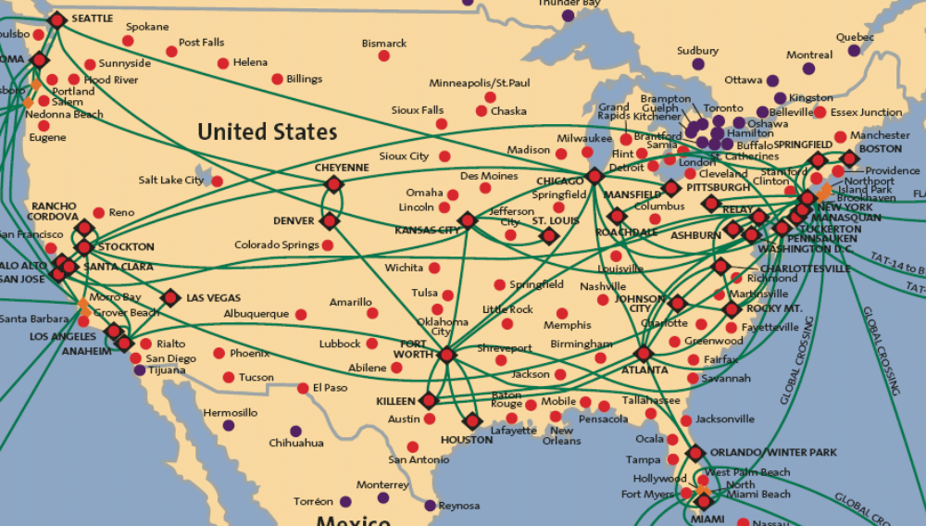
Tier-1 ISP: e.g., Sprint
POP: point-of-presence
to/from backbone
…
peering
….
…
…
…
to/from customers

Slide 10
Internet structure: network of networks
“tier-2” ISPs: smaller (often regional) ISPs
  connect to one or more tier-1 (provider) ISPs
    each tier-1 has many tier-2 customer nets
    tier 2 pays tier 1 provider
  tier-2 nets sometimes peer directly with each other (bypassing tier 1) , or at IXP
Tier 2
ISP
IXP
IXP
Tier 2
ISP
Tier 2
ISP
Tier 1 ISP
Large Content
Distributor
(e.g., Akamai)
Large Content
Distributor
(e.g., Google)
Tier 1 ISP
Tier 1 ISP
Tier 2
ISP
Tier 2
ISP
Tier 2
ISP
Tier 2
ISP
Tier 2
ISP
Tier 2
ISP

Slide 11
Internet structure: network of networks
“Tier-3” ISPs, local ISPs
customer of tier 1 or tier 2 network
  last hop (“access”) network (closest to end systems)
Tier 2
ISP
IXP
IXP
Tier 2
ISP
Tier 2
ISP
Tier 1 ISP
Large Content
Distributor
(e.g., Akamai)
Large Content
Distributor
(e.g., Google)
Tier 1 ISP
Tier 1 ISP
Tier 2
ISP
Tier 2
ISP
Tier 2
ISP
Tier 2
ISP
Tier 2
ISP
Tier 2
ISP

Slide 12
Internet structure: network of networks
a packet passes through many networks from source host to destination host
Tier 2
ISP
IXP
IXP
Tier 2
ISP
Tier 2
ISP
Tier 1 ISP
Large Content
Distributor
(e.g., Akamai)
Large Content
Distributor
(e.g., Google)
Tier 1 ISP
Tier 1 ISP
Tier 2
ISP
Tier 2
ISP
Tier 2
ISP
Tier 2
ISP
Tier 2
ISP
Tier 2
ISP

Slide 13
Overview
Network access and physical media
Internet structure and ISPs
Delay & loss in packet-switched networks
Protocol layers, service models

Slide 14
How do loss and delay occur?
packets queue in router buffers
packet arrival rate to link exceeds output link capacity
packets queue, wait for turn
packet being transmitted (delay)
A
B
packets queueing (delay)
free (available) buffers: arriving packets
dropped (loss) if no free buffers

Slide 15
Four sources of packet delay
transmission
A
propagation
B
nodal
processing
queueing
d_{nodal} = d_{proc} + d_{queue} + d_{trans} + d_{prop}
d_{proc}: nodal processing
check bit errors
determine output link
typically < msec
d_{queue}: queueing delay
time waiting at output link for transmission
depends on congestion level of router

Slide 16
Four sources of packet delay
transmission
A
propagation
B
nodal
processing
queueing
d_{nodal} = d_{proc} + d_{queue} + d_{trans} + d_{prop}
d_{trans}: transmission delay:
L: packet length (bits)
R: link bandwidth (bps)
d_{trans} = L/R
d_{prop}: propagation delay:
d: length of physical link
s: propagation speed in medium (~2x10⁸ m/sec)
d_{prop} = d/s
d_{trans} and d_{prop}
very different

Slide 17
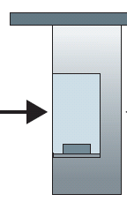

Caravan analogy
100 km
100 km
ten-car
caravan
toll
booth
toll
booth
cars “propagate” at
100 km/hr
toll booth takes 12 sec to service car (transmission time)
car~bit; caravan ~ packet
Q: How long until caravan is lined up before 2nd toll booth?

Slide 18
Caravan analogy
100 km
100 km
ten-car
caravan
toll
booth
toll
booth
cars “propagate” at
100 km/hr
toll booth takes 12 sec to service car (transmission time)
car~bit; caravan ~ packet
Q: How long until caravan is lined up before 2nd toll booth?
time to “push” entire caravan through toll booth onto highway = 12*10 = 120 sec
time for last car to propagate from 1st to 2nd toll both: 100km/(100km/hr)= 1 hr
A: 62 minutes

Slide 19
Caravan analogy (more)
100 km
100 km
ten-car
caravan
toll
booth
toll
booth
cars now “propagate” at 1000 km/hr
toll booth now takes 1 min to service a car
Q: Will cars arrive to 2nd booth before all cars serviced at 1st booth?

Slide 20
Caravan analogy (more)
100 km
100 km
ten-car
caravan
toll
booth
toll
booth
cars now “propagate” at 1000 km/hr
toll booth now takes 1 min to service a car
Q: Will cars arrive to 2nd booth before all cars serviced at 1st booth?
A: Yes! After 7 min, 1st car arrives at second booth; three cars still at 1st booth.
1st bit of packet can arrive at 2nd router before packet is fully transmitted at 1st router!

Slide 21


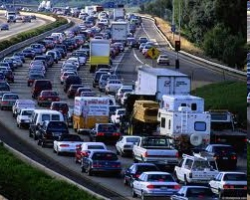
Queueing delay (revisited)
R: link bandwidth (bps)
L: packet length (bits)
a: average packet arrival rate
average queueing delay
traffic intensity
= La/R
La/R ~ 0
La/R ~ 0: avg. queueing delay small
La/R -> 1: avg. queueing delay large
La/R > 1: more “work” arriving
than can be serviced, average delay infinite!
La/R -> 1

Slide 22
“Real” Internet delays and routes
What do “real” Internet delay & loss look like?
Traceroute program: provides delay measurement from source to router along end-end Internet path towards destination. For all i:
  sends three packets that will reach router i on path towards destination
  router i will return packets to sender
  sender times interval between transmission and reply.
3 probes
3 probes
3 probes

Slide 23
“Real” Internet delays and routes
traceroute: zappa.cs.nwu.edu to www.zju.edu.cn
Three delay measements from Zappa.cs.cs.nwu.edu to 1890mpl-idf-vln-122.northwestern.edu
1 1890mpl-idf-vln-122.northwestern.edu (129.105.100.1) 0.287 ms 0.211 ms 0.193 ms
2 lev-mdf-6-vln-54.northwestern.edu (129.105.253.53) 0.431 ms 0.315 ms 0.321 ms
3 abbt-mdf-1-vln-902.northwestern.edu (129.105.253.222) 0.991 ms 0.950 ms 1.151 ms
4 abbt-mdf-4-ge-0-1-0.northwestern.edu (129.105.253.22) 1.659 ms 1.255 ms 1.520 ms
5 starlight-lsd6509.northwestern.edu (199.249.169.6) 1.713 ms 1.368 ms 1.278 ms
6 206.220.240.154 (206.220.240.154) 1.284 ms 1.204 ms 1.279 ms
7 206.220.240.105 (206.220.240.105) 2.892 ms 2.003 ms 2.808 ms
8 202.112.61.5 (202.112.61.5) 116.475 ms 196.663 ms 241.792 ms
9 sl-gw25-stk-1-2.sprintlink.net (144.223.71.221) 145.502 ms 150.033 ms 151.715 ms
10 sl-bb21-stk-8-1.sprintlink.net (144.232.4.225) 166.762 ms 177.180 ms 166.235 ms
11 sl-bb21-hk-2-0.sprintlink.net (144.232.20.28) 331.858 ms 340.613 ms 346.332 ms
12 sl-gw10-hk-14-0.sprintlink.net (203.222.38.38) 346.842 ms 356.915 ms 366.916 ms
13 sla-cent-3-0.sprintlink.net (203.222.39.158) 482.426 ms 495.908 ms 509.712 ms
14 202.112.61.193 (202.112.61.193) 515.548 ms 501.186 ms 509.868 ms
15 202.112.36.226 (202.112.36.226) 537.994 ms 561.658 ms 541.695 ms
16 shnj4.cernet.net (202.112.46.78) 451.750 ms 263.390 ms 342.306 ms
17 hzsh3.cernet.net (202.112.46.134) 349.855 ms 366.082 ms 380.849 ms
18 zjufw.zju.edu.cn (210.32.156.130) 350.693 ms 394.553 ms 366.636 ms
19 * * *
* * *
21 www.zju.edu.cn (210.32.0.9) 353.623 ms 397.532 ms 396.326 ms
trans-oceanic
link
* means no reponse (probe lost, router not replying)

Slide 24
Packet loss
queue (aka buffer) preceding link in buffer has finite capacity
packet arriving to full queue dropped (aka lost)
lost packet may be retransmitted by previous node, by source end system, or not at all
buffer
(waiting area)
packet being transmitted
A
B
packet arriving to
full buffer is lost

Slide 25
Throughput
throughput: rate (bits/time unit) at which bits transferred between sender/receiver
  instantaneous: rate at given point in time
  average: rate over longer period of time
link capacity
R_{s} bits/sec
link capacity
R_{c} bits/sec
server, with
file of F bits
to send to client
pipe that can carry
fluid at rate
R_{s} bits/sec)
pipe that can carry
fluid at rate
R_{c} bits/sec)
server sends bits
(fluid) into pipe

Slide 26
Throughput (more)
R_{s} < R_{c} What is average end-end throughput?
R_{s} bits/sec
R_{c} bits/sec
R_{s} > R_{c} What is average end-end throughput?
R_{s} bits/sec
R_{c} bits/sec
bottleneck link
link on end-end path that constrains end-end throughput

Slide 27
Throughput: Internet scenario
per-connection end-end throughput: min(R_{c},R_{s},R/10)
in practice: R_{c} or R_{s} is often bottleneck
R_{s}
R_{s}
R_{s}
R
R_{c}
R_{c}
R_{c}
10 connections (fairly) share backbone bottleneck link R bits/sec

