Slide 1
An E-mail
Aleksandar,
Accounts have been created for any students in EECS 340 who did not already have one. Physical access to the labs has also been granted.
If any of your students require either physical or electronic access, please have them contact root@eecs.northwestern.edu with their NetID
and student ID number.

Slide 2
Network Edge: Connection-oriented Service
Goal: data transfer between end systems
handshaking: setup (prepare for) data transfer ahead of time
  Hello, hello back human protocol
  set up “state” in two communicating hosts
TCP - Transmission Control Protocol
  Internet’s connection-oriented service
TCP service [RFC 793]
reliable, in-order byte-stream data transfer
  loss: acknowledgements and retransmissions
flow control:
  sender won’t overwhelm receiver
congestion control:
  senders “slow down sending rate” when network congested

Slide 3
Network Edge: Connectionless Service
Goal: data transfer between end systems
  same as before!
UDP - User Datagram Protocol [RFC 768]: Internet’s connectionless service
  unreliable data transfer
  no flow control
  no congestion control
App’s using TCP:
HTTP (Web), FTP (file transfer), Telnet (remote login), SMTP (email)
App’s using UDP:
streaming media, teleconferencing, DNS, Internet telephony

Slide 4
A Taxonomy of Communication Networks
The fundamental question: how is data transferred through net (including edge & core)?
Communication networks can be classified based on how the nodes exchange information:
Communication Networks
Switched
Communication Network
Broadcast
Communication Network
Circuit-Switched
Communication Network
Packet-Switched
Communication Network
TDM
FDM
Datagram
Network
Virtual Circuit Network

Slide 5
Broadcast vs. Switched Communication Networks
Broadcast communication networks
  Information transmitted by any node is received by every other node in the network
    Examples: usually in LANs (Ethernet)
  Problem: coordinate the access of all nodes to the shared communication medium (Multiple Access Problem)
Switched communication networks
  Information is transmitted to a sub-set of designated nodes
    Examples: WANs (Telephony Network, Internet)
  Problem: how to forward information to intended node(s)
    This is done by special nodes (e.g., routers, switches) running routing protocols

Slide 6
A Taxonomy of Communication Networks
The fundamental question: how is data transferred through net (including edge & core)?
Communication networks can be classified based on how the nodes exchange information:
Communication Networks
Switched
Communication Network
Broadcast
Communication Network
Circuit-Switched
Communication Network
Packet-Switched
Communication Network
TDM
FDM
Datagram
Network
Virtual Circuit Network

Slide 7





Circuit-Switched Network
End-end resources reserved for “call”
Link bandwidth, switch capacity
Three phases
  circuit establishment
  data transfer
  circuit termination
Dedicated resources
+ Guaranteed performance
- no sharing

Slide 8
Circuit Switching
Examples
Telephone networks
ISDN (Integrated Services Digital Networks)
network resources (e.g., bandwidth) divided into “pieces”
Pieces allocated to calls
Resource piece idle if not used by owning call (no sharing)
Dividing link bandwidth into “pieces”
  frequency division
  time division
Notes:
Integrated Services Digital Network (ISDN) is comprised of digital telephony and data-transport services offered by regional telephone carriers. ISDN involves the digitization of the telephone network, which permits voice, data, text, graphics, music, video, and other source material to be transmitted over existing telephone wires.

Slide 9
Circuit Switching: FDM and TDM
Example:
FDM
4 users
frequency
time
TDM
frequency
time
Notes:
Two simple multiple access control techniques.
Each mobile’s share of the bandwidth is divided into portions for the uplink and the downlink. Also, possibly, out of band signaling.
As we will see, used in AMPS, GSM, IS-54/136

Slide 10
A Taxonomy of Communication Networks
The fundamental question: how is data transferred through net (including edge & core)?
Communication networks can be classified based on how the nodes exchange information:
Communication Networks
Switched
Communication Network
Broadcast
Communication Network
Circuit-Switched
Communication Network
Packet-Switched
Communication Network
TDM
FDM
Datagram
Network
Virtual Circuit Network

Slide 11
Packet Switching
Data is sent as formatted bit-sequences (Packets)
Packets have the following structure:
  Header and Trailer carry control information (e.g., destination address, check sum)
Each packet traverses the network from node to node along some path (Routing)
At each node the entire packet is received, stored briefly, and then forwarded to the next node (Store-and-Forward Networks)
No dedicated allocation or resource reservation – no guarantees!
Header
Data
Trailer

Slide 12
Packet Switching: Statistical Multiplexing
10 Mbs
Ethernet
A
C
statistical multiplexing
1.5 Mbs
B
queue of packets
waiting for output
link
D
E
Sequence of A & B packets does not have fixed pattern ➔ statistical multiplexing.
In TDM each host gets same slot in revolving TDM frame.

Slide 13
Packet Switching versus Circuit Switching
Packet switching allows more users to use network!
1 Mbit link
Each user:
  100 kbps when “active”
  active 10% of time
Circuit-switching:
  10 users
Packet switching:
  with 35 users, probability > 10 active less than .0004
N users
1 Mbps link

Slide 14
Packet Switching versus Circuit Switching
Great for bursty data
  resource sharing
  simpler, no call setup
Excessive congestion: packet delay and loss
  protocols needed for reliable data transfer, congestion control
Q: How to provide circuit-like behavior?
  bandwidth guarantees needed for audio/video apps
  still an unsolved problem (chapter 7)

Slide 15
A Taxonomy of Communication Networks
The fundamental question: how is data transferred through net (including edge & core)?
Communication networks can be classified based on how the nodes exchange information:
Communication Networks
Switched
Communication Network
Broadcast
Communication Network
Circuit-Switched
Communication Network
Packet-Switched
Communication Network
TDM
FDM
Datagram
Network
Virtual Circuit Network

Slide 16
Datagram Packet Switching
Each packet is independently switched
  Each packet header contains destination address which determines next hop
  Routes may change during session
  E.g., post-office analogy
No resources are pre-allocated (reserved) in advance
Example: IP networks

Slide 17
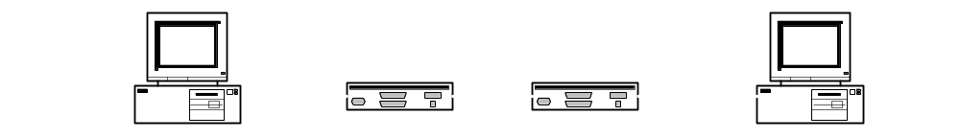
Timing of Datagram Packet Switching
Host 1
Host 2
Node 1
Node 2
Packet 1
propagation
delay between
Host 1 and
Node 2
transmission
time of Packet 1
at Host 1
Packet 2
Packet 1
Packet 3
processing
delay of Packet 1 at Node 2
Packet 2
Packet 3
Packet 1
Packet 2
Packet 3

Slide 18
Datagram Packet Switching
Host C
Host A
Host D
Node 1
Node 2
Node 3
Node 5
Host B
Node 7
Host E
Node 6
Node 4

Slide 19
A Taxonomy of Communication Networks
The fundamental question: how is data transferred through net (including edge & core)?
Communication networks can be classified based on how the nodes exchange information:
Communication Networks
Switched
Communication Network
Broadcast
Communication Network
Circuit-Switched
Communication Network
Packet-Switched
Communication Network
TDM
FDM
Datagram
Network
Virtual Circuit Network

Slide 20
Virtual-Circuit Packet Switching
Hybrid of circuit switching and packet switching
  All packets from one packet stream are sent along a pre-established path (= virtual circuit)
  Each packet carries tag (virtual circuit ID), tag determines next hop
Features
  Guarantees in-sequence delivery of packets (+)
  However, packets from different virtual circuits may be interleaved (+)
  Requires per-flow state in the network (-)
Notes:
Asynchronous Transfer Mode

Slide 21
Virtual-Circuit Packet Switching
Communication with virtual circuits takes place in three phases
  VC establishment
  data transfer
  VC disconnect
Note: packet headers don’t need to contain the full destination address of the packet

Slide 22
Timing of Virtual-Circuit Packet Switching
Host 1
Host 2
Node 1
Node 2
propagation delay
between Host 1
and Node 1
VC
establishment
Packet 1
Packet 2
Packet 1
Packet 3
Packet 2
Packet 3
Packet 1
Data
transfer
Packet 2
Packet 3
VC
termination

Slide 23
Virtual-Circuit Packet Switching
Host C
Host A
Host D
Node 1
Node 2
Node 3
Node 5
Host B
Node 7
Host E
Node 6
Node 4

Slide 24
Reminder
Project 1 out
  If you don’t have a TLAB account contact root@eecs.northwestern.edu.
  To enter the TLAB classroom (Tech F-252), again contact root@eecs.northwestern.edu.
  Find partner (groups of 2-3 preferred)
Recitation on Tuesday (01/13) and Thursday (01/15) on UNIX programming and project 1 at 11:00 AM in TBA.
Homework 1 out, due 1/23

Slide 25
Overview
Network access and physical media
Internet structure and ISPs
Delay & loss in packet-switched networks
Protocol layers, service models

Slide 26

Access networks and physical media
Q: How to connect end systems to edge router?
residential access nets
institutional access networks (school, company)
mobile access networks
Keep in mind:
  bandwidth (bits per second) of access network?
  shared or dedicated?

Slide 27
Dial-up Modem
central
office
telephone
network
Internet
home
PC
home
dial-up
modem
ISP
modem
(e.g., AOL)
uses existing telephony infrastructure
  home directly-connected to central office
up to 56Kbps direct access to router (often less)
can’t surf, phone at same time: not “always on”

Slide 28
Digital Subscriber Line (DSL)
Existing phone line:
0-4KHz phone; 4-50KHz upstream data; 50KHz-1MHz downstream data
Internet
home
phone
DSLAM
telephone
network
splitter
DSL
modem
central
office
home
PC
  uses existing telephone infrastructure
  up to 1 Mbps upstream (today typically < 256 kbps)
  up to 8 Mbps downstream (today typically < 1 Mbps)
  dedicated physical line to telephone central office

Slide 29
Residential access: cable modems
uses cable TV infrastructure, rather than telephone infrastructure
HFC: hybrid fiber coax
  asymmetric: up to 30Mbps downstream, 2 Mbps upstream
network of cable, fiber attaches homes to ISP router
  homes share access to router
  unlike DSL, which has dedicated access

Slide 30
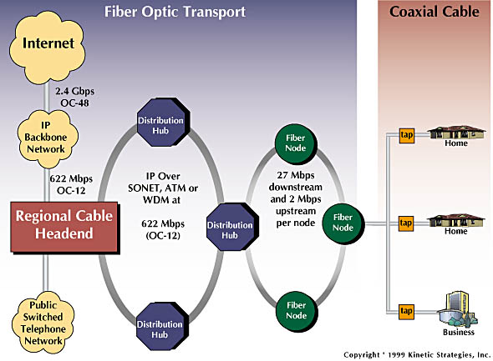
Residential access: cable modems
Diagram: http://www.cabledatacomnews.com/cmic/diagram.html

Slide 31

Cable Network Architecture: Overview
Typically 500 to 5,000 homes
cable headend
cable distribution
network (simplified)
home

Slide 32
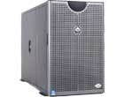
Cable Network Architecture: Overview
server(s)
cable headend
cable distribution
network
home

Slide 33
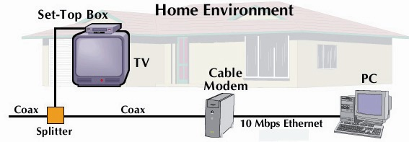
Cable Network Architecture: Overview
cable headend
cable distribution
network (simplified)
home

Slide 34
Cable Network Architecture: Overview
FDM (more shortly):
C
O
N
T
R
O
L
V
I
D
E
O
V
I
D
E
O
V
I
D
E
O
V
I
D
E
O
V
I
D
E
O
V
I
D
E
O
D
A
T
A
D
A
T
A
1
2
3
4
5
6
7
8
9
Channels
cable headend
cable distribution
network
home

Slide 35
Fiber to the Home
ONT
Internet
optical
fibers
optical
fiber
ONT
OLT
optical
splitter
central office
optical links from central office to the home
two competing optical technologies:
  Passive Optical Network (PON) (shown in the figure)
  Active Optical Network (AON)
much higher Internet rates (10-20 Mbps download; 1-2 Mbps upload); fiber also carries television and phone services
ONT
Notes:
AON is essentially switched Ethernet.
PAN is shown in the figure.
Each home has optical network terminator (which is connecting dedicated optical fiber to a neighborhood splitter).
The splitter combines a number of homes, typically less than 100.
A shared optical fiber goes to the Optical Line Terminator (OLT), which converts optical to electrical signals.
In the PON architecture, all packets sent from OLT to the splitter are replicated at the splitter.
Download 10-20 Mbps.
Upload 1-2 Mbps.
TV and phone goes through this.

Slide 36
Ethernet Internet access
100 Mbps
institutional
router
Ethernet
switch
to institution’s
ISP
100 Mbps
1 Gbps
100 Mbps
server
typically used in companies, universities, etc
  10 Mbps, 100Mbps, 1Gbps, 10Gbps Ethernet
  today, end systems typically connect into Ethernet switch

