Slide 1
An introduction of X-ray ﻿analysis for V1025_Cen
鲍通
DZ1926002

Slide 2
Introduction
Observation
Data reduction
Contents
Results

Slide 3
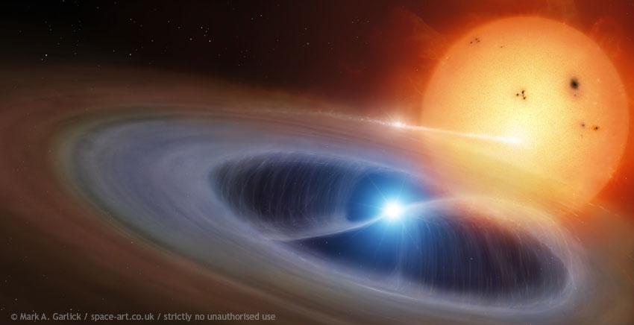
Introduction
V1025 Cen is an intermediate polar, consist of a white dwarf and a normal star.
Its orbit period and spin period were determined at 5077 s and 2147s respectively, by Buckley, et.al.,1998.
Notes:
You can get it from RK catalog(http://physics.open.ac.uk/RKcat/)

Slide 4
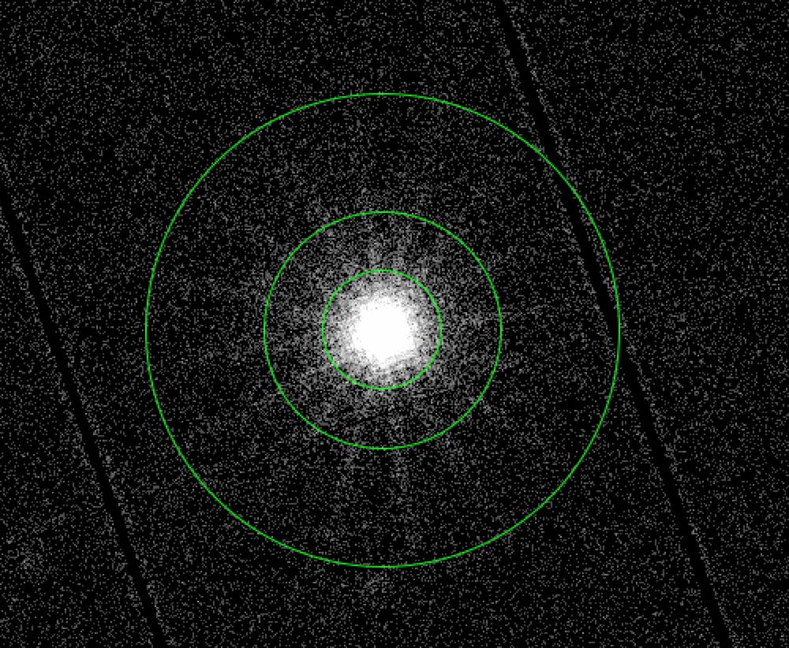
Observation and data reduction
Observation of XMM-Newton
ObsID: 0673140601
Exposure time: 16513s
Run emchain and epchain to ﻿ produce calibrated photon event file.
Run evselect to ﻿extract the source and background spectra.
Run barycen to correct event time to TDB.

Slide 5
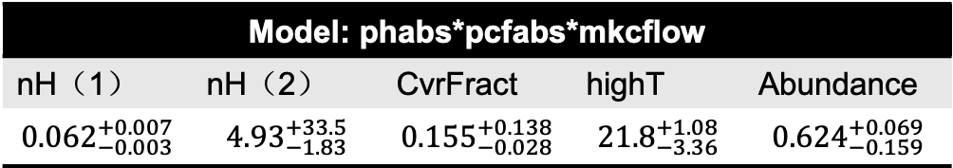
Spectral analysis
Model: phabs*pcfabs*mkcflow
nH（1） | nH（2） | CvrFract | highT | Abundance
$${0.062}_{−0.003}^{+0.007}$$ | $${4.93}_{−1.83}^{+33.5}$$ | $${0.155}_{−0.028}^{+0.138}$$ | $${21.8}_{−3.36}^{+1.08}$$ | $${0.624}_{−0.159}^{+0.069}$$

Slide 6
Timing analysis
Bin=50
Orbit
Spin

Slide 7
Thank you！

