Slide 1
Probability and Information Theory
Lecture slides for Chapter 3 of Deep Learning
www.deeplearningbook.org
Ian Goodfellow
2016-09-26
adapted by m.n. for CMPS 392

Slide 2
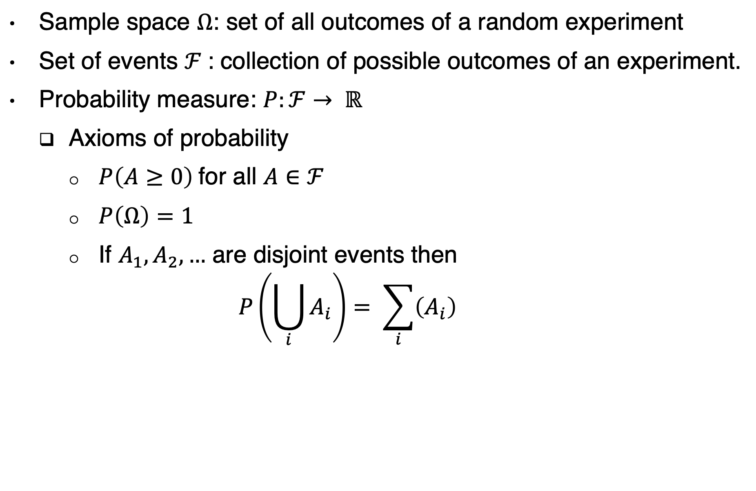
Probability
Sample space $Ω$: set of all outcomes of a random experiment
Set of events $ℱ$: collection of possible outcomes of an experiment.
Probability measure: $P:ℱ→ ℝ$
Axioms of probability
$P\left(A≥0\right)$for all $A∈ℱ$
$P\left(Ω\right)=1$
If $A_{1},A_{2},…$ are disjoint events then
$$P\left(\bigcup_{i}{A_{i}}\right)= \sum_{i}{\left(A_{i}\right)}$$

Slide 3
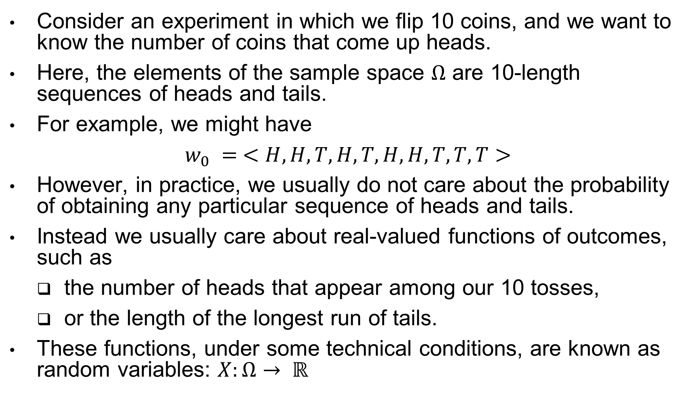
Random variable
Consider an experiment in which we flip 10 coins, and we want to know the number of coins that come up heads.
Here, the elements of the sample space $Ω$ are 10-length sequences of heads and tails.
For example, we might have
$w_{0} = <H, H, T, H, T, H, H, T, T, T>$
However, in practice, we usually do not care about the probability of obtaining any particular sequence of heads and tails.
Instead we usually care about real-valued functions of outcomes, such as
the number of heads that appear among our 10 tosses,
or the length of the longest run of tails.
These functions, under some technical conditions, are known as random variables: $X:Ω→ ℝ$

Slide 4

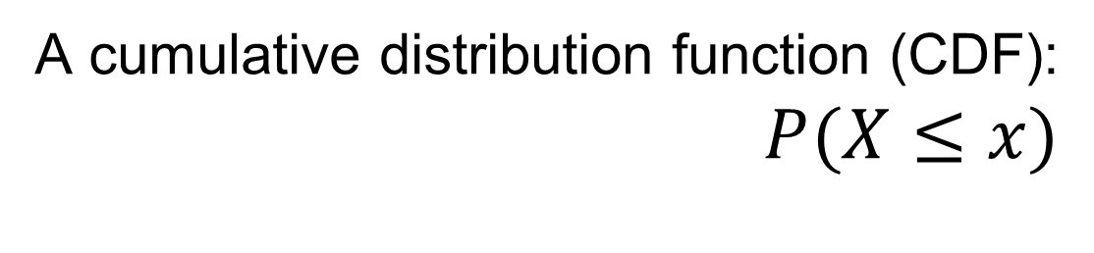
Discrete vs. continuous
Discrete random variable:
$P\left(X=k\right)=P\left(\left\{w:X\left(w\right)=k\right\}\right)$
Continuous random variable:
$P\left(a≤ X≤b\right)=P\left(\left\{w:a≤X\left(w\right)≤b\right\}\right)$
A cumulative distribution function (CDF):
$P(X≤x)$

Slide 5
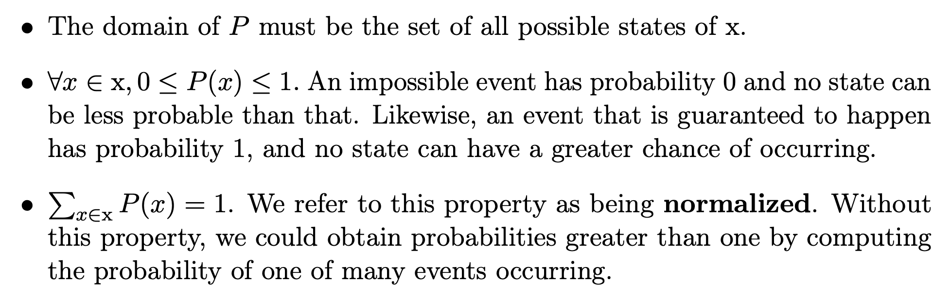
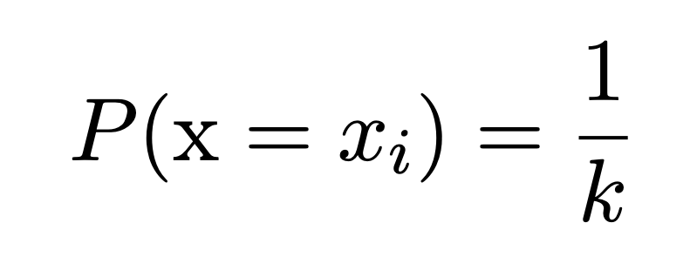
Probability Mass Function (discrete variable)
Example: uniform distribution:

Slide 6
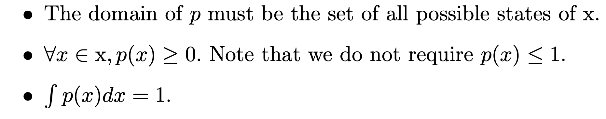
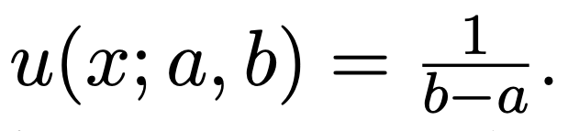
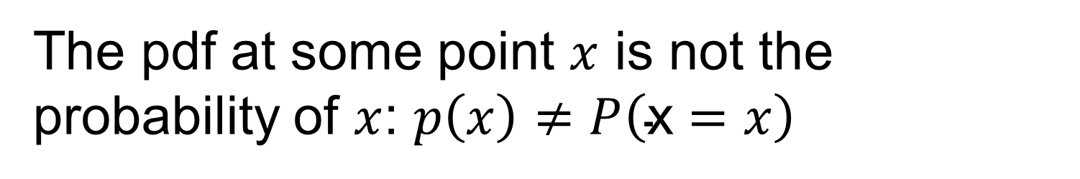
Probability Density Function (continuous variable)
Example: uniform distribution:
The pdf at some point $x$ is not the probability of $x$: $p\left(x\right)≠P\left(\text{x}=x\right)$
Notes:
For some continuous random variables, the cumulative distribution function (CDF) is differentiable
everywhere. In these cases, we define the Probability Density Function or PDF as the derivative
of the CDF.

Slide 7
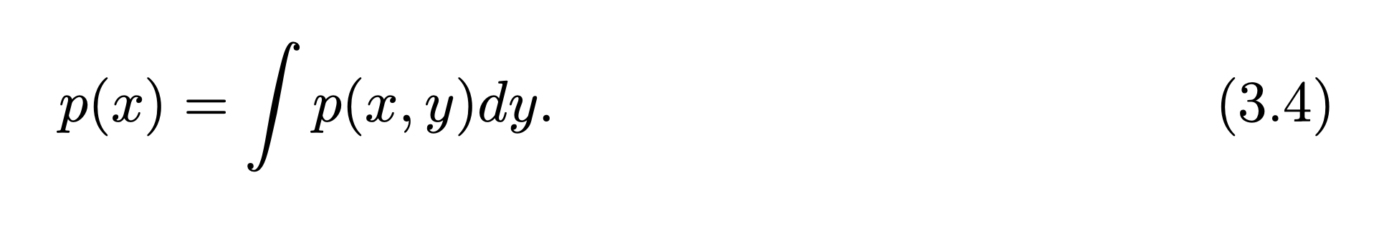
Computing Marginal Probability with the Sum Rule

Slide 8
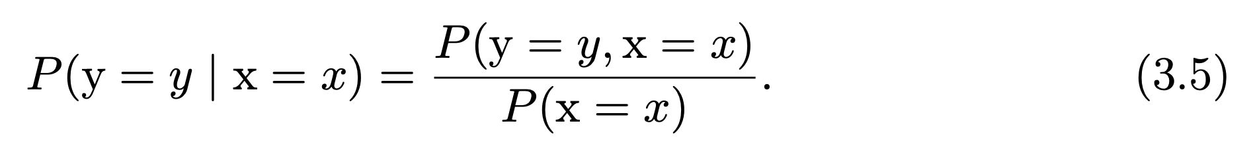
Conditional Probability

Slide 9
Chain Rule of Probability

Slide 10
Independence

Slide 11
Conditional Independence

Slide 12
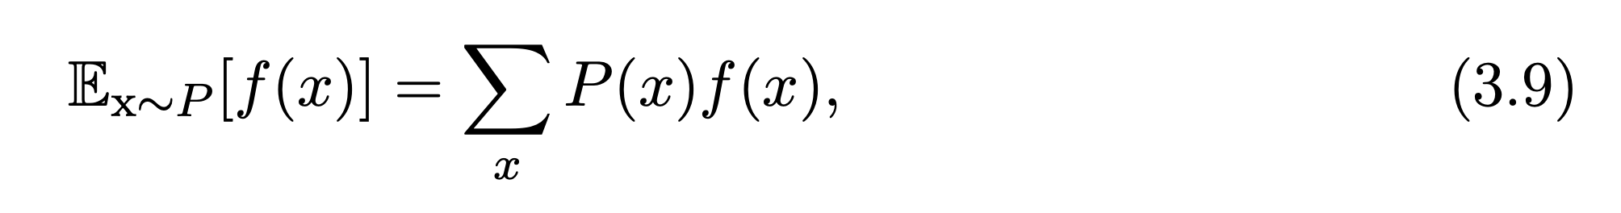
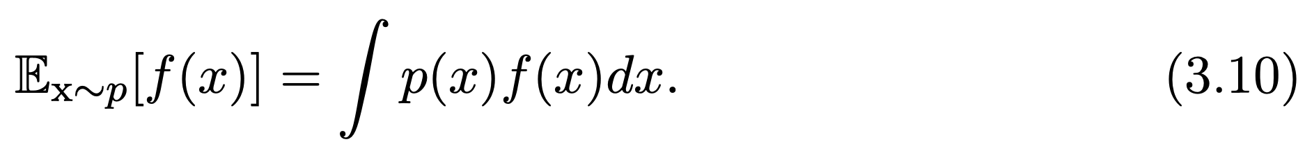
Expectation
linearity of expectations:
Notes:
the expectation of f(x) can be thought of as a “weighted average” of the values that
f(x) can taken on for different values of x
To have the expectation of random variable set f(x) = x

Slide 13
Variance and Covariance
Covariance matrix:
Notes:
The variance of a random variable X is a measure of how concentrated the distribution of a random
variable X is around its mean.

Slide 14
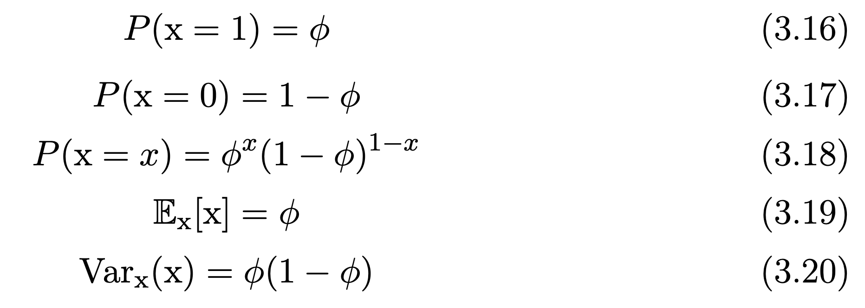
Bernoulli Distribution

Slide 15
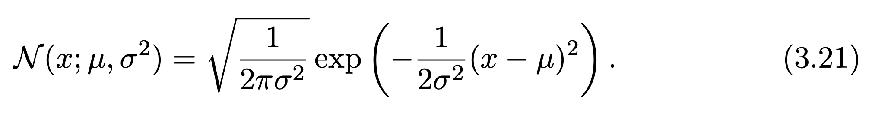
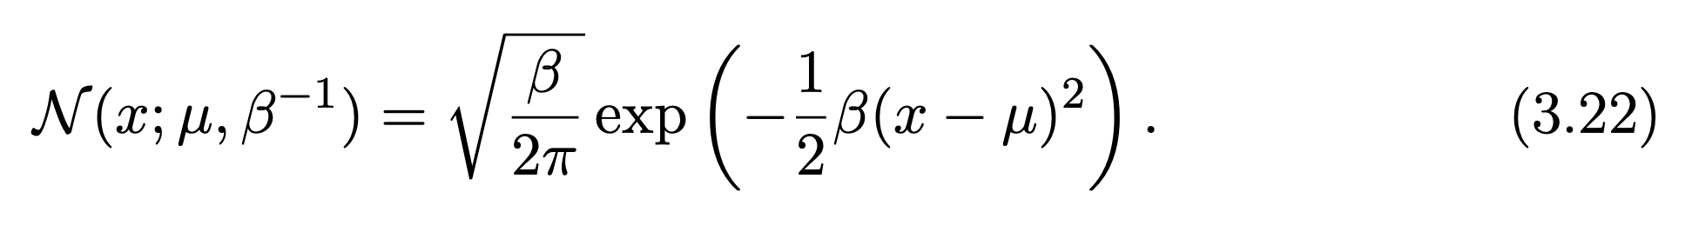
Gaussian Distribution
Parametrized by variance:
Parametrized by precision:
Notes:
The central limit theorem shows that the sum of many independent
random variables is approximately normally distributed.

Slide 16
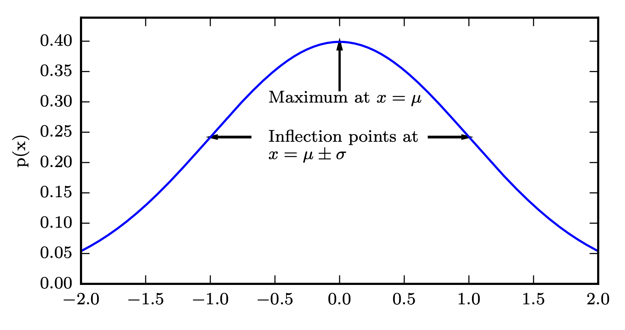
Gaussian Distribution
Figure 3.1

Slide 17
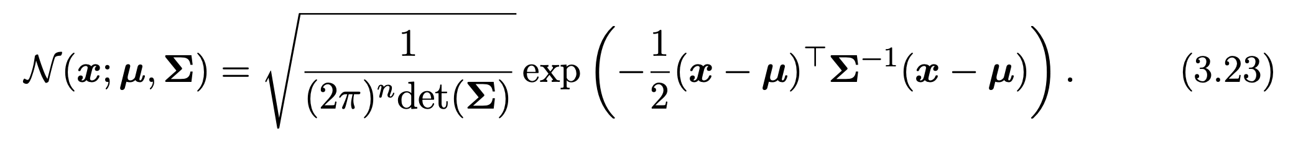
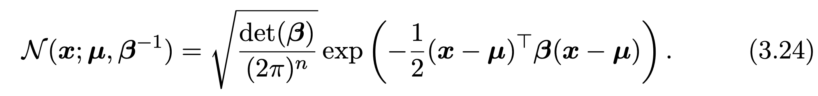
Multivariate Gaussian
Parametrized by covariance matrix:
Parametrized by precision matrix:
Notes:
The parameter Σ gives the covariance matrix of the distribution

Slide 18
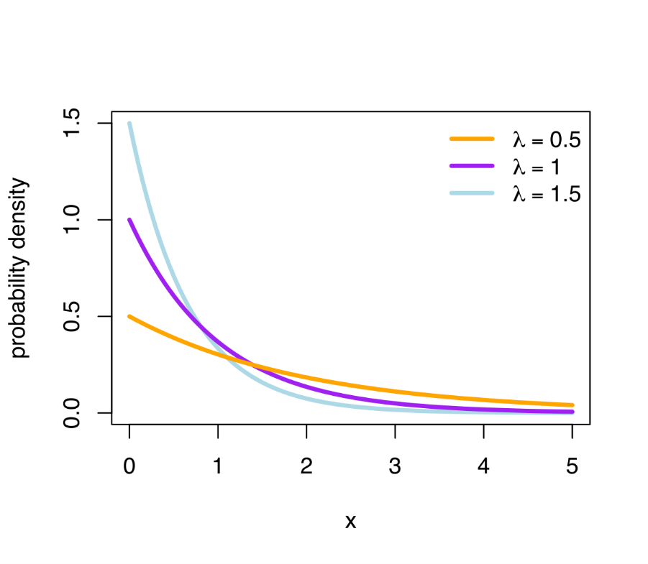
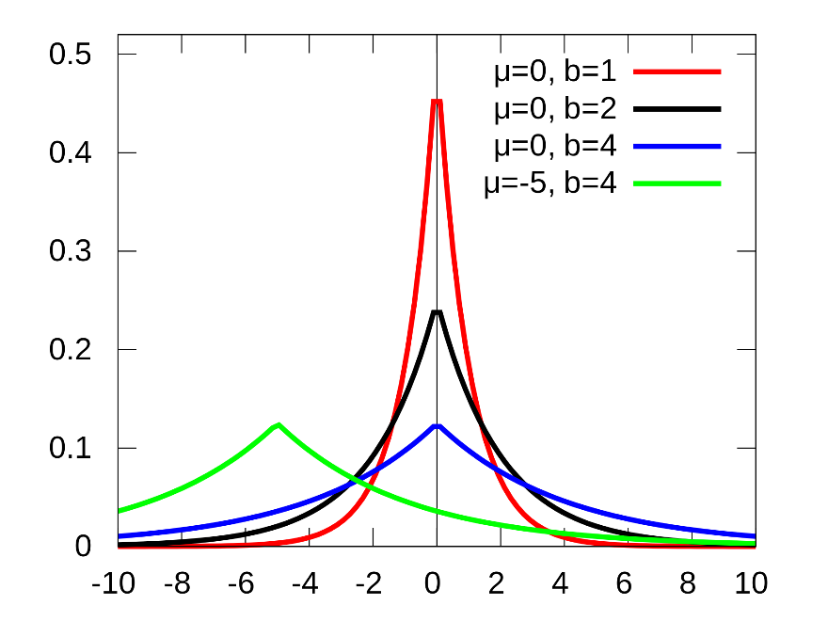
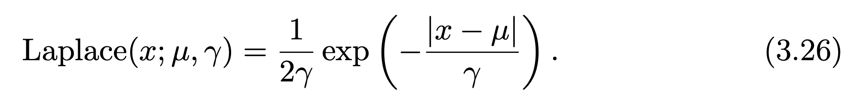
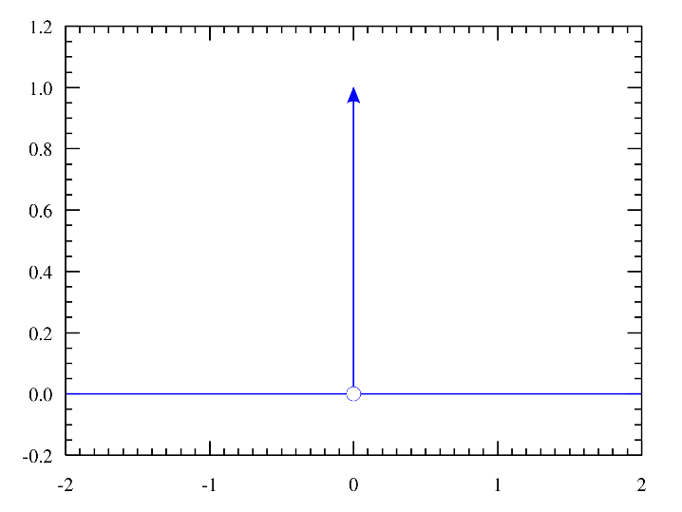
More Distributions
Exponential:
Laplace:
Dirac:

Slide 19
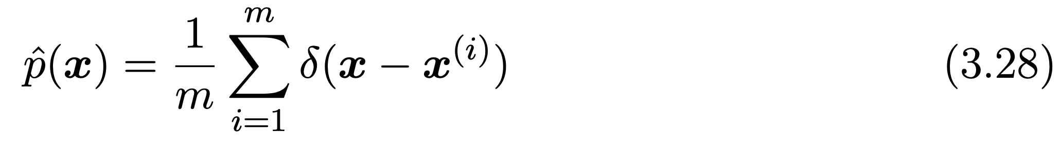
Empirical Distribution

Slide 20
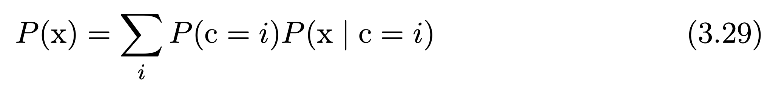
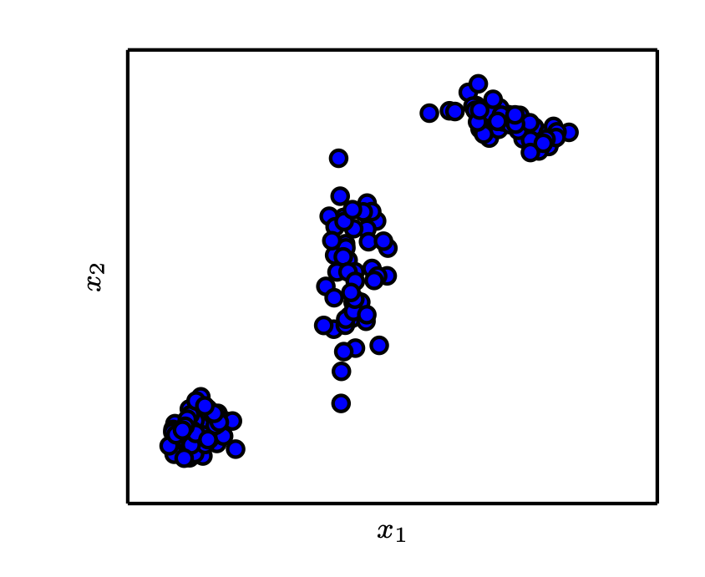
Mixture Distributions
Gaussian mixture with three components
Figure 3.2

Slide 21
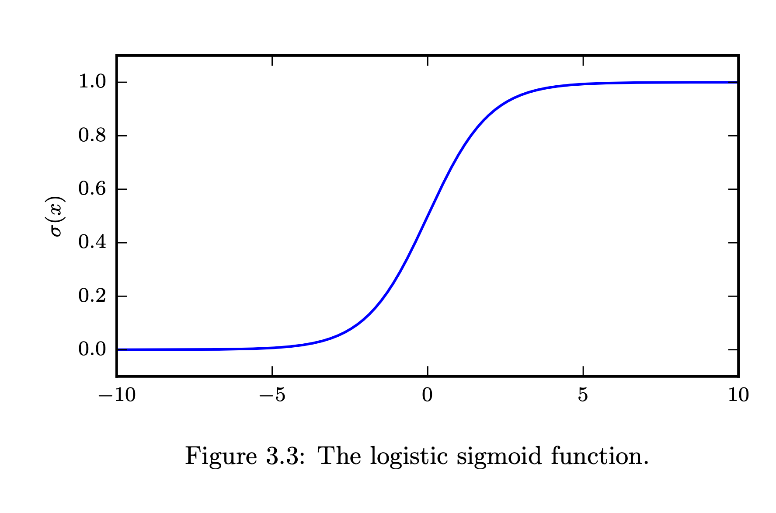
Logistic Sigmoid
Commonly used to parametrize Bernoulli distributions
Notes:
One reason is that phi is somewhere between 0 and 1 !!!

Slide 22
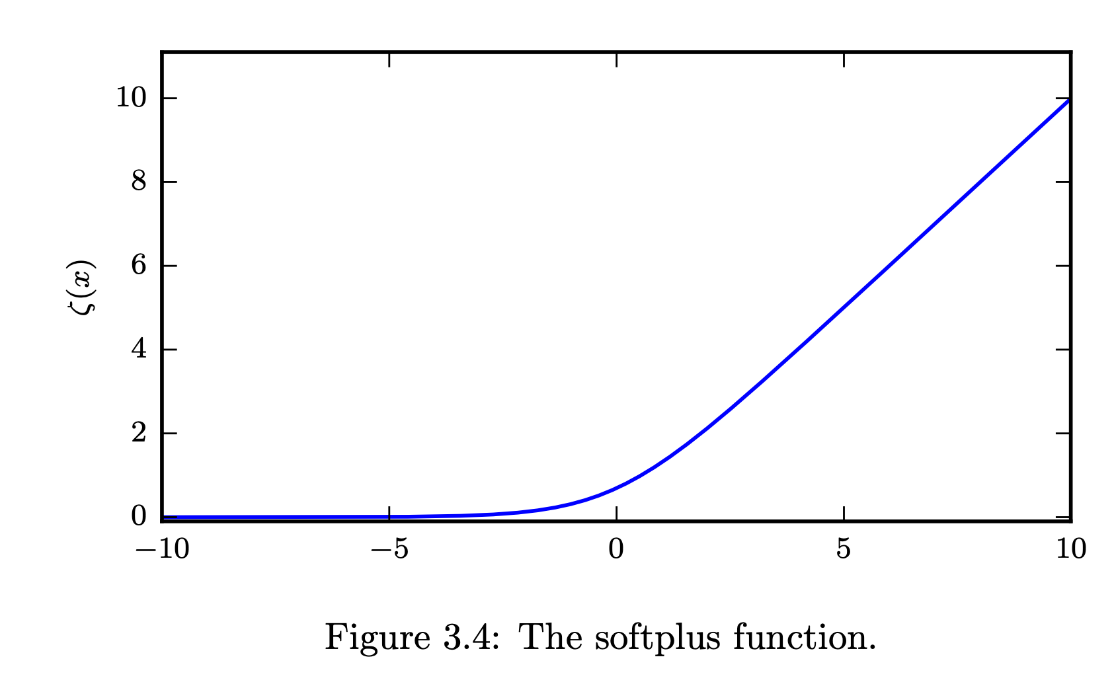
Softplus Function
A smoothed version of

Slide 23
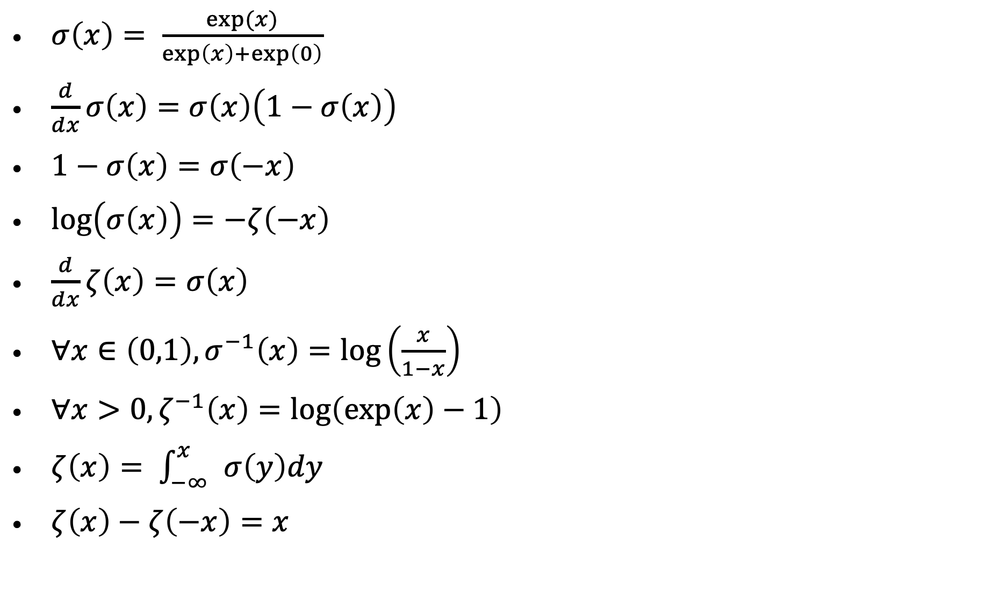
Useful Properties
$σ\left(x\right)= \frac{exp⁡(x)}{\exp\left(x\right)+\exp\left(0\right)}$
$\frac{d}{dx}σ\left(x\right)=σ\left(x\right)\left(1−σ\left(x\right)\right)$
$1−σ\left(x\right)=σ\left(−x\right)$
$\log\left(σ\left(x\right)\right)=−ζ\left(−x\right)$
$\frac{d}{dx}ζ\left(x\right)=σ\left(x\right)$
$∀x∈\left(0,1\right), σ^{−1}\left(x\right)=\log\left(\frac{x}{1−x}\right)$
$∀x>0, ζ^{−1}\left(x\right)=\log\left(\exp\left(x\right)−1\right)$
$ζ\left(x\right)= \int_{−∞ }^{x}{σ\left(y\right)dy }$
$ζ\left(x\right)−ζ\left(−x\right)=x$

Slide 24
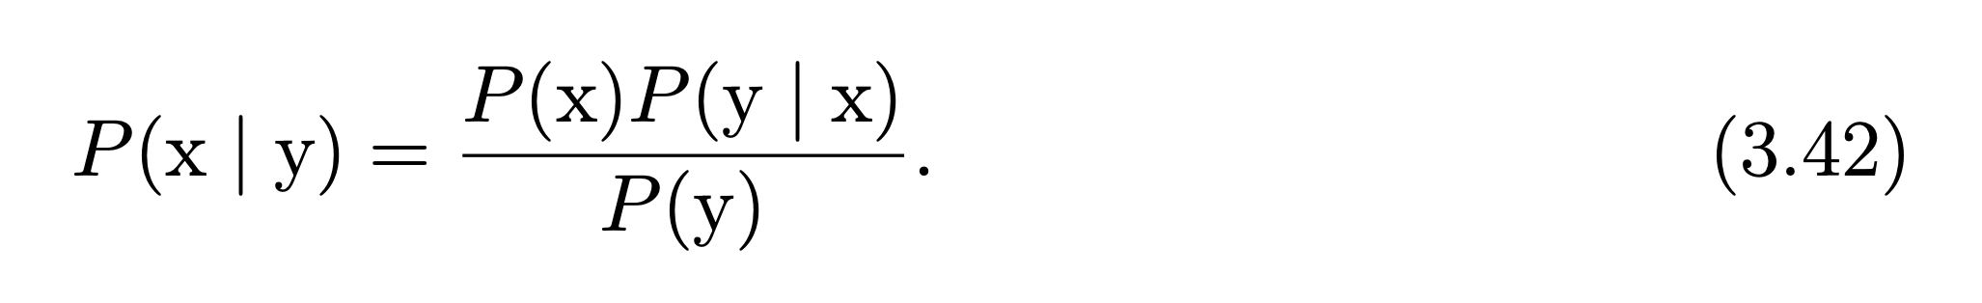
Bayes’ Rule

Slide 25
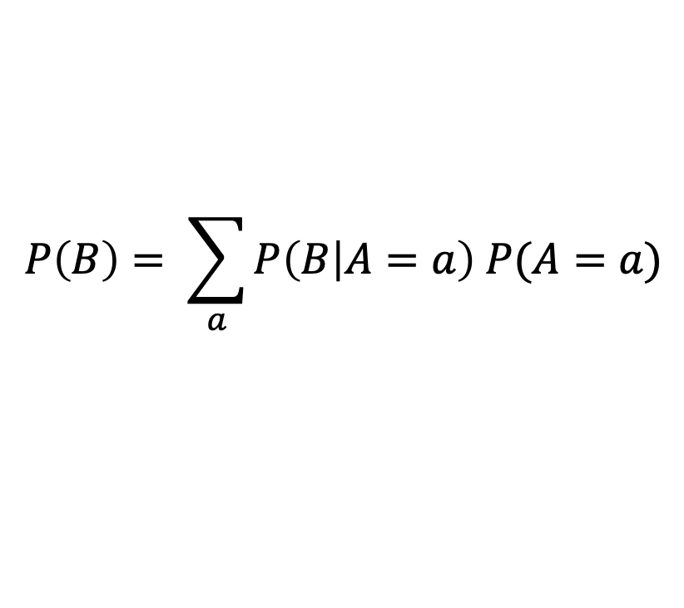

Bayes Rule
$$P(A|B) = \frac{P(B|A) P(A)}{P(B)}$$
Prior
Posterior
Likelihood
Marginal likelihood
computed by the total probability rule:
$$P\left(B\right)= \sum_{a}{P\left(B | A=a\right) P(A=a)}$$

Slide 26
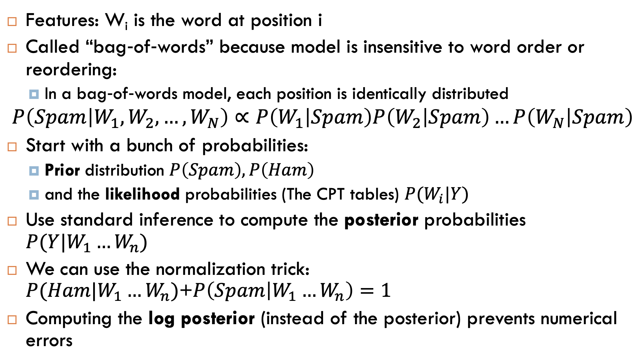
Bag‐of‐words Naïve Bayes:
Features: W_{i} is the word at position i
Called “bag‐of‐words” because model is insensitive to word order or reordering:
In a bag‐of‐words model, each position is identically distributed
$$P\left(Spam | W_{1},W_{2},…, W_{N}\right)∝P\left(W_{1} | Spam\right)P\left(W_{2} | Spam\right)…P\left(W_{N} | Spam\right)$$
Start with a bunch of probabilities:
Prior distribution $P\left(Spam\right), P\left(Ham\right)$
and the likelihood probabilities (The CPT tables) $P(W_{i}|Y)$
Use standard inference to compute the posterior probabilities $P(Y|W_{1}…W_{n})$
We can use the normalization trick: $P(Ham|W_{1}…W_{n})$+$P\left(Spam | W_{1}…W_{n}\right)=1$
Computing the log posterior (instead of the posterior) prevents numerical errors

Slide 27
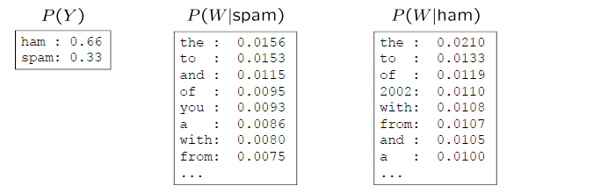
Example
Word | P(w|spam) | P(w|ham) | Total spam (log) | Total ham (log)
(prior) | 0.333 | 0.666 | -1.1 | -0.4
The | 0.005 | 0.013 | -5.27 | -4.27
Year | … | … | … | …
2002
…
Notes:
The decision is SPAM if total Spam > total Ham
Here we use log base e but any other log would be good

Slide 28
Bag of words exercise
Spam messages:
Offer is secret
Click secret link
Secret sports link
Ham messages:
Play sports today
Went play sports
Secret sports event
Sports is today
Sports costs money
Size of vocabulary= ?
P(SPAM) = ?
P_{ML}(“Secret”|SPAM) = ?
P_{ML}(“Secret”|HAM)=?
how many parameters to represent the Naïve Bayes Network?
P(SPAM|”Sports”)=?
P(SPAM| “Secret is secret”) = ?
P(SPAM|”Today is secret”)=?
Notes:
12, 3/8, 3/9, 1/15, 23, 1/6, 25/26, 0

Slide 29
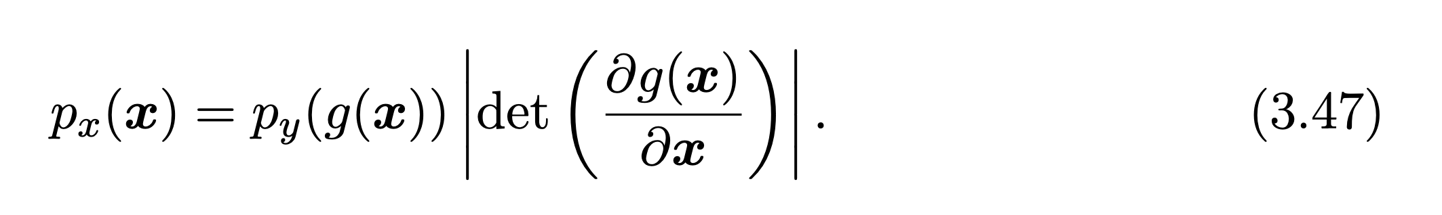
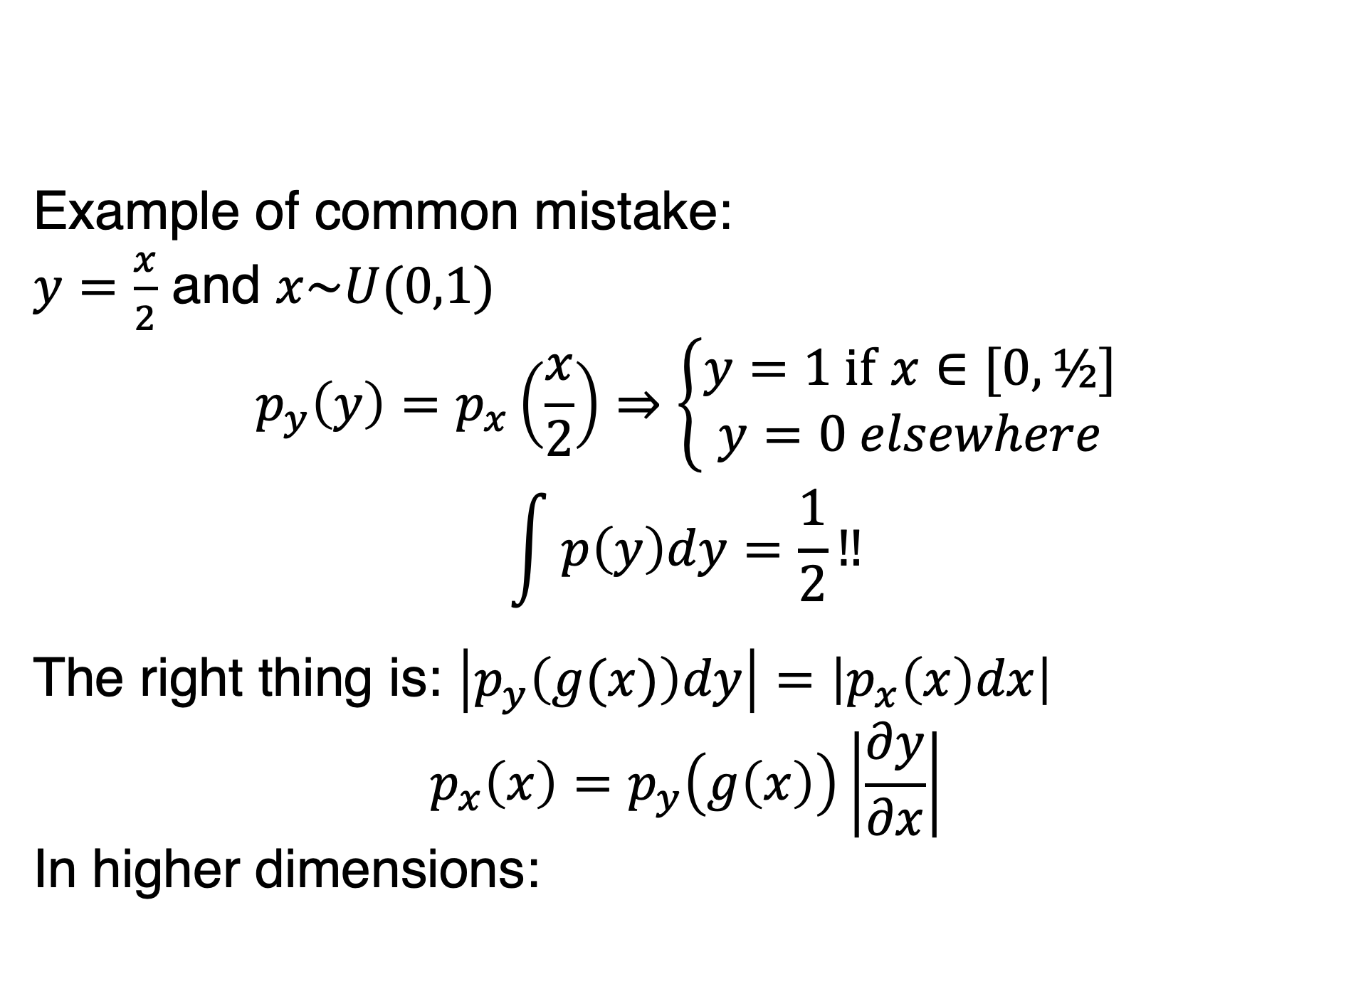
Change of Variables
Example of common mistake:
$y=\frac{x}{2}$ and $x\sim U(0,1)$
$$p_{y}\left(y\right)=p_{x}\left(\frac{x}{2}\right)⇒\left\{\begin{aligned}y=\text{1 }\text{if} x∈[0,½] \\ y=0 elsewhere\end{aligned}\right.$$
$$\int{p\left(y\right)dy=\frac{1}{2}}‼$$
The right thing is: $\left|p_{y}\left(g(x)\right)dy\right|=\left|p_{x}\left(x\right)dx\right|$
$$p_{x}\left(x\right)=p_{y}\left(g\left(x\right)\right)\left|\frac{∂y}{∂x}\right|$$
In higher dimensions:

Slide 30
Information theory
Learning that an unlikely event has occurred is more informative that learning that a likely event has occurred!
Which statement has more information?
“The sun rose this morning”
“There was a solar eclipse this morning”
Independent events should have additive information:
Finding out that a tossed coin has come up heads twice has two time more information that finding out that a tossed coin has come up heads one time!

Slide 31
Self-Information
Log base e => unit is nats
Log base 2 => unit is bits or shannons

Slide 32
Entropy
Entropy:
Entropy is a lower bound on the number of bits needded on average to encode symbols drawn from a distribution P.
Distributions that are nearly deterministic have low entropy
Distributions that are nearly uniform have high entropy

Slide 33
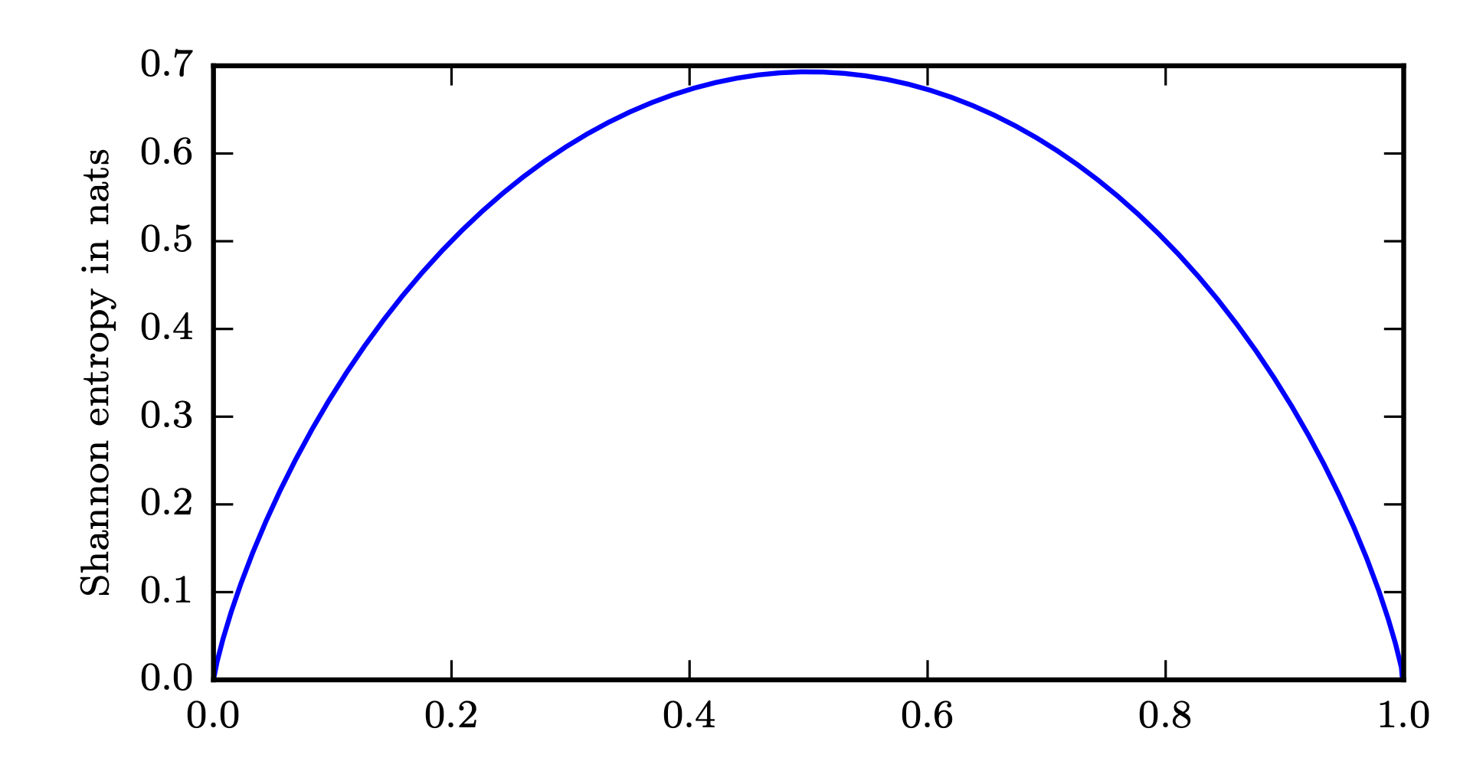
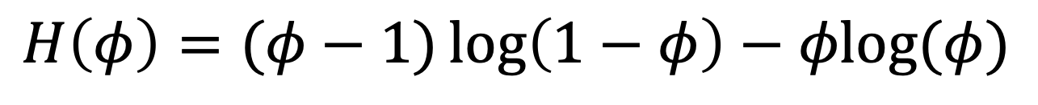
Entropy of a Bernoulli Variable
$$H\left(φ\right)=(φ−1)\log\left(1−φ\right)−φlog⁡(φ)$$
Bernoulli parameter
Figure 3.5

Slide 34
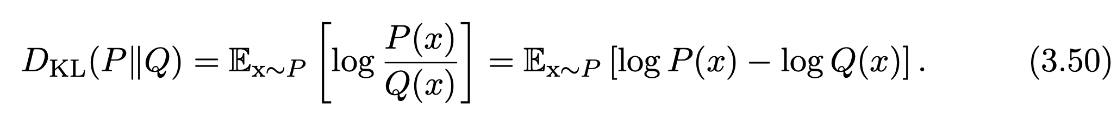
Kullback-Leibler Divergence
KL divergence:
KL-divergence is the extra amount of information needed to send a message containing symbols drawn from P, when we use a code designed to minimize the length of messages containing symbols drawn from Q
KL-divergence is non-negative
KL-divergence = 0 if P and Q are the same distribution

Slide 35

KL-divergence
It can be used as a distance measure between distributions
But it is not a true distance measure since it is not symmetric:
$D_{KL}(P|\left|Q\right)≠D_{KL}(Q|\left|P\right)$

Slide 36
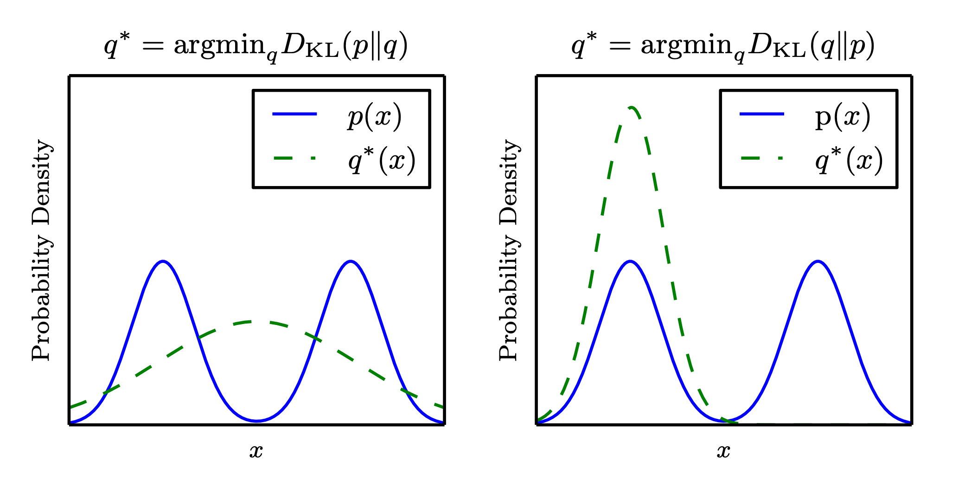
The KL Divergence is Asymmetric
Mixture of two Gaussians for P, One Gaussian for Q
Figure 3.6

Slide 37
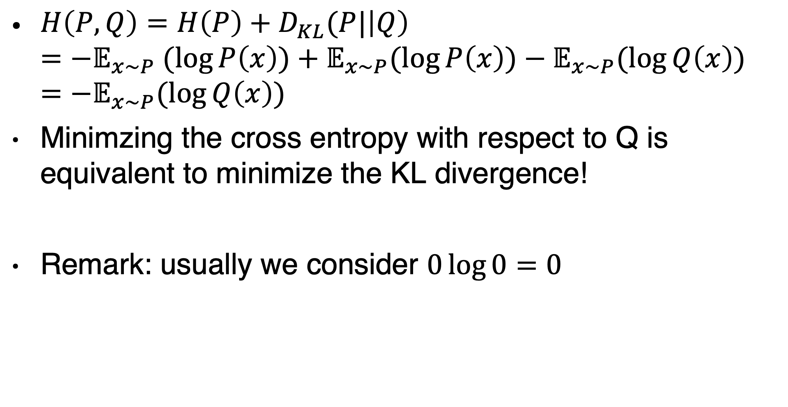
Cross-entropy
$H\left(P,Q\right)=H\left(P\right)+D_{KL}(P|\left|Q\right)$ $=−𝔼_{x\sim P} (\log{P\left(x\right)})+𝔼_{x\sim P}(\log{P\left(x\right))−𝔼_{x\sim P}(\log{Q\left(x\right)) } }$ $=−𝔼_{x\sim P}(\log{Q\left(x\right)) }$
Minimzing the cross entropy with respect to Q is equivalent to minimize the KL divergence!
Remark: usually we consider $0\log{0}=0$

Slide 38
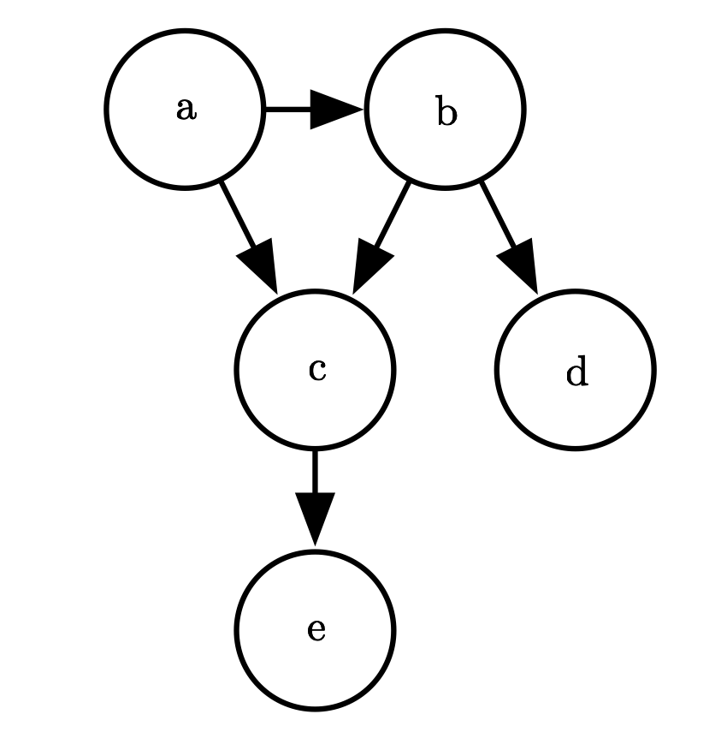
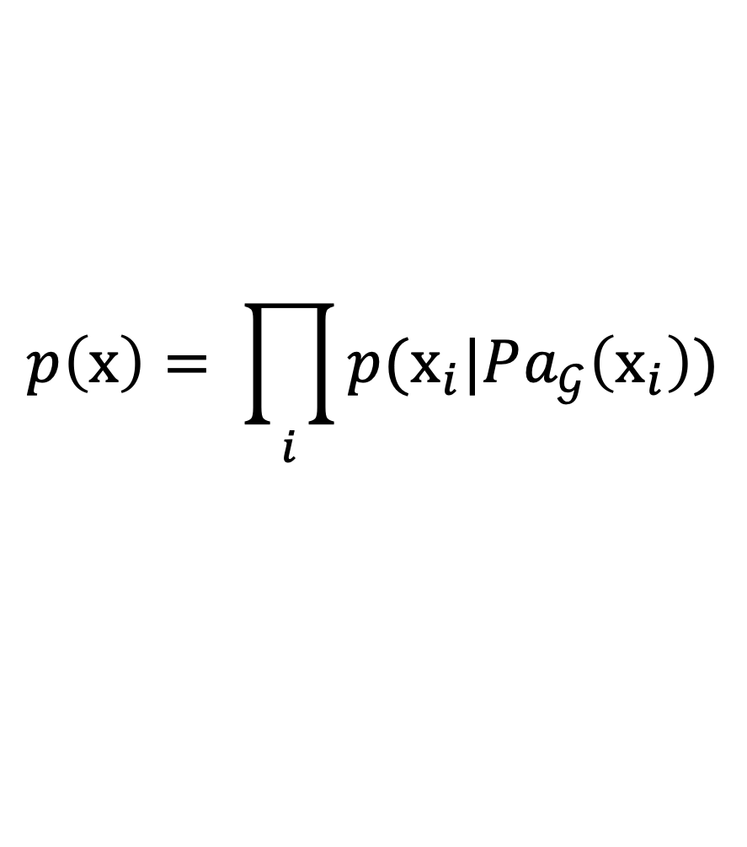
Directed Model
Figure 3.7
$$p\left(\text{x}\right)= \prod_{i}{p({\text{x}}_{i}|Pa_{𝒢}\left({\text{x}}_{i}\right))}$$

