Slide 1
Linear Algebra
Lecture slides for Chapter 2 of Deep Learning
Ian Goodfellow
2016-06-24
Adapted by m.n. for CMPS 392

Slide 2
About this chapter
Not a comprehensive survey of all of linear algebra
Focused on the subset most relevant to deep learning
For a full introductory linear algebra course, I recommend the course and book of Gilbert strang.
https://ocw.mit.edu/faculty/gilbert-strang/

Slide 3

Scalars
A scalar is a single number
Integers, real numbers, rational numbers, etc.
We denote it with italic font:

Slide 4
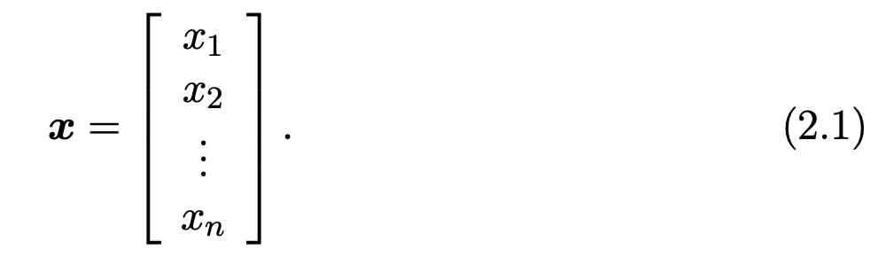
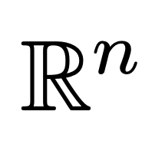
Vectors
A vector is a 1-D array of numbers:
Can be real, binary, integer, etc.
Example notation for type and size:

Slide 5
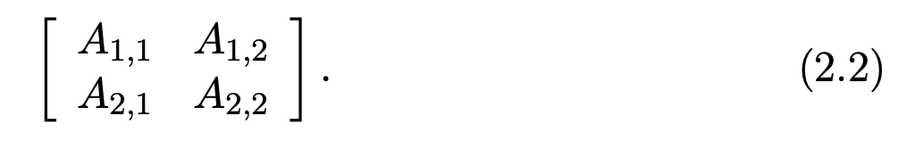
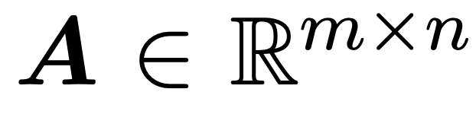
Matrices
A matrix is a 2-D array of numbers:
Example notation for type and shape:
Row
Column

Slide 6
Tensors
A tensor is an array of numbers, that may have
zero dimensions, and be a scalar
one dimension, and be a vector
two dimensions, and be a matrix
or more dimensions.

Slide 7
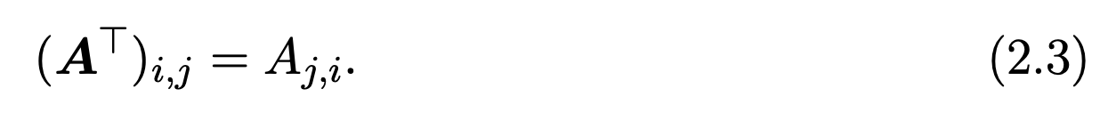
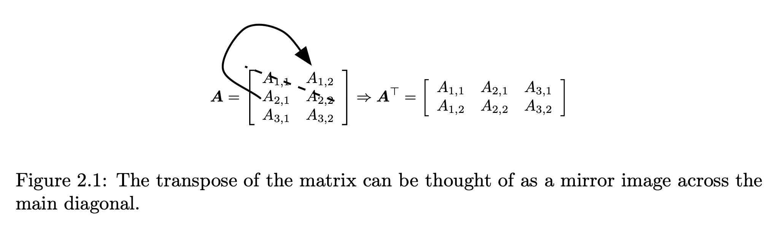
Matrix Transpose

Slide 8
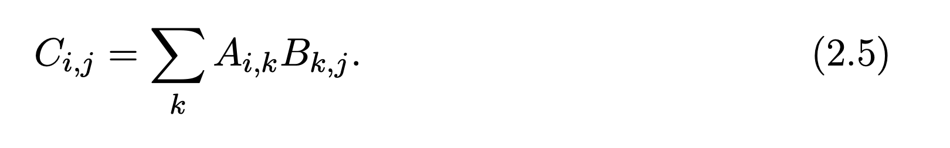

Matrix (Dot) Product
m
=
m
•
n
p
p
n
Must
match

Slide 9
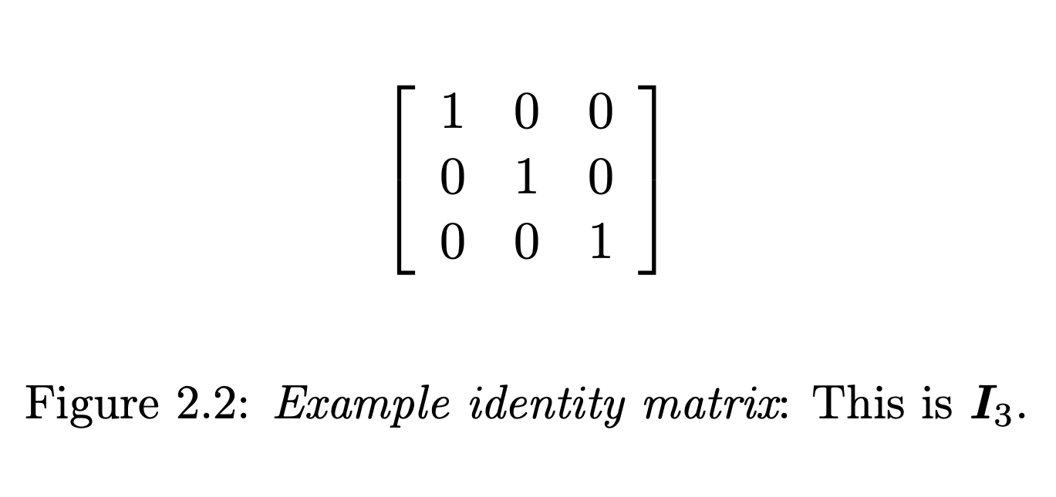
Identity Matrix

Slide 10
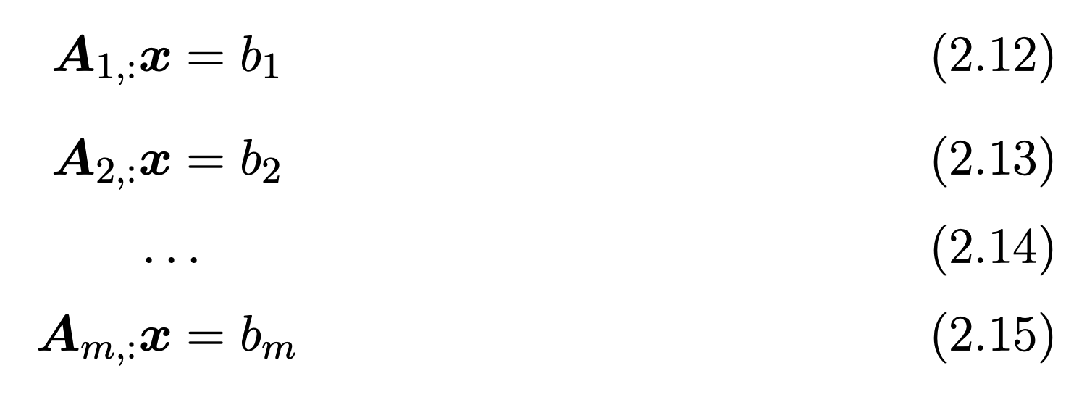
Systems of Equations
expands to

Slide 11
Solving Systems of Equations
A linear system of equations can have:
No solution
Many solutions
Exactly one solution: this means multiplication by the matrix is an invertible function

Slide 12
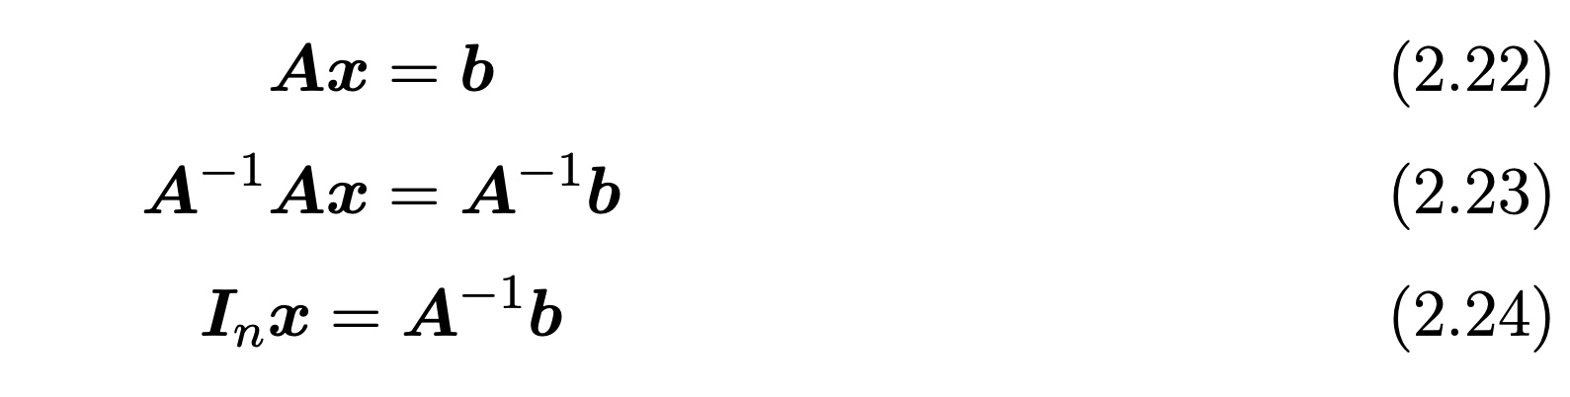
Matrix Inversion
Matrix inverse:
Solving a system using an inverse:
Numerically unstable, but useful for abstract analysis

Slide 13
Invertibility
Matrix can’t be inverted if…
More rows than columns
More columns than rows
Redundant rows/columns (“linearly dependent”, “low rank”)

Slide 14
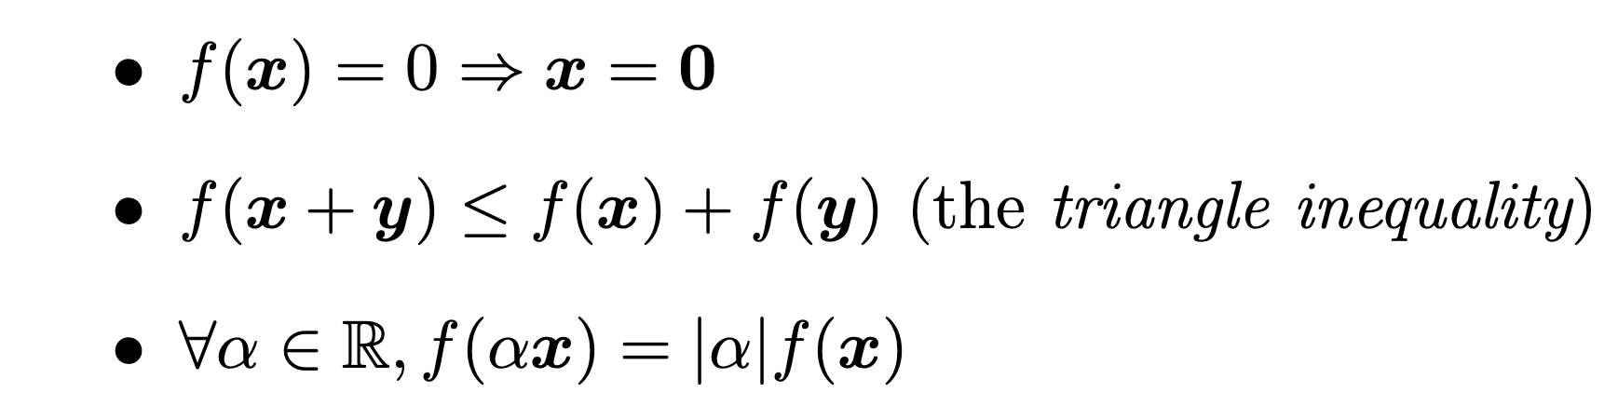
Norms
Functions that measure how “large” a vector is
Similar to a distance between zero and the point represented by the vector

Slide 15
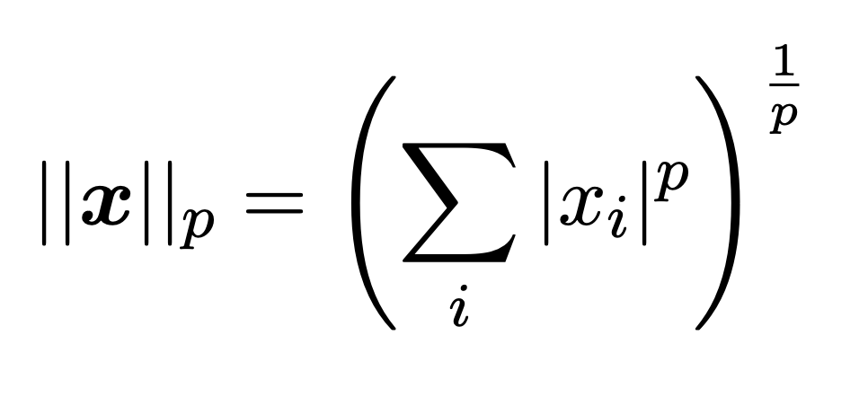
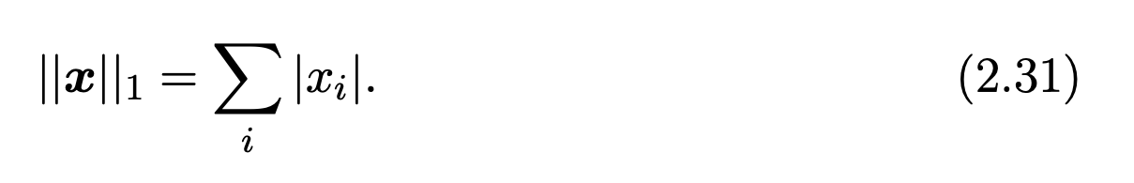
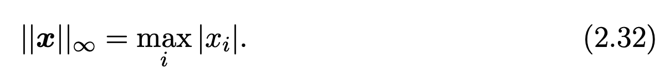
Norms
L^{p} norm
Most popular norm: L2 norm, p=2
L1 norm, p=1:
Max norm, infinite p:

Slide 16
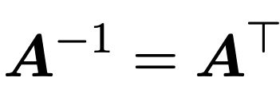
Special Matrices and Vectors
Unit vector:
Symmetric Matrix:
Orthogonal matrix:

Slide 17
Eigendecomposition
Eigenvector and eigenvalue:
Eigendecomposition of a diagonalizable matrix:
Every real symmetric matrix has a real, orthogonal eigendecomposition:

Slide 18
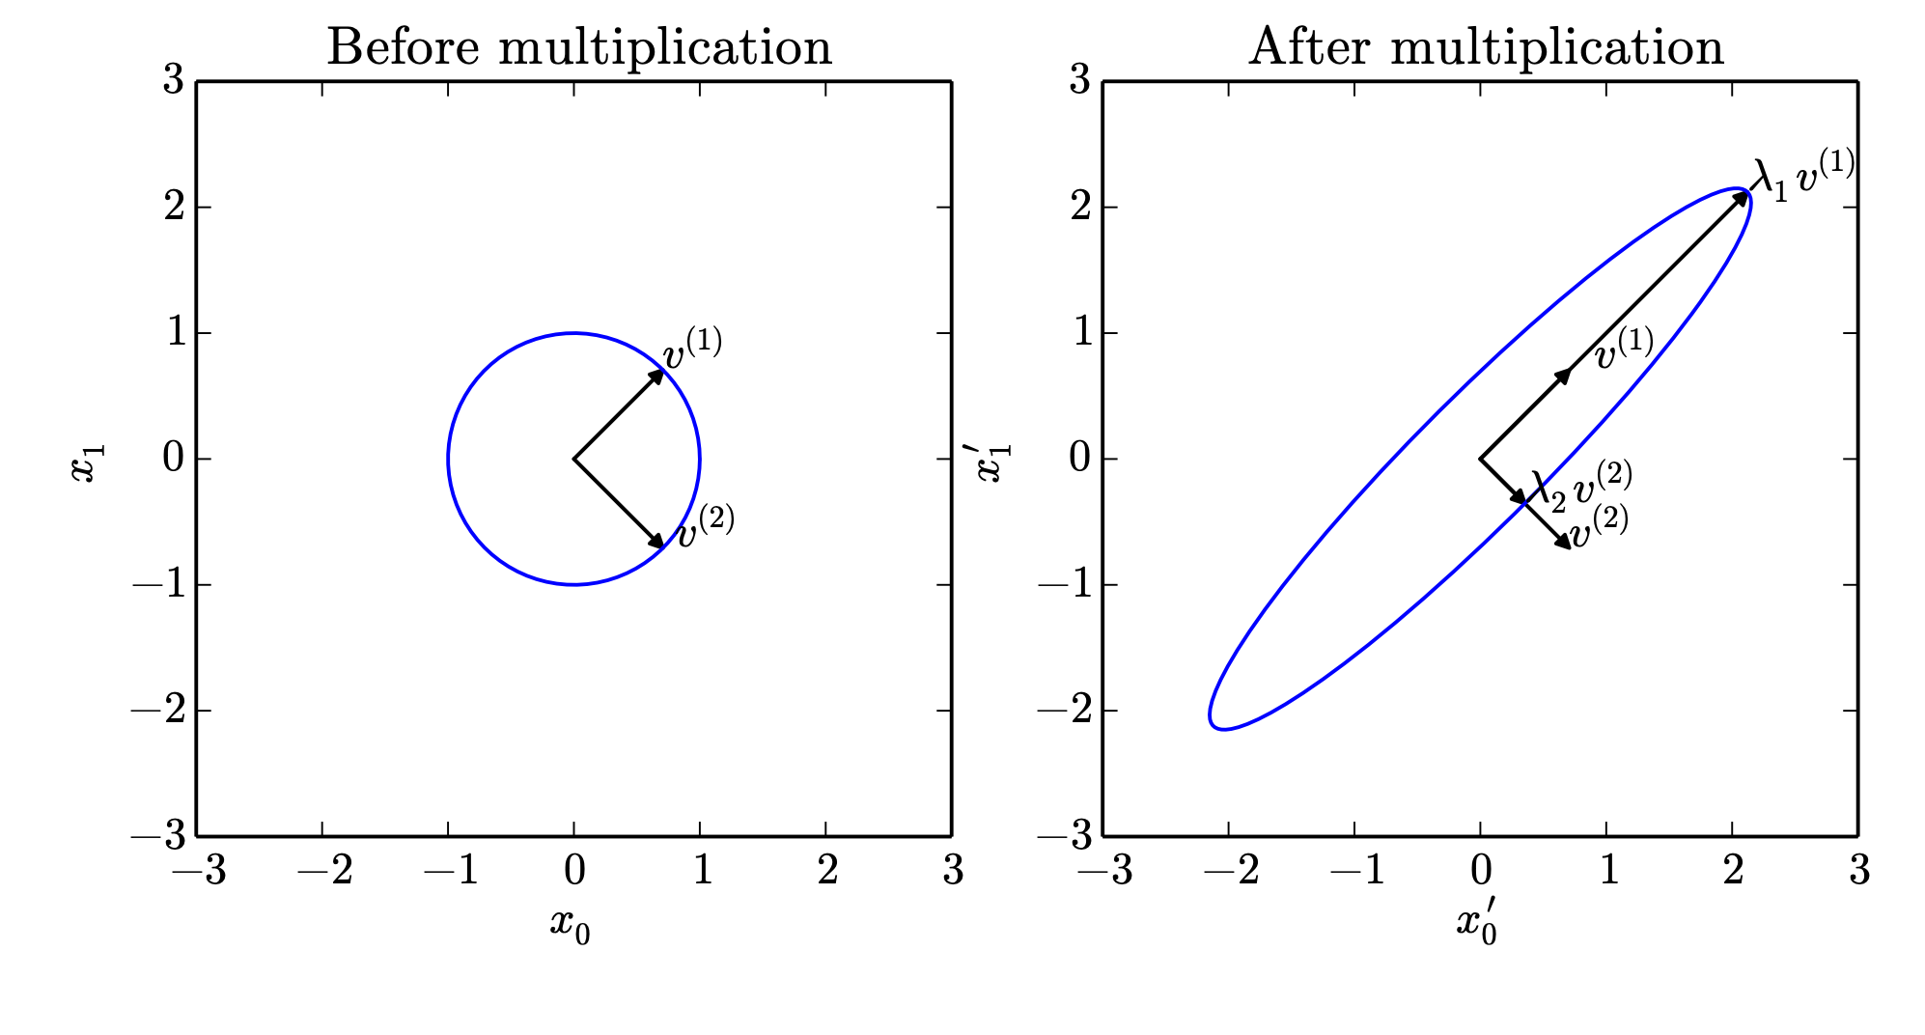
Effect of Eigenvalues

Slide 19
Singular Value Decomposition
Similar to eigendecomposition
More general; matrix need not be square

Slide 20
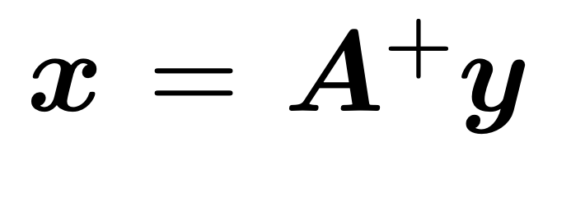
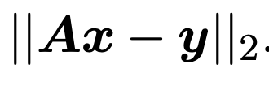
Moore-Penrose Pseudoinverse
If the equation has:
Exactly one solution: this is the same as the inverse.
No solution: this gives us the solution with the smallest error
Many solutions: this gives us the solution with the smallest norm of x.

Slide 21
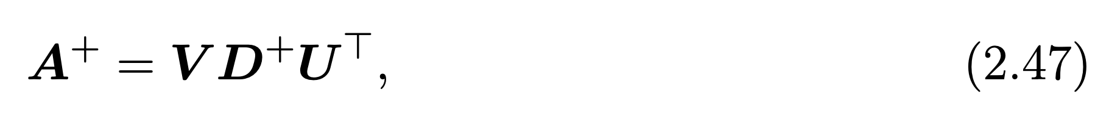
Computing the Pseudoinverse
The SVD allows the computation of the pseudoinverse:
Take reciprocal of non-zero entries

Slide 22
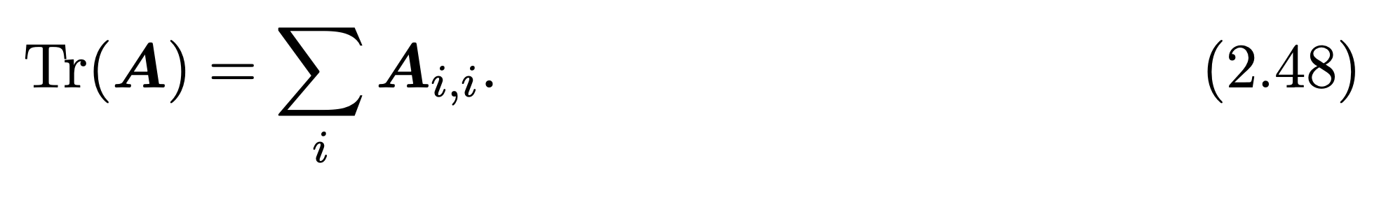
Trace

Slide 23
Learning linear algebra
Do a lot of practice problems
Start out with lots of summation signs and indexing into individual entries
Eventually you will be able to mostly use matrix and vector product notation quickly and easily

