Slide 1





Report Design Mul/Div 32 bits unsigned

Slide 2



1.
Mul 32 bits
Let’s start with the first set of slides

Slide 3
Control Words
Pseudocode:
1. D_A := A
D_B := B
2. Tmp := 0
While (count != 32) repeat
3. If (A[0])
Tmp := Tmp + B
4. A << 1
B >> 1
Endwhile
5. Outport := Out
Step | IE | SA[1..0] | SB[1..0] | ST[0] | EN | OE
1 | 1 | Load A | Load B | Load Tmp | 0 | 0
2 | 0 | No Change | No change | No change | 1 | 0
3 | 0 | No Change | No change | Load Tmp | 0 | 0
4 | 0 | Shift right | Shift left | No change | 0 | 0
5 | X | No Change | No change | No change | 0 | 1
Repeated
While
Count != 32

Slide 4
Analysis
Các thành phần cần trong Datapath:
2 Thanh ghi dịch của A, B
1 Thanh ghi Tmp
1 bộ cộng 64 bit
1 bộ đếm
1 Thanh ghi Output

Slide 5
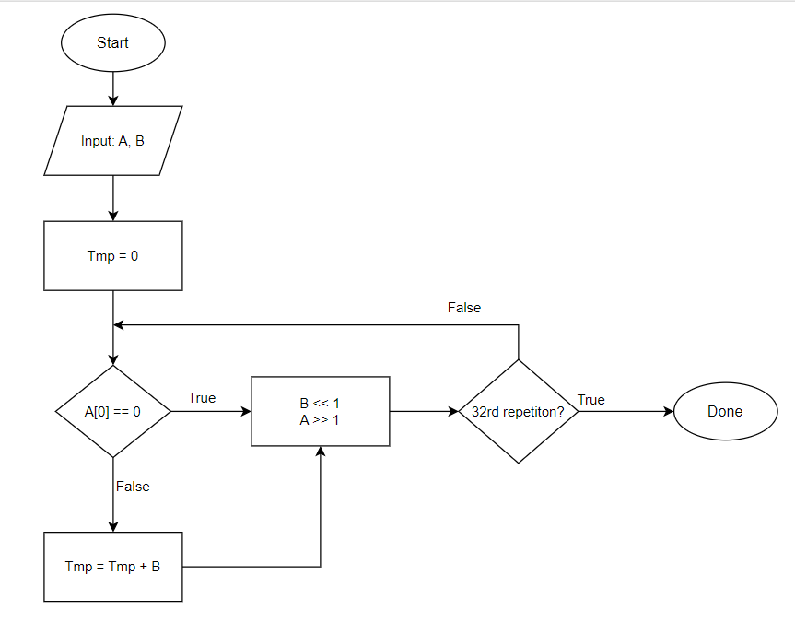
FlowChart

Slide 6
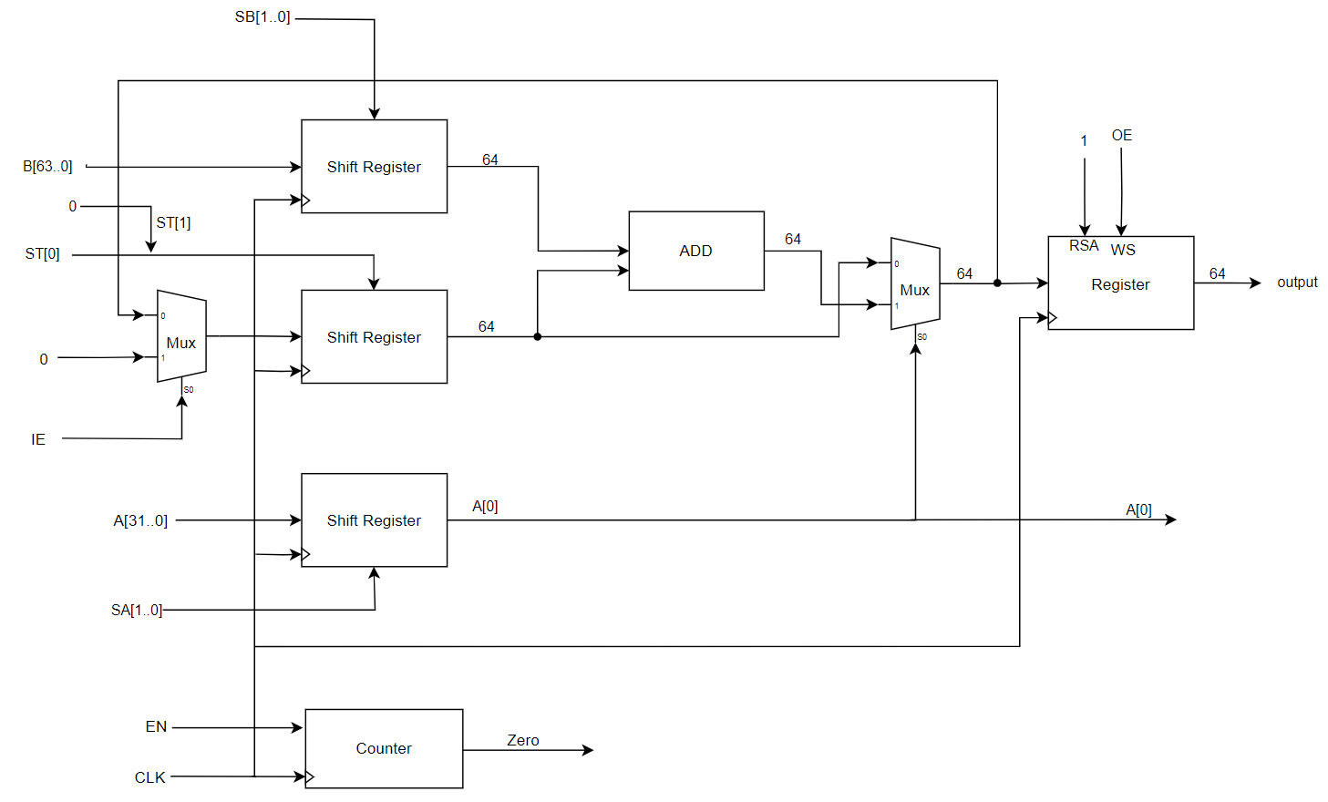
Datapath
S[1..0] | Ope
00 | No change
01 | Load Value
10 | Shift left 1
11 | Shift right 1
RS | WS | O
0 | X | Z
1 | 0 | Q
1 | 1 | I

Slide 7
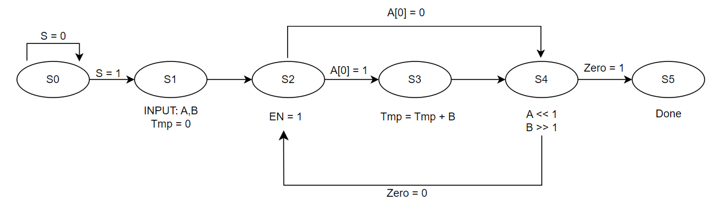
FSM

Slide 8
Next State
 | Q2Q1Q0 | S,A,Z
 |  | 000 | 001 | 010 | 011 | 100 | 101 | 110 | 111
s0 | 000 | 000 | 000 | 000 | 000 | 001 | 001 | 001 | 001
s1 | 001 | 010 | 010 | 010 | 010 | 010 | 010 | 010 | 010
s2 | 010 | 100 | 100 | 011 | 011 | 100 | 100 | 011 | 011
s3 | 011 | 100 | 100 | 100 | 100 | 100 | 100 | 100 | 100
s4 | 100 | 010 | 101 | 010 | 101 | 010 | 101 | 010 | 101
s5 | 101 | 000 | 000 | 000 | 000 | 000 | 000 | 000 | 000
D2 = A'Q2'Q1 + Q2'Q1Q0 + ZQ2Q1'Q0’
D1 = Q2'Q1'Q0 + Z'Q2Q1'Q0' + AQ2'Q1Q0’
D0 = ZQ2Q1'Q0' + AQ2'Q1Q0' + SQ2'Q1'Q0'

Slide 9
Output logic
 | Q2Q1Q0 | Step | IE | SA[1..0] | SB[1..0] | ST[0] | EN | OE
s0 | 000 | 0 | X | 00 | 00 | 0 | 0 | 0
s1 | 001 | 1 | 1 | 01 | 01 | 1 | 0 | 0
s2 | 010 | 2 | 0 | 00 | 00 | 0 | 1 | 0
s3 | 011 | 3 | 0 | 00 | 00 | 1 | 0 | 0
s4 | 100 | 4 | 0 | 11 | 10 | 0 | 0 | 0
s5 | 101 | 5 | X | 00 | 00 | 0 | 0 | 1
IE = Q2'Q1'
SA[1] = Q2Q1'Q0'
SA[0] = Q2'Q1'Q0 + Q2Q1'Q0'
SB[1] = Q2Q1'Q0'
SB[0] = Q2'Q1'Q0
ST[0] = Q2'Q0
EN = Q2'Q1Q0'
OE = Done = Q2Q1'Q0

Slide 10
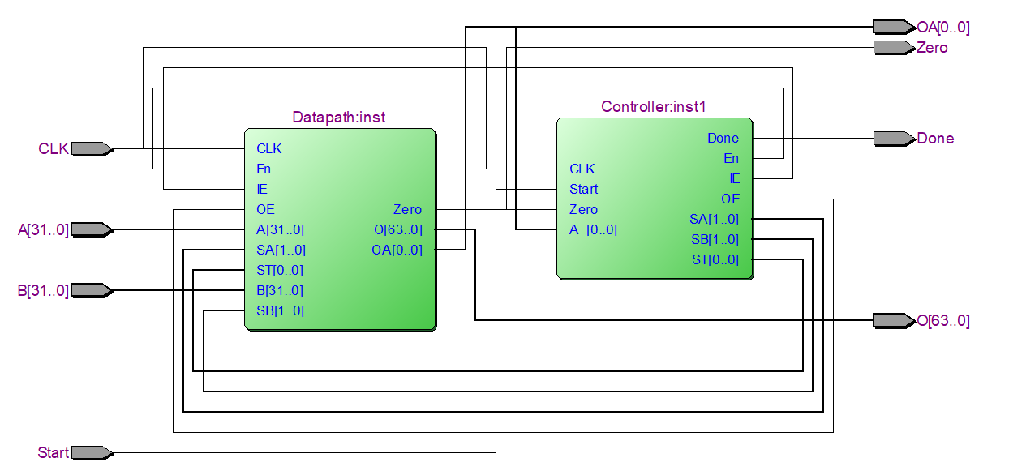
Schematic

Slide 11
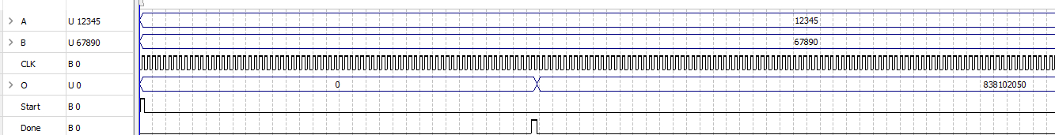
Simulation
Example:
A = 12,345
B = 67,890
M = 838,102,050

Slide 12
2.
Div 32 bits
Let’s start with the first set of slides

Slide 13
Control Words
Pseudocode:
1. D_A := A
D_B := B
Q := 0
While (count != 33) repeat
2. A := A – B
3. Q << 1 (với Q[0] là A[63]')
If (A[63] == 1)
4. A := A + B
5. B >> 1
Endwhile
6. Outport := Out
Step | IE | SA[1..0] | SB[1..0] | SQ[0] | SO | CE | OE
1 | 1 | Input A | Input B | Q = 0 | X | 0 | 0
2 | 0 | Write Enable | No change | No change | 1 | 1 | 0
3 | 0 | No Change | No change | Shift left | 0 | 0 | 0
4 | 0 | Write Ena | No change | No change | 0 | 0 | 0
5 | 0 | No Change | Shift right | No change | X | 0 | 1
6 | 0 | No change | No change | No change | X | 0 | 1
Repeated
While
Count != 33

Slide 14
Analysis
Các thành phần cần trong Datapath:
2 Thanh ghi dịch của A (số bị chia / số dư), B(số chia)
1 Thanh ghi Q
1 bộ cộng, 1 bộ trừ 64 bits
1 bộ đếm
2 Mux dùng OE xuất Qu, R

Slide 15
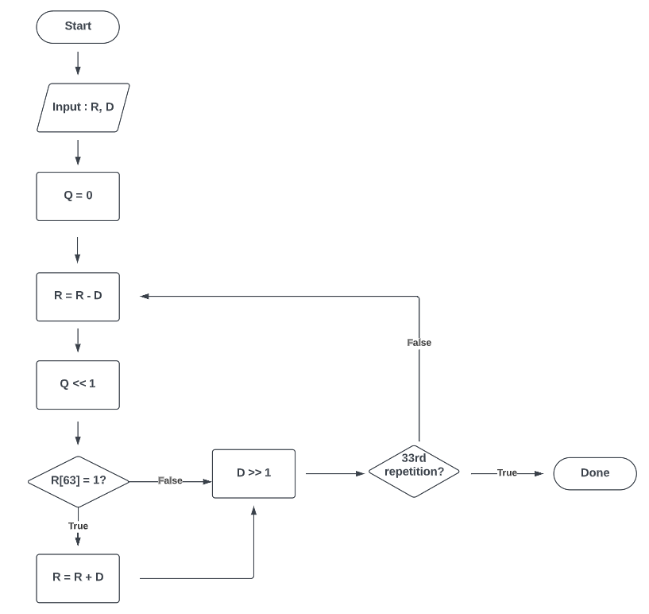
FlowChart

Slide 16
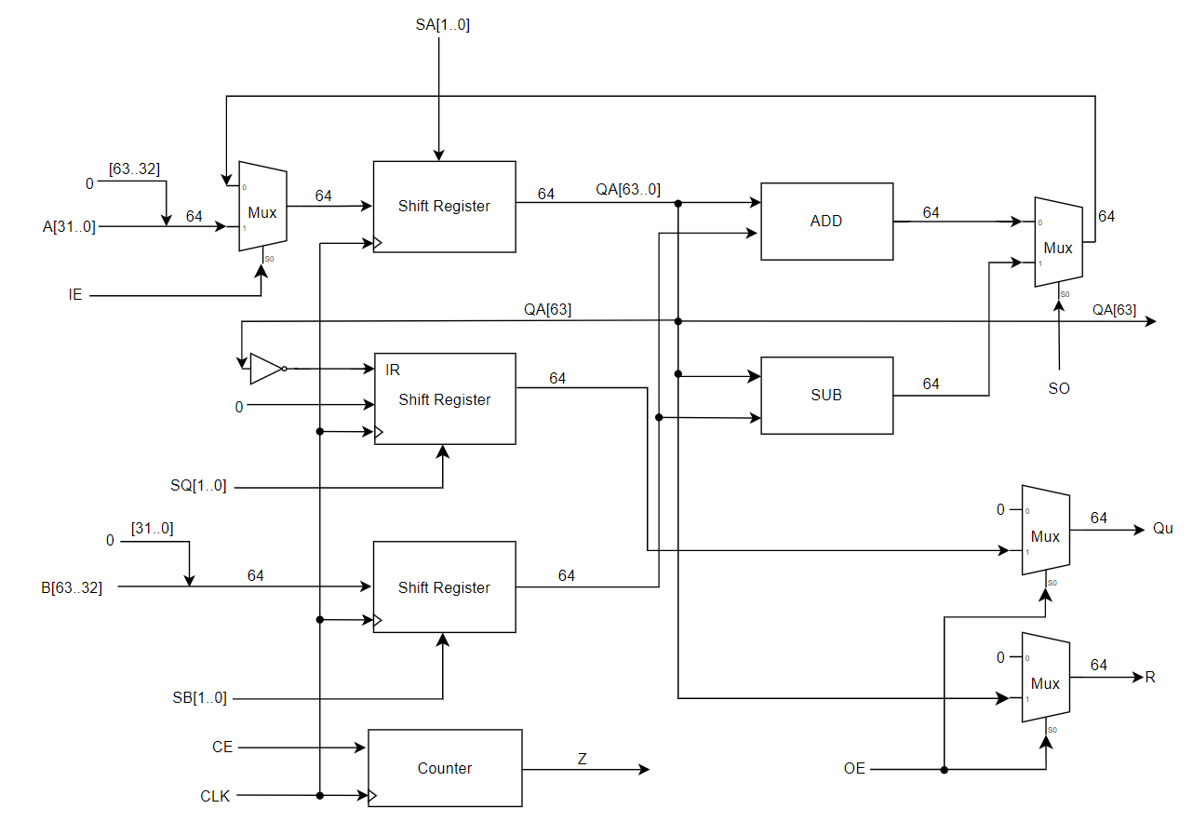
Datapath
S[1..0] | Ope
00 | No change
01 | Load Value
10 | Shift left 1
11 | Shift right 1

Slide 17
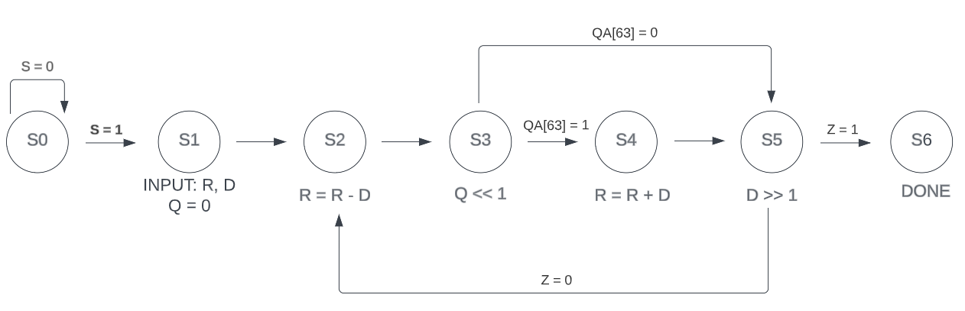
FSM

Slide 18
Next State
TTHT | TTKT/NGÕ VÀO FF Q2Q1Q0
 | SCZ
 | 000 | 001 | 010 | 011 | 100 | 101 | 110 | 111
000 | 000 | 000 | 000 | 000 | 001 | 001 | 001 | 001 | S0
001 | 010 | 010 | 010 | 010 | 010 | 010 | 010 | 010 | S1
010 | 011 | 011 | 011 | 011 | 011 | 011 | 011 | 011 | S2
011 | 101 | 101 | 100 | 100 | 101 | 101 | 100 | 100 | S3
100 | 101 | 101 | 101 | 101 | 101 | 101 | 101 | 101 | S4
101 | 010 | 110 | 010 | 110 | 010 | 110 | 010 | 110 | S5
110 | 000 | 000 | 000 | 000 | 000 | 000 | 000 | 000 | S6
111 | 000 | 000 | 000 | 000 | 000 | 000 | 000 | 000 | S7
D2 = Q2'Q1Q0 + Q2Q1'Q0' + Q2Q1’Z
D1 = Q1'Q0 + Q2'Q1Q0’
D0 = Q2'Q0'S + Q2'Q1Q0' + Q2'Q1C' + Q2Q1'Q0'

Slide 19
Output logic
TTHT | IE | SA | SB | SQ | SO | OE | CE | Trạng thái
000 | 0 | 00 | 00 | 00 | X | 0 | 0 | S0
001 | 1 | 01 | 01 | 01 | X | 0 | 0 | S1
010 | 0 | 01 | 00 | 00 | 1 | 0 | 1 | S2
011 | 0 | 00 | 00 | 10 | X | 0 | 0 | S3
100 | 0 | 01 | 00 | 00 | 0 | 0 | 0 | S4
101 | 0 | 00 | 11 | 00 | X | 0 | 0 | S5
110 | 0 | 00 | 00 | 00 | X | 1 | 0 | S6
111 | 0 | 00 | 00 | 00 | X | 0 | 0 | S7
SQ[1] = Q2'Q1Q0
SQ[0] = Q2'Q1'Q0
SO = Q2'
OE = Done = Q2Q1Q0'
CE = Q2'Q1Q0'
IE = Q2'Q1'Q0
SA[1] = 0
SA[0] = Q2'Q1'Q0 + Q2'Q1Q0' + Q2Q1'Q0'
SB[1] = Q1Q1'Q0
SB[0] = Q1'Q0

Slide 20
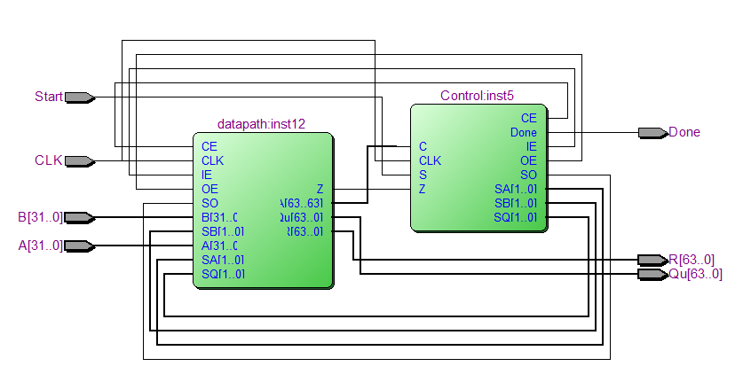
Schematic

Slide 21
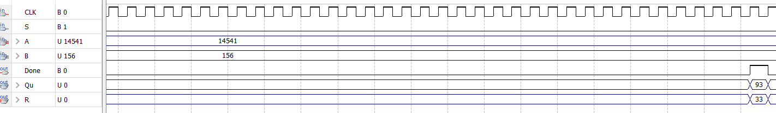
Simulation
Example:
A = 14,541
B = 156
Q = 93, R = 33

Slide 22
THE END THANKS FOR LISTENING AND WATCHING OUR REPORT

