Slide 1
Framework Design
Team 28
Ru Zhao, Zekun Lyu, Xinyue Wu

Slide 2
Outline
Design Decision
API
Framework
Data Plugin
Analysis Plugin
Interaction

Slide 3
Design Decision
The framework process and analyze data for specific input user.
The framework has a set of data structures to differentiate and hold data mainly on post, location and time.
The framework can pre-process data, which makes them interesting.

Slide 4
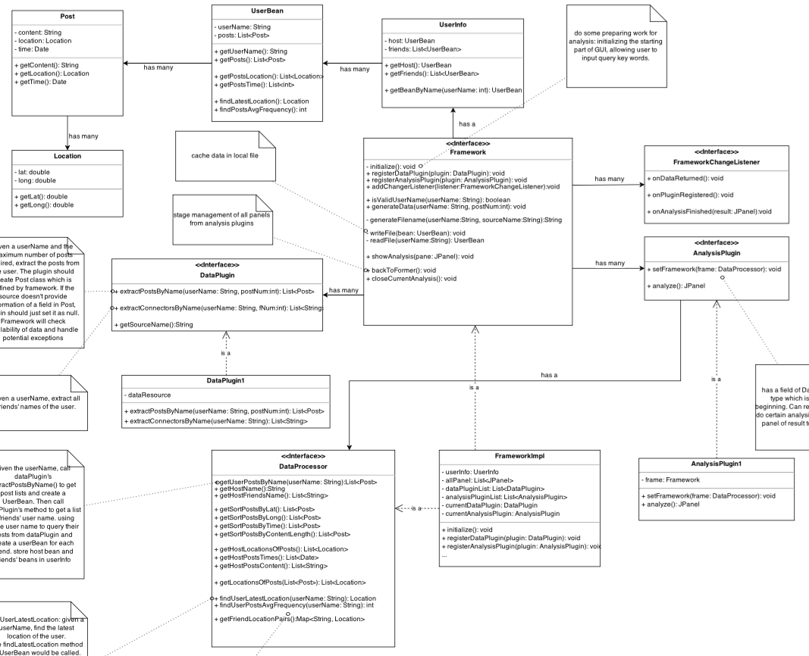

Slide 5
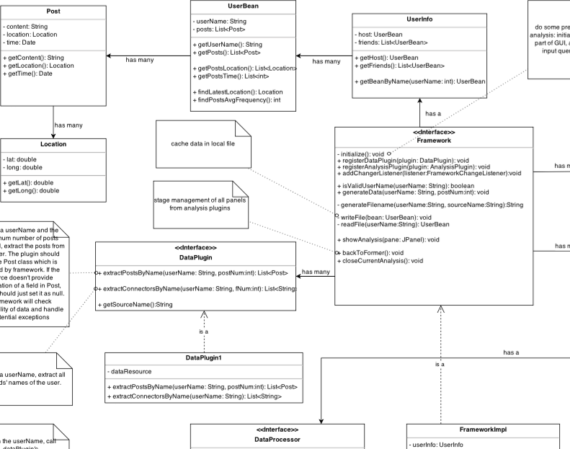
API - Framework
Tasks
Extension Points
Data structure:
UserInfo, UserBean
Post, Location

Slide 6
API - Data Plugin
Extract posts
by username
Extract
connectors
by username

Slide 7
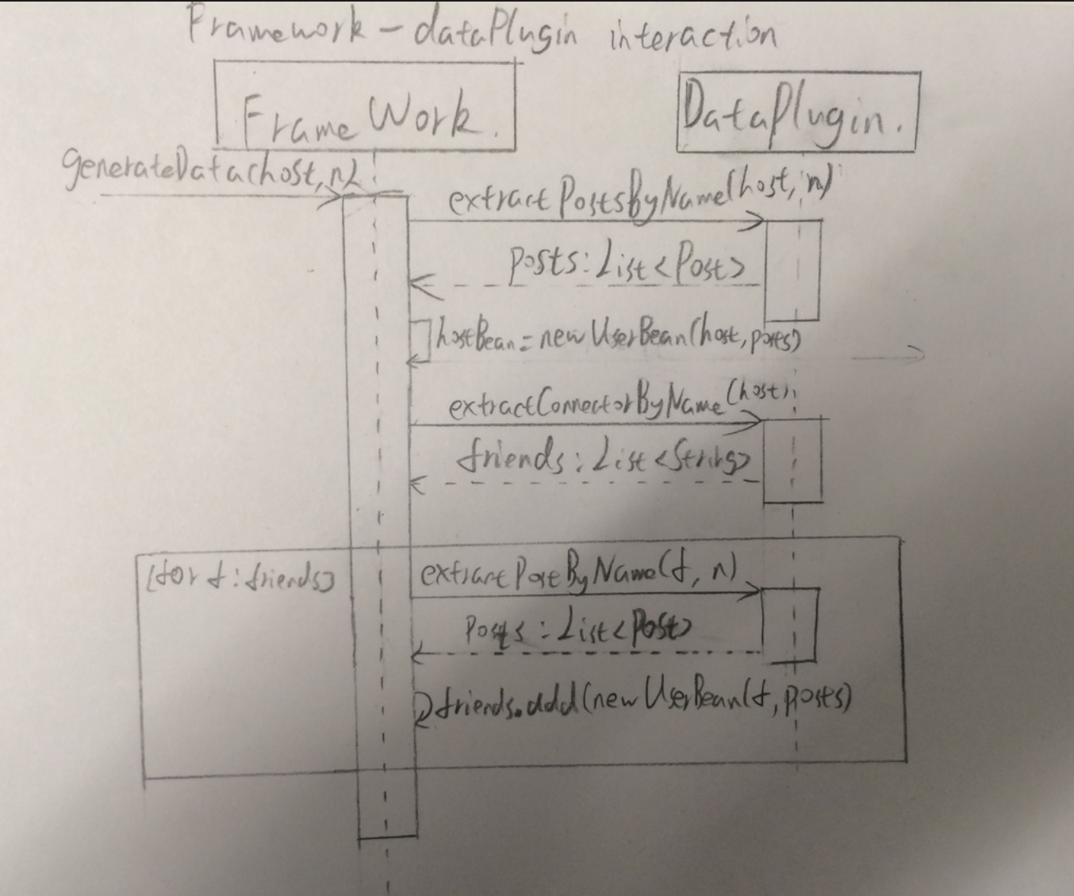
Interaction

Slide 8
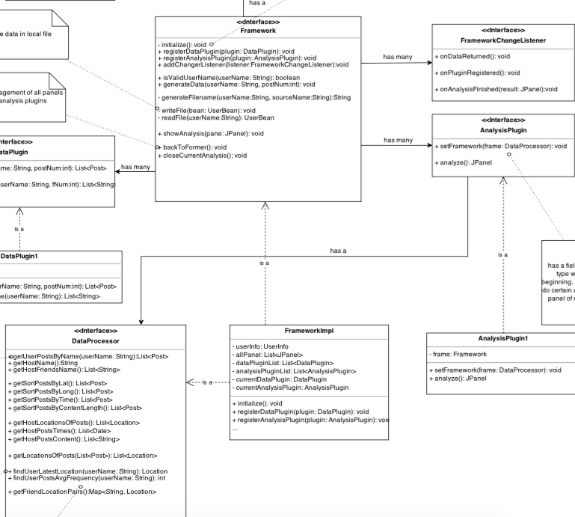
API - Analysis Plugin
Set framework
analyze
DataProcessor

Slide 9
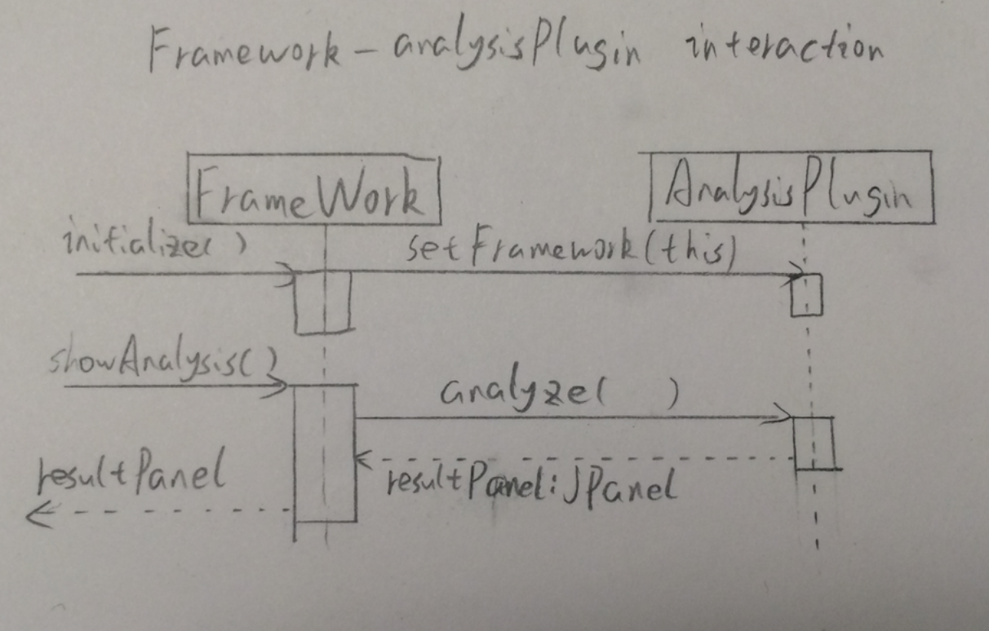
Interaction

