Slide 1
Cuisine Sharing System
Cuisine Group
2017/11/20

Slide 2





Description of System
1
technology
Based on Internet
2
Spring MVC
1
Billions Capita inefficiency
Sharing
Economy
2
Helping each other
Cuisine
sharing
3
Group by interesting
1
Open
community
Exchange cooking tech
2
Sharing food between different style.
3
Comment & grade food

Slide 3
Cuisine Sharing System
Based on the Internet and sharing economy
User Registration and Management.
Sharing online or face-To-face.
Strictly authentication & authorization
Food Visible & comment freely.
Optimal interface to user.

Slide 4
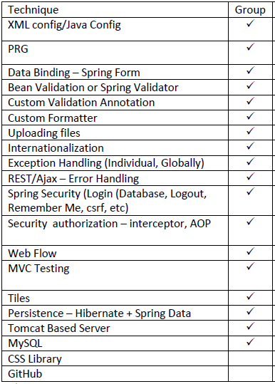
Technology and Framework
Tools & API
STS, Junit, Annotation, Exception etc.
Tools
Spring MVC
Controller, JSP, Restful & MVC
Interceptor and security
Coding
Database
Database
Display
MySQL database
JSP/html
HTML, CSS, js, JQUERY & Bootstrap
View
Controller
Service
Repository
DB

Slide 5
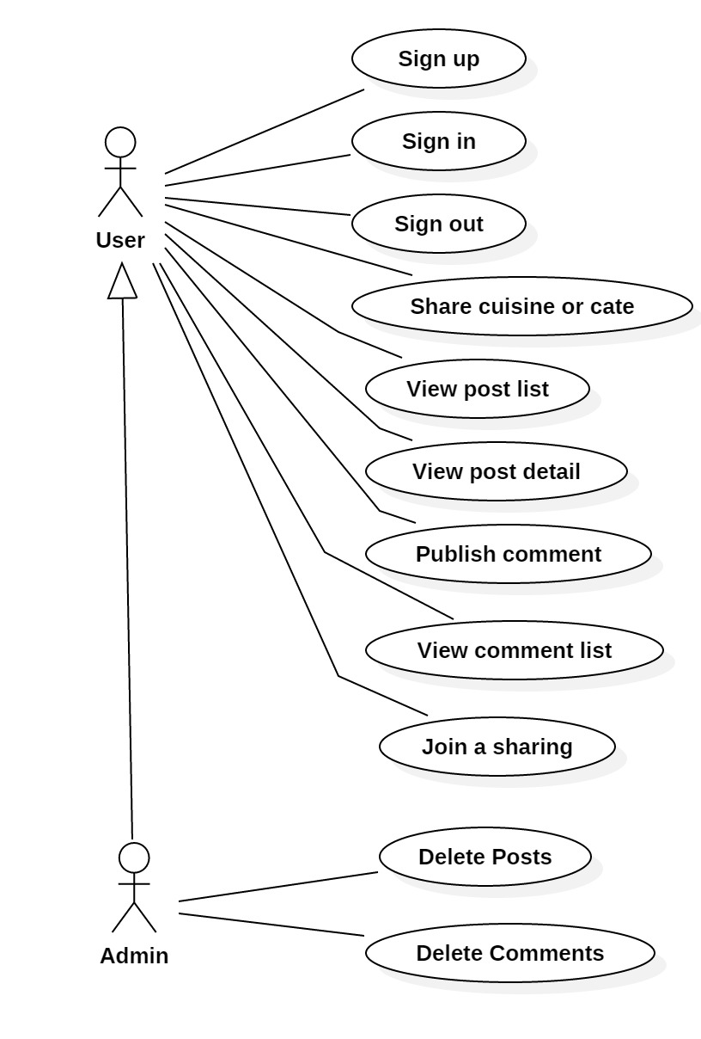
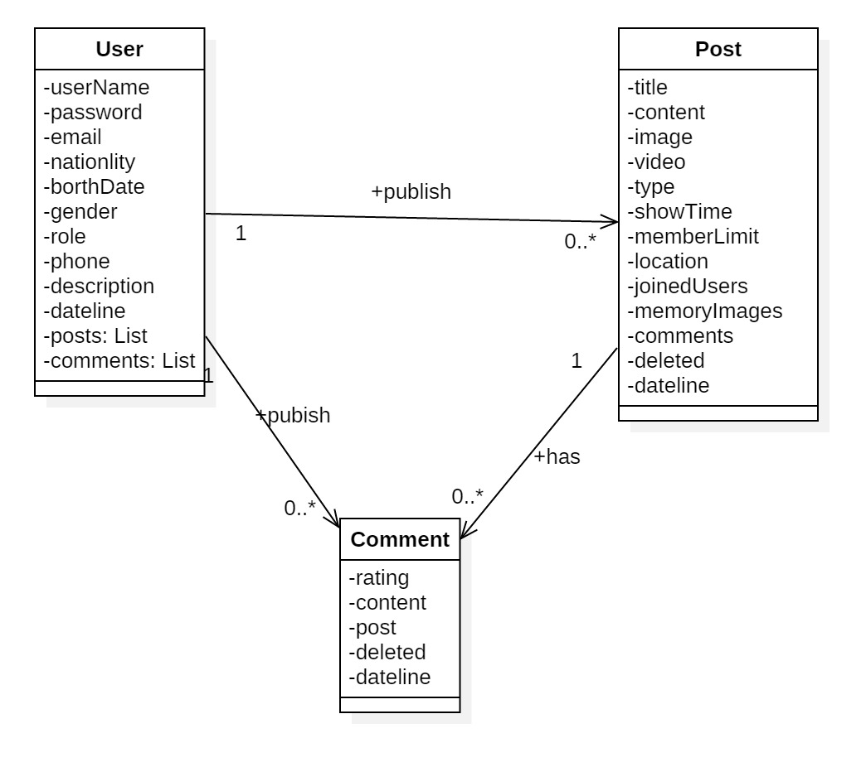
Class diagram

Slide 6
Flow of Application
Whole process
All based on Web
Register
Welcome
Sharing
commenting
Repository
Sign up
Login
post
comment
database
Account
Personal picture
information
Authentication
Authorization
Face to face
Online sharing
Location
schedule
Rating
Commenting
History

Slide 7
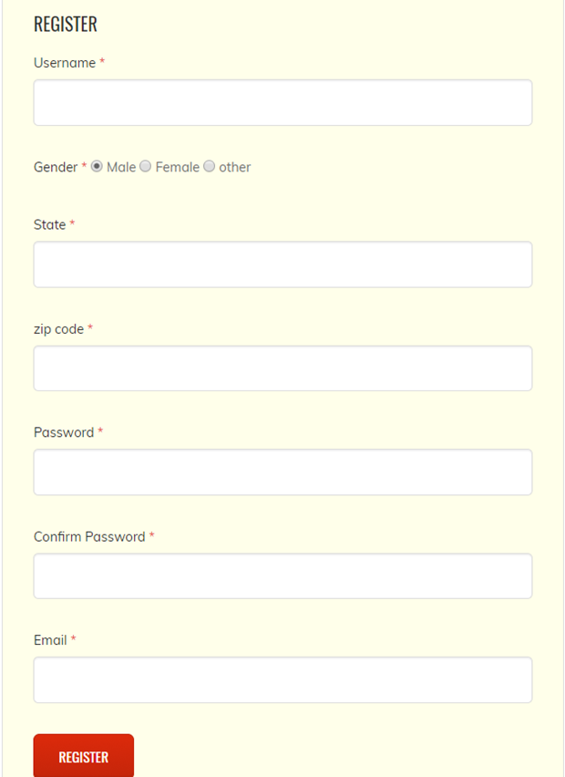


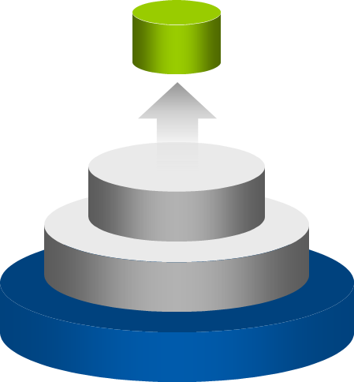

Registration & Personal information
Menu
Register

Slide 8
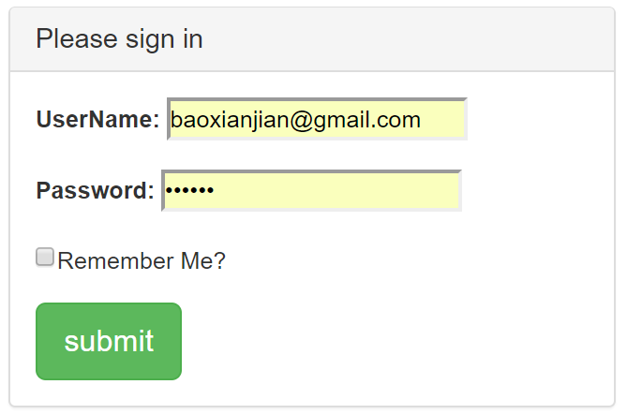
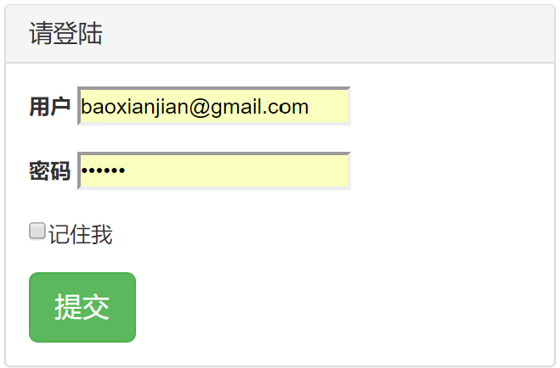
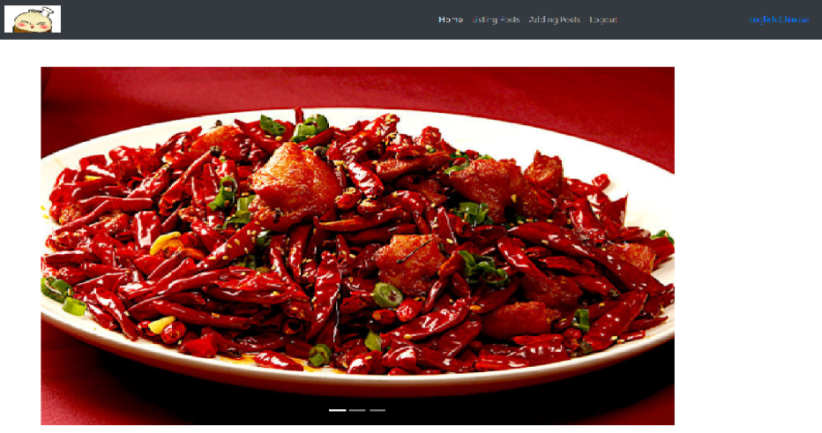
Login System & Internationalization
Login
After login

Slide 9
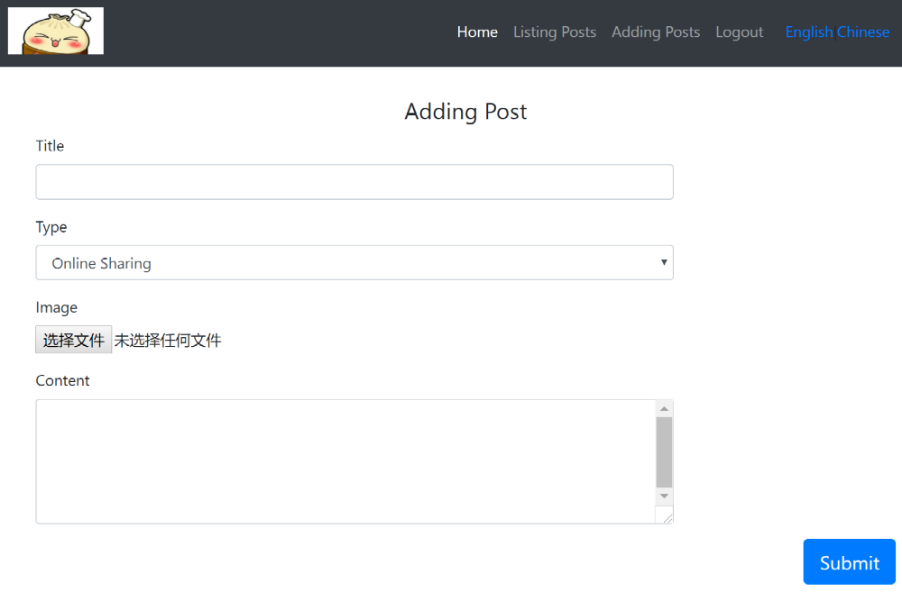




Post Sharing Cuisine
3

Slide 10
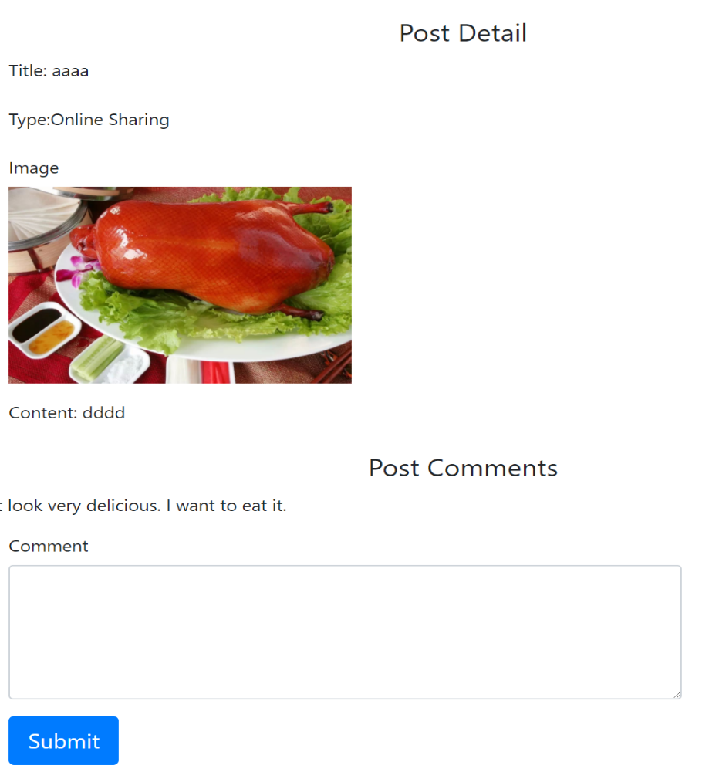


Comment & Rating

Slide 11
Members’ tasks
Each was responsible to do one of Three parts of system.
Member | task
Fangxiao Jiang | Authentication & Authorization, Login & Roles manage
Xianjian Bao | Posting Cuisine and schedule activities.
Shike Miao | Comment the Food freely.

Slide 12


Q&A

