Slide 1
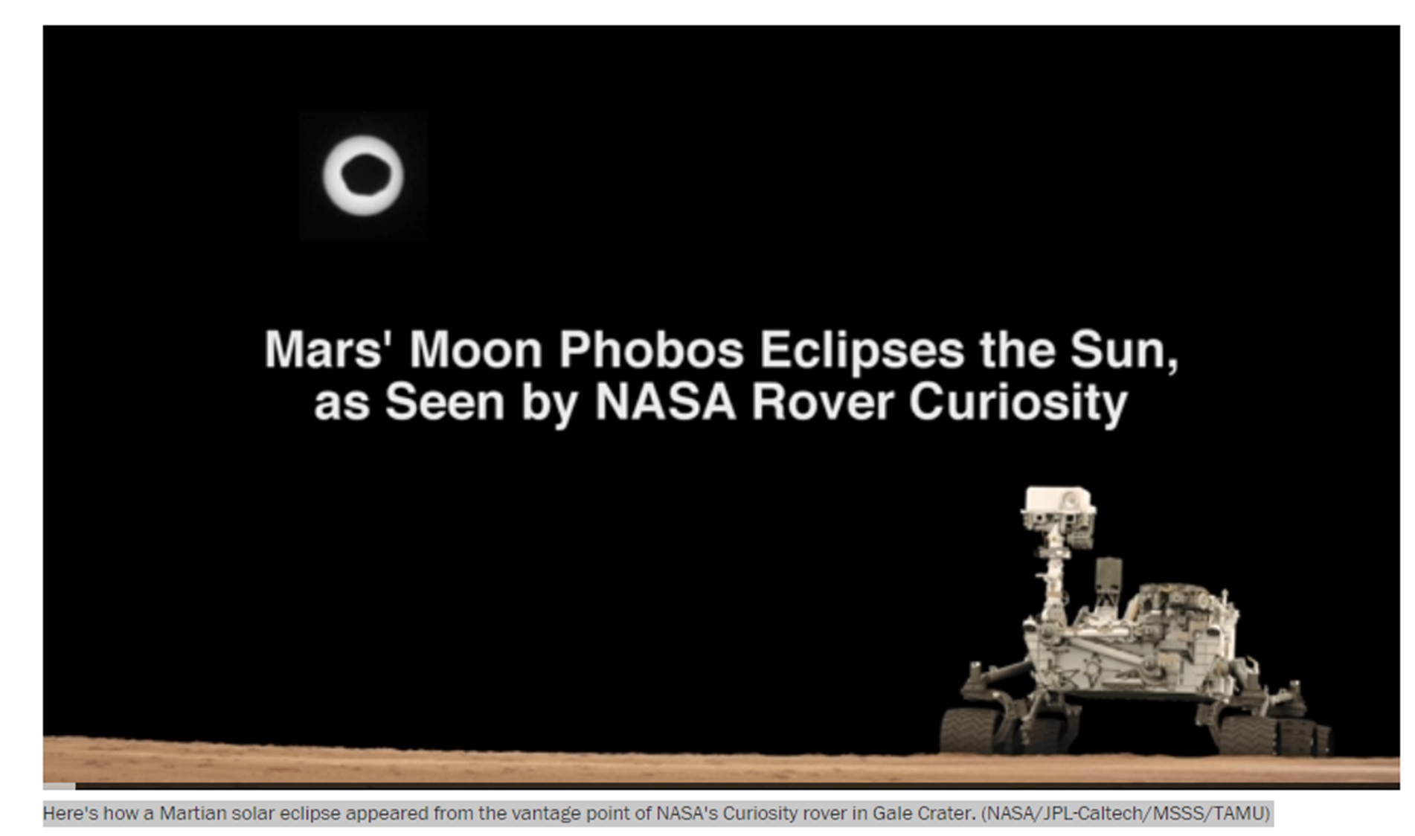
GROUP 4
Quick Observations on Solar ECLIPSES IN MARS
Using Data from The Mars Express Spacecraft orbiting around Mars
And applying Python, Pandas and Matplotlib for analysis and visualization
Mahathi Veluri
Baoxing Wang
Luis Santana

Slide 2
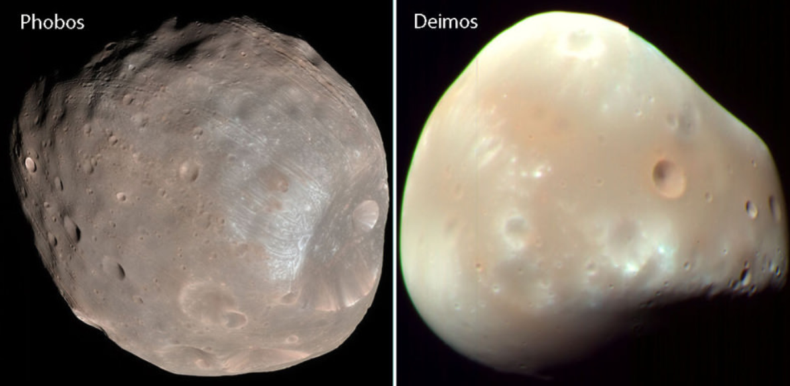
Background
Solar eclipses: obscuration of the light of the sun by the intervention of the moon between it and a point on Earth (in our case Mars)
Earth most years have 2 solar eclipses
Mars has two moons: Phobos and Deimos
However just one moon, Phobos, can produce eclipses:
Phobos has 25 Km diameter, less than 1 % of the diameter of our moon
However, it is just 6K miles away from Mars. Our moon is 240K miles away from Earth
It moves fast! It cross the Martian sky twice a day! Our moon? 27 days to orbit earth
Speed of our moon: 1 km/seg.
Speed of Phobos: 2,138 km/seg.
Notes:
*: counting partial solar eclipses (when the moon doesn't fully obscure the sun) and lunar eclipses (when the earth's shadow partially obscures the moon).
“Our” Moon is 238K away from earth

Slide 3
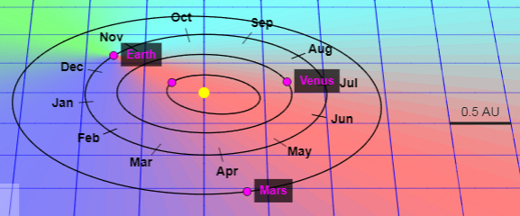
Our Burning Questions
1.- What is the number of observed eclipses in Mars per year?
2.- What is the average and P50 duration of these Eclipses per year?
3.- What is the shortest and the longest Eclipse by year?
4.- Are the numbers of eclipses a function of Mars changing distance to sun?

Slide 4
Data Inputs
Data taken from The Mars Express spacecraft orbiting around Mars and operated by the European Space Agency (ESA)
Measured data for the following four Martian years:
Year 1: 2008-08-22 to 2010-07-10
Year 2: 2010-07-10 to 2012-05-27
Year 3: 2012-05-27 to 2014-04-14
Year 4: 2014-04-14 to 2016-03-01
A Martian year is defined by 687 earth days.
File A: Events
ut_ms: unix timestamp in milliseconds. Over 300,000 events reported
description: short description of the event
File B: Data
ut_ms: unix timestamp in milliseconds, this data provides one sample per day
sunmars_km: the distance in kilometers between the Sun and Mars
earthmars_km: the distance in kilometers between the Earth and Mars
sunmarsearthangle_deg: Sun-Mars-Earth angle in degrees
Notes:
Note that space communication issues may have introduced gaps in the given data.

Slide 5
Results and Observations

Slide 6
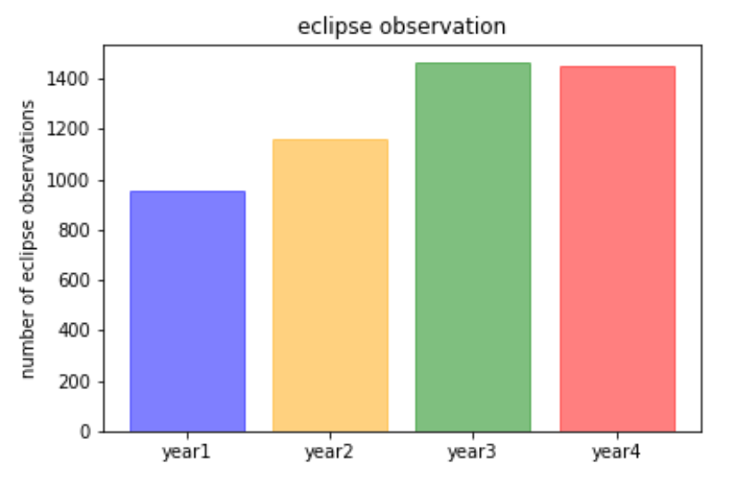
Q1.- What is the number of observed eclipses in Mars per year?
Year | Eclipse Count
1 | 952
2 | 1161
3 | 1465
4 | 1447
AVG | 1256
Base on the available data the average number of eclipses observed in Mars is 1,256 per year!
Is it not amazing?!!

Slide 7
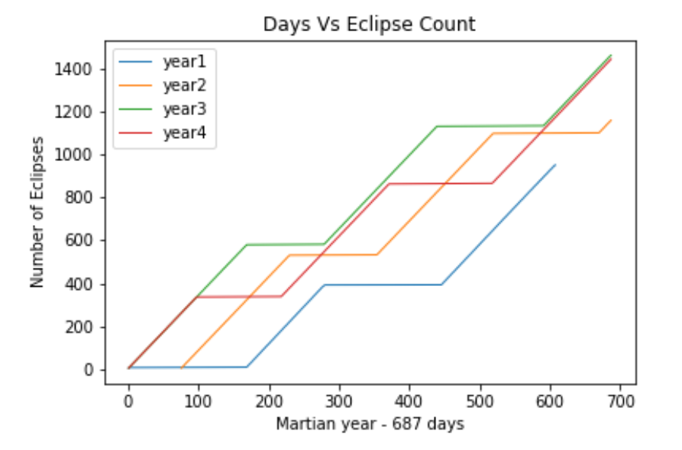
Q1.- What is the number of observed eclipses in Mars per year?
In Mars Solar Eclipses are practically a daily event!

Slide 8
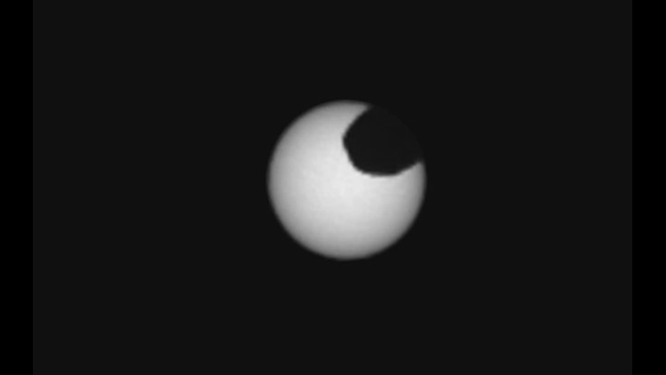
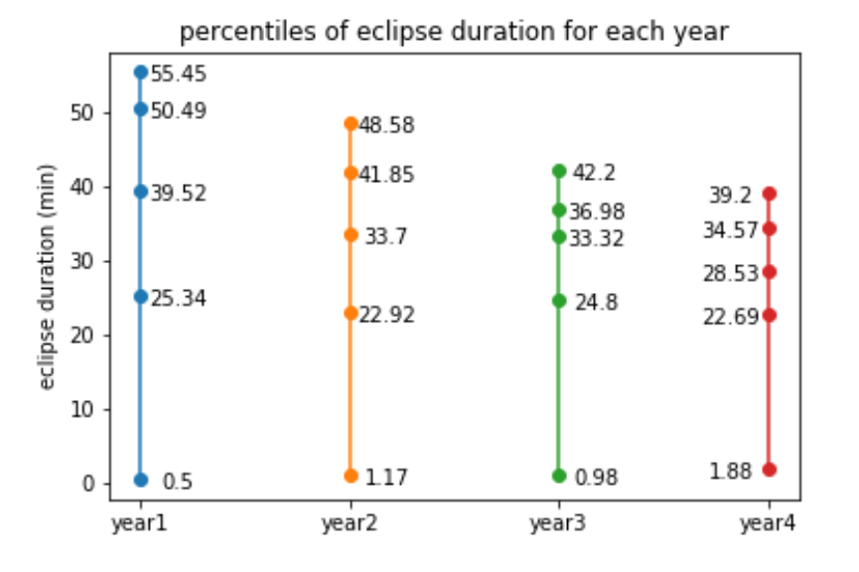
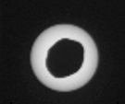
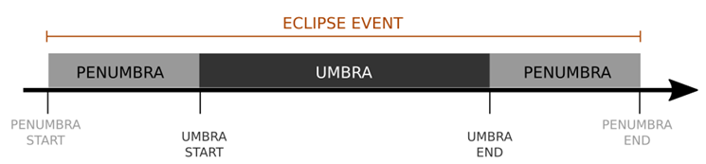
Q2 & Q3.- What is the average and P50 duration of these Eclipses per year?
Max
Avg
P50
Min
Eclipses in Mars can last for as long as 55 minutes and could be as short as half a minute.
As P50 goes, they last 34 minutes!

Slide 9
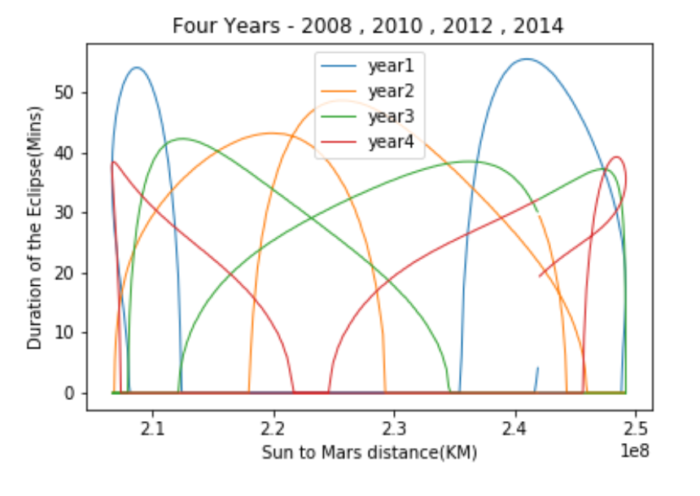
Q4- Are the numbers of eclipses a function of Mars distance to sun?
The Mars distance to sun is always changing.
It increases for periods of time and decreases in other periods of time.
Let’s plot just 1 year and just when in moving away from the sun!!

Slide 10
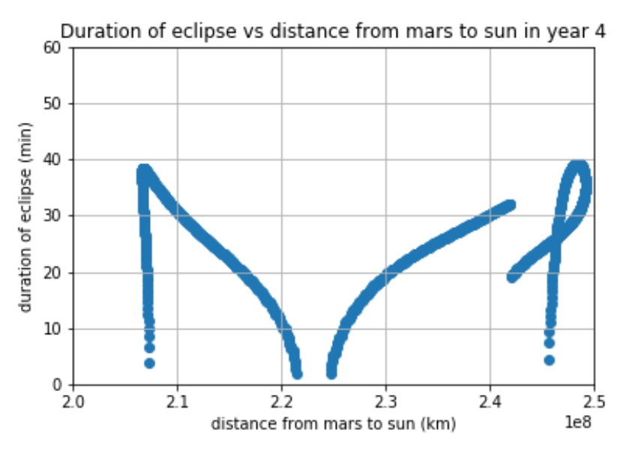
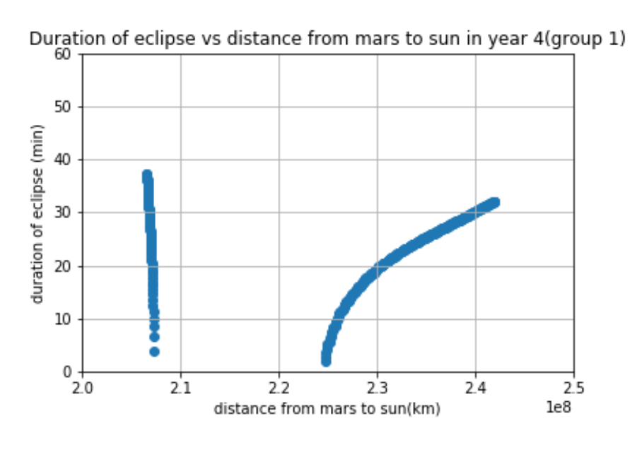
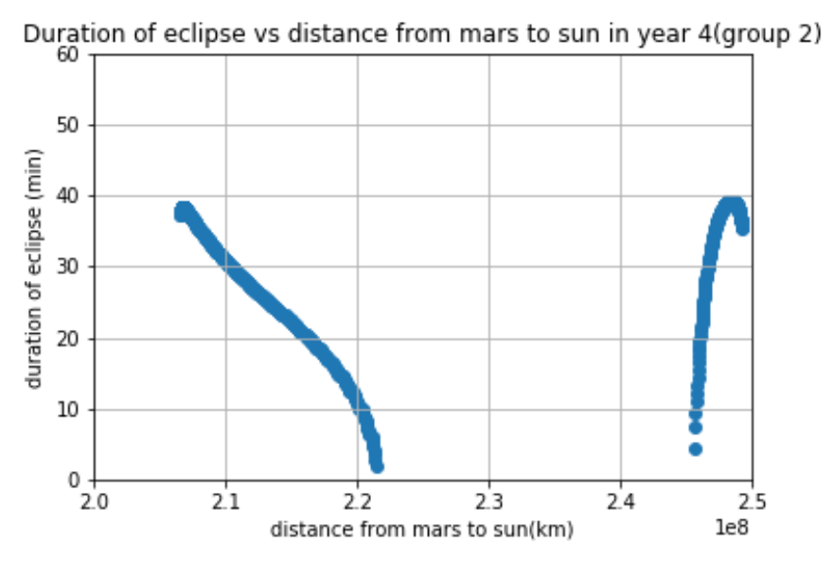
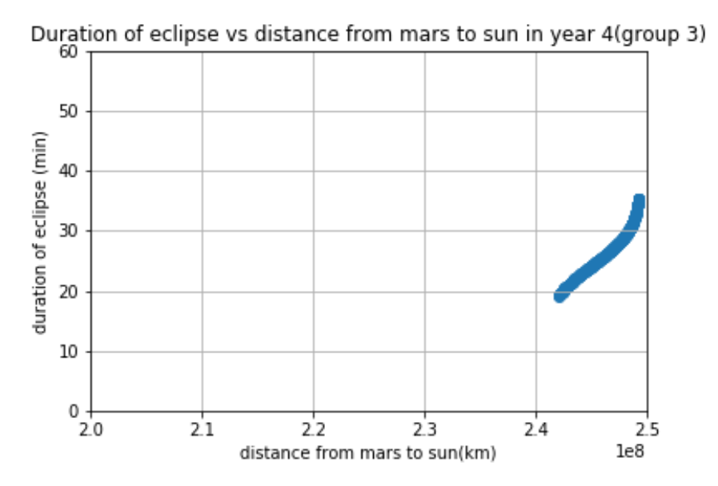
Q4- Are the numbers of eclipses a function of Mars distance to sun?
From 4th year of data:
All 4th year Eclipses duration
There is NOT an OBVIOUS connection, at least that we can explain looking straight at the plots, between the distance from the sun and its possible impact on the eclipses duration.
We still guess that there may be a connection but it is not clear to point out from just a linear reading from the plots done in this analysis.
Moving closer to the sun
Moving away from the sun
Moving back closer to the sun

Slide 11
Summary
Pending questions/work:
1.- A straight comparison between findings in this study and our Eclipses experiences in Earth.
2.- Maximum Time Duration of the Eclipses by year is decreasing in our data. What can be causing it? Is there any plot that can shed light on this?
3.- Is there any impact caused by the angles formed by the Sun, Mars and Phobos that may be also impacting the Eclipses duration?
1.- What is the number of eclipses observed in Mars per year?
2.- Based on analyzed data, What is the average number of eclipses per year?
3.- What is the P50 Eclipses duration and ranges?
4.- Are the Eclipses Duration related to Mars changing distance to sun?
No obvious connection detected but it may still be.
Year | Eclipse Count
1 | 952
2 | 1161
3 | 1465
4 | 1447
Year | Eclipse Count
AVG | 1256
Year | P50 Duration (min) | Min Duration (min) | Max Duration (min)
1 | 39.52 | 0.5 | 55.45
2 | 33.7 | 1.17 | 48.58
3 | 33.31 | 0.98 | 42.2
4 | 28.53 | 1.88 | 39.2

Slide 12
Abstract
The Rice Data Analytics and Visualization Team #4 that we will call “The Team” (Luis, Bao and Mahati) analyzed the data acquired between the years of 2008 and 2014 by the Mars Express Spacecraft (“MES”) orbiting around Mars. The Team can now point out key amazing differences between our Earth experiences with Eclipses versus what we will experience in Mars if we were habitants of the last one.
For The Team it was important to research elemental facts about Mars before graving any data file. The team learned that a Martian year last for 687 days and that Mars has two moons with two distinct characteristics on size, speed and distance from Mars that will have implications on the experienced Eclipses. One of its moon is in fact incapable of producing Eclipses due to its small diameter and its large distance from Mars.
During the data acquisition time of 2,748 days, 113477 unique Martian events were recorded and reported. Out of these events many occurred multiple times making the data extremely large. From these events we concentrated our attention on Eclipses observed. We counted them, calculated the time duration of all these Eclipses from starting to exiting the Penumbra Phase, we define the 50% probability (P50) of its duration by year and the ranges of these durations. We also check the influence of the changing distance of Mars from the Sun over the time duration of the Eclipses.
After analysis, we can point out that the number of Eclipses experienced in Mars is always changing and based on our data they can be as many as 1,497 and as few as 952 per year. In terms of observed limits on duration of a Mars Eclipse, they can take as long as 55 minutes and can be as short as half a minute.

Slide 13
In average, Eclipses in Mars happens 1,256 times per year! This find was fascinating for the team.
The duration of a Mars Eclipse was plot against the distance from sun and the plots were separated depending of “Getting closer to the Sun” and “Getting away from the Sun”. This separation were done with the intention to facilitate the conveying message from the plots.
On this topic, is NOT OBVIOUS connection, at least that we can explain looking straight at the plots, between the distance from the sun and its possible impact on the eclipses duration. We still guess that they may be a connection but is not clear to point out from just a linear reading from the plots done in this analysis.

