Slide 1

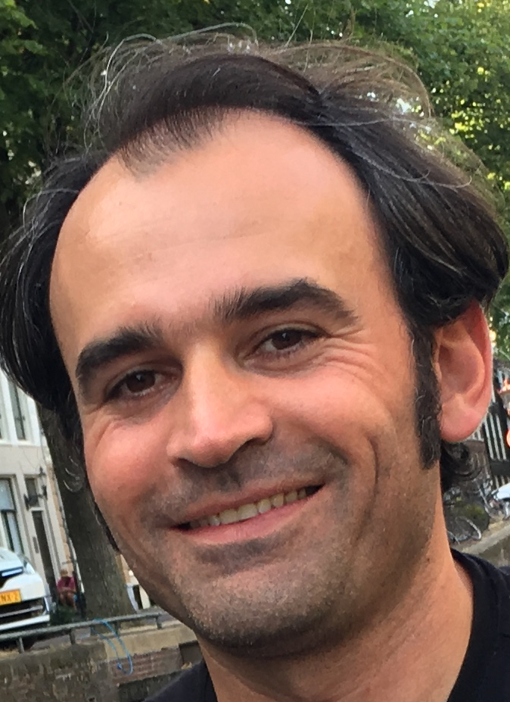
Gen AI with Java and Spring
By Ali Gelenler

Slide 2
Install and configure Java
https://www.oracle.com/java/technologies/downloads/#java25
java -version
export PATH=$PATH:PATH_TO_JAVA_BIN_FOLDER
echo $JAVA_HOME / echo %JAVA_HOME%
export JAVA_HOME=PATH_TO_JAVA_INSTALLATION_FOLDER

Slide 3
Install and configure Maven
https://maven.apache.org/download.cgi
mvn --version
export PATH=$PATH:PATH_TO_MAVEN_BIN_FOLDER
echo $M2_HOME / echo %M2_HOME%
export M2_HOME=PATH_TO_MAVEN_INSTALLATION_FOLDER

Slide 4
Install and configure IntelliJ IDEA
https://www.jetbrains.com/idea/
JDK setup and Hello-world java application
Maven settings
Initialize git project

Slide 5
Install and configure Git & Github
https://git-scm.com/downloads
git --version
https://github.com/
Git bash for windows users
Create a github account

Slide 6
Install and configure Docker
https://www.docker.com/get-started
docker --version
Run hello-world application: docker pull hello-world & docker run hello-world
Docker-compose: https://docs.docker.com/compose/install/
docker-compose -version

Slide 7
Install and configure Postman
https://www.postman.com/downloads/
Import the collection provided in source code

Slide 8
Gen AI with Java and Spring
By Ali Gelenler

