Slide 1

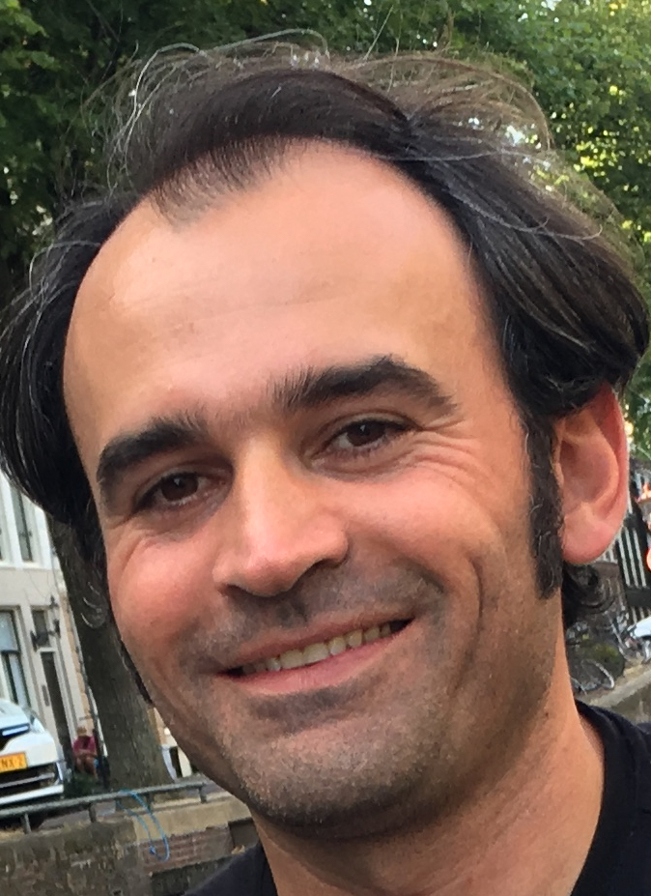
Gen AI with Java and Spring
By Ali Gelenler

Slide 2
Using multiple AI models
Coding to interface: ChatClient
Switch to different AI models/providers: Gemini, Anthropic, Deepseek or even local models with Ollama

Slide 3
Gen AI with Java and Spring
By Ali Gelenler

