Slide 1
IBM DATA-SCIENCE CERTIFICATION
Coursera Capstone
The Battle of Neighborhoods

Slide 2
The Battle of Neighborhoods
Abstract
This study provides an decision framework for young families willing to start a new life and New York city. By k-Means clustering approaches New York City’s boroughs and neighborhoods will be examined in detail focusing on which borough and which neighborhood will fit young family’s preferences best. The study comes to the end, that Staten Island will be a good location for young families settling over to New York and provides clusters of interesting neighborhoods based on most common venues.

Slide 3
Introduction
aim of this project: help people to explore different living opportunities and to help make better decisions before migrating to NYC
create an analysis of features for a comparative analysis
features include statistics like population, land area, population per square mile, household income, per capita income, housing units, mean travel time to work, housing owner costs (with a mortgage as well as without a mortgage), and median gross rent
features will be potential factors to help people to get awareness before starting a new life
focuses on the moving decision of young families, because their decision usually needs to be better prepared and is usually irreversible
young families as main audience
Young Families will be defined as young couples with at least one child in school age

Slide 4
Data
study will based on location data provided by Foursquare, some socio-economic statistics will be taken in account also
Foursquare API as primarily data source; due to http request limitations the number of places per neighborhood parameter would reasonably be set to 100
QuickFacts Data from US Census Bureau (https://www.census.gov/) is used to supplement the Foursquare data
Data will be prepared directly in Jupyter notebook with the help of some essential python libraries (numpy, pandas, geopy, matploblib, sklearn and folium)
For data preparation some functions are defined to handle data more convenient

Slide 5
Methodology
Transformation of geospatial data into a proper data frame consists of borough, neighborhood, latitude, and longitude
Slicing the data frame for exploratory analysis and data Aggregation with socio-economic statistics from US Census Bureau
Exploratory data analysis with maps and bar charts, then comparative analysis by k-Means clustering approach
Foursquare API was utilized to get venue data on neighborhood level; resulting JSON-file was normalized and filtered, to gather venue name, venue categories, and venue location data (zip code, latitude, and longitude).
Restructuring data frame for a comparative analysis of the most common venues by a further k-means clustering approach

Slide 6
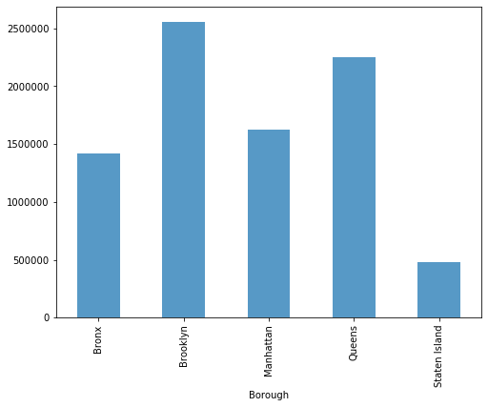
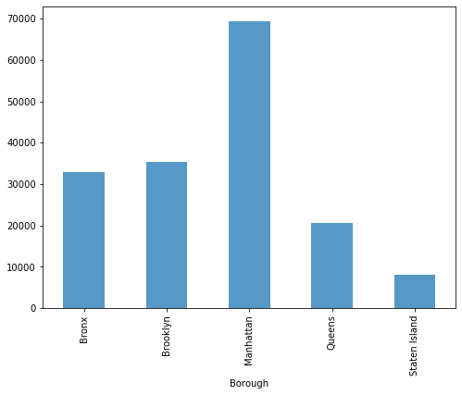
Results (1/7)
Population estimates
Population density

Slide 7
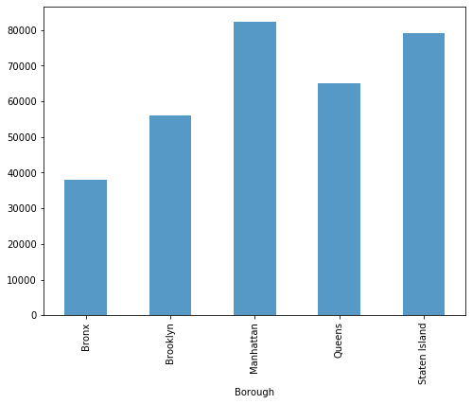
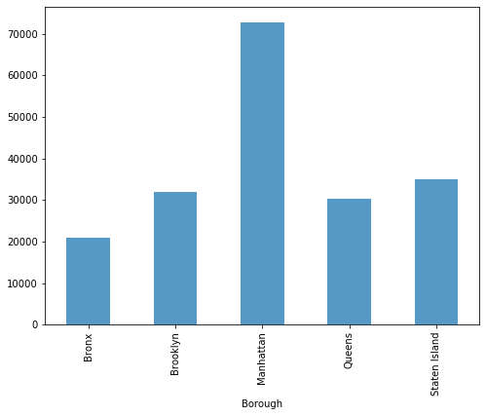
Results (2/7)
Median Household Income
Per Capita Income

Slide 8
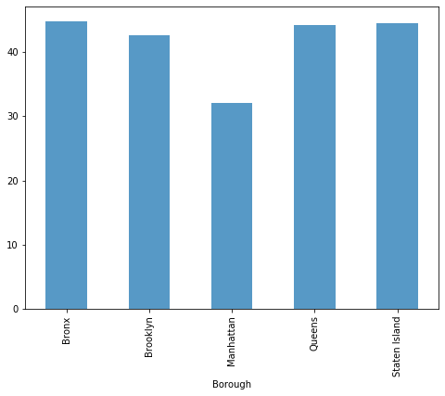
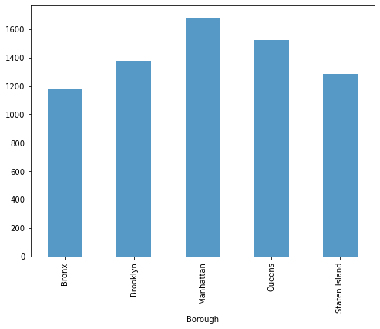
Results (3/7)
Mean Travel Time to Work
Median Gross Rent

Slide 9
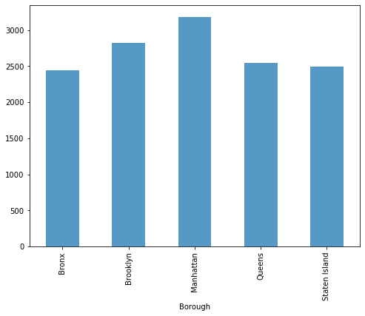
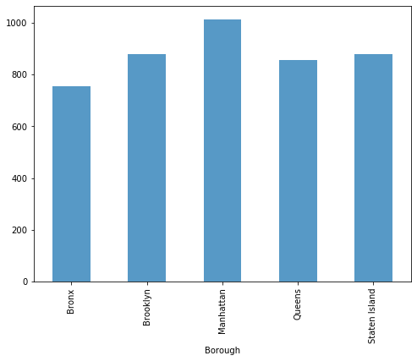
Results (4/7)
Ownership Costs
(monthly, with mortgage)
Ownership Costs
(monthly, without mortgage)

Slide 10
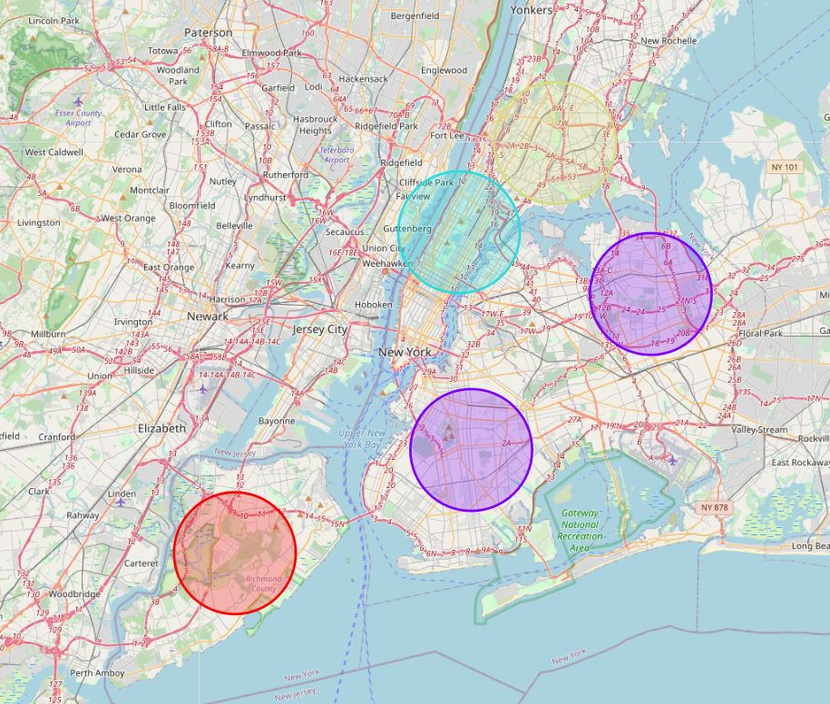
Results (5/7)
Borough Clustering
4 clusters:
Staten Island seems to be a good choice for young families because of low population density, proper income levels, and relatively low housing costs
Borough | Population per square mile | Median household income | Per capita income | Mean travel time to work | owner costs with a mortgage | owner costs without a mortgage | Median gross rent
Bronx | 0,47 | 0,46 | 0,29 | 1,00 | 0,77 | 0,74 | 0,70
Brooklyn | 0,51 | 0,68 | 0,44 | 0,95 | 0,89 | 0,87 | 0,82
Manhattan | 1,00 | 1,00 | 1,00 | 0,72 | 1,00 | 1,00 | 1,00
Queens | 0,30 | 0,79 | 0,42 | 0,98 | 0,80 | 0,84 | 0,90
Staten Island | 0,12 | 0,96 | 0,48 | 0,99 | 0,78 | 0,87 | 0,76

Slide 11
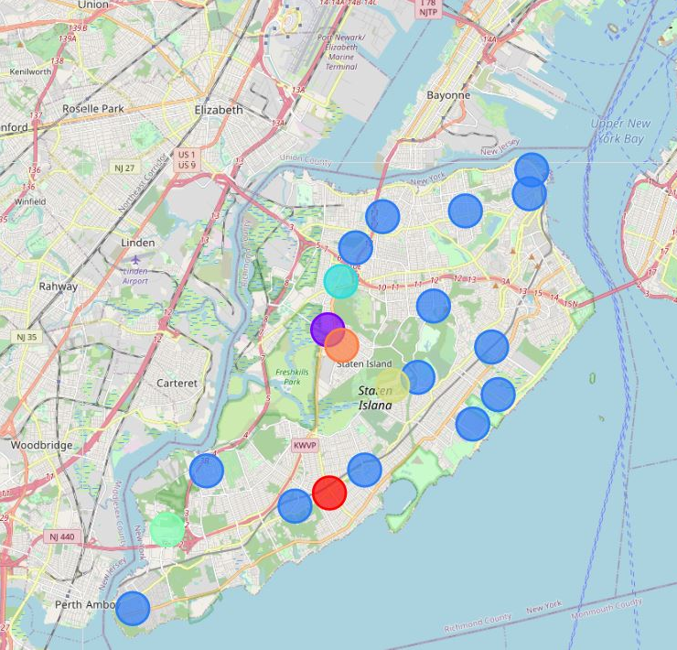
Results (6/7)
Neighborhood Clustering
7 clusters:
Decision highly depends on the family’s preferences. This study will not anticipate the individual preferences, instead provide a decision framework based on the clusters.

Slide 12
Results (7/7)
Neighborhood | Cluster Labels | 1st Most Common Venue | 2nd Most Common Venue | 3rd Most Common Venue | 4th Most Common Venue | 5th Most Common Venue
St. George | 2 | Ice Cream Shop | Clothing Store | Coffee Shop | Women's Store | Discount Store
West Brighton | 2 | Donut Shop | Women's Store | Department Store | Gym / Fitness Center | Grocery Store
New Springville | 1 | Clothing Store | Toy / Game Store | Furniture / Home Store | Cosmetics Shop | Department Store
Great Kills | 2 | Bakery | Women's Store | Department Store | Gym / Fitness Center | Grocery Store
Eltingville | 0 | Pharmacy | Video Game Store | Cosmetics Shop | Grocery Store | Golf Course
Annadale | 2 | Bagel Shop | Women's Store | Department Store | Gym / Fitness Center | Grocery Store
Tottenville | 2 | Bank | Women's Store | Department Store | Gym / Fitness Center | Grocery Store
Tompkinsville | 2 | Gym / Fitness Center | Fast Food Restaurant | Women's Store | Department Store | Grocery Store
Graniteville | 2 | Coffee Shop | Women's Store | Department Store | Gym / Fitness Center | Grocery Store
Dongan Hills | 2 | Bank | Women's Store | Department Store | Gym / Fitness Center | Grocery Store
Midland Beach | 2 | Paper / Office Supplies Store | Discount Store | Women's Store | History Museum | Gym / Fitness Center
New Dorp Beach | 2 | Supplement Shop | Furniture / Home Store | Burger Joint | Sandwich Place | Women's Store
Charleston | 4 | Cosmetics Shop | Bakery | Health & Beauty Service | Supplement Shop | Pet Store
Rossville | 2 | Bagel Shop | Mexican Restaurant | Women's Store | Discount Store | Gym / Fitness Center
Heartland Village | 6 | Hookah Bar | Shoe Store | Furniture / Home Store | Food & Drink Shop | Liquor Store
Bulls Head | 3 | Baseball Field | Chinese Restaurant | Playground | Women's Store | Discount Store
Elm Park | 2 | Department Store | Mobile Phone Shop | Sandwich Place | Women's Store | Grocery Store
Manor Heights | 2 | Trail | Campground | Women's Store | Department Store | Gym / Fitness Center
Egbertville | 2 | Park | Women's Store | History Museum | Gym / Fitness Center | Grocery Store
Lighthouse Hill | 5 | Italian Restaurant | Art Museum | Golf Course | Spa | Women's Store

Slide 13
Discussion
Exploratory analysis of NYC’s socio-economic statistics is showing different socio-economic situations within the particular boroughs
Assumption: young families (= main audience) will focus on relatively low housing costs (rent as well as ownership), enough area for play and relax, relatively short time to travel to work, as well as relatively good income level and relatively good local supply by retail and gastronomy
The Brooklyn-Queens-Cluster suits to the young family decision assumptions, but Staten Island suits much better. By this, Staten Island was chosen for deeper analysis.
Young families can decide on which neighborhood to choose based on the derived clusters.
This study will not make further recommendations for decision-makers because there are no information about possible preferences

Slide 14
Conclusion
This study provides a decision framework for young families which will start a new life at NYC. By doing so, the study clustered the particular boroughs of NYC according to socio-economic statistics first, and clustered the particular neighborhoods of the chosen borough according to their most common venues second.
The first step is highly based on the assumptions of the main audience’s preferences. By this, it is highly sensitive and susceptible to criticism. Even smallest changes in the preferences can significantly alter the results and turn the framework into nonsense. So, more information on possible preferences will be desirable, but go beyond the frame of this course.
The second step is not based on assumptions of unknown preferences but depends highly on the Foursquare venue data. Because of API limitations the dataset is only a small snapshot of Staten Island neighborhood’s features. By this, the derived clusters will be not representative and much more data will be desirable, but also go beyond the frame of this course.

Slide 15
Thanks ☺
For reading and grading as well as for this beautiful course!

