Slide 1
GEOG 178/258 -- Week 4:
To be, or not to be …
mike johnson

Slide 2
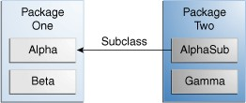
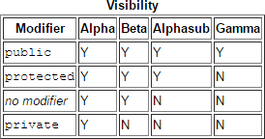
Private vs. Public
Week
4
Private v. Public
*Where are the member of the Alpha Class accessible
Tips on Choosing an Access Level:
If other programmers use your class, you want to ensure that errors from misuse cannot happen. Access levels can help you do this.
Use the most restrictive access level that makes sense for a particular member. Use private unless you have a good reason not to.
Avoid public fields except for constants. (Many of the examples in the tutorial use public fields. This may help to illustrate some points concisely, but is not recommended for production code.) Public fields tend to link you to a particular implementation and limit your flexibility in changing your code.

Slide 3
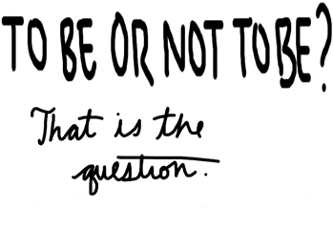

Slide 4
The ‘famous’ question…
The question “To be or not to be….” was first
asked in Shakespeare’s Hamlet.
Week
4
How can we:
(A) model this question,
(B) model a human asking it, and
(C) model a debate of the question
Lets assume that “To be” is the primary argument (TRUE) and “Not to be” is the secondary argument (FALSE).
Lets also assume the question is fluid and every time it’s debated its state changes.
We’ll also assume humans will change their mind to sync with reality after a debate
Lets also assume that this question can only be asked so many times before it becomes pointless…
Example

Slide 5
To start
Create a new Java Project in a workspace
under Week 4
Week
4
In this project file create three Java Classes
1) Question
2) Human
3) Test
Example

Slide 6
1. Question Class

Slide 7
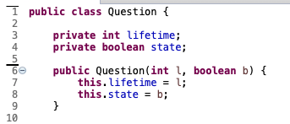
Class and constructors
Week
4
Question Class
Line 1: Here we create the class Question
Line 3: We state that all questions have a lifetime. That is, a number of times it can be asked before it becomes useless. Here this value is declared as a private so
it can not be set or changed outside of the ‘blackbox’ of the class Question.
Line 4: All questions (in this model) also have a binary TRUE or FALSE condition. Again this variable is private as we don’t want an outside entity to change the state of the question.
Line 6-9: CONSTRUCTOR here we require a user to provide a lifetime and state of the question.

Slide 8
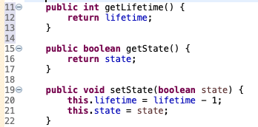
Getters and setters
Week
4
Question Class
Line 11 - 13: Here we create a getter method for lifetime (a public method that returns a integer)
Line 15 – 17: Here we create a getter method for state (a public method that returns a Boolean
Line 19 – 22: Here we create a setter method for state( a public method that returns nothing and expects a Boolean value.
Why have we included the lifetime modifier within this method?

Slide 9
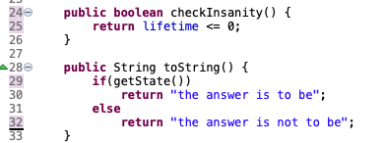
Define the methods
Week
4
Question Class
Line 24 - 26: Here we create a method that will return whether or not the lifetime of a question has dropped to zero ( a public method that returns a Boolean value).
Line 28 – 32: Here we override the toString method telling a Question object how to interpret a Boolean state condition as a string. Note that we are calling on the getState getter to implement this method. (think back to assumption 1)

Slide 10
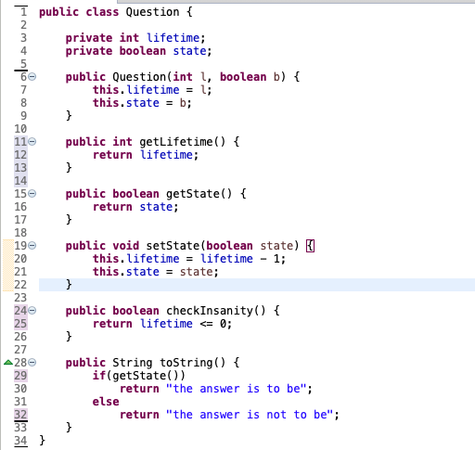
Complete code:
Week
4
Question Class

Slide 11
2. Human Class

Slide 12
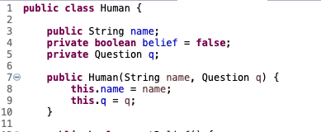
Class and construction…
Week
4
Human Class
Line 2: Create the class of Human making sure that it is public…
Line 3: Here we say that all humans have a name (String) that is publicly accessible
Line 4: All humans have a belief about a question. We assume that humans are always skeptical and will not believe a statement until its been debated and proven TRUE, and that their belief can only be altered by themselves (private)
Line 5: In this model all humans exist with a question in mind, this question is part of their fundamental ’existence’ in our data model.
Line 7 – 10: CONSTRUCTOR, all humans are created from an input name and question. These inputs become a central member of the specific human object.

Slide 13
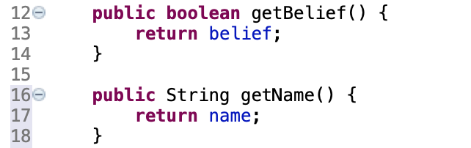
Getters
Week
4
Human Class
Line 12 - 14: Here we create a public get method from returning a human objects belief about the question.
Line 16 - 18: Here we create a public get method from returning a human objects name.

Slide 14
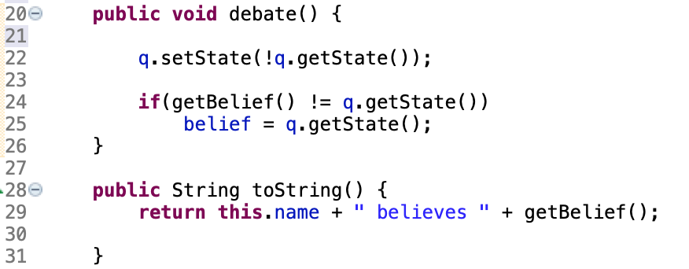
Methods
Week
4
Human Class
Line 20 - 26: Here we are creating a public method called debate(). This method requires no inputs and returns a no values. In it, the function first sets the state of the current question to the opposite of its current state (respecting our assumption 2), and then aligns the current belief of the human with that reality (assumption 3)
What happens if line 22 dnd 24:25 are switched??
Line 28 – 31: Here we over ride the toString method to return a more useful print statement with a public method.

Slide 15
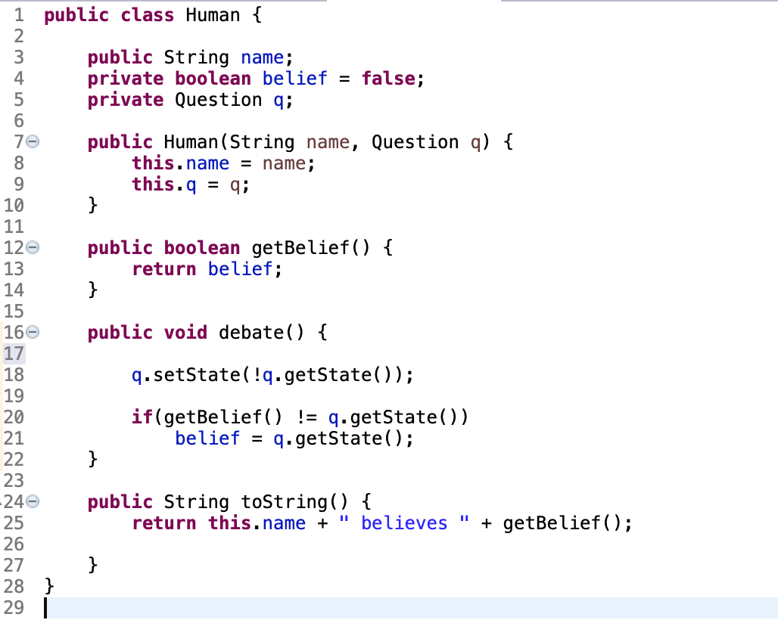
Complete code…
Week
4
Human Class

Slide 16
4. Test Class

Slide 17
Challenge!!
Can you combine these methods in the TEST class to ask/answer meaningful questions?
How can you combine methods to be sure that the human and the question are in sync?
Can you break your program?
How can you fix it?
What happens if a human gets new information and the lifespan of the question should be reset?
What other issues can you find? How might you fix them?
Week
4
Test Class

Slide 18
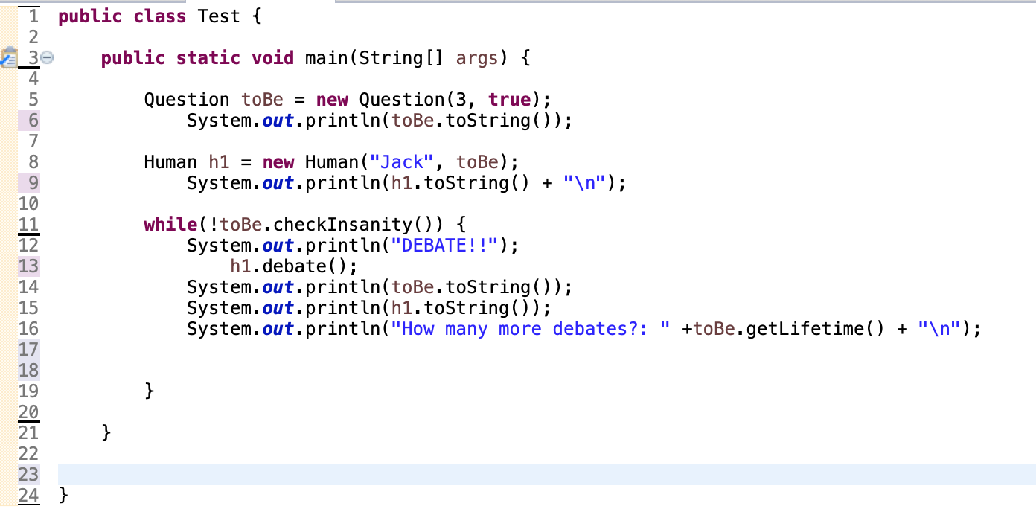
Example…
Week
4
Test Class

Slide 19
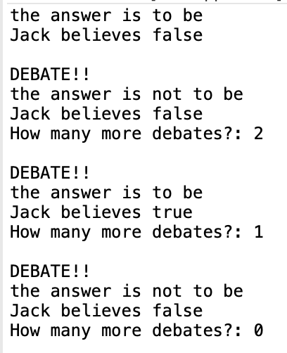
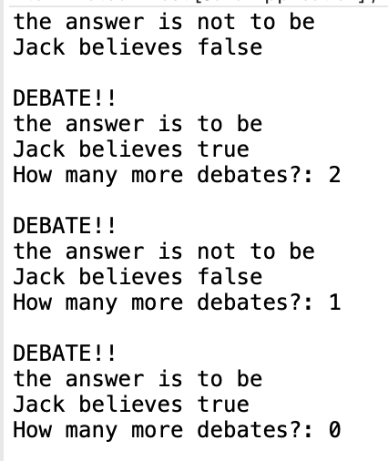
Output!
Week
4
Test Class
This code is not fully complete… can you find a reason why?

Slide 20
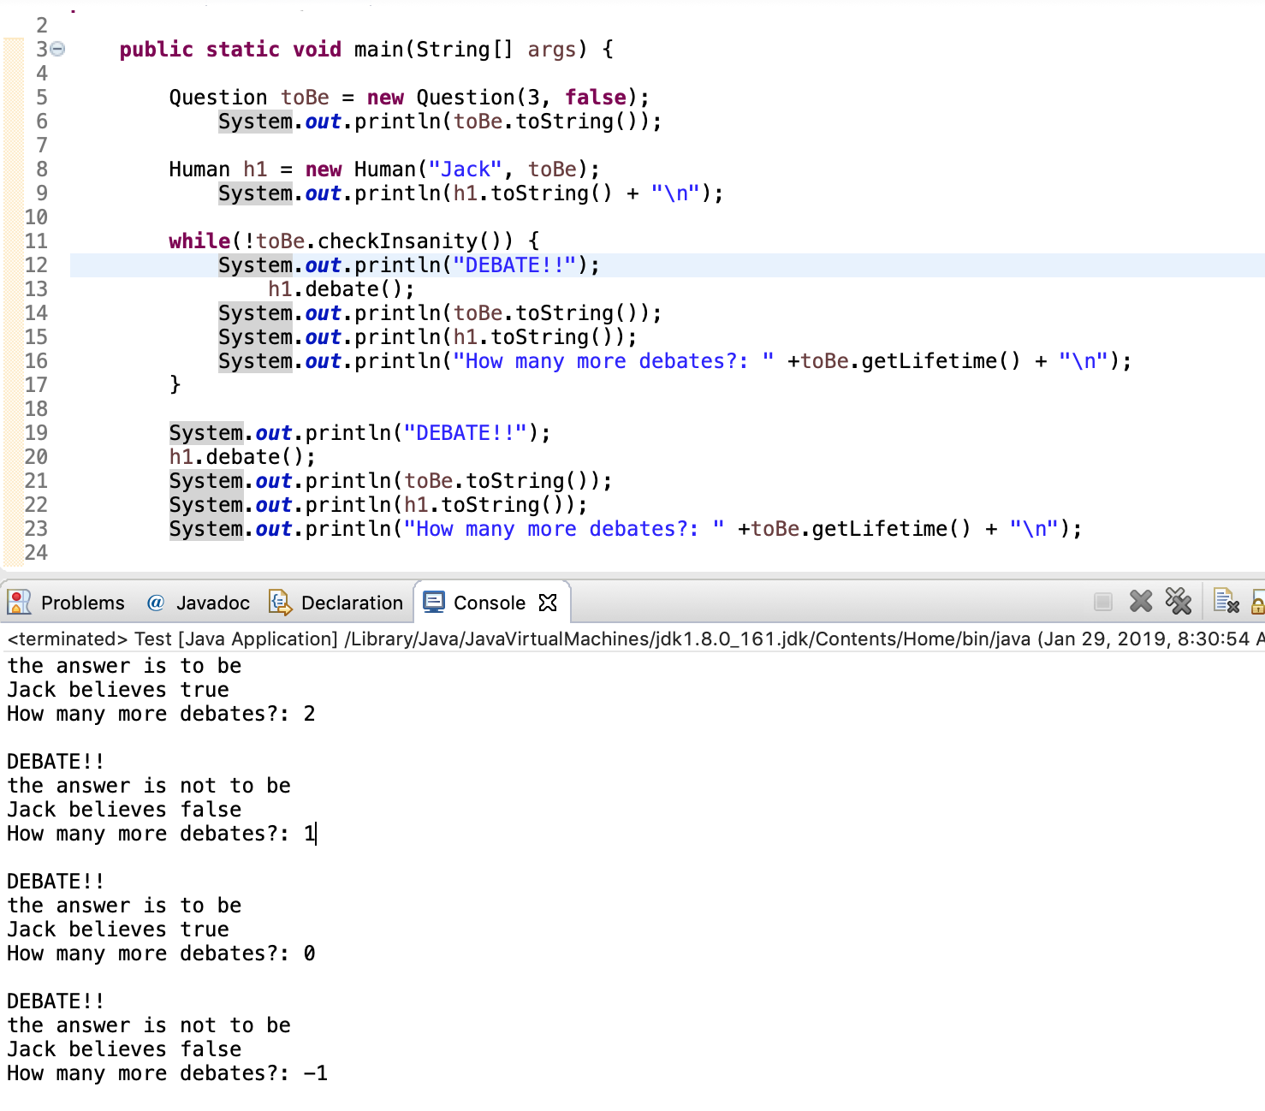
Answer…
In the codes current set up every time that Jack debates, even if the conversation has surpassed its lifespan, he will keep changing his mind…
Week
4
Test Class

Slide 21
Summary…
1. When creating classes it is important to think
of what kind of questions and what kind of
information you are interested in regarding an
object….
Week
4
End
2. Think about how much of that information
should be controlled by the user, and how
much should be hidden…
3. Finally remember that all coding is “a work in
progress” Unlike an essay, you don’t start at
the beginning and write to the end.

Slide 22
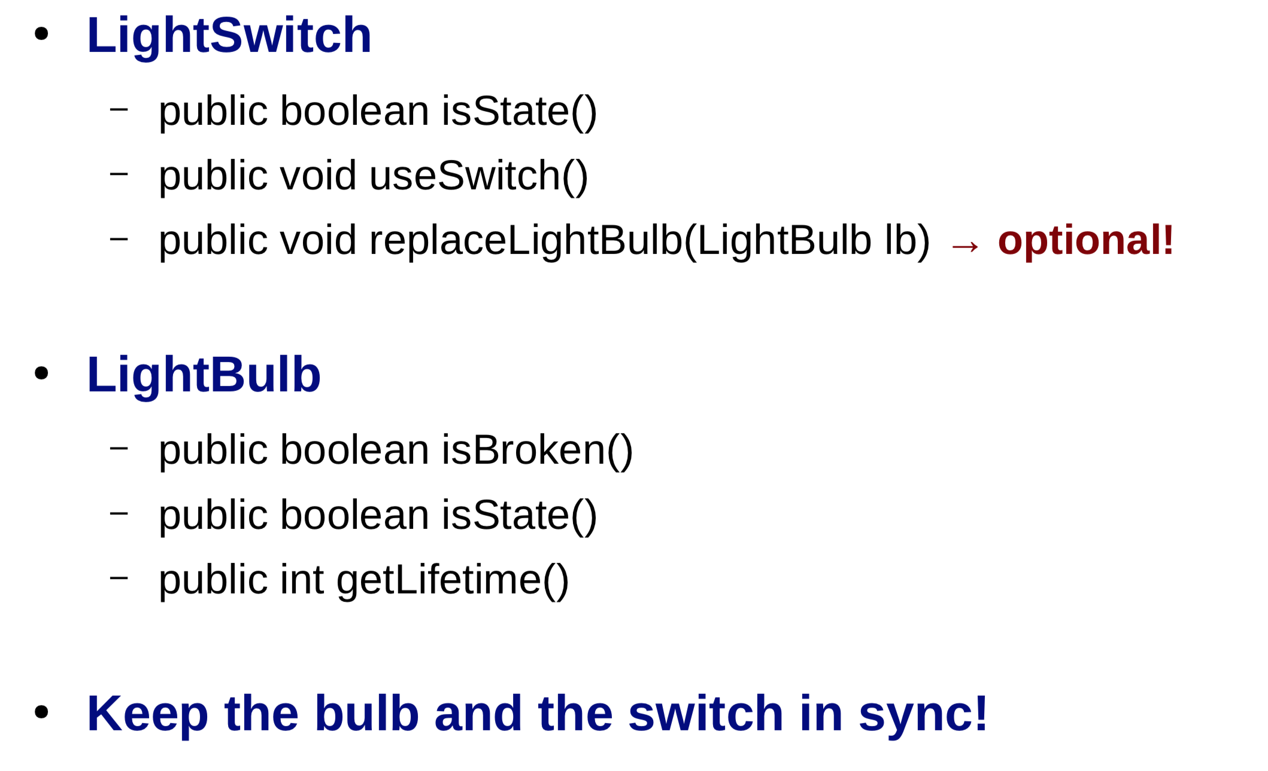
Homework hints…
How are Human and light switch similar?
How are they different?
How are Question and a light bulb similar?
How are they different?

