Slide 1



GEOG 178/258
Week 5:
Inheritance and Delegation
mike johnson

Slide 2
Inheritance
1. Inheritance is one of the key features of OOP and
allows a class to use the PROPERTIES and
METHODS of another class!
Week
5
Inheritance
2. To do this, subclasses can inherit the STATES and
BEHAVIORS of a super class through EXTENSION…
Subclasses can also add variables and methods to
differentiate it from the superclass.
Note that a super class can have multiple subclasses, however a subclass can only have one superclass

Slide 3
Delegation
1. In Java, when an object receives a request it can
either perform the operation itself OR pass it to
another object
Week
5
2. Thus, delegation refers to a way of applying a
method to an object outside of its direct class.
Delegation
In a way, delegation can be seen as a “pointer” or a
reference to a method
Example:
Say a request is sent to object 1. Object 1 choses NOT to execute the responsibility and passes the responsibility (and itself) to object 2.
Object 2 is now the delegate and processes the request!

Slide 4
So what’s the Difference?
1.By using Inheritance, a subclass inherits all of
the states and behaviors defined in the
superclass.
Week
5
2.By delegation you write another class with
additional functionality that uses instances of
the original class to provide the original functionality.
Inheritance
v. Delegation
3.In other words:
When using inheritance, the subclass is simply a version of the superclass with some additional (or specific) functionality.
When using delegation, your delegating class contains a reference to an instance of the superclass and delegates the method calls to the superclass.

Slide 5
Things to Note about Private v. Public
1. The derived class inherits all the members and
methods that are declared as public or protected.
Week
5
2. If declared as private it can not be inherited by the
derived classes.
Example 2
The private members can be accessed only in its
own class.
The private members can be accessed through assessor methods as shown in the example below. The derived class cannot inherit a member of the base class if the derived class declares another member with the same name.

Slide 6
But what about constructors?
1. The constructor in the superclass is responsible for
building the object of the superclass.
Week
5
2. The constructor of the subclass builds the object of
subclass.
Example 2
However! When the subclass constructor is called,
it by default invokes the default constructor of
super-class.
Hence, in inheritance the objects are constructed top-down.

Slide 7
POINTS, POLYLINES, POLYGONS
EXAMPLE # 1

Slide 8
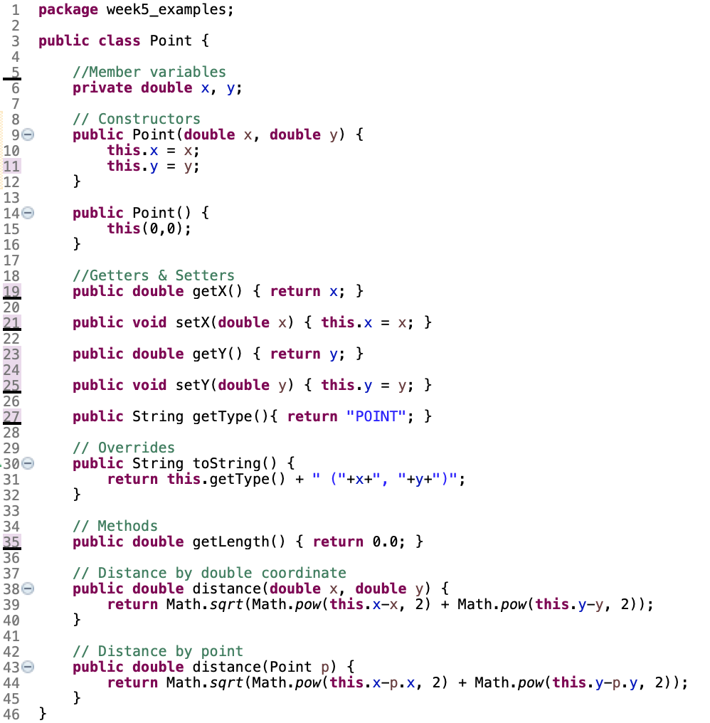
Lets look at our point class….
Week
5
Example 1

Slide 9
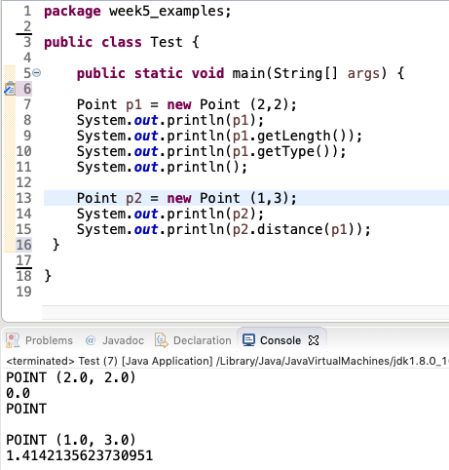
Tests!
Week
5
Example 1

Slide 10
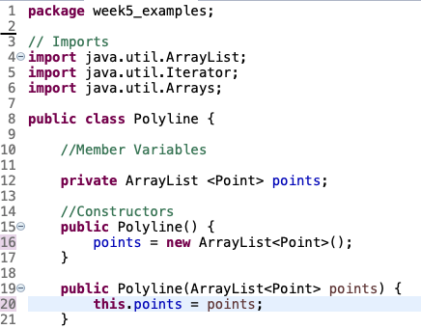
Creating a class of POLYLINE
What do we know about Polylines?
They are made up of points
They must have at least 2 points
Week
5
Example 1

Slide 11
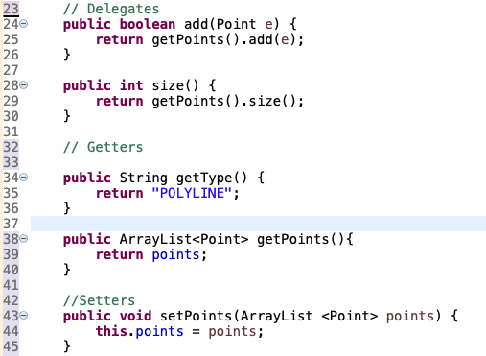
Delegating ARRAYLIST methods. Getter and Setters
Week
5
Example 1
‘Add’ and ‘size’ are methods of ARRAYLISTS. When it comes to POLYLINES we want them to behave in a certain way. Therefore we must DELEGATE the method.

Slide 12
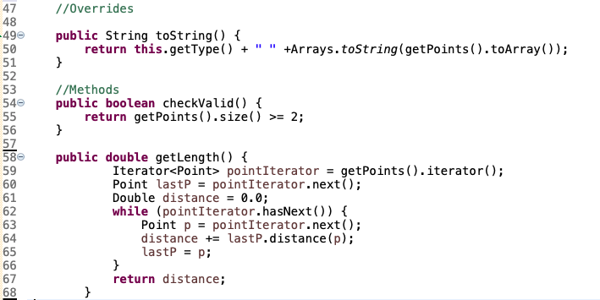
Overrides and Methods
Week
5
Example 1

Slide 13
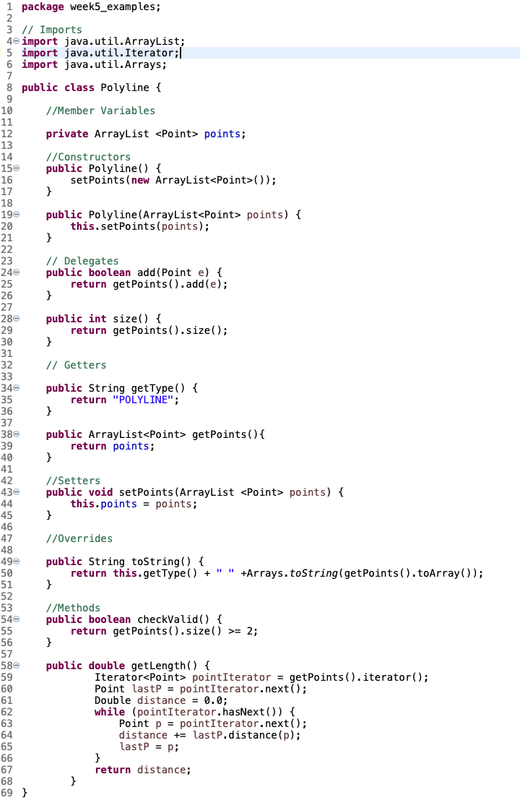
Full Polyline
Week
5
Example 1

Slide 14
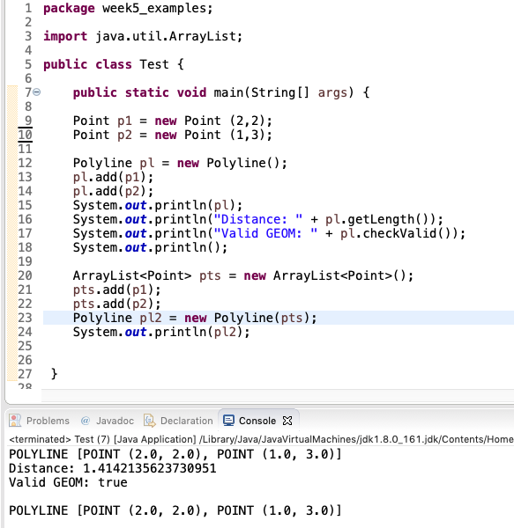
Tests!
Week
5
Example 1

Slide 15
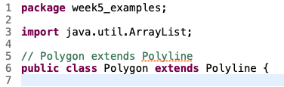
POLYGON
What do we know about Polygons?
They are closed polylines
They require 3 or more unique points
Almost all polyline methods apply to polygon
Week
5
Example 1

Slide 16
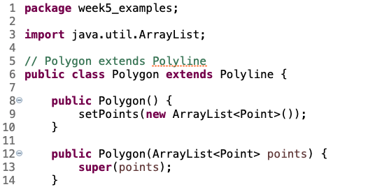
POLYLINE → POLYGON
Week
5
Example 1
Will this work??

Slide 17
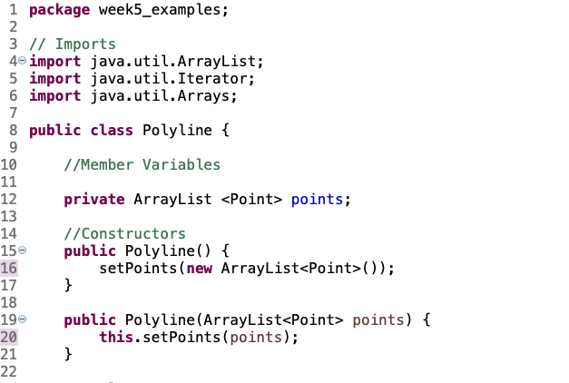
POLYLINE → POLYGON
Week
5
Example 1
‘points’ is PRIVATE!
Encapsulation

Slide 18
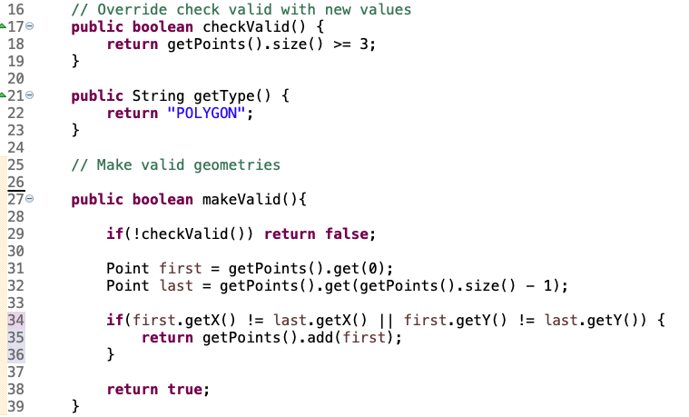
POLYLINE → POLYGON
Week
5
Example 1

Slide 19
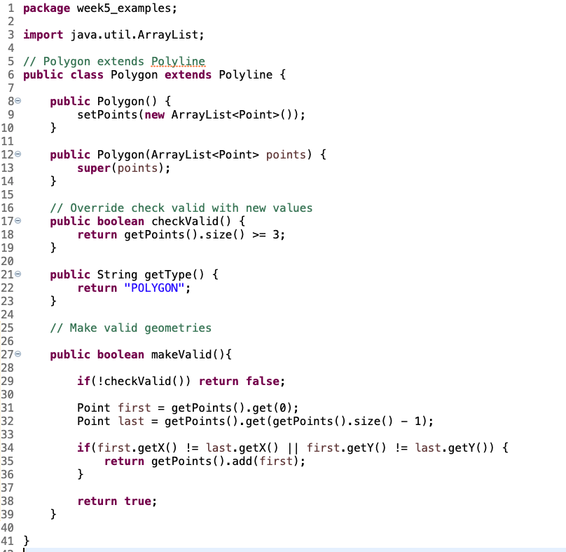
Full Polygon
Week
5
Example 1

Slide 20
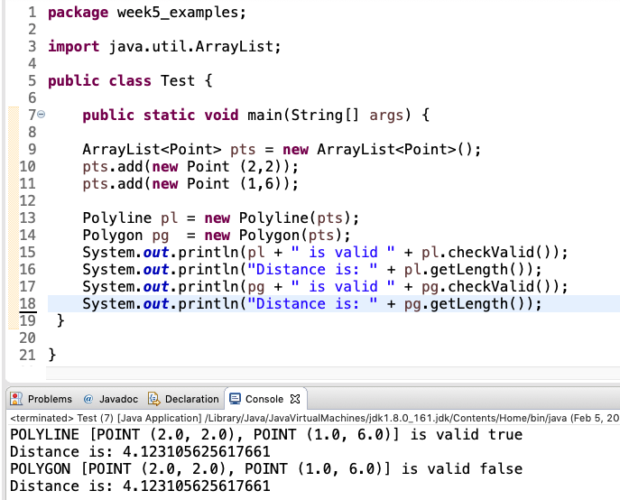
Tests!
Week
5
Example 1

Slide 21
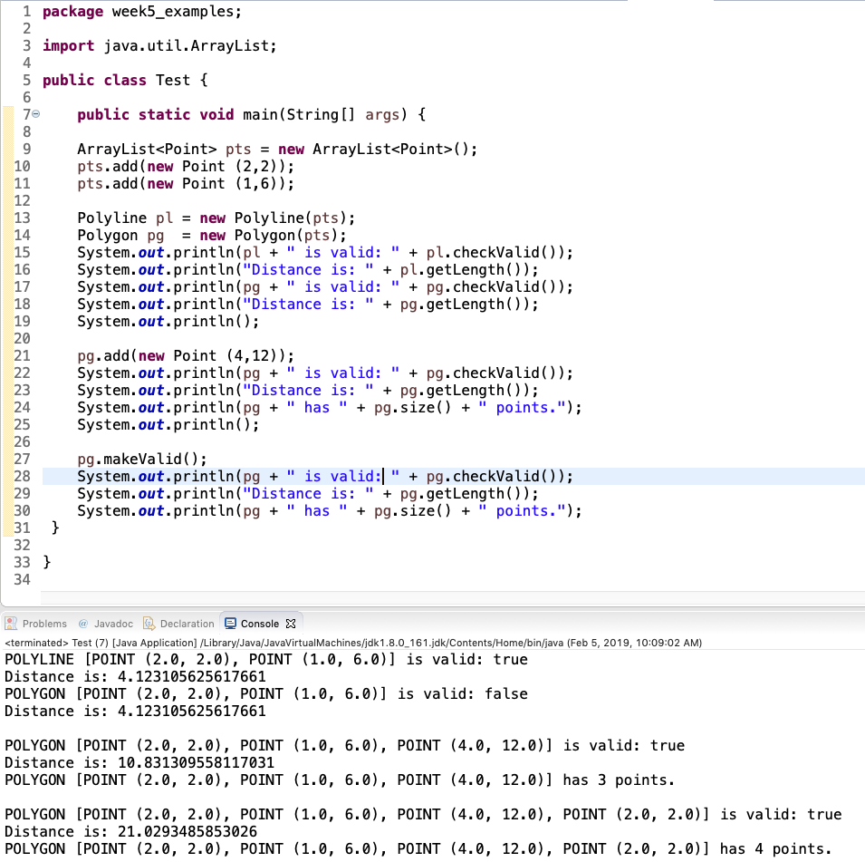
Tests!
Week
5
Example 1

Slide 22
BOUNDING BOXES, DISASTERS, FLOODS
EXAMPLE # 2

Slide 23
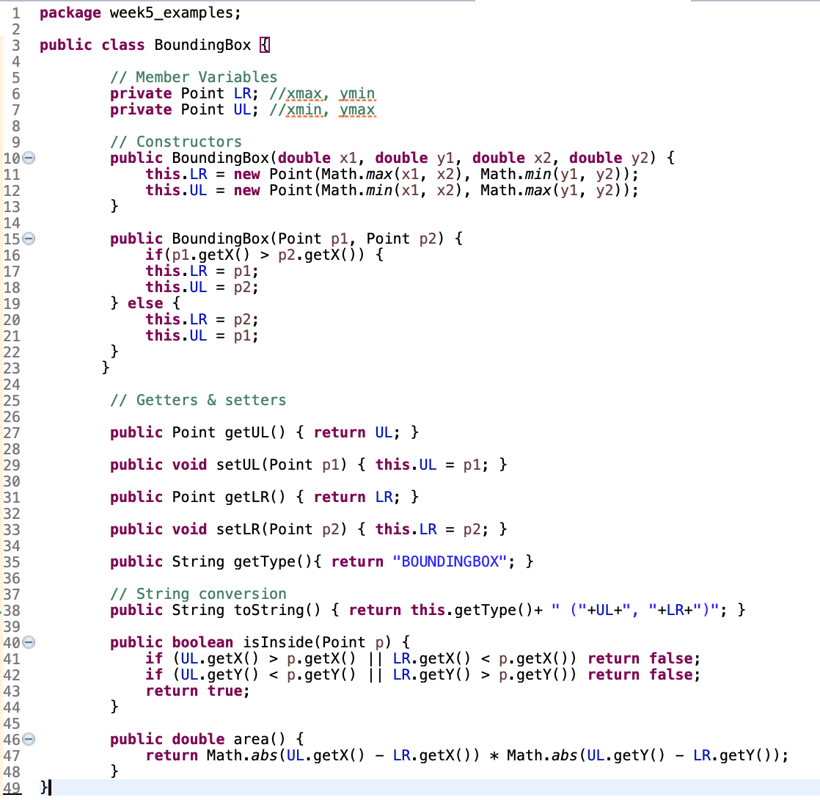
Bounding Boxes
Week
5
Example 2

Slide 24
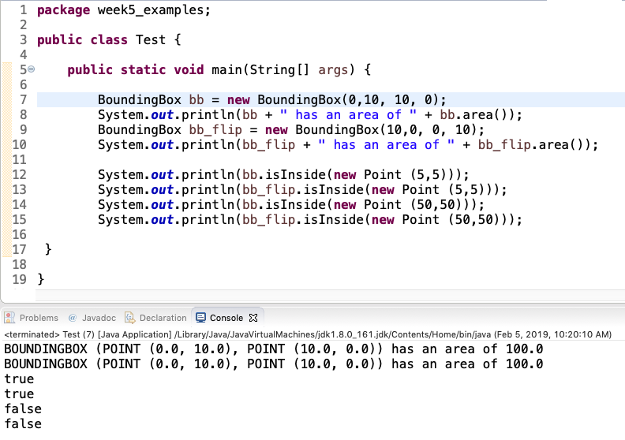
Tests
Week
5
Example 2

Slide 25
Work through together in class

Slide 26
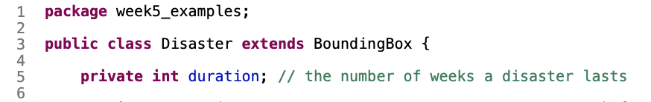
Disasters are temporal BBOXs!
Week
5
Example 2

Slide 27
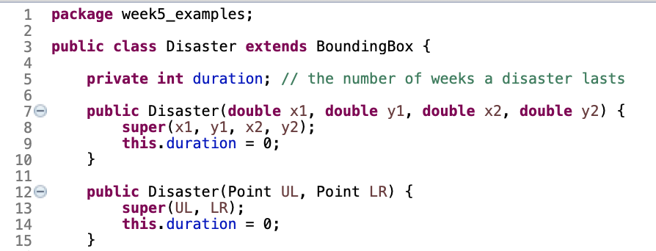
Inherit the constructors and member variables from BBOX
Week
5
Example 2
Note that (x1,y1,x2,y2,UL,LR) are all inherited from the super class BoundingBox while duration is a member variable of the class disaster.

Slide 28
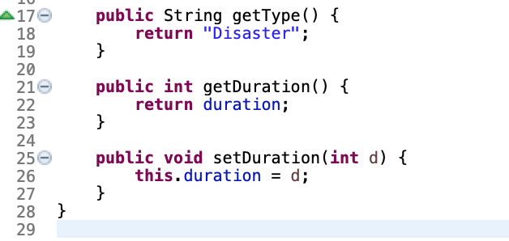
Add getters and setters
Week
5
Example 2

Slide 29
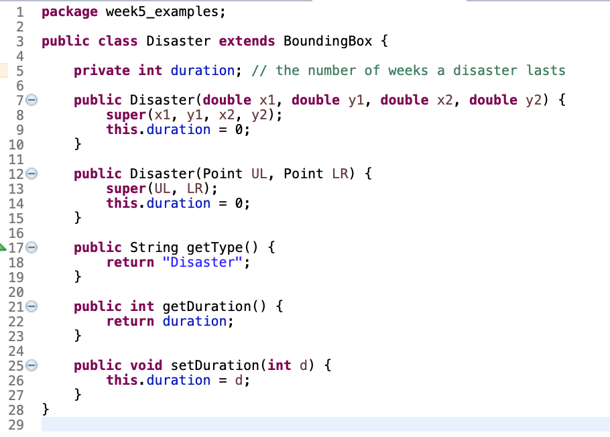
Full Disaster Class
Week
5
Example 2

Slide 30
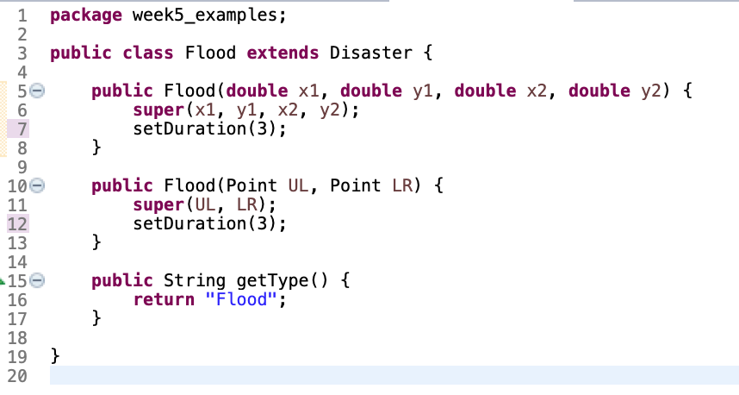
Disaster to Flood
Week
5
Example 2
The setDuration() method allows us access to the private duration member variable of DIASASTER (encapsulation)

Slide 31
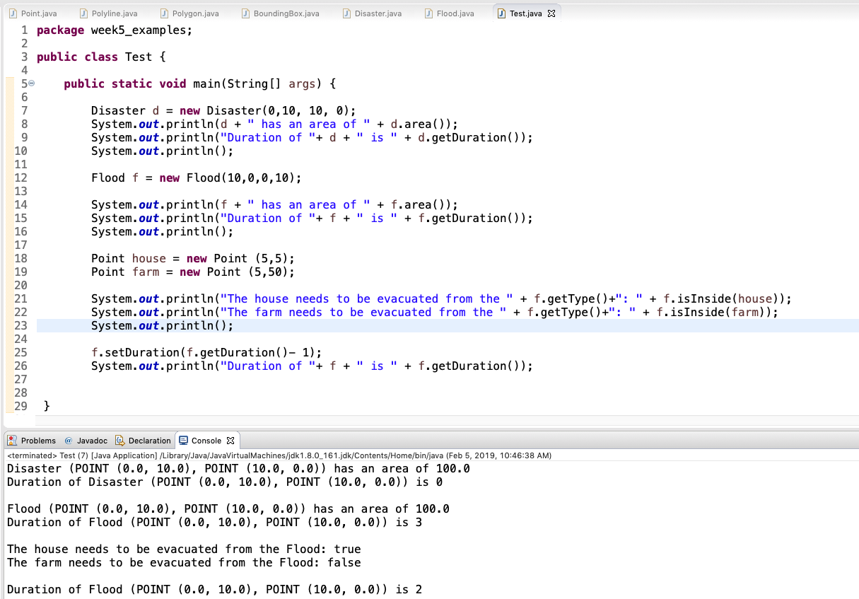
Tests
Week
5
Example 2

Slide 32
Homework Hints!
Inheritance
Superclass | Point | Bounding Box
Sub-class | Building | Disaster
Sub-class | Hospital; Farm; Store | Flood; Fire
Week
5
Homework Hints
Print the following three statements with the information filled
in correctly:
There are <#> farms, <#> stores and <#> hospitals within the
<disaster type> bounding box.
<#> structures are unaffected.
3) The <#> is defined by the points <P1>, <P2>.

