Slide 1
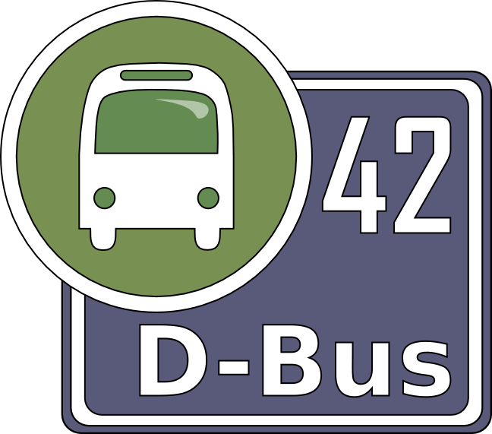
D-Bus with Perl
Emmanuel Rodriguez
Vienna 2008

Slide 2
What is D-Bus?
A message bus system (IPC)
  Influenced by KDE's DCOP
  Language independent (C/C++, Python, Perl, etc)
Simple way for applications to talk to one another
Provides a system and session bus
Used in Gnome, KDE, maemo, OLPC, etc

Slide 3
Yet another IPC?
One-to-one, peer-to-peer or client-server
Low-latency
  avoids round trips and can be asynchronous
Low-overhead
  protocol is binary and can be in machine's endianness
Fully introspectable
Multiple transports (Unix sockets, TCP/IP, etc)
Supports authentication

Slide 4
Implementation
Low level library (libdbus)
Message bus daemon (dbus-daemon)
  System bus for kernel events and main daemons
  Session bus for applications and desktop session
High level bindings
  Glib (C)
  Perl (Glib)
  Python
  Java (Glib or pure java)

Slide 5
Communication between
Desktop applications in the same session
  Programs
  Session
Desktop
Session bus
Power Management
Settings
Rhythmbox
Pidgin
Skype
Desktop session and the OS
  Kernel
  System daemons
Kernel
Hal
Network Manager
Bluetooth
Avahi
dhcp
System bus
Desktop

Slide 6
D-Bus objects
Services (applications) are found by name
  org.gnome.Rhythmbox
A service can export multiple objects
  /org/gnome/Rhythmbox/Player
  /org/gnome/Rhythmbox/Shell
Each object implements at least one interface
  org.gnome.Rhythmbox.Player
  org.freedesktop.DBus.Introspectable

Slide 7
Example - Client
Connect to Pidgin and list all the accounts
use Net::DBus;
# Connect to Pidgin through D-Bus
my $pidgin = Net::DBus->session
->get_service('im.pidgin.purple.PurpleService')
->get_object('/im/pidgin/purple/PurpleObject')
;
# Loop through all accounts available in Pidgin
my $accounts = $pidgin->PurpleAccountsGetAll();
foreach my $account (@{ $accounts }) {
# For each account get the protocol and the name
my $protocol = $pidgin->PurpleAccountGetProtocolName($account);
my $name = $pidgin->PurpleAccountGetUsername($account);
printf "%-4s %s\n", $protocol, $name;
}

Slide 8
Example – Service (1)
D-Bus object that can be shared
package DBus::Greeting;
# Invoke the exporter utility and specify the default interface name
use Net::DBus::Exporter 'org.example.Greeting';
# Become a D-Bus object
use base 'Net::DBus::Object';
sub new {
my ($class, $service) = @_;
# Call the parent's constructor with a service and a path for this instance
my $self = $class->SUPER::new($service, '/org/example/Greeting');
bless $self, $class;
}
# Register a method named “Hello” that takes a string as argument
# and returns a string
dbus_method('Hello', ['string'], ['string']);
sub Hello {
my $self = shift;
my ($name) = @_;
return "Hello $name";
}

Slide 9
Example – Service (2)
Share a D-Bus object with the world
use Net::DBus;
use Net::DBus::Reactor;
# Our object (previous slide)
use DBus::Greeting;
# Request a service name for the object to be shared
my $service = Net::DBus->session->export_service('org.example.Greeting');
# Export an object to our service
my $object = DBus::Greeting->new($service);
# Start a main loop and wait for incoming requests
Net::DBus::Reactor->main->run();

Slide 10
Exporting services
The bus knows all services exported
It can also start services on demand if a service is not running yet
Simply create a .service file in /usr/share/dbus-1/services/
[D-BUS Service]
Name=org.example.FileWatcher
Exec=/tmp/dbus/dbus-file-watcher.pl

Slide 11
Introspectable
dbus-send --session --dest=org.example.FileWatcher –print-reply
/org/example/FileWatcher org.freedesktop.DBus.Introspectable.Introspect
<node name="/org/example/FileWatcher">
<interface name="org.example.FileWatcher">
<method name="GetMonitoredFolders">
<arg type="as" direction="out"/>
</method>
<method name="MonitorFolder">
<arg type="s" direction="in"/>
</method>
<method name="Shutdown">
</method>
<method name="UnmonitorFolder">
<arg type="s" direction="in"/>
</method>
</interface>
<interface name="org.freedesktop.DBus.Introspectable">
<method name="Introspect">
<arg type="s" direction="out"/>
</method>
</interface>
...
</node>

Slide 12
Typical usage
Application gets a connection to a bus
  Each connection gets a unique bus name (:1.12)
There's no distinction between client/service
  A service usually:
    Exports a service name (org.freedesktop.Hal)
    Shares at least one object (/org/freedesktop/Hal)
    Responds to method calls and can emits signals
  A client usually:
    Gets an instance to a known object (shared by a service)
    Invokes methods or connects to signals

Slide 13
Messages Types
Method Calls (client -> service)
Responses (service -> client)
  No reply
  Value(s)
  Errors (exceptions)
Signals (service -> clients)

Slide 14
Data Types
Basic types
  invalid, byte, boolean, int, double, string
Containers
  Struct (just like in C)
  Array
  Variant (Generic scalar value)
  Dictionnary (Hashtable key must be a basic type)

Slide 15
End
Questions?

