Slide 1

Gtk2
GTK+ (the GIMP ToolKit)
Bratislava, 2008

Slide 2
Gtk2 - Overview
Graphical toolkit native to X11 (Linux, Unix)
Ported to Windows and OS X
Written in C, bindings for Perl, Python, C++, etc
LGPL license
Desktops (GNOME, XFCE, ROX, Maemo)
Installed on all Linux desktops
UTF-8, i18n, accessibility

Slide 3
Gtk2 – Internals
Uses an event loop which:
  Allows nested calls (ex: dialogs, libnotify)
  Is shared with other libraries (gstreamer, GIO, etc)
Event based
Memory management through reference counts
Object oriented (even in C)
Hierarchical layout

Slide 4
Gtk2 – Widgets family
With a 'window'
  Windows, buttons, toggles, data entry and menus
  MVC (trees, lists, icon views and text views)
Without a 'window'
  Label, image, system tray
Containers
  Boxes, panes, table, notebook, scroll, layout
Custom
  Mozilla, terminal, movie player, source view
  Canvas

Slide 5

Gtk2 – C
#include <gtk/gtk.h>
int main(int argc, char *argv[] ) {
gtk_init(&argc, &argv);
GtkWidget *window = gtk_window_new(GTK_WINDOW_TOPLEVEL);
GtkWidget *label = gtk_label_new("Hello World");
gtk_container_add(GTK_CONTAINER(window), label);
gtk_widget_show_all(window);
// The main event loop
gtk_main();
return 0;
}
/**
* Compile with:
* gcc -o hello-world -g -O2 -std=c99 `pkg-config --cflags --libs gtk+-2.0` hello-world.c
*/

Slide 6

Gtk2 – Perl
#!/usr/bin/perl
use strict;
use warnings;
use Gtk2 '-init';
exit main();
sub main {
my $window = Gtk2::Window->new();
my $label = Gtk2::Label->new('Hello World!');
$window->add($label);
$window->show_all();
# Main event loop
Gtk2->main();
return 0;
}

Slide 7
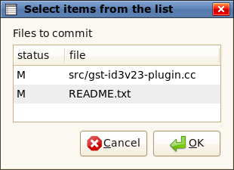
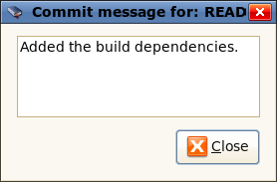
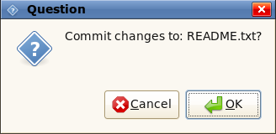
Gtk2 – Shell script
#!/bin/bash
## SVN graphical user interface
# Ask whcih files to commit
files=$( zenity --list --text="Files to commit" \
--column=status --column=file --multiple \
--print-column=2 `svn status | grep -v '^[?] '` )
[ $? -eq 0 ] || exit 1
[ "$files" = "" ] && exit 2
# Ask for the commit message
message=$( zenity --text-info --editable \
--title "Commit message for: $files" )
[ $? -eq 0 ] || exit 3
[ "$message" = "" ] && exit 3
# Confirm the commit
zenity --question --text="Commit changes to: $files?"
[ $? -eq 0 ] || exit 4
echo svn commit -m "$message" $files

Slide 8
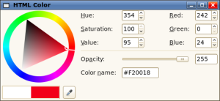
Gtk2 Example - Color picker
# The color chooser and the main window
my $color_selection = Gtk2::ColorSelection->new();
$color_selection->show_all();
my $win = Gtk2::Window->new('toplevel');
$win->add($color_selection);
# Create a system tray icon
my $tray = Gtk2::StatusIcon->new_from_stock('gtk-color-picker');
# Set the HTML value of the color selected
$color_selection->signal_connect(color_changed => sub {
# Get the color's HTML value
my $color = $color_selection->get_current_color();
my $html = $color_selection->palette_to_string($color);
# Update the clipboards with the HTML value
my $clipboard = Gtk2::Clipboard->get(Gtk2::Gdk->SELECTION_CLIPBOARD);
$clipboard->set_text($html_value);
});
# Show/hide the main window
$tray->signal_connect(activate => sub {$win->visible ? $win->hide() : $win->present();});
Gtk2->main();

Slide 9
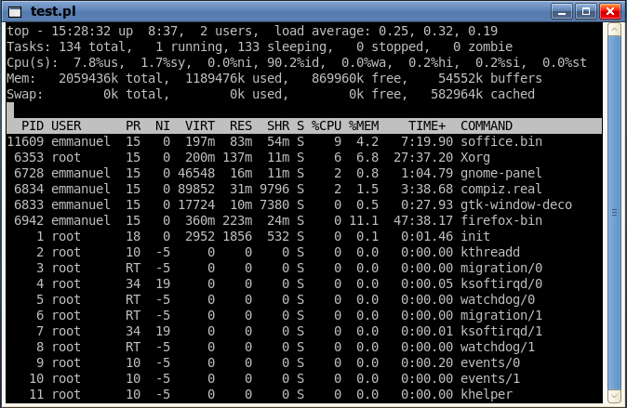
Gnome Example - Terminal
use Glib qw(TRUE FALSE);
use Gtk2 -init;
use Gnome2::Vte;
my $terminal = Gnome2::Vte::Terminal->new();
# Set up scrolling in the terminal
my $scrollbar = Gtk2::VScrollbar->new();
$scrollbar->set_adjustment($terminal->get_adjustment);
# Start a command in the terminal (doesn't have to be a shell)
$terminal->fork_command('/usr/bin/top', ['top'], undef, '/tmp', FALSE, FALSE, FALSE);
$terminal->signal_connect(child_exited => sub { Gtk2->main_quit });
# Layout
my $window = Gtk2::Window->new();
my $hbox = Gtk2::HBox->new();
$hbox->pack_start($terminal, TRUE, TRUE, 0);
$hbox->pack_start($scrollbar, FALSE, FALSE, 0);
$window->add($hbox);
# Start the application
$window->show_all();
Gtk2->main();

Slide 10
Widget properties and layout
my $vbox = Gtk2::VBox->new;
$vbox->set_border_width(2);
$vbox->set_spacing(2);
$vbox->pack_start($hbox, FALSE, FALSE, 0);
$vbox->pack_start($pane, TRUE, TRUE, 0);
$vbox->pack_start($status, FALSE, FALSE, 0);
Too many properties
Temporary layout containers
Callback setting is repetitive
my $window = Gtk2::Window->new('toplevel');
$window->set_position('center');
$window->set_default_size(600, 400);
$window->set_border_width(0);
$window->set_title($NAME);
$window->signal_connect(
delete_event => \&close_program
);
$window->add_accel_group($accels);

Slide 11
Gtk2::GladeXML
Easy graphical GUI builder
All Gtk2 and Gnome widgets are available
  Properties
  Signals
  Packing
XML file format
  Simple to read, edit and manipulate
  The same for all bindings (C/C++, Perl, Python)

Slide 12
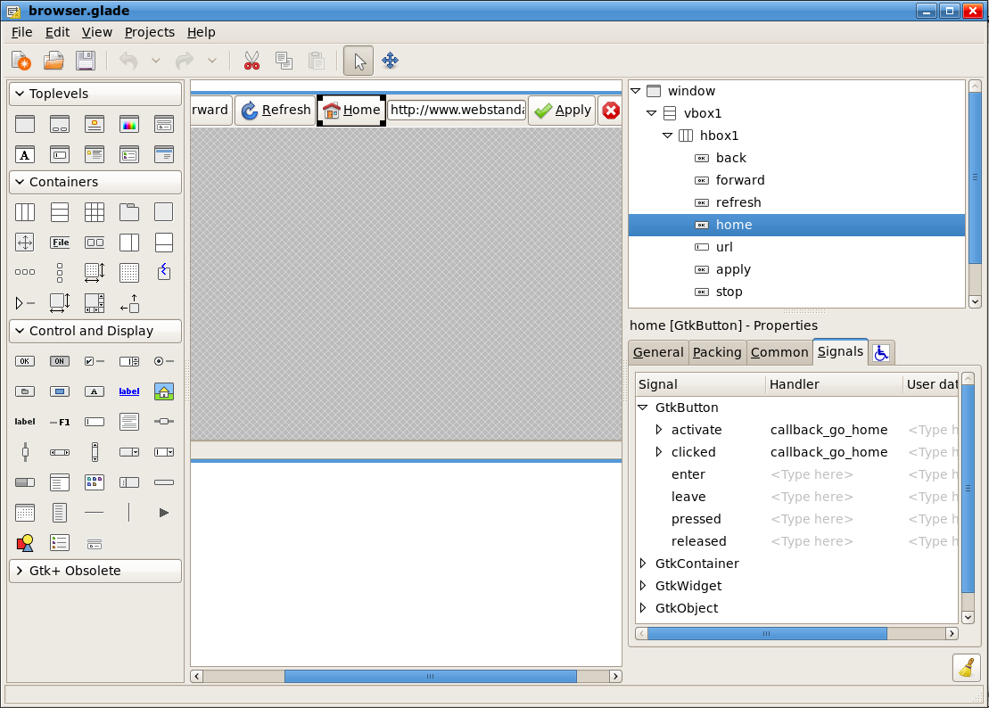
Glade

Slide 13
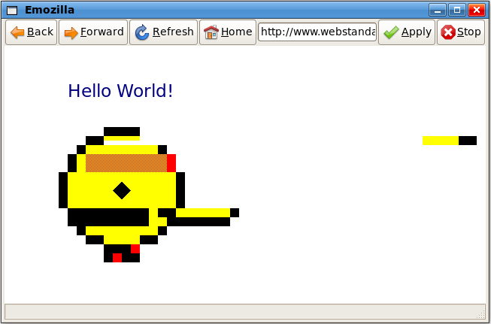
Glade Example - MozEmbed
Simple web browser
Rendering by Mozilla
GUI by Glade
All in 70 lines!

Slide 14
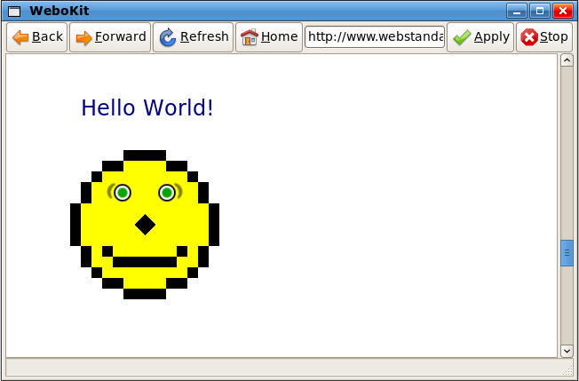
Glade Example - WebKit
Simple web browser
Rendering by WebKit
Same glade file
All in 73 lines!

Slide 15
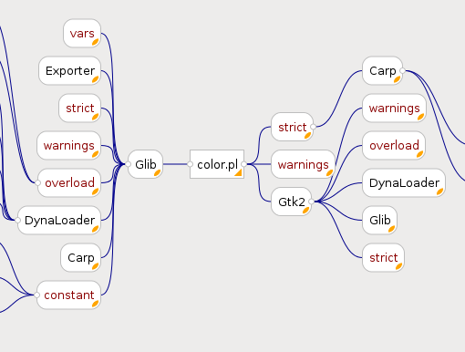
Mind Map Example

Slide 16
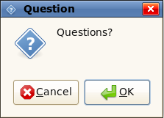
Gtk2->main_quit();

