Slide 1
Red Hat JBoss Fuse
Application Messaging and Data Integration
by
Brad Powell
brad.powell@spark14.com
for
Bartlesville User Group
June 18th, 2015

Slide 2
Fuse Overview
Development and Tooling | Web Services framework Apache CXF | Integration framework Apache Camel | Management and Monitoring
 | Reliable Messaging Apache ActiveMQ
 | Java Runtime Container Apache Karaf (OSGi)
Operating System (Linux, Windows, ...)

Slide 3
Red Hat and Open Source
Red Hat:
  Combines the open source pieces into a “release”
  QA's the release
  Offers support for the release
Everything is fed back to the upstream open source projects.

Slide 4
Java
Cross-platform, including cloud
OSGi (Apache Karaf)
  Dynamic configuration
  Deploy/update modules live
Development and Tooling | Web Services Apache CXF | Integration Apache Camel | Management and Monitoring
 | Reliable Messaging Apache ActiveMQ
 | Java Runtime / Container Apache Karaf (OSGi)
Operating System (Linux, Windows, ...)

Slide 5
ActiveMQ
Messaging server
aka JBoss A-MQ
Development and Tooling | Web Services Apache CXF | Integration Apache Camel | Management and Monitoring
 | Reliable Messaging Apache ActiveMQ
 | Java Runtime / Container Apache Karaf (OSGi)
Operating System (Linux, Windows, ...)

Slide 6
detour...
Why Messaging?

Slide 7
Traditional Point-to-Point Integration
Synchronous
RPC
Application guarantees delivery
Tightly-coupled
DB
DB
DB
App A
App B
App C
App D

Slide 8
Integration with Messaging
Asynchronous, event-driven
Fire-and-forget
Guaranteed delivery
Loosely-coupled
DB
DB
DB
App A
App B
App C
App D
Messaging Backbone (aka MOM: Message-Oriented Middleware)

Slide 9
Messaging Semantics
Queues:
point-to-point
Topics:
publish/subscribe
Consumers
Subscribers
Producer
App B
Publisher
App D
App A
Queue
App C
Topic
App B’
App E
2 messages
1
2 messages
1
2
1
myQueue
messages
not copied
1
myTopic
messages
are copied
2
2
2
1
2
persistence
persistence

Slide 10
...back to Fuse

Slide 11
ActiveMQ
Protocols & Transports
Multi-protocol
  Default:
    OpenWire over TCP/SSL/HTTP(S)/UDP/IP
  Also:
    STOMP, AMQP (RabbitMQ), MQTT, REST
  Can bridge protocols
  WebSocket
    STOMP and MQTT over WebSockets
Device
Topic
App

Slide 12
ActiveMQ
Clients
Multi-platform
  Clients for just about any platform
    Native:
      JMS, .NET, C++
    Other:
      JavaScript, Ruby, Perl, Python, PHP, Smalltalk, ...

Slide 13
ActiveMQ
Code Example – Java/JMS
http://activemq.apache.org/hello-world.html
// Create a ConnectionFactory
ActiveMQConnectionFactory connectionFactory = new ActiveMQConnectionFactory("vm://localhost");
// Create a Connection
Connection connection = connectionFactory.createConnection();
connection.start();
// Create a Session
Session session = connection.createSession(false, Session.AUTO_ACKNOWLEDGE);
// Create the destination (Topic or Queue)
Destination destination = session.createQueue("TEST.FOO");
// Create a MessageProducer from the Session to the Topic or Queue
MessageProducer producer = session.createProducer(destination);
producer.setDeliveryMode(DeliveryMode.NON_PERSISTENT);
// Create a messages
String text = "Hello world! From: " + Thread.currentThread().getName() + " : " + this.hashCode();
TextMessage message = session.createTextMessage(text);
// Tell the producer to send the message
System.out.println("Sent message: "+ message.hashCode() + " : " + Thread.currentThread().getName());
producer.send(message);
// Clean up
session.close();
connection.close();

Slide 14
ActiveMQ
Code Example – .NET/NMS
http://activemq.apache.org/nms/nms-examples.html
Uri connecturi = new Uri("activemq:tcp://activemqhost:61616");
IConnectionFactory factory = new NMSConnectionFactory(connecturi);
using(IConnection connection = factory.CreateConnection())
using(ISession session = connection.CreateSession())
{
IDestination destination = SessionUtil.GetDestination(session, "queue://FOO.BAR");
// Create a consumer and producer
using(IMessageConsumer consumer = session.CreateConsumer(destination))
using(IMessageProducer producer = session.CreateProducer(destination))
{
// Start the connection so that messages will be processed.
connection.Start();
producer.DeliveryMode = MsgDeliveryMode.Persistent;
// Send a message
ITextMessage request = session.CreateTextMessage("Hello World!");
request.NMSCorrelationID = "abc";
request.Properties["NMSXGroupID"] = "cheese";
request.Properties["myHeader"] = "Cheddar";
producer.Send(request);
// Consume a message
ITextMessage message = consumer.Receive() as ITextMessage;
if(message == null) {
Console.WriteLine("No message received!");
}
else {
Console.WriteLine("Received message with ID: " + message.NMSMessageId);
Console.WriteLine("Received message with text: " + message.Text);
}
}
}

Slide 15
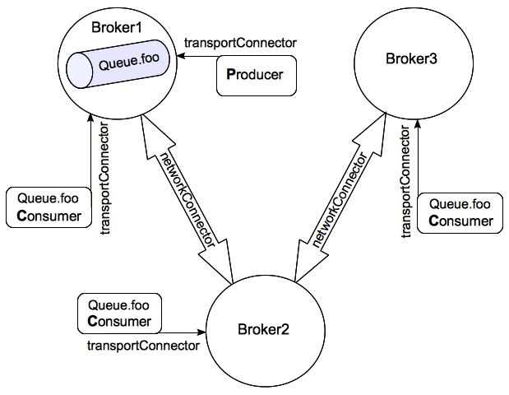
ActiveMQ
Architectures
Simple, stand-alone
Master/Slave, with failover protocol
Network-of-Brokers:
https://access.redhat.com/documentation/en-US/Red_Hat_JBoss_A-MQ/6.1/html/Product_Introduction/FMBScalable.html

Slide 16
ActiveMQ
Marketplace Comparison
RabbitMQ (AMQP)
MSMQ
Mosquitto (MQTT)
Amazon SQS
Kafka
ZeroMQ (library)
… many others

Slide 17
Camel
Data integration framework
Development and Tooling | Web Services Apache CXF | Integration Apache Camel | Management and Monitoring
 | Reliable Messaging Apache ActiveMQ
 | Java Runtime / Container Apache Karaf (OSGi)
Operating System (Linux, Windows, ...)

Slide 18
Camel
Overview
Lightweight and embeddable
Components (i.e. connectors)
  150+ out-of-the-box components
  The usual:
    DB, File, (S)FTP, HTTP(S), JMS, etc.
  And many more:
    SAP, SalesForce, HDFS, HBase, MongoDB, Dropbox, GMail, Facebook, Twitter, ...
Domain Specific Language
  Based on Enterprise Integration Patterns (EIPs)
  DSL implementations: Java, XML, Scala, ...

Slide 19
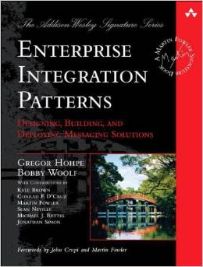
Camel
EIPs
http://www.enterpriseintegrationpatterns.com
Book by Gregor Hohpe and Bobby Woolf

Slide 20
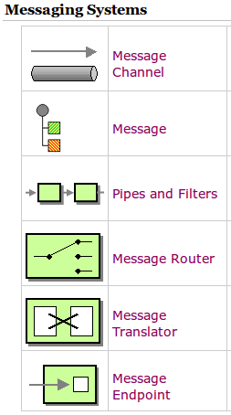
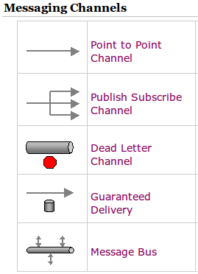
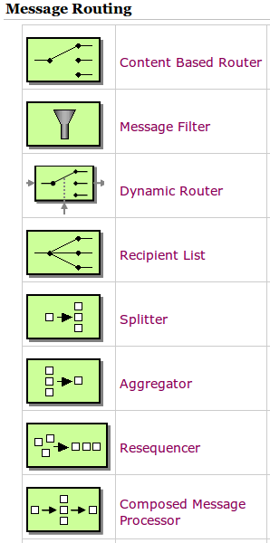
Camel
EIPs
...and more patterns (65 in total)

Slide 21
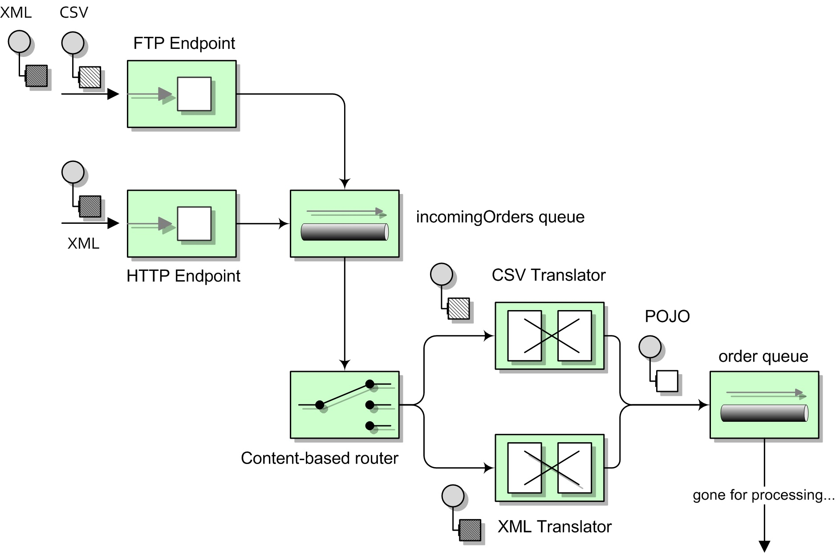
Camel
EIP Example
http://java.dzone.com/articles/open-source-integration-apache

Slide 22
Camel
Code Examples
Java DSL (fluent)
    from ("file:/tmp").to("jms:aQueue");
Spring XML DSL
    <route>
      <from uri="file:/tmp"/>
      <to uri="jms:aQueue"/>
    </route>
Scala DSL
    from "file:/tmp" -> "jms:aQueue"

Slide 23
Camel
Code Examples (cont.)
Java DSL, with content-based routing (http://camel.apache.org/java-dsl.html)
    // Process input files, leaving them in place ('noop' flag), then
    // perform content-based-routing on the message using XPath.
    from("file:src/data?noop=true")
      .choice()
        .when(xpath("/person/city = &#39;London&#39;"))
          .to("file:target/messages/uk")
        .otherwise()
          .to("file:target/messages/others");

Slide 24
Camel
“Framework vs Platform”
Camel is an integration “framework”, not a full integration platform, like Talend, Mule, TIBCO, Informatica, PI, BizTalk, etc.
  Although, when combined with all of the associated tooling, such as A-MQ, CXF, Hawtio, JBoss Studio, etc., it’s more-or-less a platform.
Skills: Java, Maven, Spring
  Good, because finding “typical” Java developers tends to be easier than finding specialists in the other integration platforms.

Slide 25
Camel
Marketplace Comparison
Java
  Spring Integration
.NET
  NServiceBus
  MassTransit

Slide 26
CXF
Services framework
Development and Tooling | Web Services Apache CXF | Integration Apache Camel | Management and Monitoring
 | Reliable Messaging Apache ActiveMQ
 | Java Runtime / Container Apache Karaf (OSGi)
Operating System (Linux, Windows, ...)

Slide 27
CXF
Overview
Build services using front-end APIs, such as:
  JAX-WS
  JAX-RS
Protocols and transports
  SOAP
  XML/HTTP
  RESTful HTTP
  JMS
  ...more

Slide 28
(side note)
Camel REST DSL
As an alternative to using CXF for RESTful services, Camel now includes a REST DSL
e.g.
  rest("/customers/")
    .get("/{id}").to("direct:customerDetail")
    .get("/{id}/orders").to("direct:customerOrders")
    .post("/neworder").to("direct:customerNewOrder”);

Slide 29
Development and Tooling
Text editor
Eclipse IDE
  JBoss Developer Studio
Typical Java build/CI tools (Git, Maven, Jenkins)
Development and Tooling | Web Services Apache CXF | Integration Apache Camel | Management and Monitoring
 | Reliable Messaging Apache ActiveMQ
 | Java Runtime / Container Apache Karaf (OSGi)
Operating System (Linux, Windows, ...)

Slide 30
Management and Monitoring
JMX
Hawtio console
JBoss Operations Network
Development and Tooling | Web Services Apache CXF | Integration Apache Camel | Management and Monitoring
 | Reliable Messaging Apache ActiveMQ
 | Java Runtime / Container Apache Karaf (OSGi)
Operating System (Linux, Windows, ...)

Slide 31
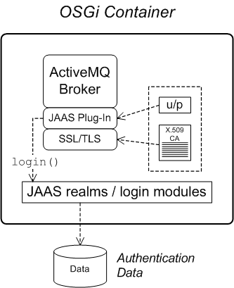
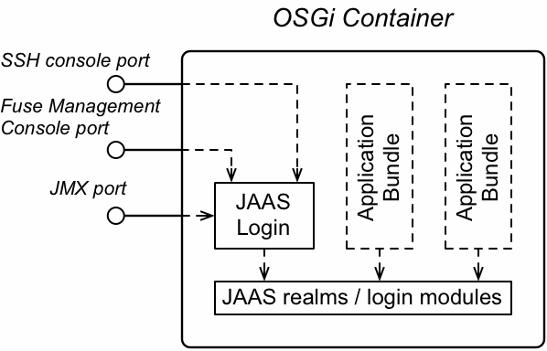
Security
https://access.redhat.com/documentation/en-US/Red_Hat_JBoss_Fuse/6.1/html/Security_Guide
JAAS: Java Authentication and Authorization Service

Slide 32
Misc
Message payloads
  JMS/NMS have common types (binary, text, etc.)
  MQTT is binary
BPM/BRMS
  Often used in conjunction with integration/messaging systems
Links
  https://access.redhat.com/documentation/en-US/Red_Hat_JBoss_Fuse/6.1/
  https://github.com/FuseByExample
  http://activemq.apache.org/
  http://camel.apache.org/

Slide 33
Questions?

