Slide 1
Lending Club Case Study
Group Facilitator: Sanjay Saini
Group Member: Manish Ranjan
Github Repo URL: https://github.com/sanjaysaini-msn/LendingClubCaseStudy

Slide 2
Business Understanding
Approach
Assumptions
Some Insights
Univariate Analysis
Segmented Univariate Analysis
Bivariate Analysis
Probability Analysis
Conclusion/Recommendation

Slide 3
Business Requirement
Help the finance company in decision making for loan approval based on the applicant’s profile
Risks involved
Not approving loans for the applicants who are likely to repay the loan
Approving loans for the applicants who are likely to default
Identify patterns using past loan application data that can trigger charge-off loans

Slide 4
Approach
Data fields understanding
Understand the purpose of different fields as available in the dataset
Data Pre-processing
Remove columns having all null values or greater than a threshold
Remove columns which are not required or have no relation to the business requirement
Remove rows with missing values using a threshold
Impute the missing values for columns having missing values less than the threshold
Convert data types for int, float and date fields
Create derived columns
Remove outliers
Exploratory Data Analysis
Visualize data and Identify important variables for decision making

Slide 5
Assumptions
Rows with Loan status “Current” are not eligible for this analysis
Threshold taken for Data pre-processing
Columns having null values in 35% or above rows
Rows having null values in 10 or more columns
Categorical variables that can trigger defaults:
Employment length
Grade/Sub-Grade
Loan Purpose
Location (State Code)
Loan Amount
Interest Rate
Annual Income

Slide 6
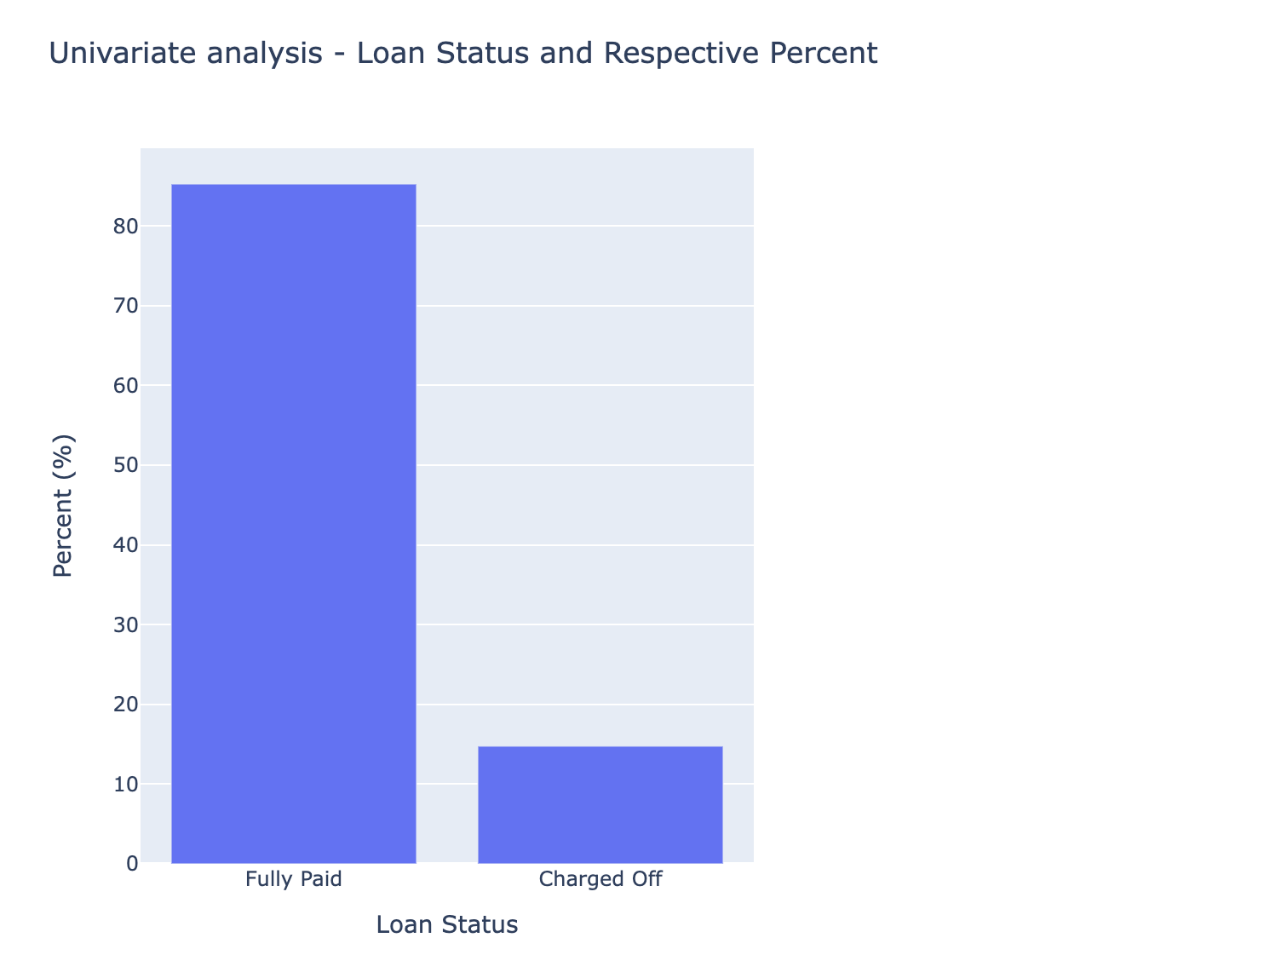
Insights – Univariate Analysis
Observation:
85.24% loans are "Fully Paid" where as 14.75% loans are "Charged Off"

Slide 7
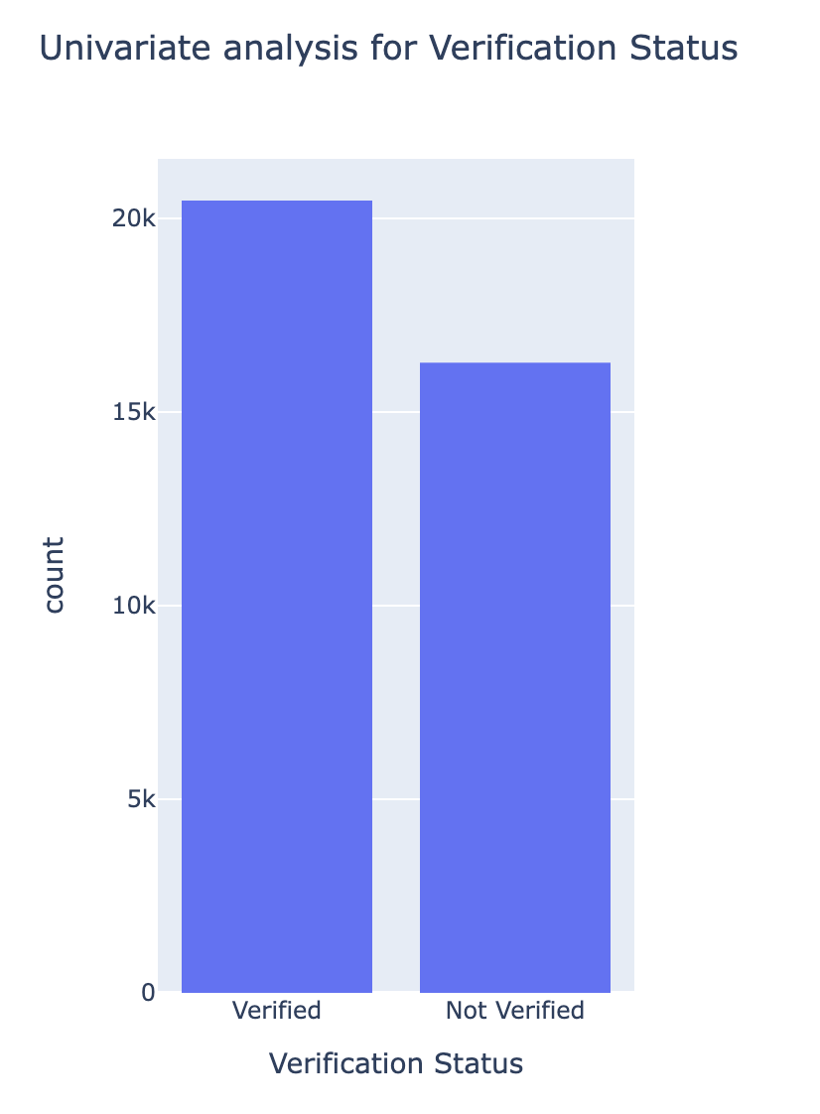
Insights – Univariate Analysis
Observation:
Number of Non-Verified loans is quite high

Slide 8
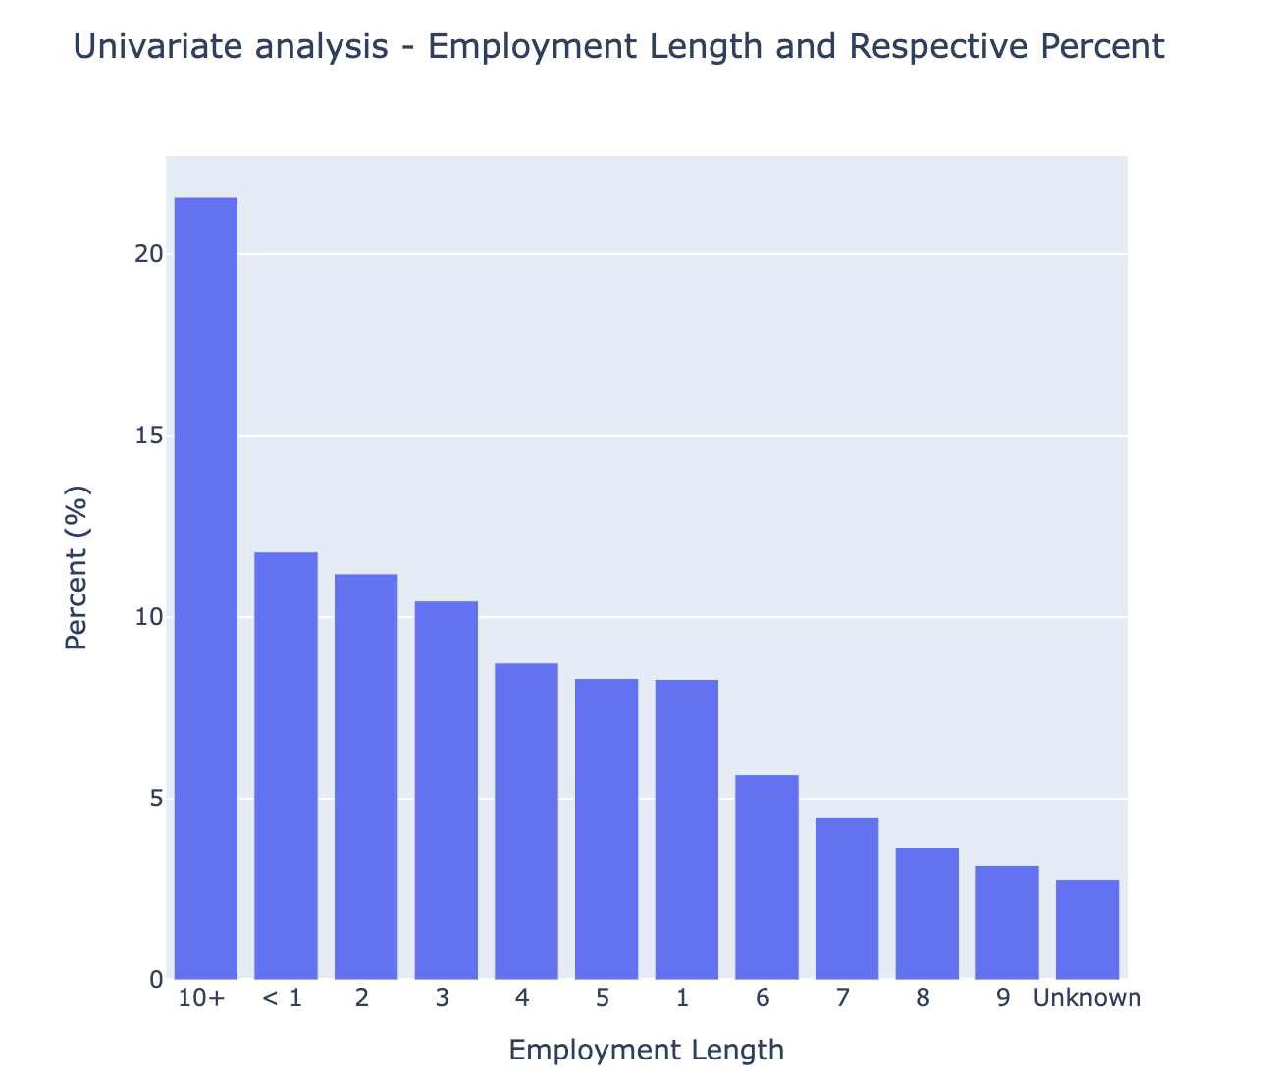
Insights – Univariate Analysis
Observation:
More than 21% loans were given to the applicants having 10+ years of employment

Slide 9
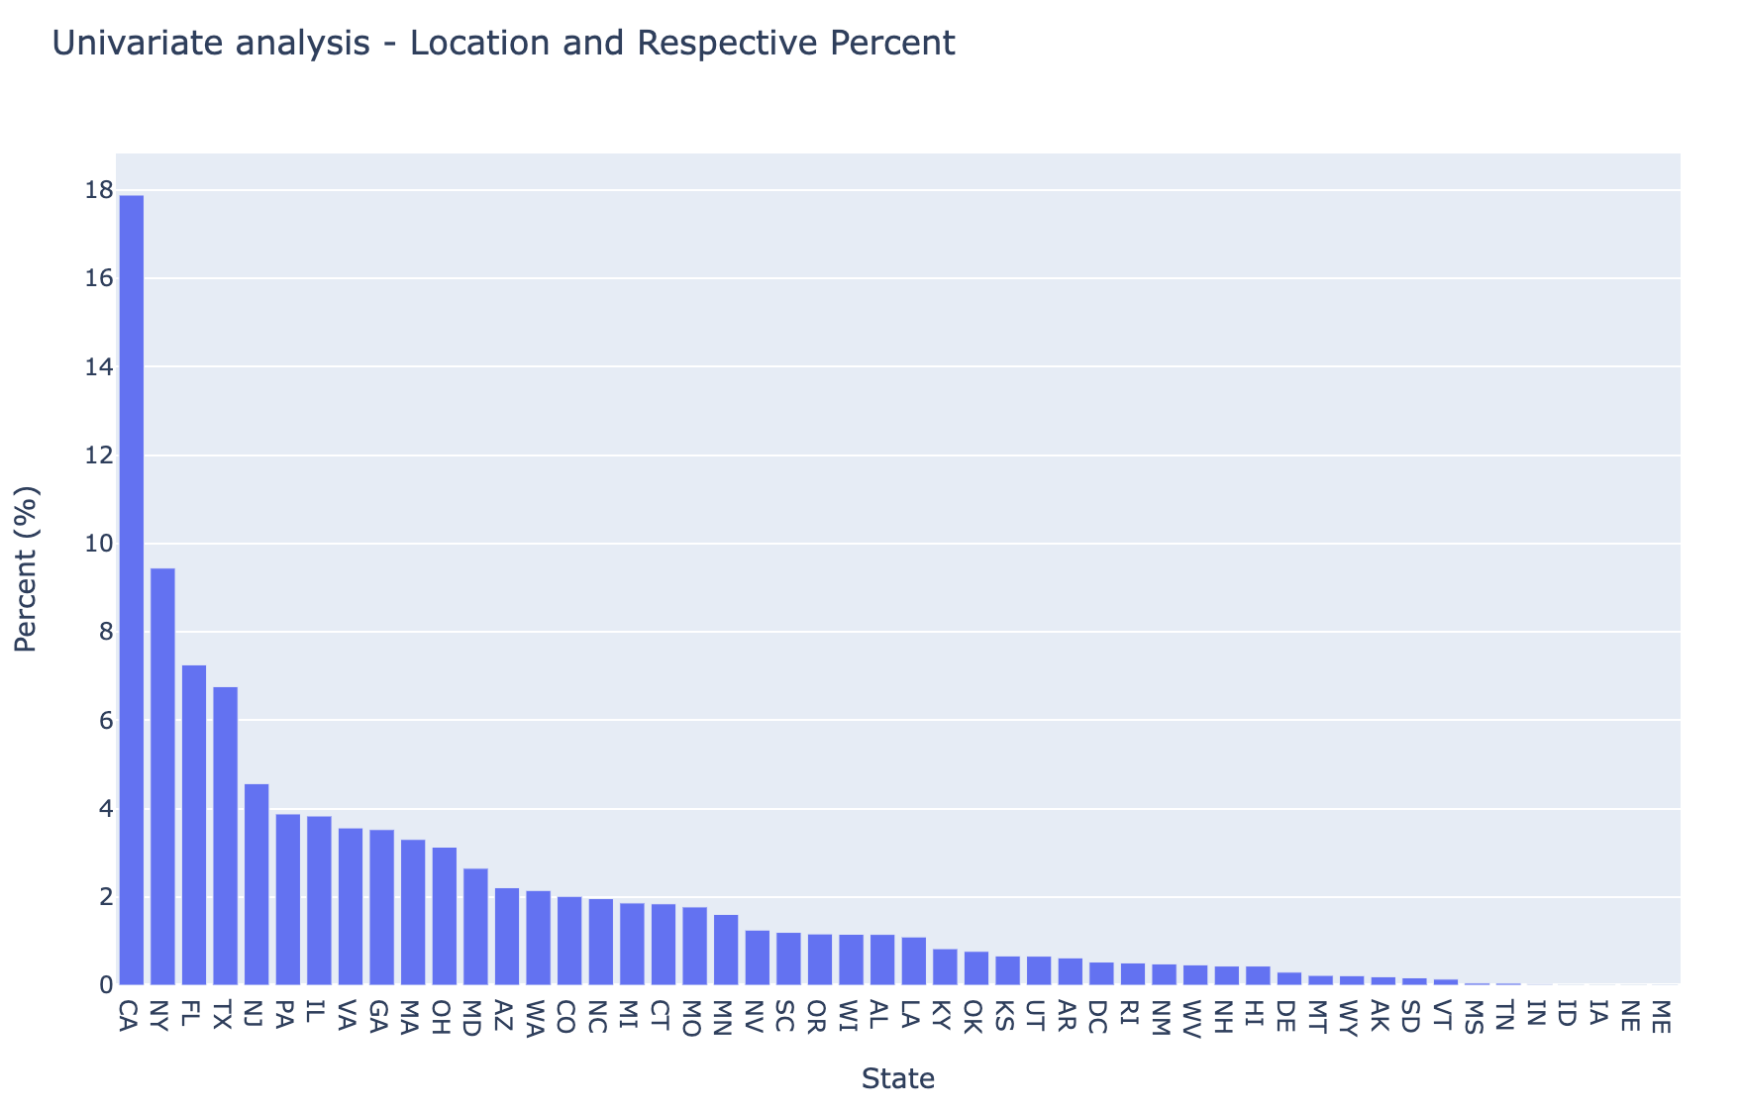
Insights – Univariate Analysis
Observation:
Around 18% loans were given to applicants from California

Slide 10
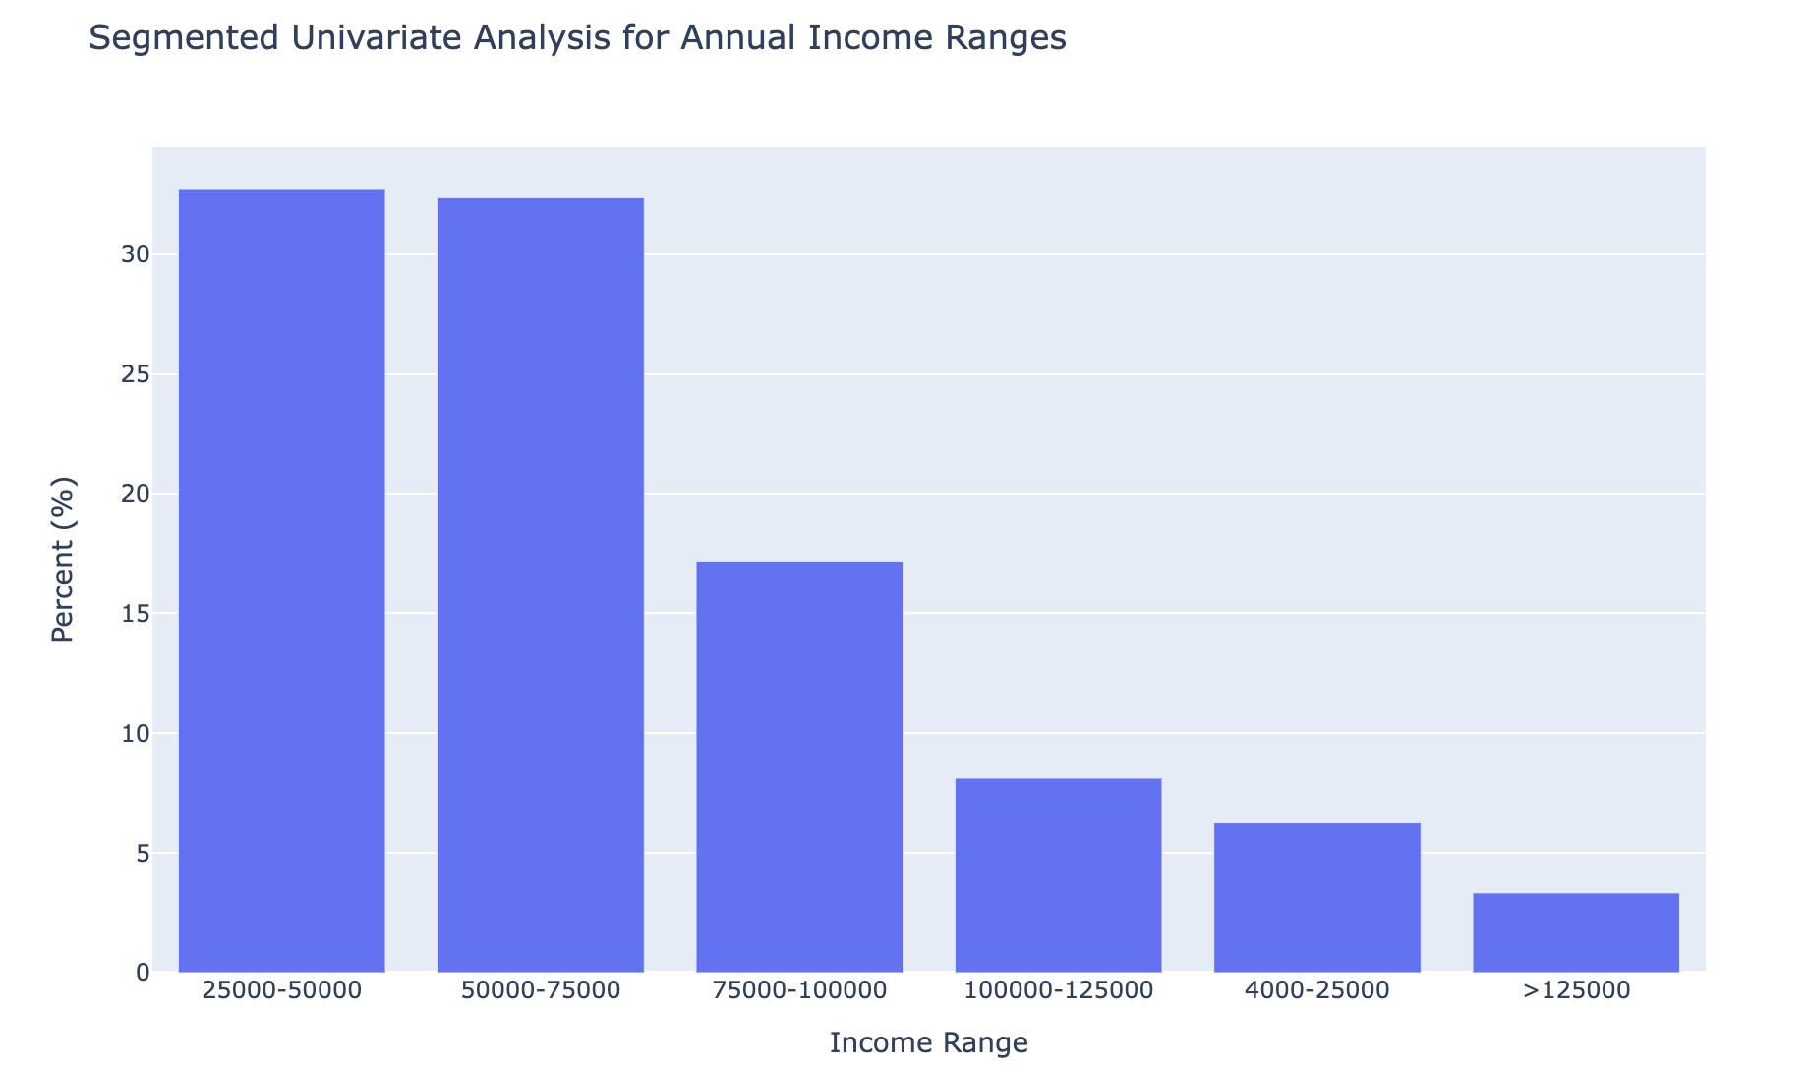
Insights – Segmented Univariate Analysis
Observation:
Annual income of 64% applicants is between 25k and 75k

Slide 11
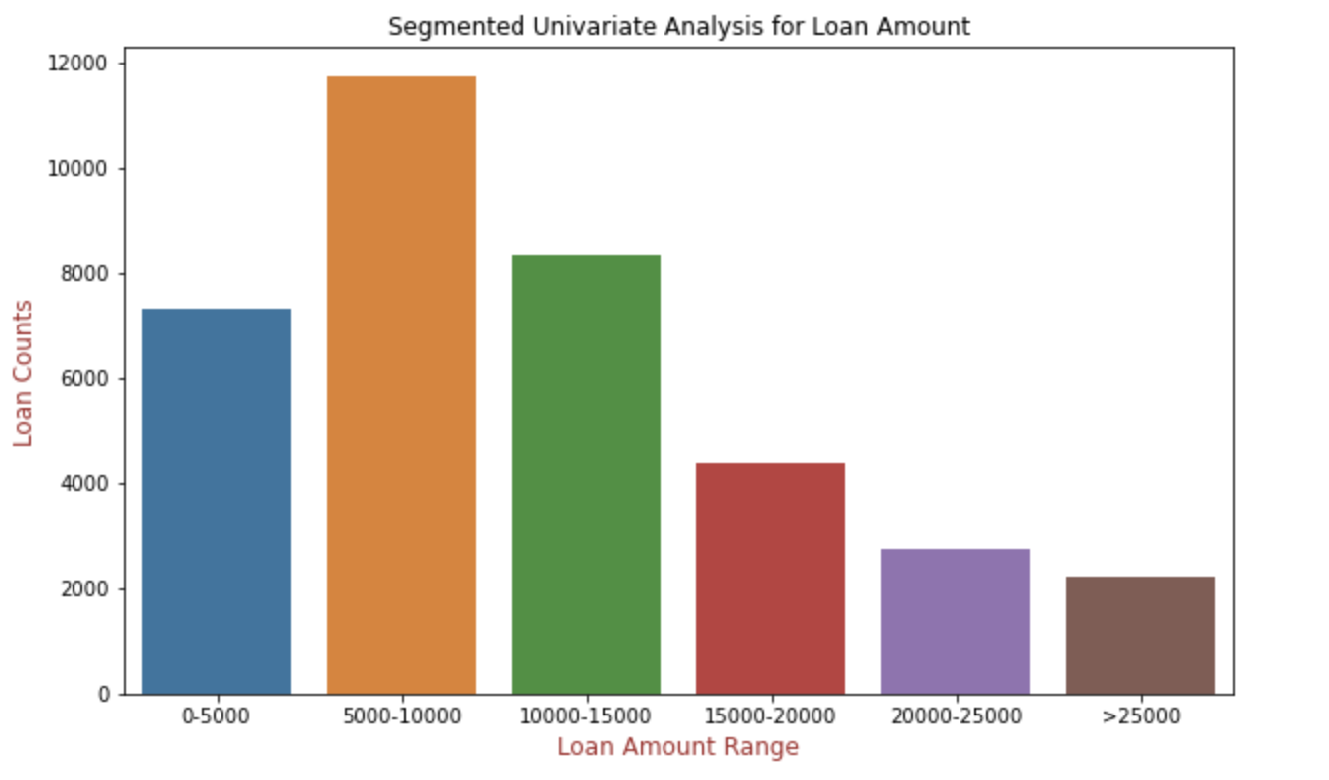
Insights – Segmented Univariate Analysis
Observation:
Maximum loans disbursed are between 5k and 10k loan amount range

Slide 12
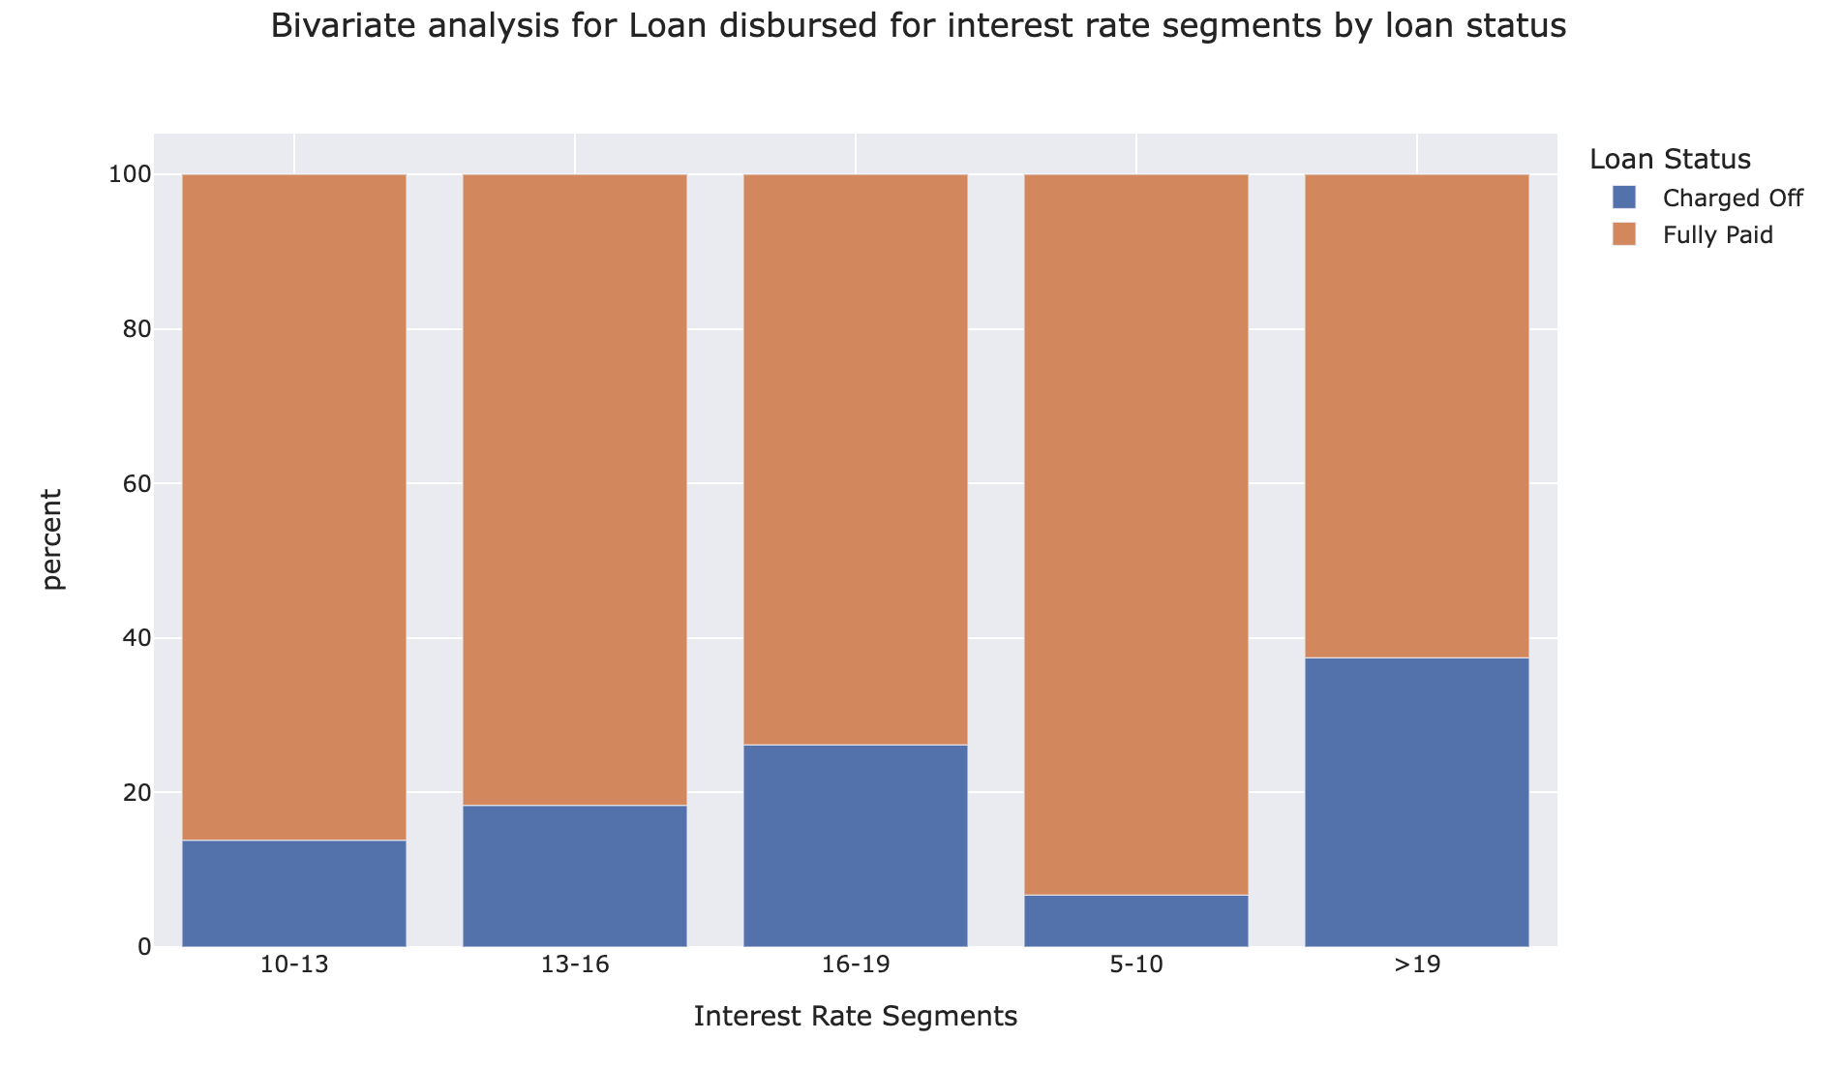
Insights – Bivariate Analysis
Observation:
Defaulters % is low for lower interest rate (5-13%)

Slide 13
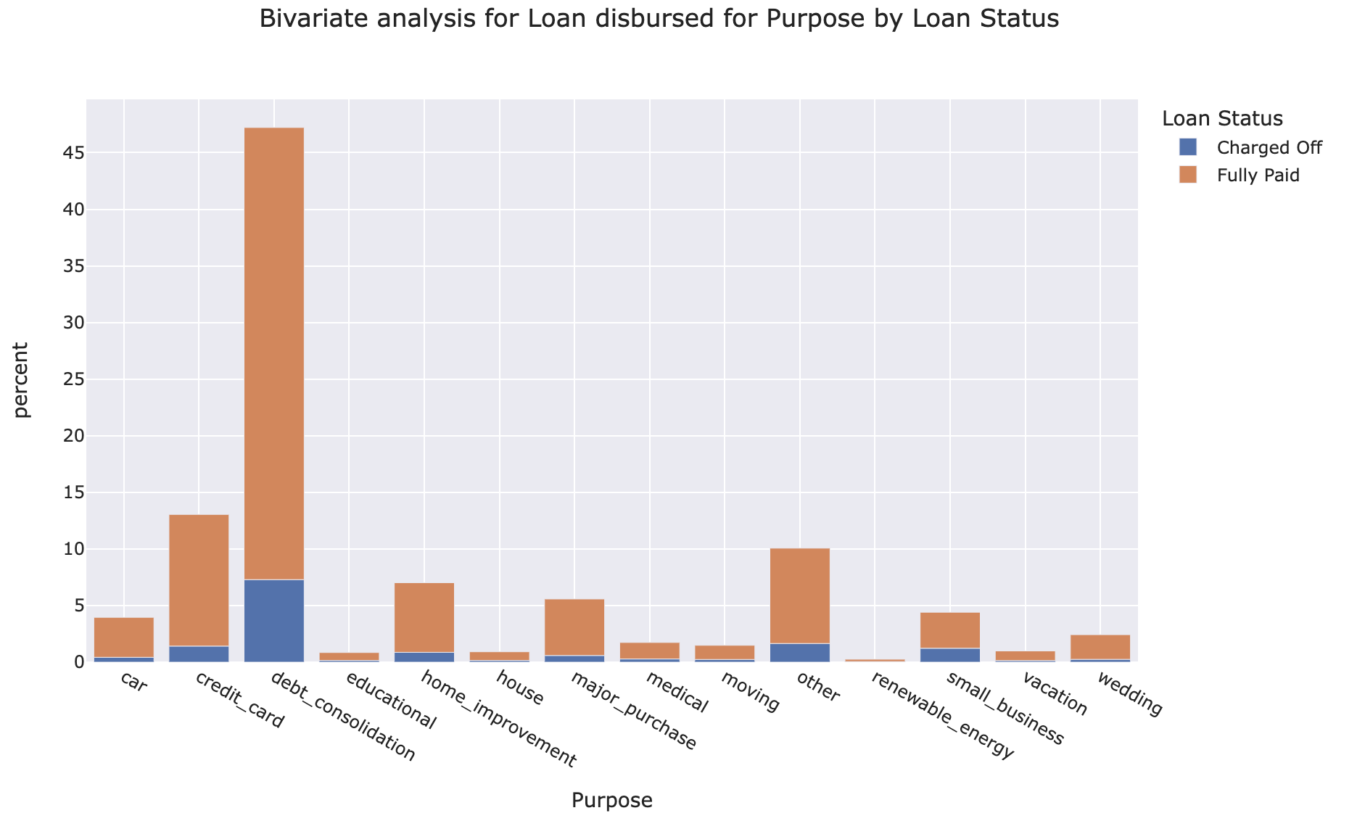
Insights – Bivariate Analysis
Observation:
Applicants who have taken loan for debt consolidation are having highest % of charged off

Slide 14
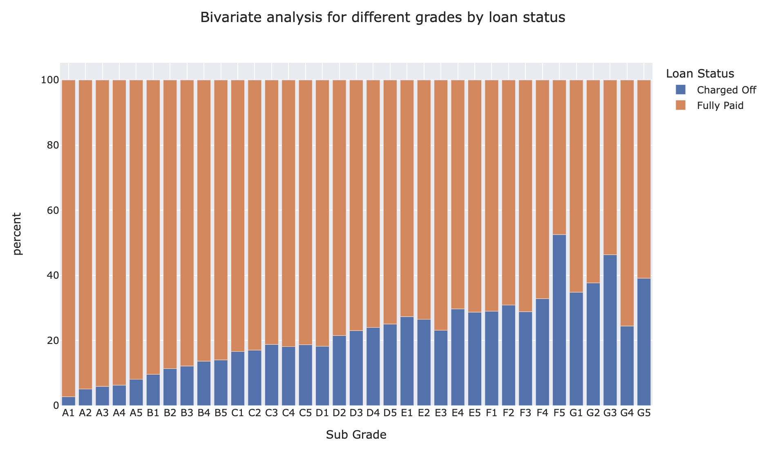
Insights – Bivariate Analysis
Observation:
Charged off % is low for grade A
Charged off % is high for sub-grade F5

Slide 15
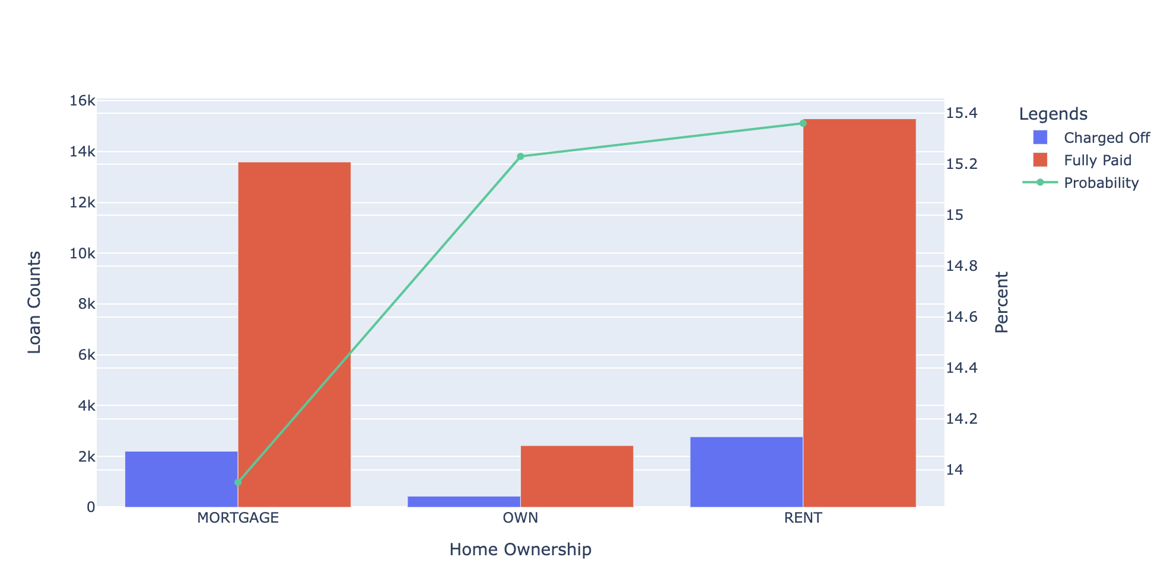
Insights – Probability Analysis
Observation:
Defaulter Probability is high for the applicants living on rent

Slide 16
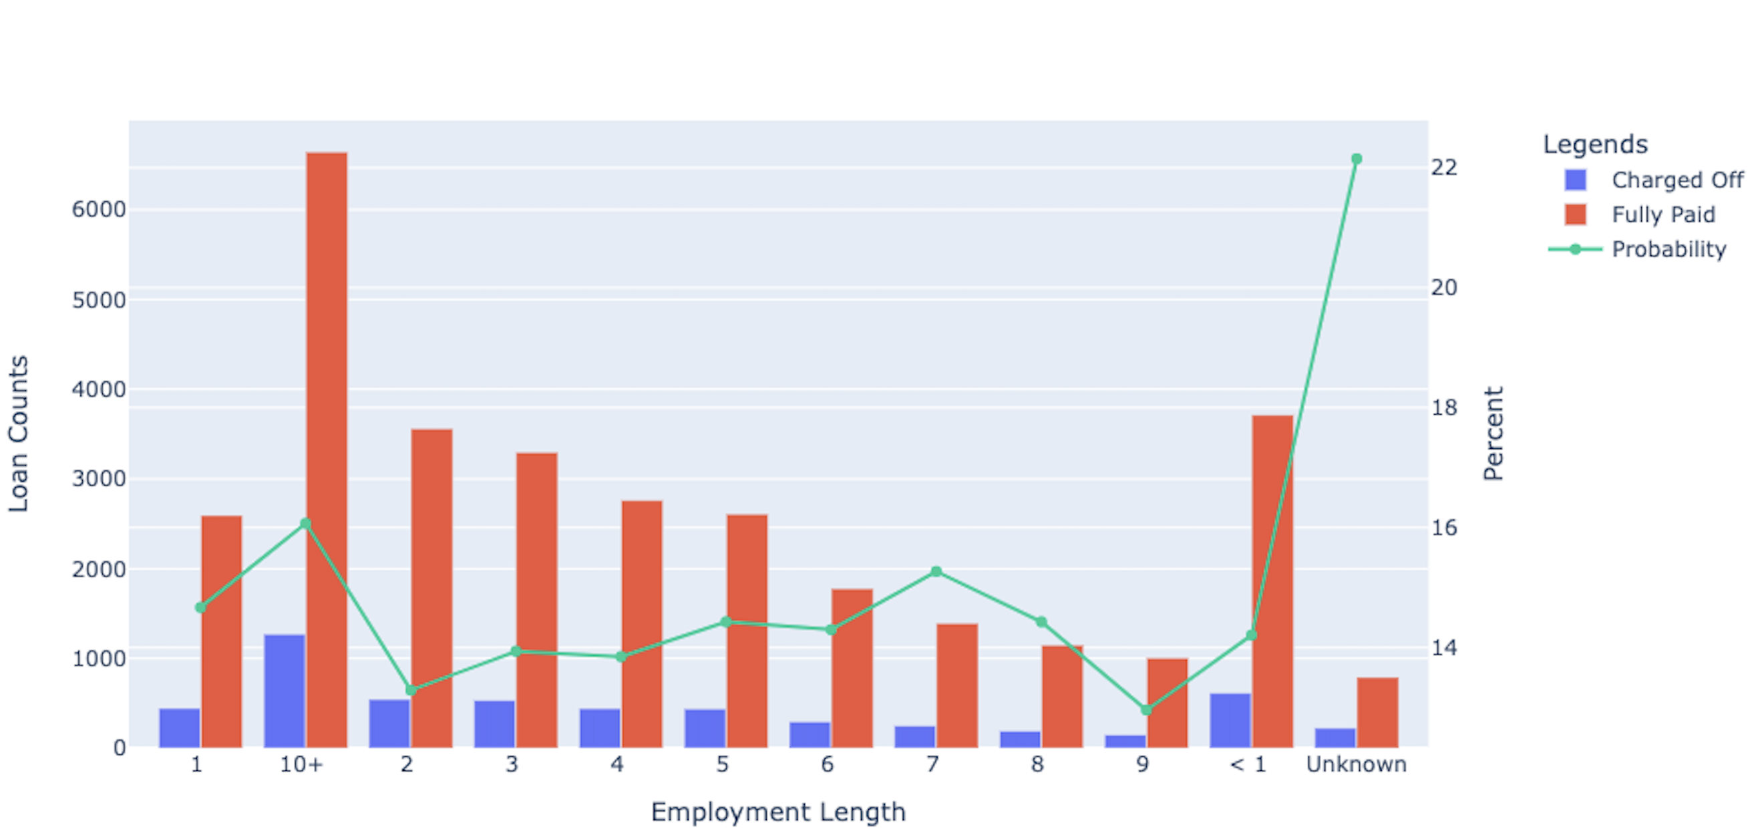
Insights – Probability Analysis
Observation:
Defaulter Probability is high for the applicants having no employment history (Unknown) and with 10+ years of employment length

Slide 17
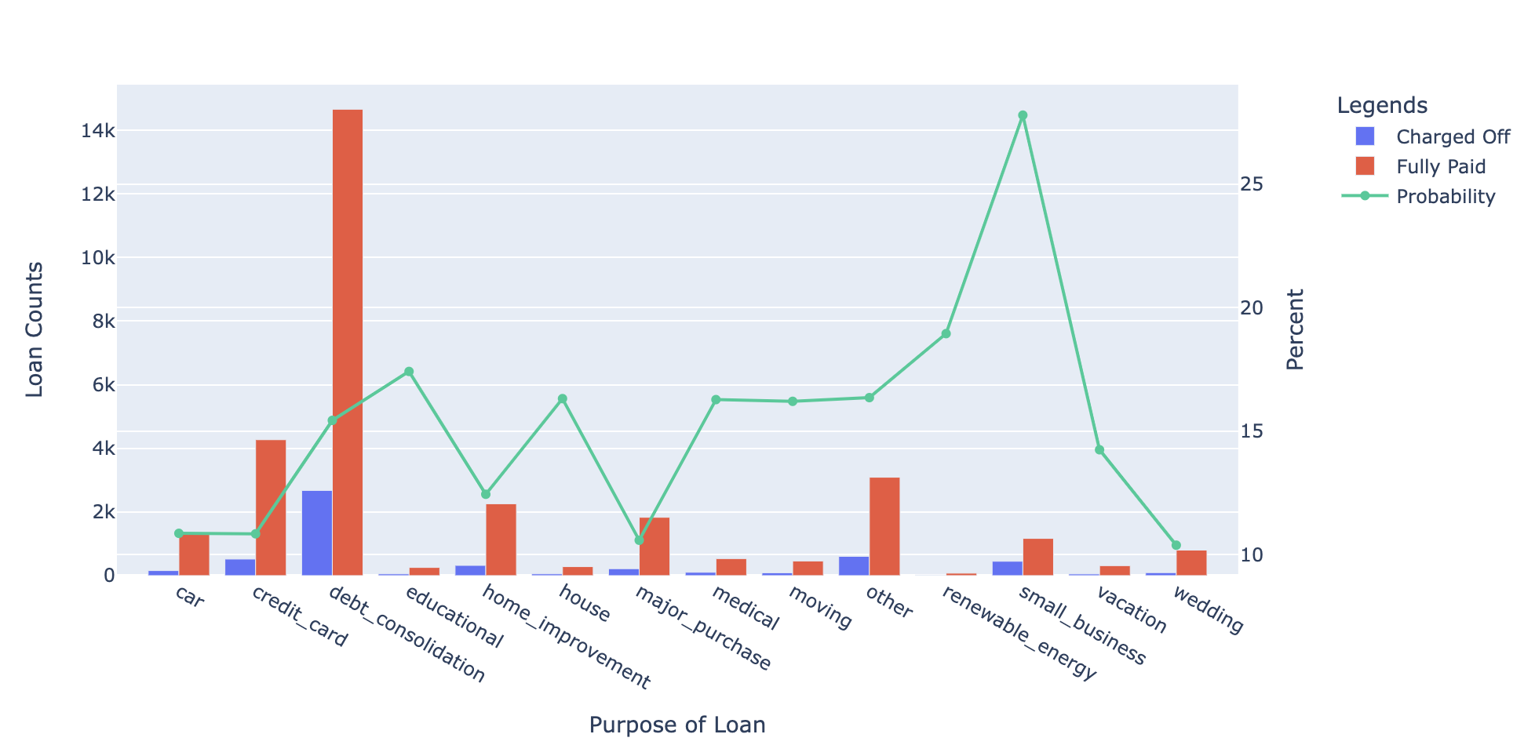
Insights – Probability Analysis
Observation:
Probability to default is high for applicants running small business

Slide 18
Insights

Slide 19
Conclusion/Recommendation
Applicants who have taken the loan for “small business” are having highest probability (27.79%) to default.
Defaulter Probability is the highest (22.15%) for the applicants having no employment history (Marked as “Unknown” in the graph)
Probability to default is increasing from grade A to G. Sub-grade F5 has maximum probability (52.5%) to default
Applicants who has taken the Loan for small business has the highest probabilty of Likely to be as a Defaulter of 26%.
Low annual income (less than 25000) are highest probable (19.59%) to default.
Probability to default is increasing with increase in Loan Amount. Applicants with Loan amount of 25000 or above are probable to default.
Probability to default is increasing with increasing Interest Rate and DTI. Loan applicants with interest rate or DTI 19% or above are probable to default.
State Nebraska (NE) has the highest probability (60%) to default.

Slide 20
Thank you

