Slide 1
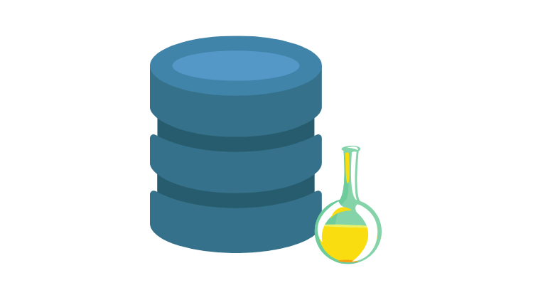
Husseinnasser.com
Updated-Oct/2021
ACID
Atomicity, Consistency, Isolation and Durability in
Relational Database Systems

Slide 2
Agenda
What is a Transaction?
Atomicity
Isolation
Consistency
Durability
Quiz

Slide 3

What is a Transaction?

Slide 4
Transaction
A collection of queries
One unit of work
E.g. Account deposit (SELECT, UPDATE, UPDATE)

Slide 5
Transaction Lifespan
Transaction BEGIN
Transaction COMMIT
Transaction ROLLBACK
Transaction unexpected ending = ROLLBACK (e.g. crash)

Slide 6
Nature of Transactions
Usually Transactions are used to change and modify data
However, it is perfectly normal to have a read only transaction
Example, you want to generate a report and you want to get consistent snapshot based at the time of transaction
We will learn more about this in the Isolation section

Slide 7
Transaction
ACCOUNT_ID | BALANCE
1 | $1000
2 | $500
$900
$900
$600
$600
Send $100 From Account 1 to Account 2
BEGIN TX1
SELECT BALANCE FROM ACCOUNT WHERE ID = 1
BALANCE > 100
UPDATE ACCOUNT SET BALANCE = BALANCE - 100 WHERE ID = 1
UPDATE ACCOUNT SET BALANCE = BALANCE + 100 WHERE ID = 2
COMMIT TX1

Slide 8
Summary
What is a Transaction?

Slide 9
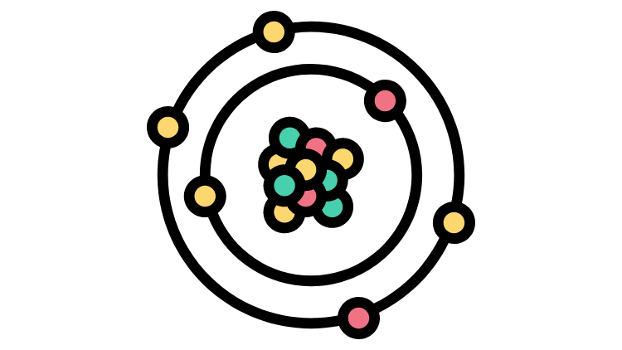
Atomicity

Slide 10
Atomicity
All queries in a transaction must succeed.
If one query fails, all prior successful queries in the transaction should rollback.
If the database went down prior to a commit of a transaction, all the successful queries in the transactions should rollback

Slide 11
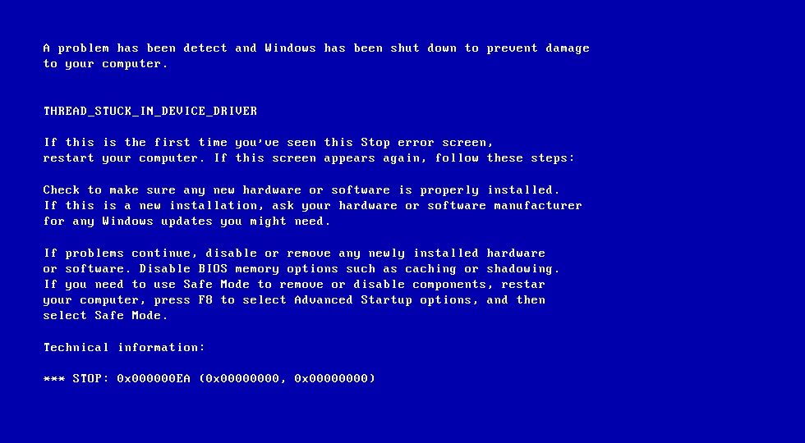
Atomicity
ACCOUNT_ID | BALANCE
1 | $1000
2 | $500
$900
Send $100 From Account 1 to Account 2
BEGIN TX1
SELECT BALANCE FROM ACCOUNT WHERE ID = 1
BALANCE > 100
UPDATE ACCOUNT SET BALANCE = BALANCE - 100 WHERE ID = 1

Slide 12
Atomicity
ACCOUNT_ID | BALANCE
1 | $900
2 | $500
After we restarted the machine the first account has been debited but the other account has not been credited.
This is really bad as we just lost data, and the information is inconsistent
An atomic transaction is a transaction that will rollback all queries if one or more queries failed.
The database should clean this up after restart.

Slide 13
Summary
Atomicity

Slide 14

Isolation

Slide 15
Isolation
Can my inflight transaction see changes made by other transactions?
Read phenomena
Isolation Levels

Slide 16
Isolation - Read phenomena
Dirty reads
Non-repeatable reads
Phantom reads
Lost updates

Slide 17
Dirty Reads
SALES
PID | QNT | PRICE
Product 1 | 10 | $5
Product 2 | 20 | $4
10
15
BEGIN TX1
BEGIN TX2
SELECT PID, QNT*PRICE FROM SALES
Product 1, 50
Product 2, 80
UPDATE SALES SET QNT = QNT+5
WHERE PID =1
SELECT SUM(QNT*PRICE) FROM SALES
We get $155 when it should be $130
We read a “dirty” value that has not been committed
COMMIT TX1
ROLLBACK TX2

Slide 18
Non-repeatable read
SALES
PID | QNT | PRICE
Product 1 | 10 | $5
Product 2 | 20 | $4
15
15
BEGIN TX1
BEGIN TX2
SELECT PID, QNT*PRICE FROM SALES
Product 1, 50
Product 2, 80
UPDATE SALES SET QNT = QNT+5
WHERE PID =1
COMMIT TX2
SELECT SUM(QNT*PRICE) FROM SALES
We get $155 when it should be $130
We did read a committed value, but it gave us inconsistent results
COMMIT TX1

Slide 19
Phantom read
SALES
PID | QNT | PRICE
Product 1 | 10 | $5
Product 2 | 20 | $4
BEGIN TX1
Product 3 | 10 | 1
Product 3 | 10 | $1
SELECT PID, QNT*PRICE FROM SALES
BEGIN TX2
Product 1, 50
Product 2, 80
INSERT INTO SALES
VALUES (‘Product 3’, 10, 1)
COMMIT TX2
SELECT SUM(QNT*PRICE) FROM SALES
We get $140 when it should be $130
We read a committed value that showed up in our range query
COMMIT TX1

Slide 20
Lost updates
SALES
PID | QNT | PRICE
Product 1 | 10 | $5
Product 2 | 20 | $4
20
15
BEGIN TX1
BEGIN TX2
UPDATE SALES SET QNT = QNT+10
WHERE PID =1
UPDATE SALES SET QNT = QNT+5
WHERE PID =1
COMMIT TX2
SELECT SUM(QNT*PRICE) FROM SALES
We get $155 when it should be $180
Our update was overwritten another transaction and as a result “lost”
COMMIT TX1

Slide 21
Isolation - Isolation Levels for inflight transactions
Read uncommitted - No Isolation, any change from the outside is visible to the transaction, committed or not.
Read committed - Each query in a transaction only sees committed changes by other transactions
Repeatable Read - The transaction will make sure that when a query reads a row, that row will remain unchanged while its running.
Snapshot - Each query in a transaction only sees changes that have been committed up to the start of the transaction. It's like a snapshot version of the database at that moment.
Serializable - Transactions are run as if they serialized one after the other.
Each DBMS implements Isolation level differently

Slide 22
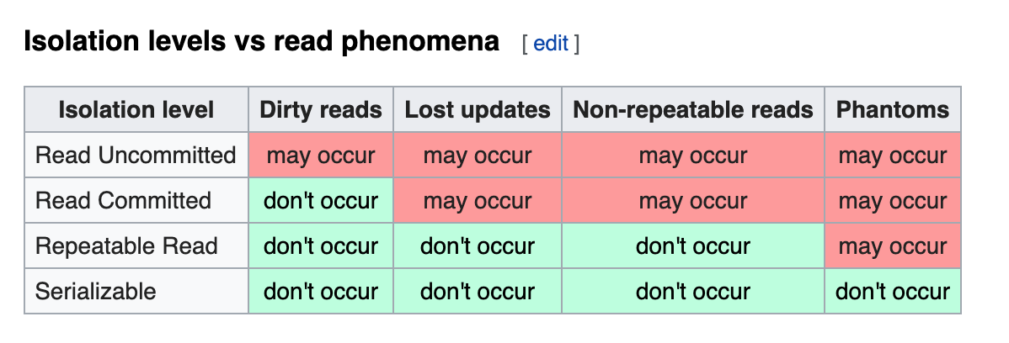
Isolation Levels vs read phenomena
https://en.wikipedia.org/wiki/Isolation_(database_systems)

Slide 23
Database Implementation of Isolation
Each DBMS implements Isolation level differently
Pessimistic - Row level locks, table locks, page locks to avoid lost updates
Optimistic - No locks, just track if things changed and fail the transaction if so
Repeatable read “locks” the rows it reads but it could be expensive if you read a lot of rows, postgres implements RR as snapshot. That is why you don’t get phantom reads with postgres in repeatable read
Serializable are usually implemented with optimistic concurrency control, you can implement it pessimistically with SELECT FOR UPDATE

Slide 24
Summary
Isolation

Slide 25

Consistency

Slide 26
Consistency
Consistency in Data
Consistency in reads

Slide 27
Consistency in Data
Defined by the user
Referential integrity (foreign keys)
Atomicity
Isolation

Slide 28
Consistency in Data
Pictures
Picture_Likes
ID (PK) | BLOB | LIKES
1 | xx | 2
2 | xx | 1
USER (PK) | PICTURE_ID (PK)(FK)
Jon | 1
Edmond | 1
Jon | 2

Slide 29
Spot inconsistency in this data
Pictures
Picture_Likes
ID (PK) | BLOB | LIKES
1 | xx | 5
2 | xx | 1
USER (PK) | PICTURE_ID (PK)(FK)
Jon | 1
Edmond | 1
Jon | 2
Edmond | 4

Slide 30
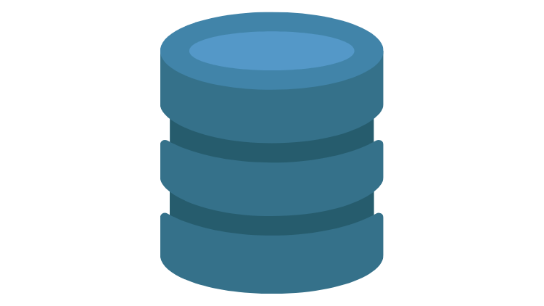
Consistency in reads
Update X
X
Read
X

Slide 31
Consistency in reads
If a transaction committed a change will a new transaction immediately see the change?
Affects the system as a whole
Relational and NoSQL databases suffer from this
Eventual consistency

Slide 32
Summary
Consistency

Slide 33

Durability

Slide 34
Durability
Changes made by committed transactions must be persisted in a durable non-volatile storage.
Durability techniques
WAL - Write ahead log
Asynchronous snapshot
AOF

Slide 35
Durability - WAL
Writing a lot of data to disk is expensive (indexes, data files, columns, rows, etc..)
That is why DBMSs persist a compressed version of the changes known as WAL (write-ahead-log segments)

Slide 36
Durability - OS Cache
A write request in OS usually goes to the OS cache
When the writes go the OS cache, an OS crash, machine restart could lead to loss of data
Fsync OS command forces writes to always go to disk
fsync can be expensive and slows down commits

Slide 37
Summary
Durability

Slide 38
Summary
What is a Transaction?
Atomicity
Isolation
Consistency
Durability

