Slide 1
MULTI NODE CLUSTER SETUP
Using
Apache Spark
Presented By,
Bappi Kumar
1611176112
Computer Science & Engineering
Rajshahi University, Rajshahi

Slide 2
What will we learn today???
Methodology
Definition of Cluster
Types of Cluster
Selected Cluster
Definition and Purposes
Software Components
Supported Language

Slide 3

Spark Features
Components of Apache Spark
Spark Architecture
Spark Cluster Managers
Applications Of Spark
Goals

Slide 4




Methodology
a. 100% operational
b. Never failing
c. Available continuously
d. Redundant power supply
e. Multiple network card
f. HA Cluster

Slide 5
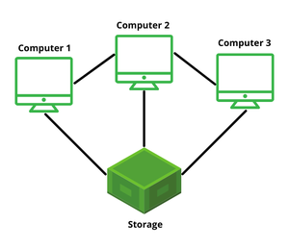
Definition of Cluster
*Group of servers and resources
*Acts like a single system
*Enable high availability
*Load balancing and parallel processing
*Provides solutions for redundant operations

Slide 6
Types of Cluster
Four major types of clusters for our need,
a. High availability(Active - Passive)
b. Load Balancing(Active - Active)
c. High performance
d. Storage

Slide 7
Selected Cluster
Cluster can be,
a. Data Torrent
b. Hadoop Cluster
c. Apache Strom Cluster
d. Apache Spark Cluster
We will working using Apache Spark for its various benefits and different purposes.

Slide 8
What is Apache Spark???
Open source data processing engine
Stores and Processes data in real time
Creates various clusters
Using a very simple programming constructs

Slide 9
Purposes of Apache Spark
Big Data Analysis
Query, Analyze and Transform Data
Performs both batch & real-time processing
Fewer lines of code
Faster than Map Reduces
Developers and Data Scientists incorporate Spark in to their apps

Slide 10
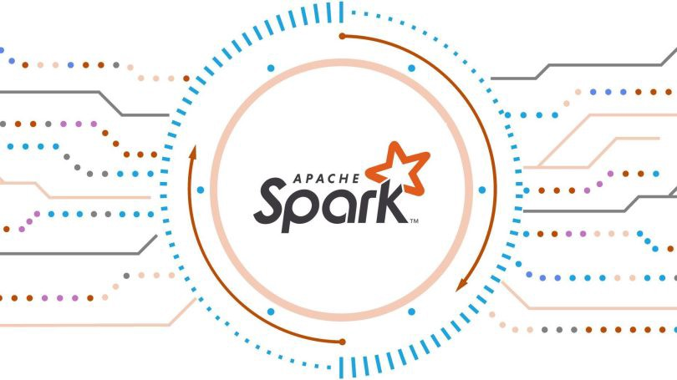
SW Components
OS like (Linux, Zorin OS, Windows)
Default Java
SSH Setup & Key Generation
Update Apache Sark installation

Slide 11

Supported Languages
R
Python
Java
Scala

Slide 12
Apache Spark Features
Components of Apache Spark
Fast Processing
In Memory Computing
Flexible
Fault Tolerance
Better Analytics
Spark Core
Spark SQL
Spark Streaming
ML lib
Graph X

Slide 13

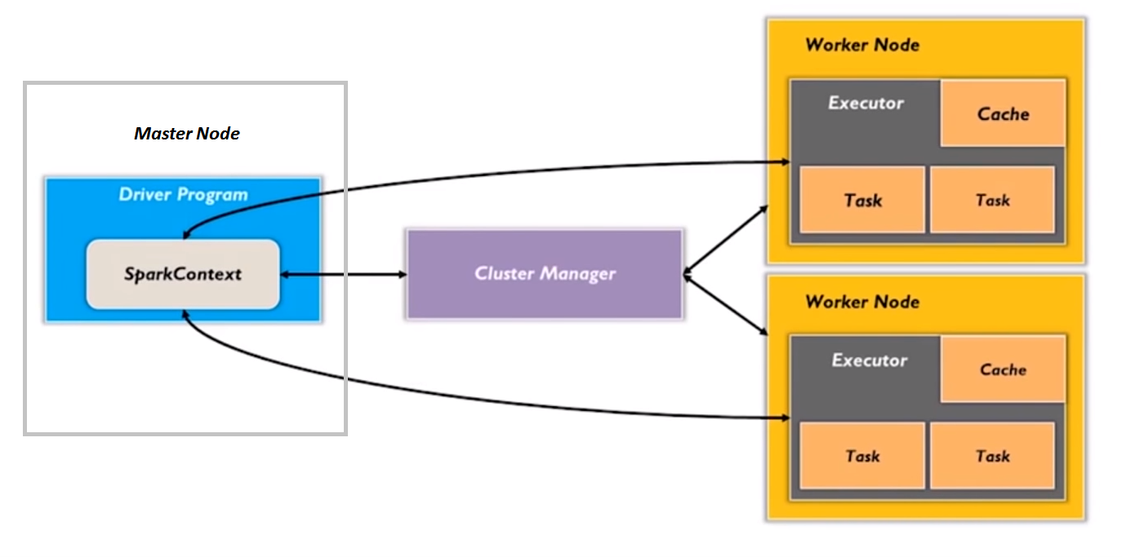



Spark Architecture
Server A
192.168.2.1
Clients
Server B

Slide 14
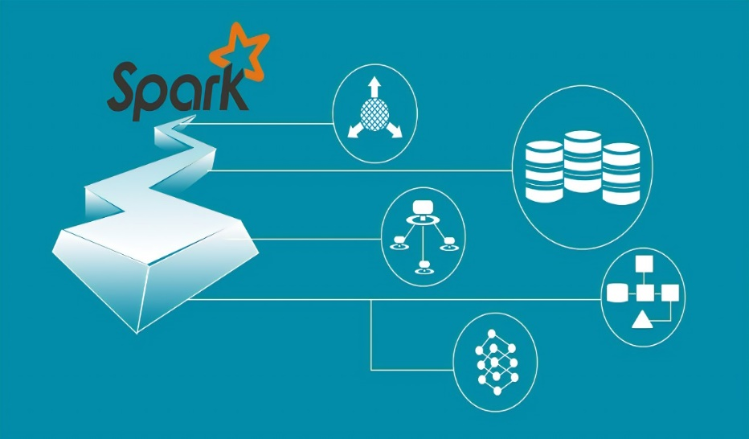
Spark Cluster Managers
Standalone Mode
Mesos
Hadoop YARN
Kubernetes

Slide 15

Applications of Spark
Banking
E-Commerce
Health Care
Entertainment

Slide 16


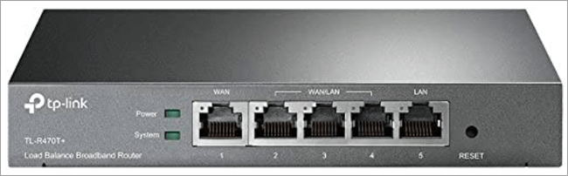

Goals
Apache Spark has its architectural foundation in the resilient distributed dataset (RDD) , a read-only multiset of data items distributed over a cluster of machines, that is maintained in a fault-tolerant way.
Application Server Instances
Data Base A
Application Server Instances
Client
Network Load
Balancer
Application Server Instances
Data Base B

Slide 17

Any QS
???

