Slide 1
Pagination-Data Table
Md.mAhmudul Haque Khan(bappy392@gmail.com)

Slide 2
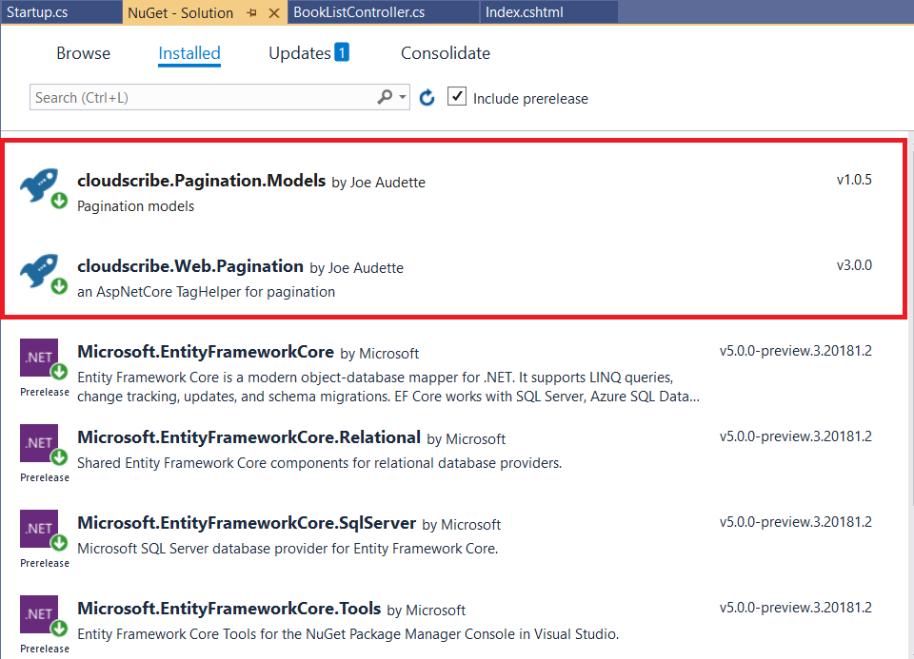

Slide 3
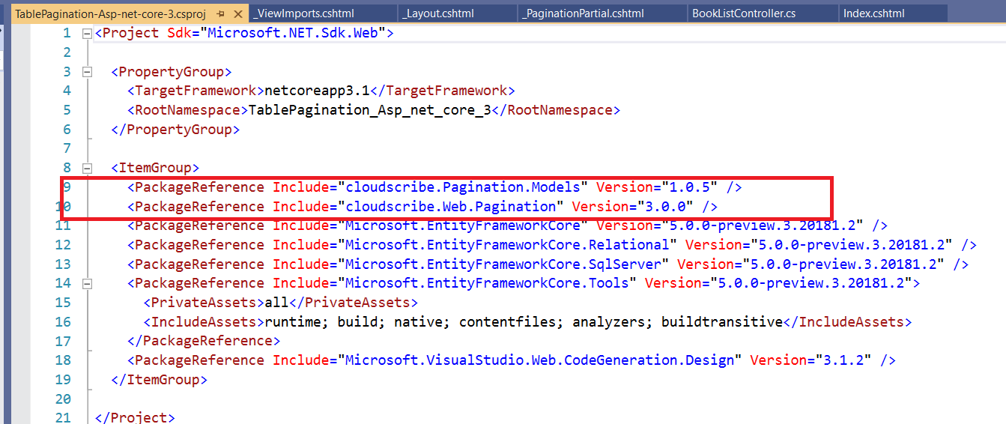
package reference

Slide 4
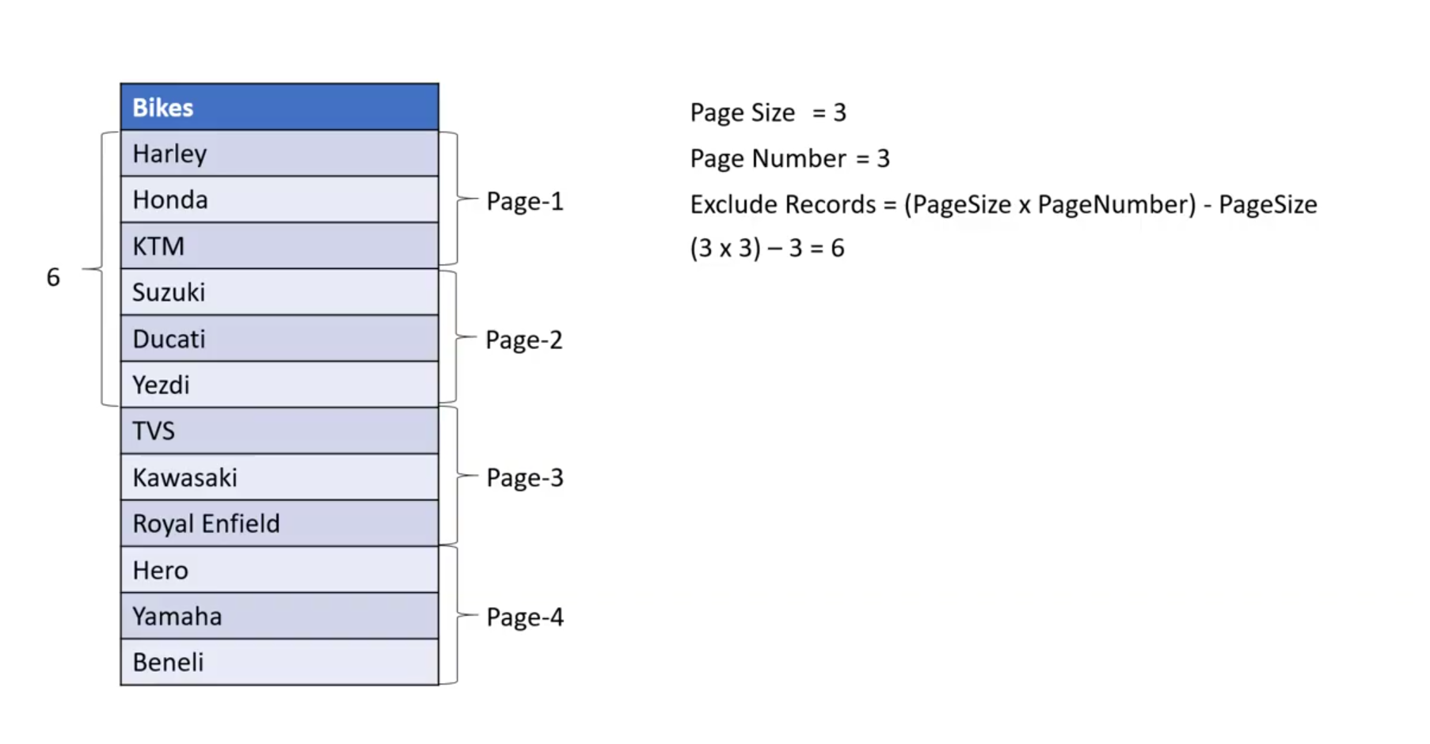
Calculation of Pagination

Slide 5
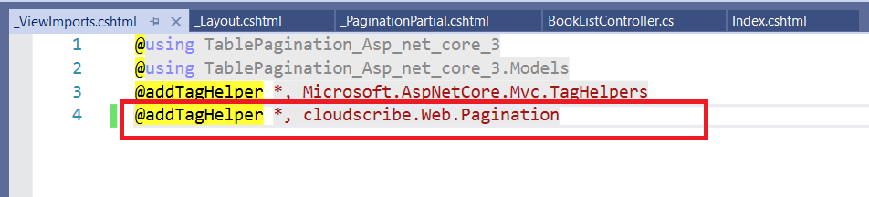
@addTagHelper *, cloudscribe.Web.Pagination

Slide 6
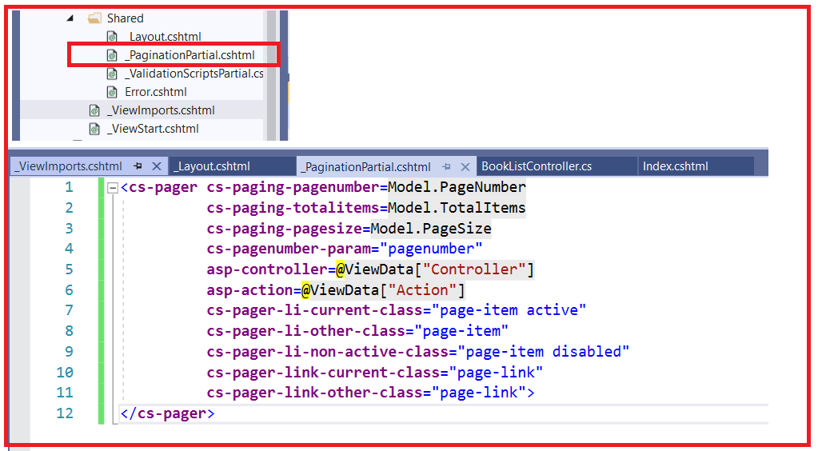
Add Shared
<cs-pager cs-paging-pagenumber=Model.PageNumber
cs-paging-totalitems=Model.TotalItems
cs-paging-pagesize=Model.PageSize
cs-pagenumber-param="pagenumber"
asp-controller=@ViewData["Controller"]
asp-action=@ViewData["Action"]
cs-pager-li-current-class="page-item active"
cs-pager-li-other-class="page-item"
cs-pager-li-non-active-class="page-item disabled"
cs-pager-link-current-class="page-link"
cs-pager-link-other-class="page-link">
</cs-pager>

Slide 7
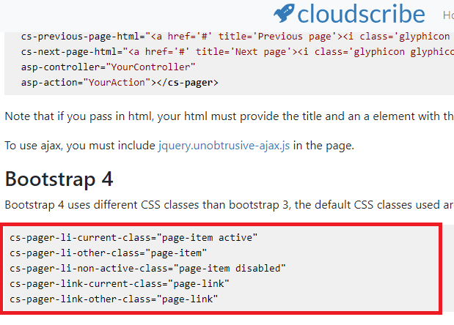
Refrence
https://www.cloudscribe.com/cloudscribe-web-pagination

Slide 8
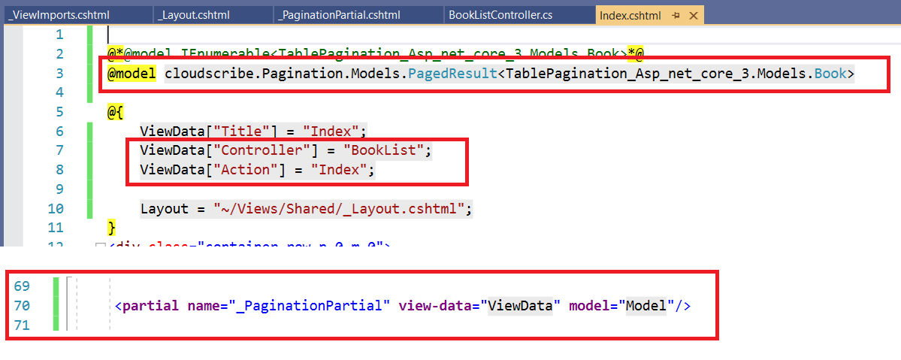
Index.Cshtml
@model cloudscribe.Pagination.Models.PagedResult<>

Slide 9
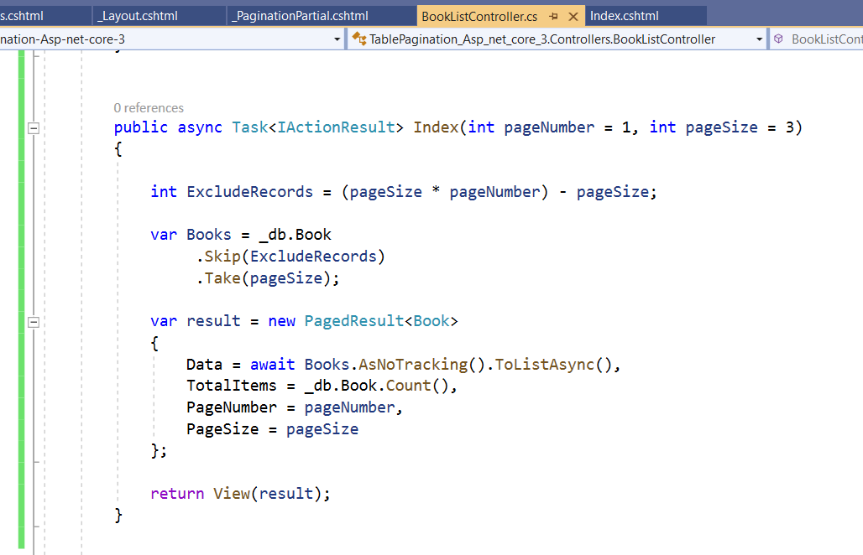
Controller
public async Task<IActionResult> Index(int pageNumber = 1, int pageSize = 3)
{
int ExcludeRecords = (pageSize * pageNumber) - pageSize;
var Books = _db.Book
.Skip(ExcludeRecords)
.Take(pageSize);
var result = new PagedResult<Book>
{
Data = await Books.AsNoTracking().ToListAsync(),
TotalItems = _db.Book.Count(),
PageNumber = pageNumber,
PageSize = pageSize
};
return View(result);
}
That is all that is needed for the UI installation. However for convenience there is also available a generic PagedResult of T class that you can use in your data retrieval to return a list of any type along with the needed pagination info such as total items, page size, and current page. Naturally you would not want a dependency in your data storage layer to a UI component like the PagerTagHelper, so the PagedResult of T is actually in a separate nuget package named cloudscribe.Pagination.Models. You can add a package reference in your data storage project without brigning in any unwanted web stuff, like this:

Slide 10
