Slide 1
Ahsanullah University of Science and Technology Department of Computer Science and Engineering CSE 3109 Assignment-I Topic: Design a digital system that demonstrates interfacing RAM and the Programmable Peripheral Interface (PPI) with a microprocessor.
Submitted By,
Student ID: 20210204071
Student ID: 20210204072
Student ID: 20210204073
Student ID: 20210204074

Slide 2
Research and Conceptual Understanding:
RAM
Static Ram
Faster access times, does not need to be refreshed periodically, simpler interface. suitable for applications requiring high-speed access and lower storage capacities.
Higher storage density, lower cost per bit, lower power consumption when idle.Suitable for applications requiring large storage capacities and cost efficiency.
Dynamic RAM
8255 Programmable Peripheral Interface(PPI)
Data Bus:
The PPI is connected to the microprocessor’s data bus
allowing data transfer between the microprocessor.
Control Bus: PPI Control signals from the microprocessor and manage data flow..
RAM Interface: The microprocessor can read from or write to RAM by addressing it directly, ensuring sensor data is stored efficiently.
PPI consists of three 8-bit ports (Port A, Port B, and Port C) and can be programmed to operate in various modes (Mode 0, Mode 1, Mode 2).
Port A,B Used for I/O & Port C for I/O & handshake Signals.
Parallel Data Transmission:
Simple Input/Output(mode 0):
Each port operates as a simple input or output port .
Single handshake Input/Output(mode 1):
Uses output buffer signal to indicate data ready and acknowledge signal to confirm data reception
Double handshake Input/Output(mode2):
uses interrupt request signal to indicate data availability and RD and WR signals to control data transfer some data bus

Slide 3
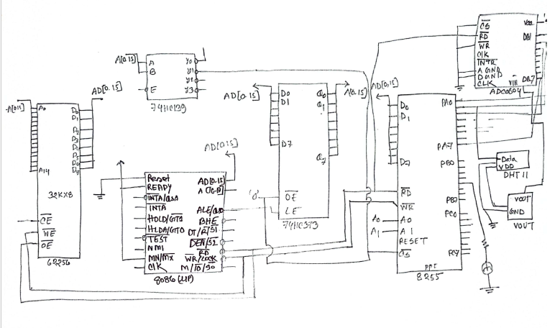
Digital System Design:
Microprocessor: Central control unit managing data flow and peripheral operations.
RAM: High-speed memory for storing real-time data.In our project we can store our data using Static RAM.
8255 PPI: Interface for connecting sensors and other peripherals. It also connect with 8086 microprocessor ,Latch and others I/O devices.
Sensors: The data needed to create a responsive, efficient, and secure office environment.
ADC0804: Convert analog to digital data. provide analog outputs based on motion detection can be digitized using the ADC0804.

Slide 4
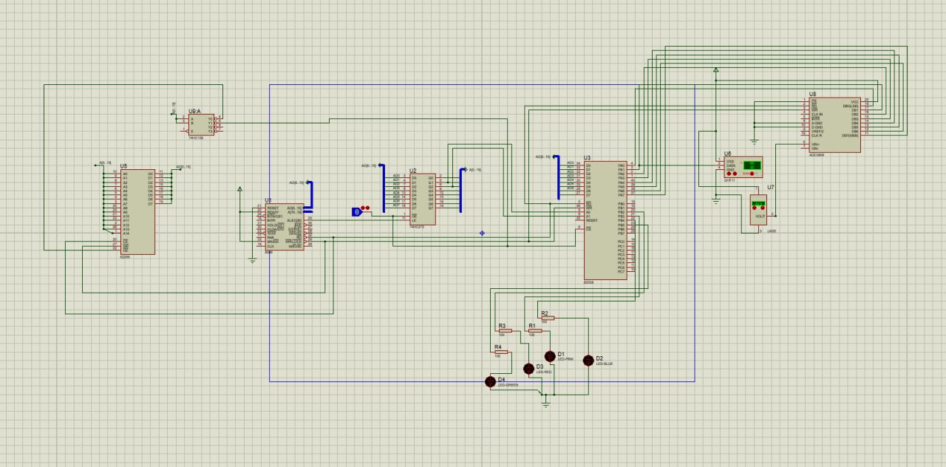
Implementation:

Slide 5
Design Justification
SRAM: Faster access times, does not need to be refresh periodically simpler interface.
8255 PPI: The 8255 PPI can be used to interface with various sensors. PPI Input ports to read data from different sensors. This data can then be processed by the microprocessor and stored in RAM .
Synchronous Parallel Transmission: Ensures high-speed and efficient data transfer.
Sensors: The data needed to create a responsive, efficient, and secure office environment.
ADC0804: The ADC0804 can convert this analog voltage into a digital value, allowing the microprocessor to monitor and control the office temperature.
Latch: When interfacing with peripherals, latches can hold the data being sent to or received from the peripheral devices.

