Slide 1
REVENUE

Slide 2
Total Revenue: The amount a firm receives for the sale of its output.
TR = P*Q
Average Revenue: Total revenue divided by the quantity sold.
Marginal Revenue: The change in total revenue from an additional unit sold.

Slide 3
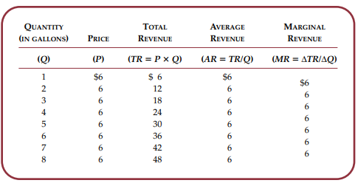

Slide 4
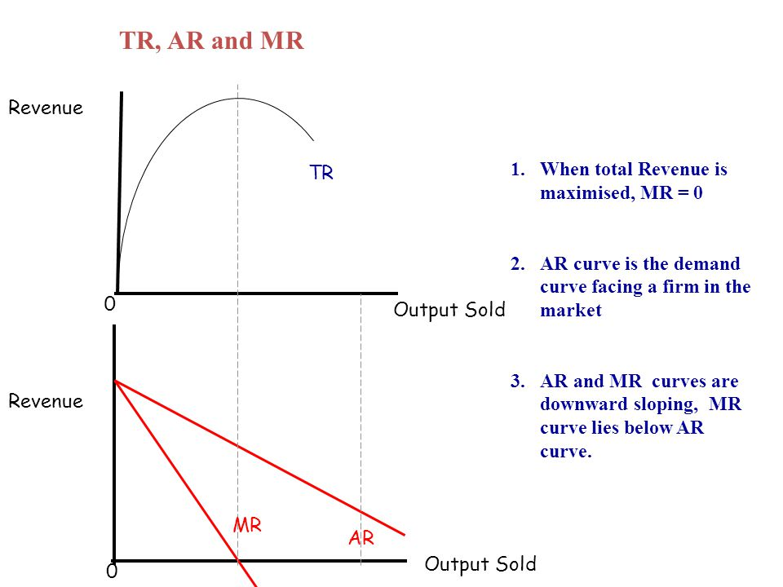
Relationship between TR, AR and MR

Slide 5
COST THEORY

Slide 6
Total Cost: The market value of the inputs a firm uses in production.
Profit = Total revenue - Total cost.
Explicit costs: Input costs that require an outlay of money by the firm.
Implicit costs: Input costs that do not require an outlay of money by the firm.
Economic Profit: total revenue minus total cost, including both explicit and implicit costs.
Accounting Profit: total revenue minus total explicit cost.

Slide 7
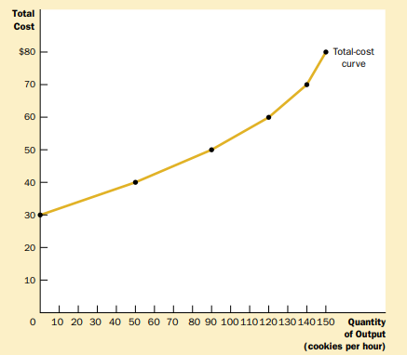
Total Cost Curve

Slide 8
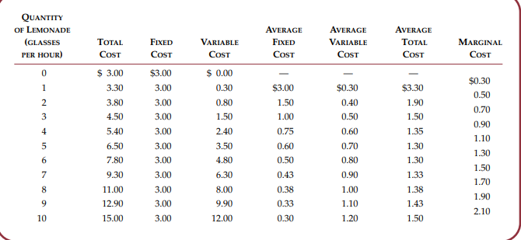

Slide 9
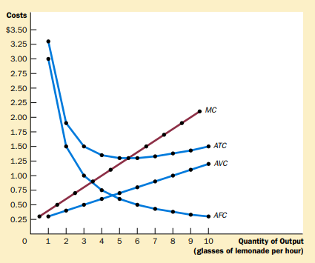


Slide 10
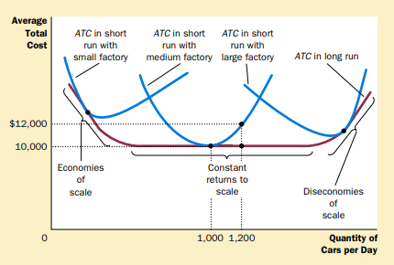
THE RELATIONSHIP BETWEEN SHORT-RUN AND LONG-RUN AVERAGE TOTAL COST:

Slide 11
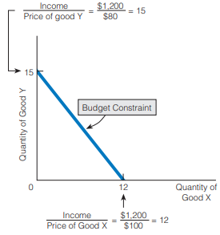
THE BUDGET CONSTRAINT
Budget Constraint: All the combinations, or bundles, of two goods a person can purchase, given a certain money income and prices for the two goods.

Slide 12
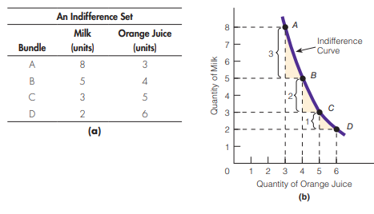
INDIFFERENCE CURVE
Indifference Curve: The curve that represents an indifference set and that shows all the bundles of two goods giving an individual equal total utility.

Slide 13
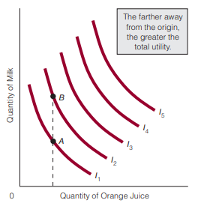
Characteristics of Indifference Curves:
Indifference curves are downward sloping.
Indifference curves are convex to the origin.
Indifference curves that are farther from the origin are preferable to those that are nearer to the origin because they represent larger bundles of goods.

Slide 14
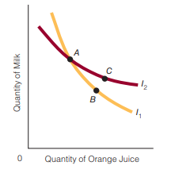
4. Indifference curves do not cross (intersect).

Slide 15
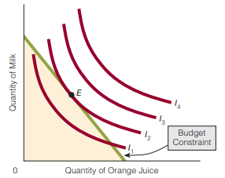
Consumer Equilibrium

