Slide 1
Virtual financial Advisor
FinVisor

Slide 2




The Useless Team
First time in in-person hackathon
Mohammad Bappy Chowdhary
Business Analyst
University of Westminster (UK)
Matej Hanus Charles University
Tomáš Chovančák
Masaryk University
Patrik Paľovčík Masaryk University

Slide 3
High level Business Requirements
ID | Details | MOSCOW
HLBR_01 | Provide personalized financial advice based on individual financial goals, risk tolerance, income, expenses, and other relevant data. | Must have
HLBR_02 | Analyse spending patterns and suggest ways to save money based on the user's spending habits and financial goals. | Must have
HLBR_03 | Recommend investment options based on the user's risk profile, investment objectives, and other relevant data, such as income and age. | Should have
HLBR_04 | Monitor investment performance and provide regular updates and recommendations based on the user's investment history and goals. | Could have
HLBR_05 | Provide educational resources on financial management, including budgeting, debt management, and retirement planning, that are tailored to the user's individual needs and preferences. | Could have

Slide 4
Functional requirements
Req_ID |  | Comments
Req_01 | User should be able to enter their name and age.
Req_02 | User should be able to enter their monthly income detail.
Req_03 | User should be able to enter their monthly expenses details
Req_04 | User should be able to view their next monthly saving prediction.
Req_05 | User should be able to create their potential risk profile
Req_06 | User should be able to select their predictions according to history and goals.
Req_07 | Create tailored notifications of the investment fund utilising on possible investments

Slide 5
Technical requirements
Req_ID |  | Comments
Req_01 | Analyse the spending patterns by corelating goals and expenditures.
Req_02 | Create an user risk profile algorithm depending on investment objectives, and other relevant data, such as income and age.
Req_03 | Create a tailored recommender system base on the risk profiles, budget, debt, history and goals.

Slide 6
Non-Functional Requirements (NFRs)
Req_ID |  | Comments
Req_01 | Accessibility and smooth navigations for all users
Req_02 | Response/generating of report SLA (Service level agreement) should within < 5seconds
Req_03 | API integration performance and volume testing should be as per product owners guidelines and approvals.

Slide 7
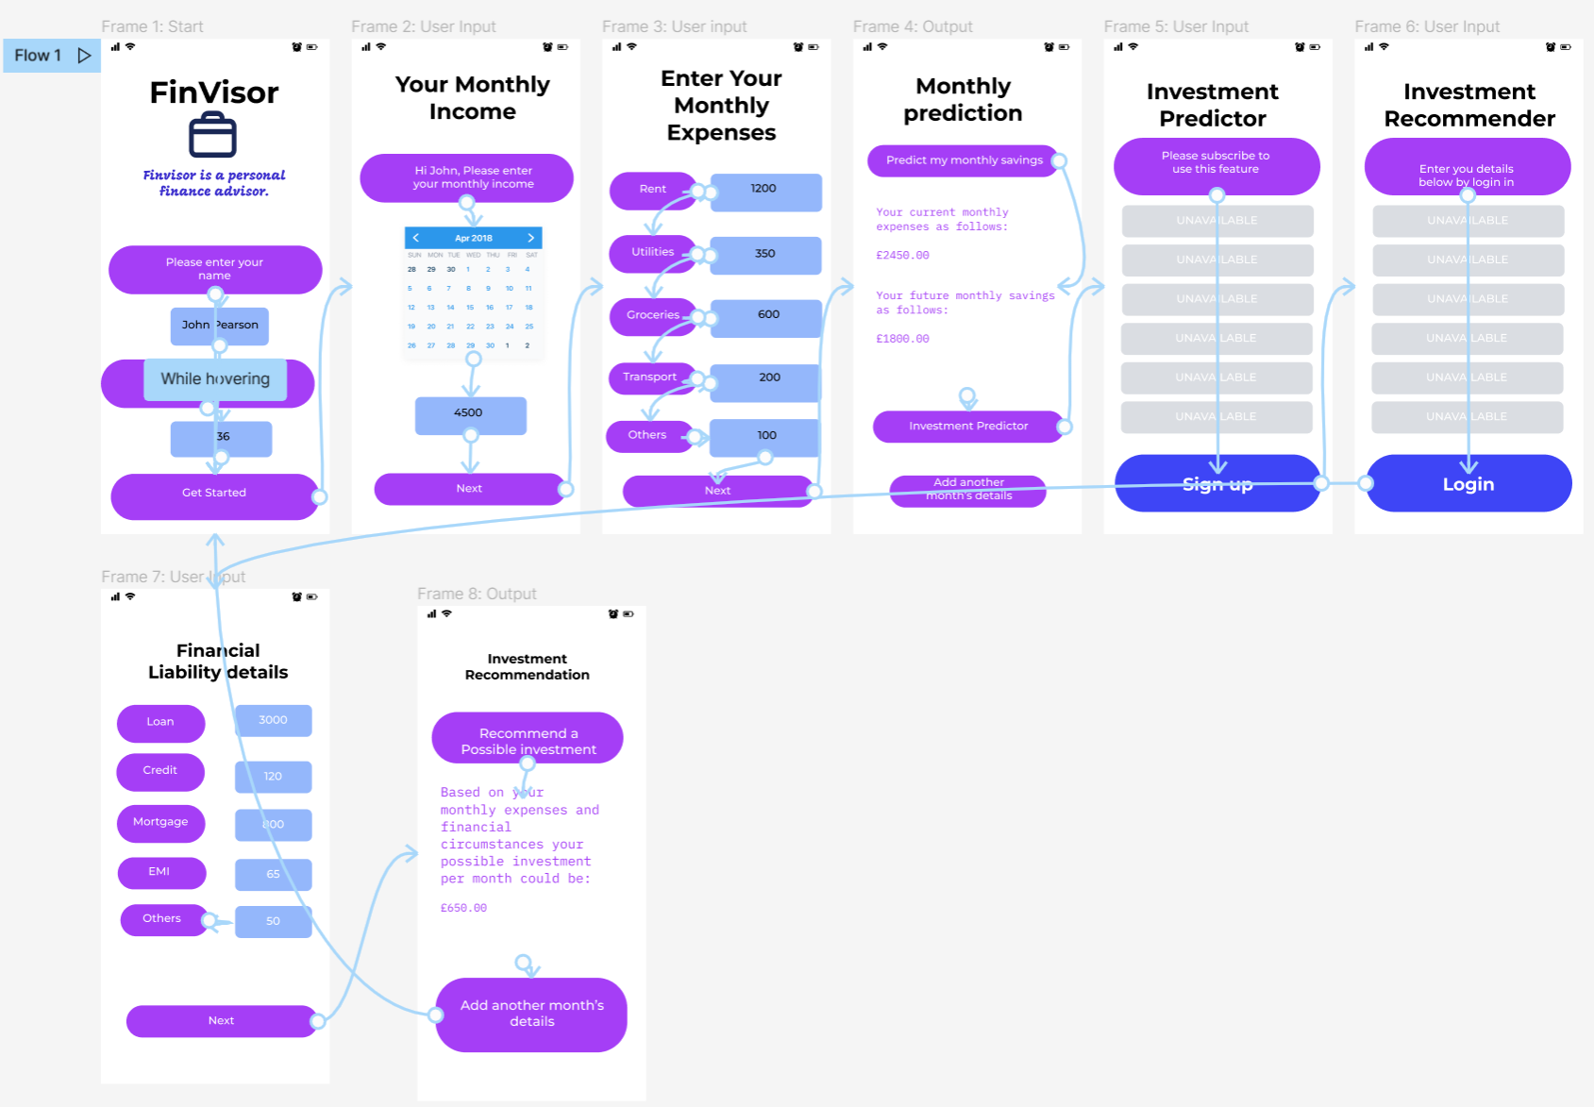

Slide 8
Thank You

