Slide 1
Jonah
Good News For The Repentant
Jonah 1 Jonah Panics

Slide 2
The main character in this story is God:
The fish is mentioned 4 times.
The city of Nineveh is mentioned 9 times.
Jonah name is mentioned 18 times.
But the words “Lord” and “God” are mentioned over 35 times.

Slide 3
Is this story true?
1) The book presents itself as a genuine historical narrative.

Slide 4
Is this story true?
The book presents itself as a genuine historical narrative.
2) Jonah was a historical person mentioned several times in the Bible. (2 Kings 14:25).

Slide 5
Is this story true?
The book presents itself as a genuine historical narrative.
2) Jonah was a historical person mentioned several times in the Bible. (2 Kings 14:25).
3) Jesus believed that the story of Jonah to be completely true. (Matthew 12:38-41; 16:4)

Slide 6
I. Jonah’s Panic Attack (1:1-3)
“The word of the LORD came to Jonah the son of Amittai saying, 2 "Arise, go to Nineveh the great city, and cry against it, for their wickedness has come up before Me." 3 But Jonah rose up to flee to Tarshish from the presence of the LORD. So he went down to Joppa, found a ship which was going to Tarshish, paid the fare, and went down into it to go with them to Tarshish from the presence of the LORD.”

Slide 7
The Hebrew words for “great” and “greatly” are frequently used.
“Great city” verse 2; 3:2 and 4:11.
“Great wind” in 1:4.
“Great storm in 1:12.
“Greatly feared” in 1:16.
“Great fish” in 1:17.
“Greatly displeased” in 4:1.
“Greatly (very) happy in 4:6.

Slide 8
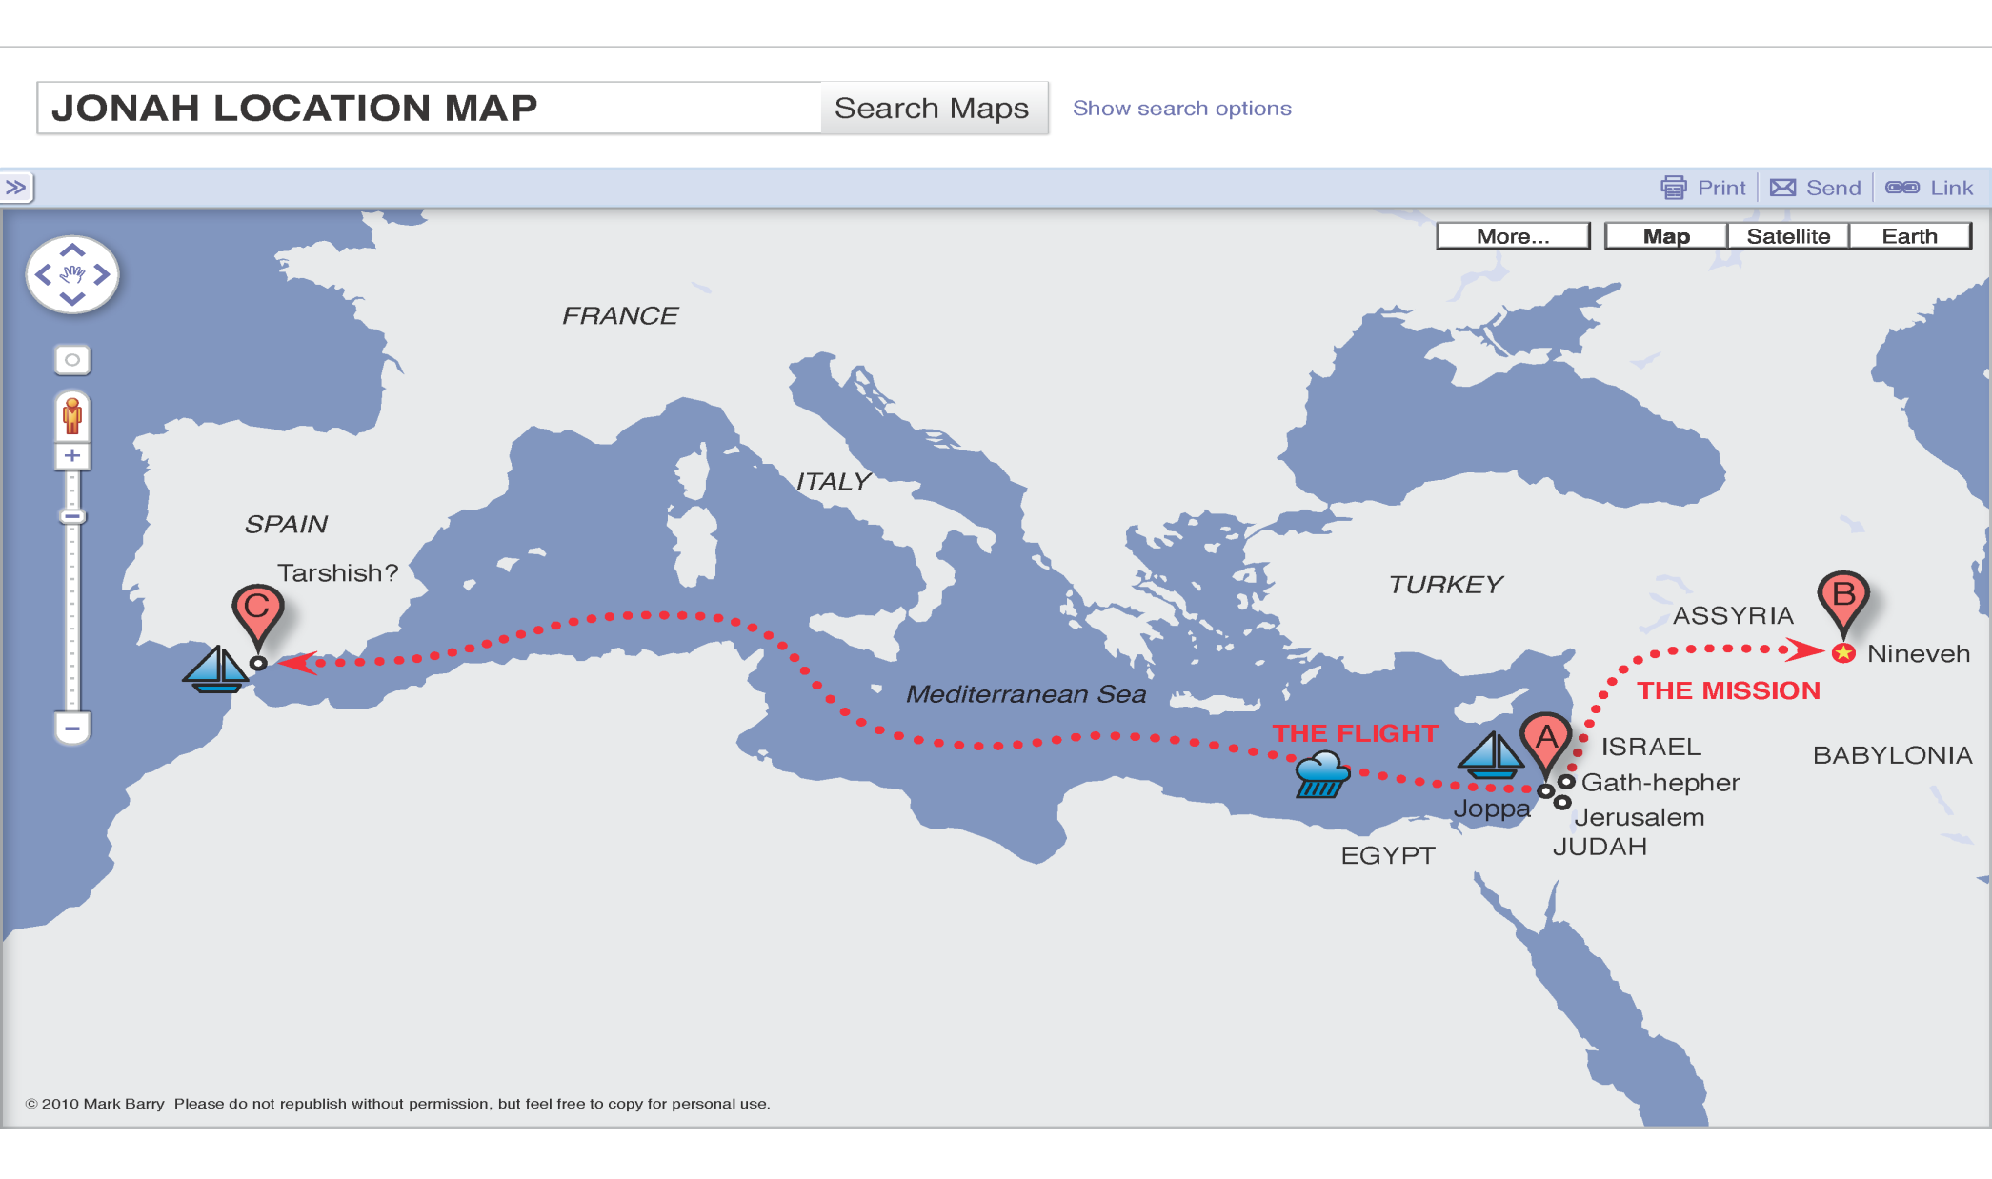

Slide 9
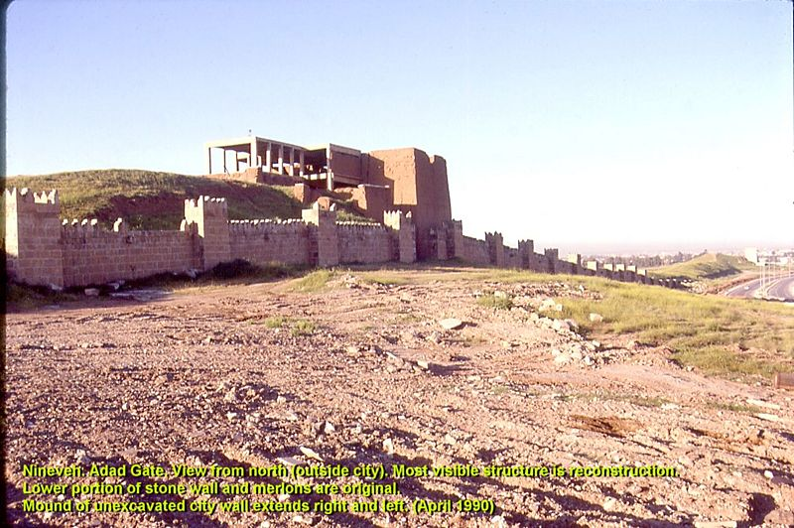

Slide 10
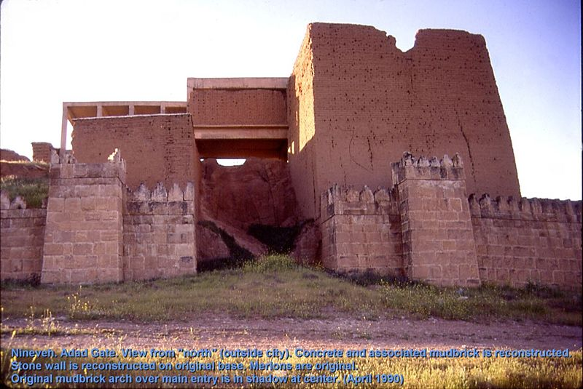

Slide 12
Why did God’s command make Jonah panic?
Jonah was the first prophet sent to minister to a Gentile nation.

Slide 13
Why did God’s command make Jonah panic?
Jonah was the first prophet sent to minister to a Gentile nation.
Jonah was concerned about his reputation.

Slide 14
Why did God’s command make Jonah panic?
Jonah was the first prophet sent to minister to a Gentile nation.
Jonah was concerned about his reputation.
The Assyrians were the worst enemy of Israel.

Slide 15
Why did God’s command make Jonah panic?
Jonah was the first prophet sent to minister to a Gentile nation.
Jonah was concerned about his reputation as a popular prophet.
The Assyrians were the worst enemy of Israel and they might kill him.
Jonah had lost sight of his God-given purpose.

Slide 16
II. God’s Tough Love (1:4-17)
“4 And the LORD hurled a great wind on the sea and there was a great storm on the sea so that the ship was about to break up. 5 Then the sailors became afraid, and every man cried to his god, and they threw the cargo which was in the ship into the sea to lighten it for them. But Jonah had gone below into the hold of the ship, lain down, and fallen sound asleep. 6 So the captain approached him and said, "How is it that you are sleeping? Get up, call on your god. Perhaps your god will be concerned about us so that we will not perish."

Slide 17
II. God’s Tough Love (1:4-17)
“7 And each man said to his mate, "Come, let us cast lots so we may learn on whose account this calamity has struck us." So they cast lots and the lot fell on Jonah. 8 Then they said to him, "Tell us, now! On whose account has this calamity struck us? What is your occupation? And where do you come from? What is your country? From what people are you?" 9 And he said to them, "I am a Hebrew, and I fear the LORD God of heaven who made the sea and the dry land."

Slide 18
II. God’s Tough Love (1:4-17)
“10 Then the men became extremely frightened and they said to him, "How could you do this?" For the men knew that he was fleeing from the presence of the LORD, because he had told them. 11 So they said to him, "What should we do to you that the sea may become calm for us?"-- for the sea was becoming increasingly stormy. 12 And he said to them, "Pick me up and throw me into the sea. Then the sea will become calm for you, for I know that on account of me this great storm has come upon you."

Slide 19
II. God’s Tough Love (1:4-17)
“13 Instead, the men did their best to row back to land. But they could not, for the sea grew even wilder than before. 14 Then they cried to the LORD, "O LORD, please do not let us die for taking this man's life. Do not hold us accountable for killing an innocent man, for you, O LORD, have done as you pleased." 15 Then they took Jonah and threw him overboard, and the raging sea grew calm. 16 At this the men greatly feared the LORD, and they offered a sacrifice to the LORD and made vows to him. 17 But the LORD provided a great fish to swallow Jonah, and Jonah was inside the fish three days and three nights.

Slide 20
God’s Tough Love (1:4-17)
Is seen in the great storm (v 4)

Slide 21
God’s Tough Love (1:4-17)
Is seen in the great storm (v 4)
Is seen in the casting of the lots by the sailors

Slide 22
Discerning God’s will
The Urim and Thummim were special stones. (Exodus 28:30; Num. 27:21 and 1 Samuel 28:6)
The fleece used by Gideon (Judges 6:36-40)
The last time in the Bible that lots were used was to choose a man to replace Judas. (Acts 1:26)
God no longer desires for believers to use such methods.
Today God has given each believer the indwelling Holy Spirit and the Bible.

Slide 23
God’s Tough Love (1:4-17)
Is seen in the great storm (v 4)
Is seen in the casting of the lots (v 7)
Is seen in the great fish (v 17)

Slide 24
Lessons For Today
We cannot successfully run from God.
Running from God makes matters worse.
Running from God results in our lives taking a downward spiral.

Slide 25
Lessons For Today
In the original Hebrew, words are used seven times to indicate that Jonah was headed downward.
He went down to Joppa (v. 3)
He went down on to the ship (v. 3)
He had gone down into the hold of the ship (v 5)
He went down into a deep sleep (v. 5)
The lot fell (down) on Jonah (v 7)
He went down into the sea (v. 15)
He went down into the belly of the fish (v. 17)

Slide 26
Lessons For Today
• This morning I’m asking each of you, in which direction are you headed?
Are you running to God or running from God?
There is no need to panic and run from God like Jonah, because the Bible teaches us that there is good news for the repentant.

