Slide 1
Jonah
Good News For The Repentant
Jonah 2 Jonah Prays

Slide 2
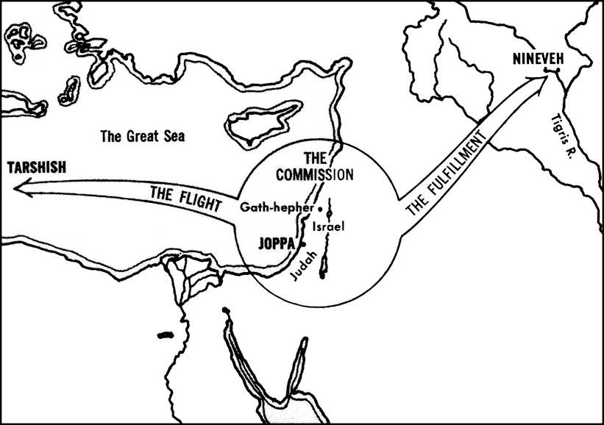

Slide 3
Jonah 1:17 “But the LORD provided a great fish to swallow Jonah, and Jonah was inside the fish three days and three nights.”

Slide 4
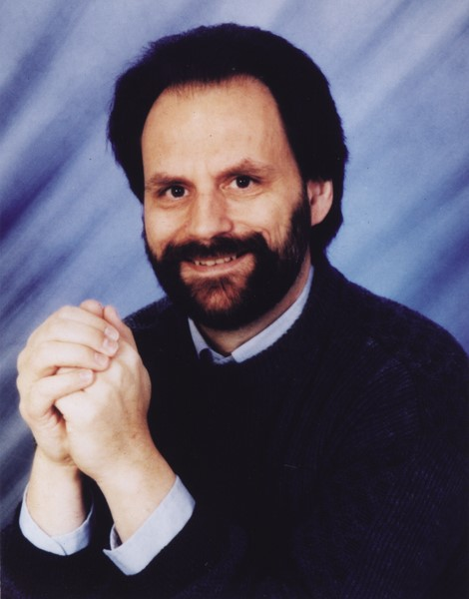
John Kohlenberger III
“It is as foolish for the liberal to deny the possibility of taking the fish literally as for the conservative to attempt to identify the species of marine animal that could swallow and sustain a human being for three days and nights. Both slight the miraculous and the power of God.”

Slide 5
Jonah 2:1-6 “From inside the fish Jonah prayed to the LORD his God. 2 He said: "In my distress I called to the LORD, and he answered me. From the depths of the grave I called for help, and you listened to my cry. 3 You hurled me into the deep, into the very heart of the seas, and the currents swirled about me; all your waves and breakers swept over me.”

Slide 6
Jonah 2:1-6 “4 I said, 'I have been banished from your sight; yet I will look again toward your holy temple.' 5 The engulfing waters threatened me, the deep surrounded me; seaweed was wrapped around my head. 6 To the roots of the mountains I sank down; the earth beneath barred me in forever. But you brought my life up from the pit, O LORD my God.”

Slide 7
I. Jonah’s Spiritual Journey Downward Continues (2:1-6)

Slide 8
A review of Jonah’s journey downward in Chapter 1
He went down to Joppa (v. 3)
He went down on to the ship (v. 3)
He went down into the hold of the ship (v. 5)
He went down into a deep sleep (v. 5)
Lots were cast and fell (down) on Jonah (v. 7)
He went down into the sea (v. 15)
He went down into the belly of the fish (v. 17)

Slide 9
Jonah’s Spiritual Journey Downward Continues (2:1-6)
The waves break over him.
The water engulfs him.
The seaweed wraps around his head.
“To the roots of the mountains I sank down.”
That is as low as you can go.

Slide 10
Jonah 2:6-10 “6 To the roots of the mountains I sank down; the earth beneath barred me in forever. But you brought my life up from the pit, O LORD my God. 7 "When my life was ebbing away, I remembered you, LORD, and my prayer rose to you, to your holy temple. 8 "Those who cling to worthless idols forfeit the grace that could be theirs.

Slide 11
Jonah 2:6-10 “9 But I, with a song of thanksgiving, will sacrifice to you. What I have vowed I will make good. Salvation comes from the LORD." 10 And the LORD commanded the fish, and it vomited Jonah onto dry land.”

Slide 12
Jonah’s Spiritual Journey Downward Continues (2:1-6)
II. Jonah’s Spiritual Journey Upward Begins
(2:6-10)
Verse 6 marks the end of the downward spiral of Jonah’s life and the beginning of an upward movement of God’s restoration of Jonah.

Slide 13
II. Jonah’s Spiritual Journey Upward Begins
(2:6-10)
In verse 8: The Hebrew word “hesed” is translate as “grace”
Hesed is God’s loving-kindness, his steadfast love, his unfailing love or his grace.
Hesed is God’s love based on his unbreakable covenant promises.

Slide 14
II. Jonah’s Spiritual Journey Upward Begins
(2:6-10)
2:6, God brought Jonah up from the “pit”
2:10 God commands the fish to vomit Jonah up out of its belly.
2:10 Jonah was vomited up onto dry land.
3:3 it says Jonah arose and went up to Nineveh.

Slide 15
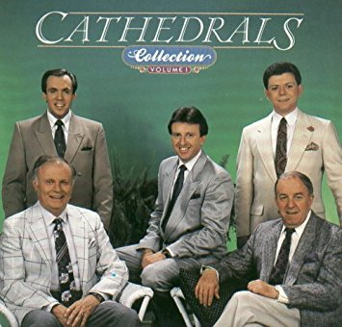
"Sin will take you farther than you want to go, keep you longer than you want to stay, and cost you more than you want to pay."

Slide 16
What it means to repent:
Ezekiel 18:30 “Repent! Turn away from all your offenses; then sin will not be your downfall.”
Acts 3:19 “Repent, then, and turn to God, so that your sins may be wiped out, that times of refreshing may come from the Lord.…”
They both indicate that the root meaning of repentance is “to turn.”

Slide 17


Slide 18
What it means to confess sin:
Proverbs 28:13 “he who conceals his sins does not prosper, but whoever confesses and renounces them finds mercy."
I John 1:9 “If we confess our sins, he is faithful and just and will forgive us our sins and purify us from all unrighteousness.”
To “confess” means to “say the same thing” or “agree with.”

Slide 19
Jonah
Good News For The Repentant

