Slide 1
Jonah
Good News For The Repentant
Jonah 3 Jonah Preaches

Slide 2
Jonah
Good News For The Repentant
Jonah Panics (chapter 1)
Jonah Prays (chapter 2)
Jonah Preaches (chapter 3)

Slide 3
I. Jonah Preaches (3:1-4)
“Then the word of the LORD came to Jonah a second time: 2 "Go to the great city of Nineveh and proclaim to it the message I give you." 3 Jonah obeyed the word of the LORD and went to Nineveh. Now Nineveh was a very important city-- a visit required three days. 4 On the first day, Jonah started into the city. He proclaimed: "Forty more days and Nineveh will be overturned."

Slide 4
I. Jonah Preaches (3:1-4)
A. Jonah Recommissioned
(v 1) God gives a second call, a second chance to Jonah.
(v 2) The Command: arise, go, and preach

Slide 5
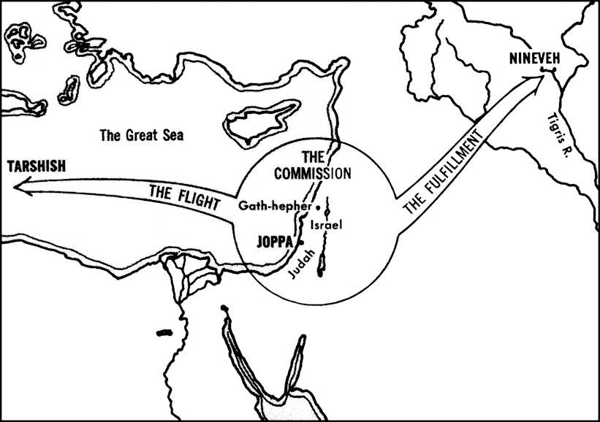

Slide 6
I. Jonah Preaches (3:1-4)
A. Jonah Recommissioned
B. The Journey
From the Mediterranean Jonah had to travel about 550 miles northeast to Nineveh.
Jonah trudged for 6 to 8 weeks in the hot sun and desert climate.

Slide 7
chapter 1 Jonah began a spiral downward:
He went down to Joppa (1:3).
He went down on to the ship (1:3)
He went down into the hold of the ship (1:5).
He went down into a deep sleep (1:5)
Lots were cast and fell (down) on Jonah (1:7)
He went down into the sea (1:15).
He went down into the belly of the fish (1:17).

Slide 8
God intervened and brought Jonah back up, up, up.
2:6, God brought Jonah up from the “pit”
2:10 God commands the fish to vomit Jonah up out of its belly.
2:10 Jonah was vomited up onto dry land.
3:2 God commands to Jonah: arise, go and preach.
3:3 Jonah arose and went up to Nineveh.

Slide 9
I. Jonah Preaches (3:1-4)
A. Jonah Recommissioned
The Journey
The City

Slide 10
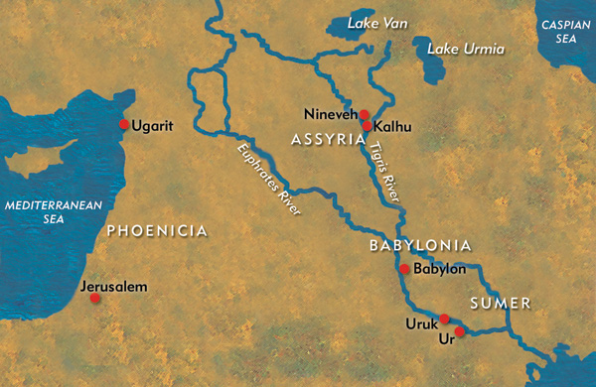

Slide 11
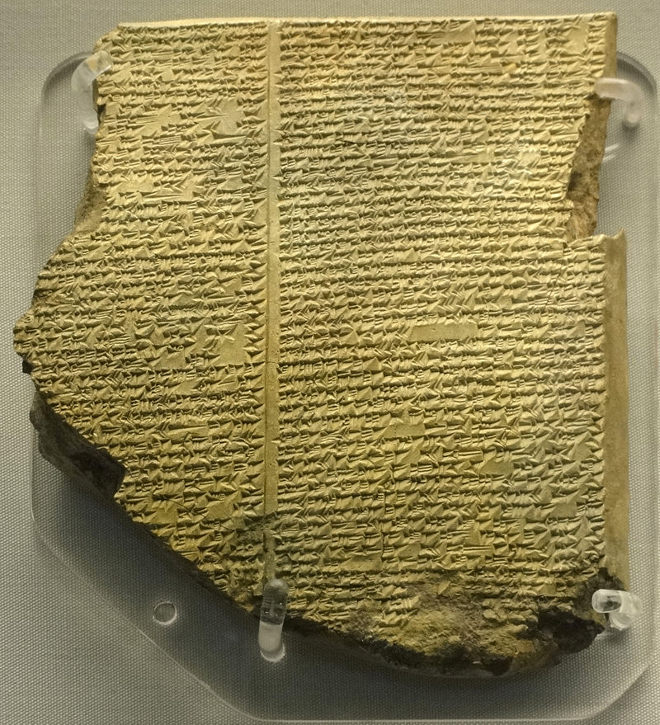
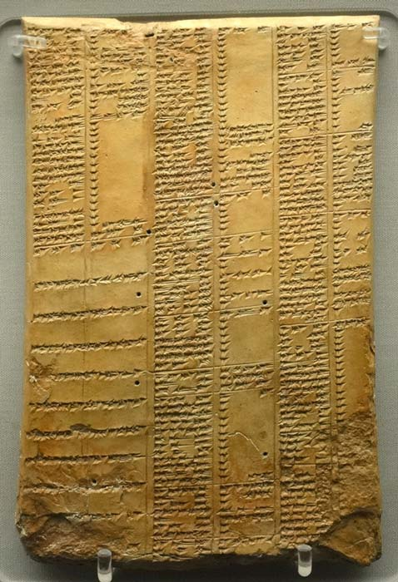
Stone tablets from the library

Slide 12
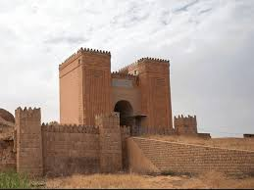
Restored ruins of Nineveh

Slide 13
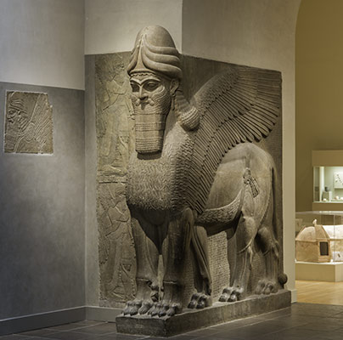
In the British museum

Slide 14
I. Jonah Preaches (3:1-4)
A. Jonah Recommissioned
The Journey
The City
D. The Sermon
“Forty more days and Nineveh will be overturned.”

Slide 15
4:5-7 “The Ninevites believed God. They declared a fast, and all of them, from the greatest to the least, put on sackcloth. 6 When the news reached the king of Nineveh, he rose from his throne, took off his royal robes, covered himself with sackcloth and sat down in the dust. 7 Then he issued a proclamation in Nineveh: "By the decree of the king and his nobles: Do not let any man or beast, herd or flock, taste anything; do not let them eat or drink."

Slide 16
4:8-9 “But let man and beast be covered with sackcloth. Let everyone call urgently on God. Let them give up their evil ways and their violence. 9 Who knows? God may yet relent and with compassion turn from his fierce anger so that we will not perish."

Slide 17
I. Jonah Preaches (3:1-4)
II. People Repent (3:5-9)

Slide 18
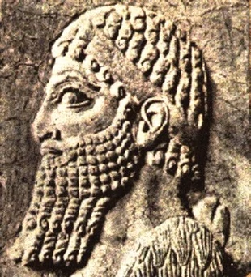
King
Ashur-dan III

Slide 19
Hebrews 4:12 “For the word of God is living and active. Sharper than any double-edged sword, it penetrates even to dividing soul and spirit, joints and marrow; it judges the thoughts and attitudes of the heart.”
Isaiah 55:11 “…my word that goes out from my mouth: It will not return to me empty, but will accomplish what I desire and achieve the purpose for which I sent it.”

Slide 20
I. Jonah Preaches (3:1-4)
II. People Repent (3:5-9)
God Pardons (3:10)
“When God saw what they did and how they turned from their evil ways, he had compassion and did not bring upon them the destruction he had threatened.”

Slide 21
Jeremiah 18:8 “and if that nation I warned repents of its evil, then I will relent and not inflict on it the disaster I had planned.
Genesis 6:6 “And the LORD was sorry that He had made man on the earth, and He was grieved in His heart.”

Slide 22
Numbers 23:19 “God is not a man, that he should lie, nor a son of man, that he should change his mind. Does he speak and then not act? Does he promise and not fulfill?”
Malachi 3:6 "I the LORD do not change.
James 1:17 “Every good and perfect gift is from above, coming down from the Father of the heavenly lights, who does not change like shifting shadows.”

Slide 23
Anthropomorphism - ánthrōpos (human) and morphē (form) - giving human attributes to an animal, an object or to a god.
physical human features given to God:
face of God, the hand of God, the arm of God, the mouth of God
physical human features given to God:
God was sorry, God was jealous, God repented, God changed His mind

Slide 24
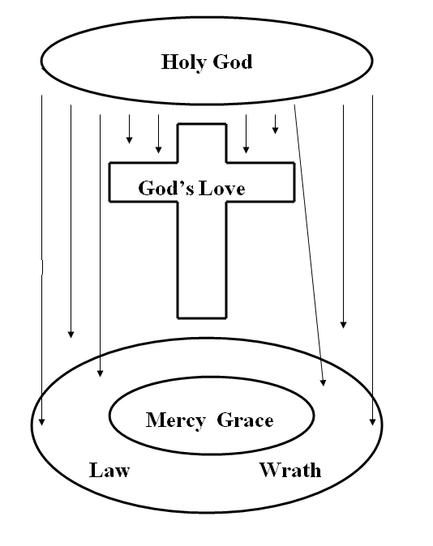

Slide 25
Conclusion
Maybe you feel you need to be restored to a life of serving God ?

Slide 26
Conclusion
Maybe you feel you need to be restored to a life of serving God ?
Maybe you need to reach people who do not yet believe in God ?

Slide 27
Conclusion
Maybe there is some one here that has not yet become a believer.
Romans 5:8 “But God demonstrates his own love for us in this: While we were still sinners, Christ died for us.”
Romans 10:13 "Everyone who calls on the name of the Lord will be saved."

Slide 28
Jonah
Good News For The Repentant

