Slide 1
Jonah
Good News For The Repentant
Jonah 4 Jonah Pouts

Slide 2
Jonah
Good News For The Repentant
Jonah Panics (chapter 1)
Jonah Prays (chapter 2)
Jonah Preaches (chapter 3)
Jonah Pouts (chapter 4)

Slide 3
I. Jonah’s Attitude (4:1-4)
“But Jonah was greatly displeased and became angry. 2 He prayed to the LORD, "O LORD, is this not what I said when I was still at home? That is why I was so quick to flee to Tarshish. I knew that you are a gracious and compassionate God, slow to anger and abounding in love, a God who relents from sending calamity. 3 Now, O LORD, take away my life, for it is better for me to die than to live." 4 But the LORD replied, "Have you any right to be angry?"

Slide 4
Verse 2
God was “abounding in love” toward these evil people.
The word “love” used here comes from the Hebrew word “hesed.”
Hesed is the faithful, unfailing, covenant love of God.

Slide 5

“Every Who down in Whoville liked Christmas a lot...But the Grinch, who lived just north of Whoville, did NOT! The Grinch hated Christmas! The whole Christmas season! Now, please don't ask why. No one quite knows the reason. It could be his head wasn't screwed on just right. It could be, perhaps, that his shoes were too tight. But I think that the most likely reason of all, may have been that his heart was two sizes too small.”

Slide 6
II. God’s Lesson (4:5-11)
“Jonah went out and sat down at a place east of the city. There he made himself a shelter, sat in its shade and waited to see what would happen to the city. 6 Then the LORD God provided a vine and made it grow up over Jonah to give shade for his head to ease his discomfort, and Jonah was very happy about the vine. 7 But at dawn the next day God provided a worm, which chewed the vine so that it withered.

Slide 7
II. God’s Lesson (4:5-11)
“8 When the sun rose, God provided a scorching east wind, and the sun blazed on Jonah's head so that he grew faint. He wanted to die, and said, "It would be better for me to die than to live." 9 But God said to Jonah, "Do you have a right to be angry about the vine?" "I do," he said. "I am angry enough to die."

Slide 8
II. God’s Lesson (4:5-11)
“10 But the LORD said, "You have been concerned about this vine, though you did not tend it or make it grow. It sprang up overnight and died overnight. 11 But Nineveh has more than a hundred and twenty thousand people who cannot tell their right hand from their left, and many cattle as well. Should I not be concerned about that great city?"

Slide 9
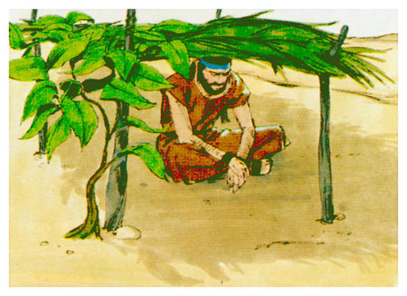
Jonah’s Shelter

Slide 10
Conclusion
In chapter 4 God had several lessons for us.
1. Our purpose is not to condemn others.

Slide 11
Conclusion
In chapter 4 God had several lessons for us.
Our purpose is not to condemn others.
Our priority is not to be comfortable.

Slide 12
Conclusion
In chapter 4 God had several lessons for us.
Our purpose is not to condemn others.
Our priority is not to be comfortable.
Forced obedience does not result in real spiritual growth.

Slide 13
Which chapter of Jonah best describes your life?
Are you living in chapter 1?
Are you in a panic running from God?

Slide 14
Which chapter of Jonah best describes your life?
Are you living in chapter 1?
Are you in a panic running from God?
Are you living in chapter 2?
Are you crying out to God in prayer?

Slide 15
Which chapter of Jonah best describes your life?
Are you living in chapter 1?
Are you in a panic running from God?
Are you living in chapter 2?
Are you crying out to God in prayer?
Are you living in chapter 3?
Are you obeying and spreading the Word?

Slide 16
Which chapter of Jonah best describes your life?
Are you living in chapter 1?
Are you in a panic running from God?
Are you living in chapter 2?
Are you crying out to God in prayer?
Are you living in chapter 3?
Are you obeying and spreading the Word?
Are you living in chapter 4?
Are you angry with God?

Slide 17
Jonah
Good News For The Repentant

