Slide 1
Letter to the seven churches
Revelation chapters 2 and 3

Slide 2
Background
This letter was dictated to the Apostle John by Jesus
Directed to the seven churches specifically and to all Christians and churches individually
Key phrase: Anyone who has an ear should listen to what the Spirit says to the churches
(Rev 2:7; 11; 17 and 29. Rev 3:6; 13; and 22)
We need to look at all seven letters individually and look at them all together. “what the Spirit says to the churches”

Slide 3
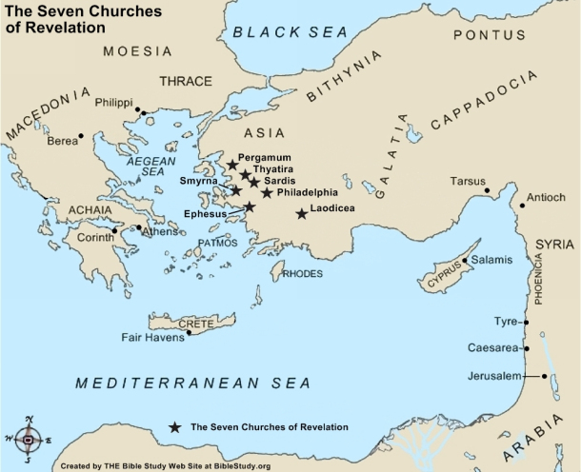
The Seven Cities

Slide 4
READ REVALATION 2:1 - 11
The Church at Ephesus
Positive statements: Works, labor, endurance, have tested false apostles, have tolerated many things because they follow Jesus and they hate the deeds of the Nicolaitans.
Nicolaitans: Were teaching false doctrine that involved things such as eating food sacrificed to idols and sexual immorality. Believe that the Nicolaitans were teaching Christian liberty to the extreme.
Negative statements: Abandoned the love you had at first
Action for the church: Remember how far you have fallen and repent

Slide 5
Read Revelation 2:8-11
The Church at Smyrna
Positive statements: Suffered through tribulation and poverty, but are rich. Suffered slander
Negative statements: None noted
Action for the church: Be faithful unto death

Slide 6
Revelation 2: 12-17
The Church at Pergamum
Positive statements: Did not deny faith in Jesus
Negative statements: Some hold to false teaching (Balam and Nicolaitans).
Action for the church: Repent

Slide 7
Revelation 2:18-29
The Church at Thyatira
Positive statements: Good works; love; faithfulness, service and endurance. Last works are greater then the first.
Negative statements: Tolerate Jezebel
Jezebel was a false prophet who lead people into immoral actions
Action for the church: Those engaged in the teachings of Jezebel - repent. Those not following the teaching of Jezebel were to hold to the teachings of Jesus

Slide 8
Revelation 3:1-6
The Church at Sardis
Positive statements: Good works and a reputation for being alive
Negative statements: Though the church has a reputation for being alive it is actually spiritually dead.
Action for the church: Be alert and strengthen what remains. Remember what you have heard, keep the teaching of Jesus and repent

Slide 9
Revelation 3:7-13
The Church at Philadelphia
Positive statements: Kept the word of Jesus; not denied His name; kept the command to endure
Negative statements: None noted
Action for the church: Hold on to what you have (in Jesus)

Slide 10
Revelation 3:14-22
The Church at Laodicea
Positive statements: They are loved by Jesus, therefore he will rebuke them.
Negative statements: Works are neither hot not cold
Action for the church: Buy gold refined in the fire from Jesus (Spiritual statement)

Slide 11
Common Positives
Good works; endured; did not deny their relationship with Jesus

Slide 12
Common Negatives
Tolerate false teaching; abandoned their first love

Slide 13
Common Action Plans
Remember and Repent

Slide 14
If you were the recipient?
What would Jesus say to the Boulder Chinese Baptist Church ?
What would Jesus say to you individually?
I believe Jesus is looking for Christians and Churches to:
Be in love with Him and His teaching
Do good works
Test those who are teaching
Not tolerate deviation from scriptural teaching

