Slide 1
Psalms
Songs of the Heart
Psalm 2 Song of Warning for Rebellious Hearts

Slide 2
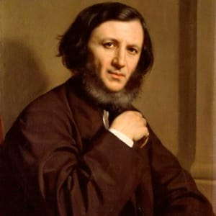
Robert Browning
(1812 – 1889)
English poet
“God’s in his heaven‑‑all’s right with the world.”

Slide 3
A Limerick – author unknown
God’s plan made a hopeful beginning,
But man spoiled his chances by sinning,
We trust that the story
Will end in God’s glory,
But at present the other side’s winning.

Slide 4
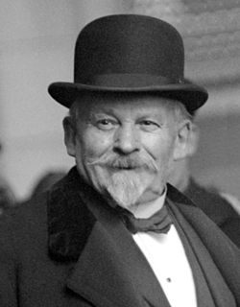
Émile Coué
(1857–1926) French psychologist
“In every day and in every way I’m getting better and better.”

Slide 5
Psalm 2
Part One (2:1-3) Rebellion on Earth
Part Two (2:4-6) Rebuke from Heaven
Part Three (2:7-9) Rule On Earth
Part Four (2:10-12) Respond Wisely

Slide 6
I. Rebellion on Earth (Psalm 2:1-3)
“Why do the nations conspire and the peoples plot in vain? 2 The kings of the earth take their stand and the rulers gather together against the LORD and against his Anointed One. 3 "Let us break their chains," they say, "and throw off their fetters."

Slide 7
John 12:31 Jesus referred to Satan as “the ruler of this world,”
2 Corinthians 4:4 “The god of this age (world) has blinded the minds of unbelievers, so that they cannot see the light of the gospel of the glory of Christ, who is the image of God.”

Slide 8
1 John 5:19 “We know that we are children of God, and that the whole world is under the control of the evil one.”

Slide 9
“A Mighty Fortress Is Our God,” by Martin Luther And though this world, with devils filled,
Should threaten to undo us,
we will not fear, for God hath willed
His truth to triumph through us.
The prince of darkness grim
we tremble not for him;
his rage we can endure,
for lo! his doom is sure,
one little word shall fell him.

Slide 10
II. Rebuke from Heaven (Psalm 2:4-6)
“The One enthroned in heaven laughs; the Lord scoffs at them. 5 Then he rebukes them in his anger and terrifies them in his wrath, saying, 6 "I have installed my King on Zion, my holy hill."”

Slide 11
Ezekiel 33:11
“‘As I live!’ declares the Lord God, ‘I take no pleasure in the death of the wicked, but rather that the wicked turn from his way and live’”

Slide 12
“proleptic” speech
A way of speaking of the future as if it were already past.
This is a common feature of Bible prophecy.

Slide 13
“proleptic” speech
2 Kings 19:25 “Have you not heard? Long ago I did it; from ancient times I planned it. Now I have brought it to pass.”

Slide 14
Zephaniah 1:14-17 "The great day of the LORD is near-- near and coming quickly. Listen! The cry on the day of the LORD will be bitter, the shouting of the warrior there. 15 That day will be a day of wrath, a day of distress and anguish, a day of trouble and ruin, a day of darkness and gloom, a day of clouds and blackness, 16 a day of trumpet and battle cry against the fortified cities and against the corner towers. 17 I will bring distress on the people and they will walk like blind men, because they have sinned against the LORD.”

Slide 15
III. Rule On Earth (Psalm 2:7-9)
“I will proclaim the decree of the LORD: He said to me, "You are my Son; today I have become your Father. 8 Ask of me, and I will make the nations your inheritance, the ends of the earth your possession. 9 You will rule them with an iron scepter; you will dash them to pieces like pottery."”

Slide 16
2 Samuel 7:14-16 “I will be his father, and he will be my son. When he does wrong, I will punish him with the rod of men, with floggings inflicted by men. 15 But my love will never be taken away from him, as I took it away from Saul, whom I removed from before you. 16 Your house and your kingdom will endure forever before me; your throne will be established forever.'"

Slide 17
IV. Respond Wisely (Psalm 2:10-12)
“Therefore, you kings, be wise; be warned, you rulers of the earth. 11 Serve the LORD with fear and rejoice with trembling. 12 Kiss the Son, lest he be angry and you be destroyed in your way, for his wrath can flare up in a moment. Blessed are all who take refuge in him.”

Slide 18
IV. Respond Wisely (Psalm 2:10-12)
be wise
be warned
serve with fear
rejoice with trembling
kiss the son

Slide 19
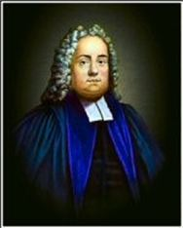
Mathew Henry
(1662–1714) English preacher and teacher
“Those that will not bow shall break.”

Slide 20
So what do we learn from Psalm 2?
2:1-3 we learn why the world is in chaos and the people are in rebellion against God.

Slide 21
2:1-3 we learn why the world is in chaos and the people are in rebellion against God.
2:4-6 we learn that though the rebellion is great, God is in no way threatened by this.

Slide 22
2:1-3 we learn why the world is in chaos and the people are in rebellion against God.
2:4-6 we learn that though the rebellion is great, God is in no way threatened by this.
2:7-9 we learn that the solution to this great rebellion is Jesus the Anointed One.

Slide 23
2:4-6 we learn that though the rebellion is great, God is in no way threatened by this.
2:7-9 we learn that the solution to this great rebellion is Jesus the Anointed One.
2:10-12 we learn that God invites anyone and everyone to wisely submit to Jesus as their king before it is too late.

Slide 24
How does all this apply to BCBC right now?
Satan sometimes causes difficulties even in the church.

Slide 25
How does all this apply to BCBC right now?
Satan sometimes causes difficulties even in the church.
If there are difficulties in the church it is because God has allowed it for some greater purpose.

Slide 26
How does all this apply to BCBC right now?
Satan sometimes causes difficulties even in the church.
If there are difficulties in the church it is because God has allowed it for some greater purpose.
The Anointed One, Jesus, is God’s solution to the problem.

Slide 27
Satan sometimes causes difficulties even in the church.
If there are difficulties in the church it is because God has allowed it for some greater purpose.
The Anointed One, Jesus, is God’s solution to the problem.
We must take seriously the invitation extended to us by God.

