Slide 1
Psalms
Songs of the Heart
Psalm 100 Song for a Thankful Heart

Slide 2
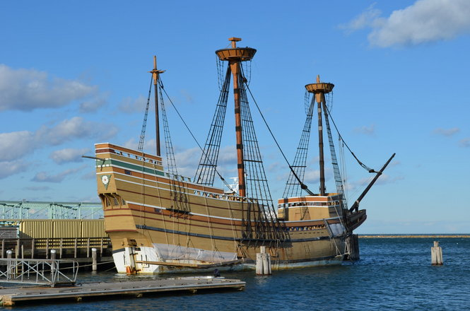
The Mayflower II

Slide 3
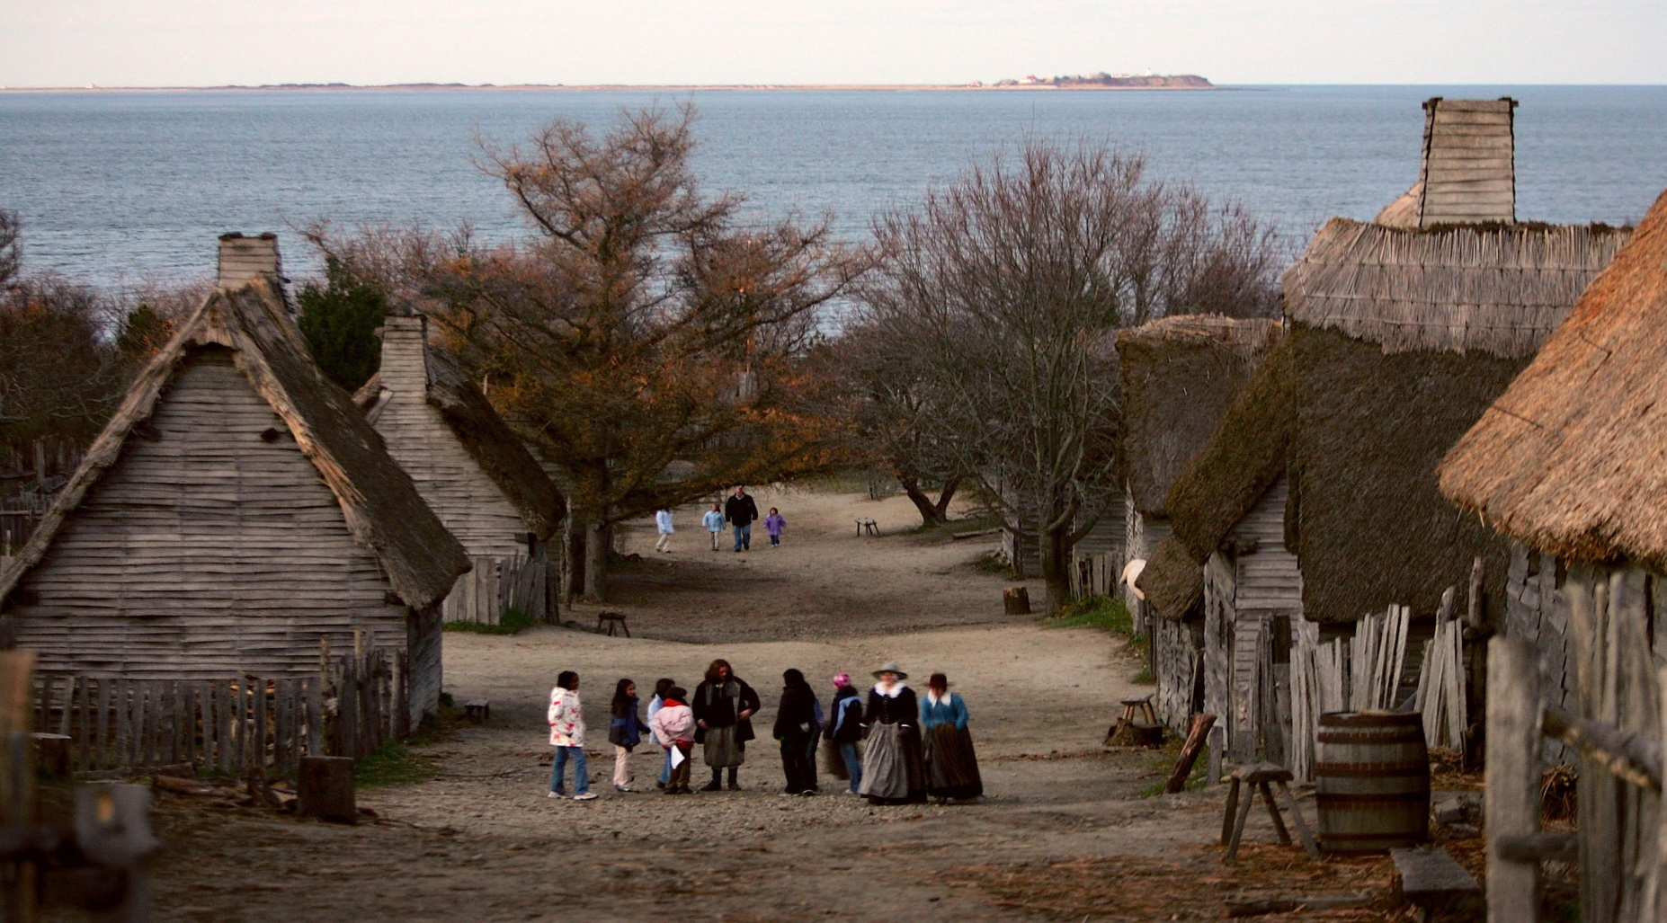
Plymouth Plantation

Slide 4
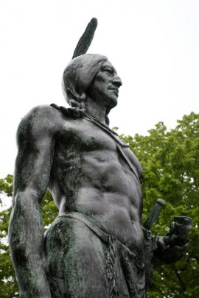
Wampanoag leader, Massasoit

Slide 5
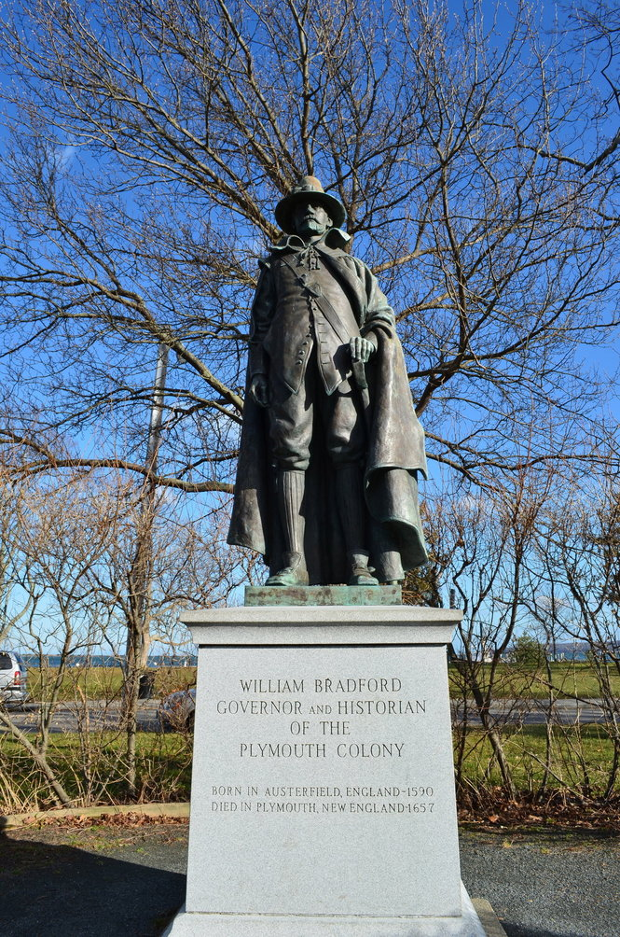
William Bradford, Governor

Slide 6
There is a simple structure to Psalm 100.
Worship of God (vv 1-2)
Knowledge of God (v 3)
Worship of God (v 4)
Knowledge of God (v 5)

Slide 7
Stanza 1: Worship of God (vv 1-2)
“Shout for joy to the LORD, all the earth. Worship the LORD with gladness; come before him with joyful songs.”
Three verbs used as commands:
“Shout” Should we be shouting in our church service?

Slide 8
2. “Worship” or “serve.”
Romans 12:1, “Therefore, I urge you, brothers, in view of God's mercy, to offer your bodies as living sacrifices, holy and pleasing to God-- this is your spiritual act of worship.”

Slide 9
Stanza 1: Worship of God (vv 1-2)
Three verbs used as commands:
“Shout”
“Worship” or “serve.”
“Come”

Slide 10
Stanza 2: Knowledge of God (v 3)
“Know that the LORD is God. It is he who made us, and we are his; we are his people, the sheep of his pasture.”
The fourth command is “know.”

Slide 11
“know” means both to know facts about God and to experience God.
If I try to experience God without proper knowledge, my worship and relationship with God will likely result in serious error.
If I know the facts about God but fail to personally experience God, then my religious knowledge is unfruitful.

Slide 12
Stanza 3: Worship of God (v 4)
“Enter his gates with thanksgiving and his courts with praise; give thanks to him and praise his name.”
Here the writer issues three more commands.
“enter” into God’s presence.

Slide 13
James 4:8
“Come near to God and he will come near to you. Wash your hands, you sinners, and purify your hearts, you double-minded.”

Slide 14
Stanza 3: Worship of God (v 4)
Here the writer issues the last two commands.
2. “give thanks” to God
3. “praise” God’s name

Slide 15
1 Thessalonians 5:18
“give thanks in all circumstances, for this is God's will for you in Christ Jesus.”

Slide 16
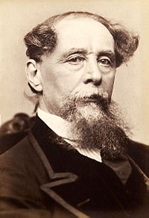
Charles Dickens
“You Americans do it backwards. You should set aside one day for complaining and use the other 364 for thanksgiving.”

Slide 17
Stanza 4: Knowledge of God (v 5)
“For the LORD is good and his love endures forever; his faithfulness continues through all generations.”
Here again the psalmist is giving us knowledge to provide proper basis for our worship.

Slide 18
Stanza 4: Knowledge of God (v 5)
“The Lord is good.”

Slide 19
Stanza 4: Knowledge of God (v 5)
“The Lord is good.”
“His love endures forever.”
The word translated here as “love” is the Hebrew word “hesed,” which is the covenant love of God.

Slide 20
“His love endures forever.”
Romans 8:38-39 “For I am convinced that neither death nor life, neither angels nor demons, neither the present nor the future, nor any powers, neither height nor depth, nor anything else in all creation, will be able to separate us from the love of God that is in Christ Jesus our Lord.”

Slide 21
Stanza 4: Knowledge of God (v 5)
“The Lord is good.”
“His love endures forever.”
“His faithfulness continues”
God’s faithfulness defined: God’s perfect loyalty and consistency in being true to his name, his character and his word.

Slide 22
Stanza 4: Knowledge of God (v 5)
“The Lord is good.”
“His love endures forever.”
“His faithfulness continues”
“aman” = “faithful”
“amen” = “so be it” or “it is certain.”

Slide 23
2 Corinthians 1:20
“For no matter how many promises God has made, they are "Yes" in Christ. And so through him the "Amen" is spoken by us to the glory of God.”

Slide 24
Conclusion
We learn from Psalm 100 that worship and knowledge go hand in hand.
Knowledge about God without worship is just unfruitful, dead doctrine.
Worship without proper knowledge of God can lead to instability or even doctrinal error.

Slide 25
Conclusion
Psalm 100 gives us seven commands to help us grow in our relationship with God:
Shout, worship (serve), come, know, enter, give thanks, and praise.
In which of these do you need to grow?

