Slide 1


Data driven recommendations for a
better marketing strategy
Andres, Baptiste, Clement, Luca & Tanguy

Slide 2
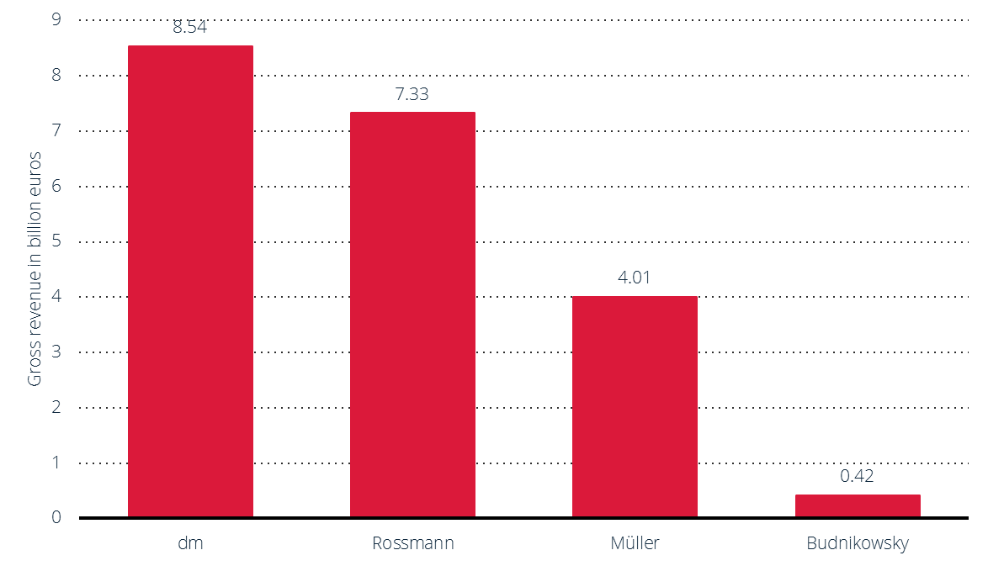
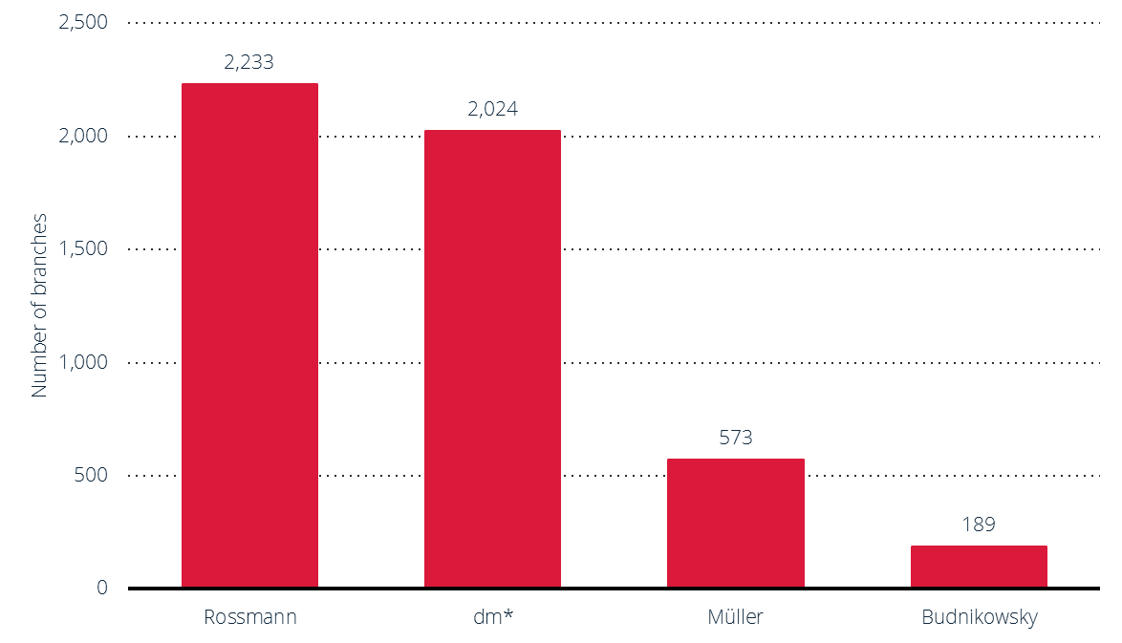
Introduction
4000 stores, around 2200 in Germany
Presence in Germany, Poland, Hungary, Czech Republic, Turkey, Albania, Kosovo & Spain
$10 billion in revenue with around constant 5% growth per year
$3 billion in revenue outside of Germany
Main competitors: dm & Mueller
Runs daily promotions through a variety of mediums:
Coupons
Mobile application
Leaflets
TV advertisements

Slide 3
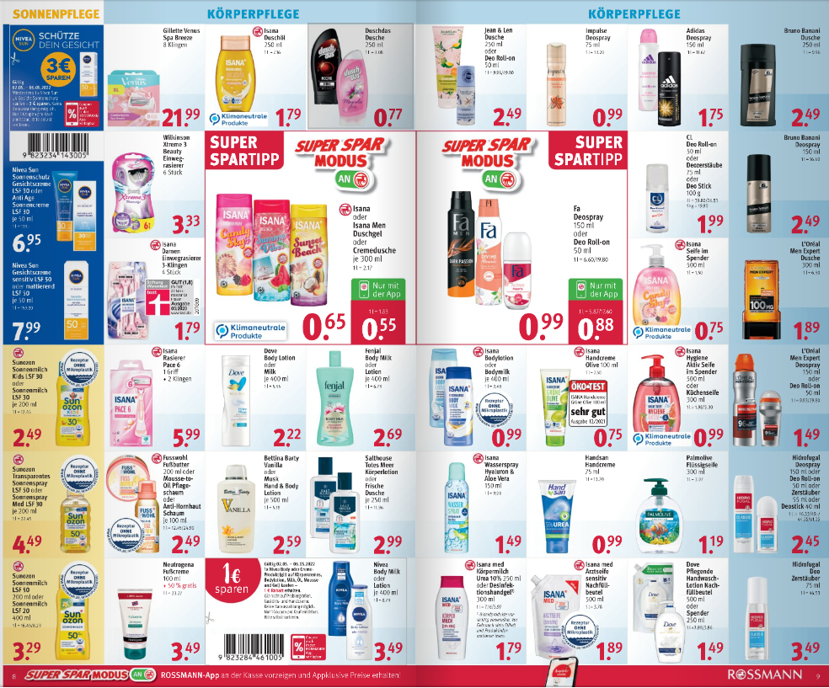
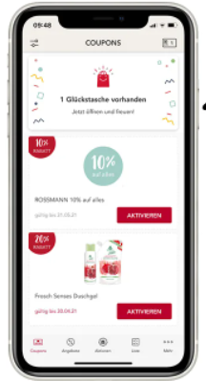
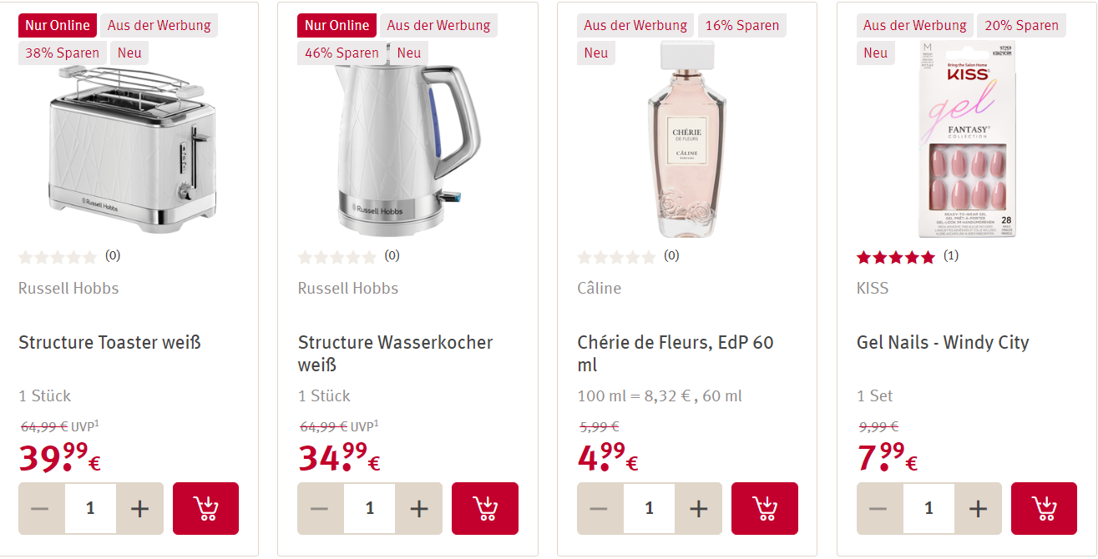
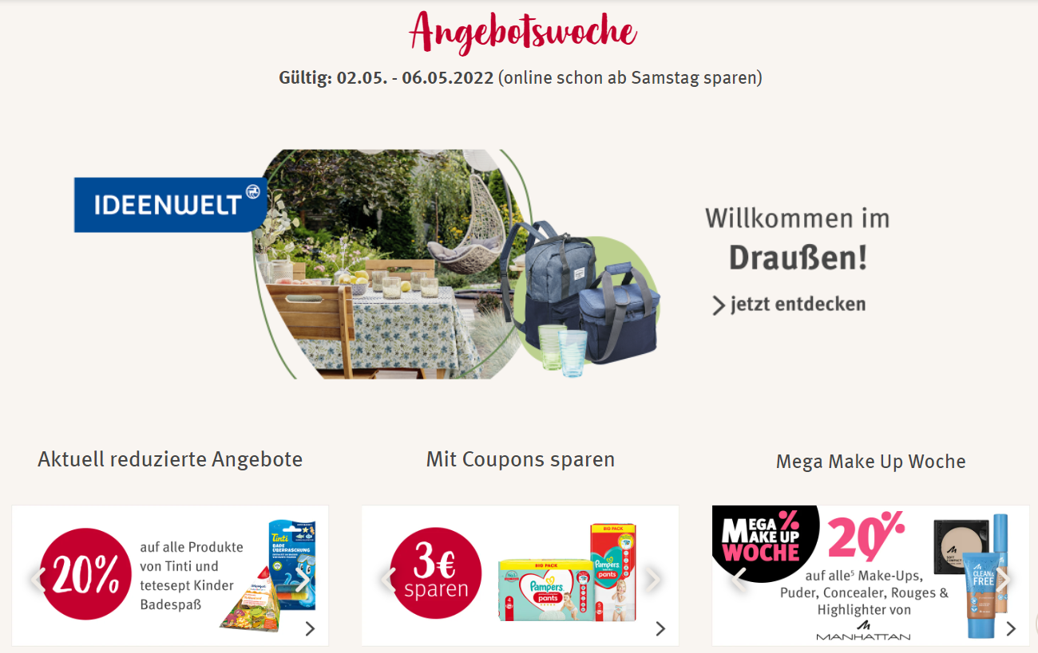
Numerous different promotions and advertisements without a coherent strategy

Slide 4
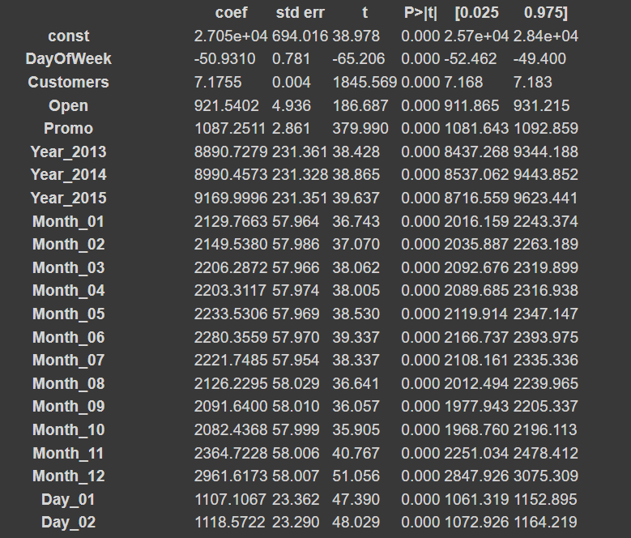
Rossmann Sales - important aspects
OLS regression with dummified dates
Some coefficients more or less significant
Most important coefficients:
“Open”
“Promo”
“Customers”
“State Holidays”
“PromoInterval”
“Assortment”
“StoreType”
December has higher positive coefficient and significance than other months.
All significant coefficients are positive
Similar results to what we would expect

Slide 5
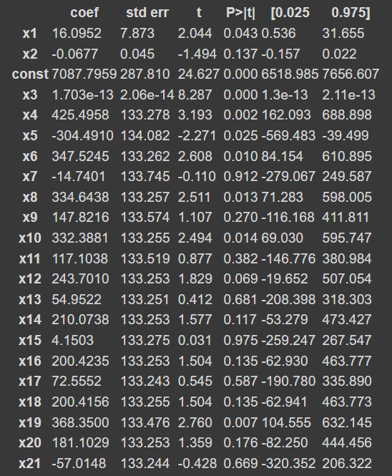
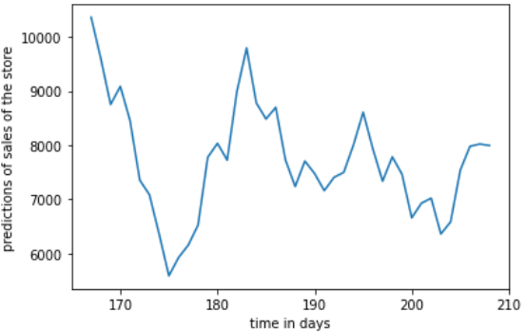
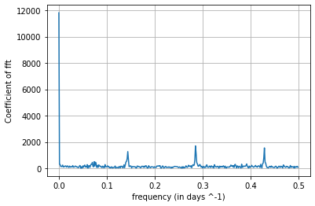
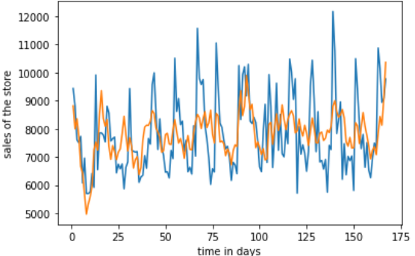
Sales forecast
Polynomial and harmonic regression forecasting with Fourier transform
Some coefficients are more or less significant
We still observe a strong seasonality
Our prediction goes 42 open days and forecasts an initial sharp drop in sales with a recovery after around 20 days

Slide 6
Different scenarios
New competitor
Older competitors have a stronger negative effect on sales
However, closer competitors result in lower sales
New promotion
We note that not running recurring promos actually results in a larger positive coefficient - one-time promotions are more effective
In-line with proposed promotions discussed later - cut back on promotions
Change in assortment
Assortments a&c seem to have the best effect on sales
The extra assortment seems to have a lower positive impact on sales

Slide 7
Promotions
Consumers will go to drugstores to buy necessities
Emphasis on Rossmann being their drug store of choice and encouraging adjacent and non-essential purchases once there
Regression shows recurring promotions have a limited effect
Rather limit promotions to fewer, key flagship items
Focus on promotions during school & public holidays
Could shift Rossmann’s position in the market, brining fewer but higher quality products related to important holidays
Once customers are in Rossmann, different in-store promotions can capitalise on consumer decision making process → impulse buying through urgency & product trial

Slide 8
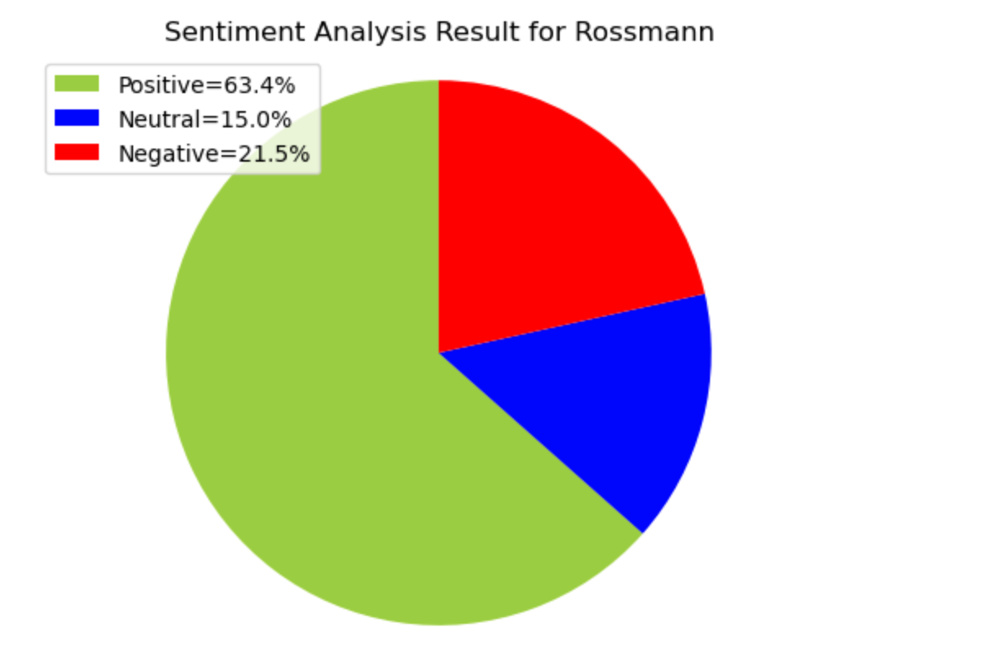
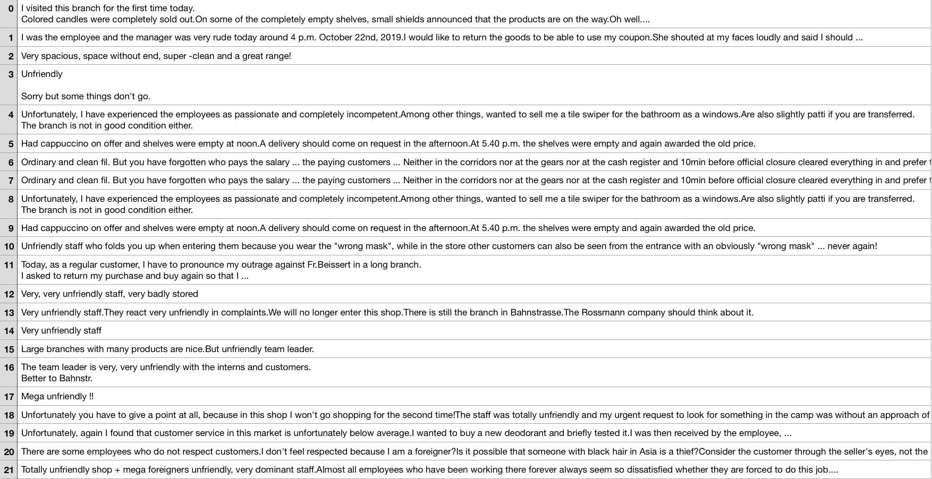
Textual analysis (Process Summary)
Results
The majority of Rossmann reviews are positive,
meaning that operations seem
to be overall satisfactory for customers
However we still
need to investigate
the motives of the 21.5% negative
reviews

Slide 9
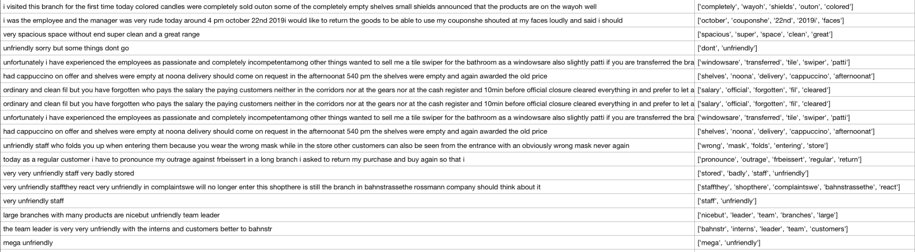
Keyword analysis
The majority of the negative reviews are related to employees behaving in an unprofessional way towards the customers
Notes:
As we can see, the vast majority of the negative reviews are related to employees behaving in a bad way towards the customers. As a consequence, we would recommend to engage in some “healing” marketing activities in the stores concerned by those type of employee related reviews. This could not only include discounts to re-engage the customers but also activities such as cosmetics products demonstrations/showcase to re-engage employees and customers, and sustain better employee involvement.

Slide 10
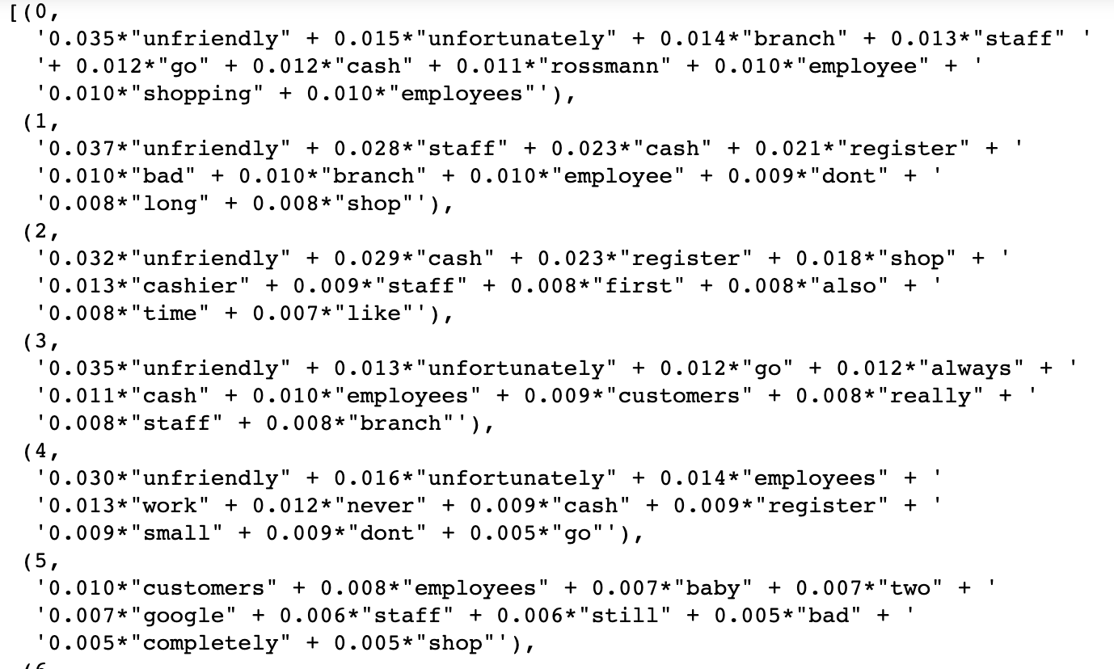
Topic analysis
The majority of the negative reviews are related to employees behaving in an unprofessional way towards the customers
Notes:
As we can see, the vast majority of the negative reviews are related to employees behaving in a bad way towards the customers. As a consequence, we would recommend to engage in some “healing” marketing activities in the stores concerned by those type of employee related reviews. This could not only include discounts to re-engage the customers but also activities such as cosmetics products demonstrations/showcase to re-engage employees and customers, and sustain better employee involvement.

Slide 11
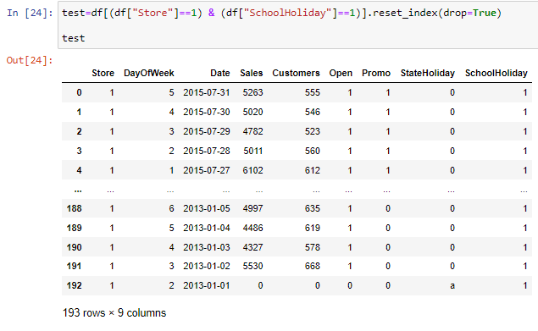
Bonus: Stores location
Groups of consecutive days were created based on school holidays and matched with official public available information.
Notes:
As we can see, the vast majority of the negative reviews are related to employees behaving in a bad way towards the customers. As a consequence, we would recommend to engage in some “healing” marketing activities in the stores concerned by those type of employee related reviews. This could not only include discounts to re-engage the customers but also activities such as cosmetics products demonstrations/showcase to re-engage employees and customers, and sustain better employee involvement.

Slide 12
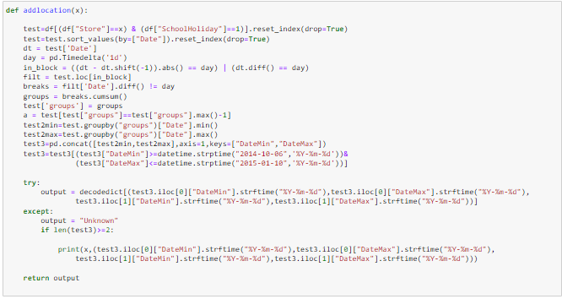
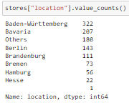
Bonus: Stores location
The following locations were found:
Notes:
As we can see, the vast majority of the negative reviews are related to employees behaving in a bad way towards the customers. As a consequence, we would recommend to engage in some “healing” marketing activities in the stores concerned by those type of employee related reviews. This could not only include discounts to re-engage the customers but also activities such as cosmetics products demonstrations/showcase to re-engage employees and customers, and sustain better employee involvement.

Slide 13
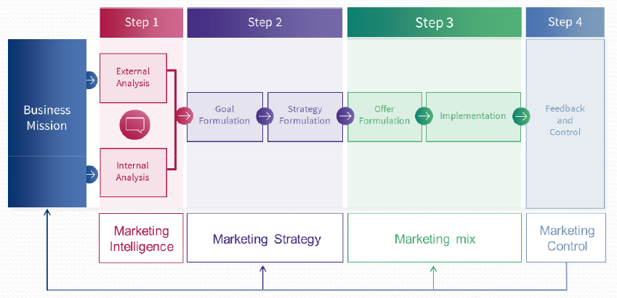
Final recommendations
The regression & textual analysis allowed us to identify the main drivers of Rossmann’s success, and main difficulties.
Rather limit promotions to fewer, key flagship items.
Focus on promotions during school & public holidays
Aim to better employee engagement through several initiatives
Have to follow the marketing framework for these initiatives to be successful
Shift Rossmann’s position in the market by creating less but more effective promotions & promoting the right brands / USP to differentiate

Slide 14
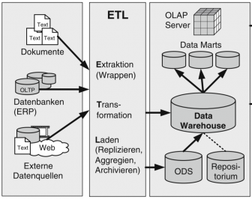
Further analysis
For further analysis, we would require more data about the company:
Customer database → demographics, spending habits, visit frequency, …
Brand/product database → product sales, promotions, cost of sale, brand perception, …
Individual store database → product sales, location, inventory, ….
Competitor analysis: customers, brands, stores
This additional data, in combination with the textual analysis and sales forecast, could be used to make more efficient marketing decisions
Shift Rossmann’s position in the market by creating less but more effective promotions & promoting the right brands / USP to differentiate

Slide 15

Thank
You
Q&A
Andres
Baptiste
Clement
Luca
Tanguy

