Slide 1


UBS - Synthetic Data Hackathon
Group 8
Baptiste Bignaud
Clement Gauvin
Luca Giglioli
Tanguy Pichelot
Elissa Al Dalccache
Felix Hobeiche
Serena Abella
Edmond Irani
Sami Rizkallah
Hussein Rahal
Toufic Ziade

Slide 2
Table of Contents
1
INTRODUCTION
2
DATA PREPARATION
3
TASK I
4
TASK II
5
CONCLUSION

Slide 3
Introduction - the data
The dataset originates from a publicly available source and contains salary alongside other characteristics •
There are missing values coded as “unavailable” (in education, race and gender) to use these variables without necessarily having to drop the observations with missing values •
However, data processing, creating new variables etc. is a prerogative to maximize performance •
The target variable is (depending on the task), base salary (possibly also total compensation or base salary + bonus)

Slide 4
Introduction - synthetic data
Synthetic data, simply put, is data artificially generated by an AI algorithm that has been trained on a real data set.
Synthetic data can generated by treating each column in a table as a random variable, modeling a joint multivariate probability distribution, and then sampling from that distribution.
Good synthetic data should be able to reproduce the statistical properties of the original dataset.
Notes:
Technical Goal:
Reproduce the statistical properties and patterns of the existing dataset.
Business Utility:
Share data with partners, governments, and other organizations to boost innovation without breaking privacy laws.
Create new revenue streams for your business by monetizing your data without compromising personal/sensitive information

Slide 5

2. Data Preparation - key steps involved
Data pre-processing
Feature selection: keep company, level, title, location, yearsofexeprience, yearsatcompany, gender, year, tag_truncated, country + label: basesalary
Data cleaning: removed missing values for basesalary + classified under-sampled categories as others + removed outlier values for basesalary
Dummification: dummification of the categorical variables using one-hot encoding

Slide 6
3. Task I - overview and procedure
Investigate whether a ML model trained on synthetic data can offer comparable levels of performance regarding a model trained on original data when tested over real data.
Steps we followed:
Preprocessed the original dataset
We split the original dataset into train and test sets
We trained a baseline regression model on the original dataset (train set)
We implemented various data synthetization techniques
We used the synthetic data generated to train the model and compare it with the baseline model

Slide 7
3. Task I - multiple linear regression
Splitting the dataset into train and test sets and generating the baseline regression:
Once the dataset was preprocessed and ready to be exploited, we split it using a 80/20 train-test ratio
Based on the the train data of the cleaned dataset, we trained a multiple linear regression using the OLS regression a of Python statsmodels to predict basesalary on the test set
We obtained an R² = 67% and a MSE = 30,942

Slide 8
3. Task I - random forest regression
Splitting the dataset into train and test sets and generating the baseline regression:
Once the dataset was preprocessed and ready to be exploited, we split it using a 80/20 train-test ratio
We also implemented a random forest regression on the cleaned data set train data to predict basesalary on the test set
We obtained a MSE = 32,306

Slide 9
3. Task I - the TVAE Model
Variational Autoencoder (VAE) is a neural network generative model. A variational autoencoder can be defined as being an autoencoder whose training is regularised to avoid overfitting and ensure that the latent space has good properties that enable generative process.
Instead of encoding an input as a single point, we encode it as a distribution over the latent space.
With the appropriate preprocessing and by modifying the loss function, we can adapt VAE to tabular data (TVAE)

Slide 10
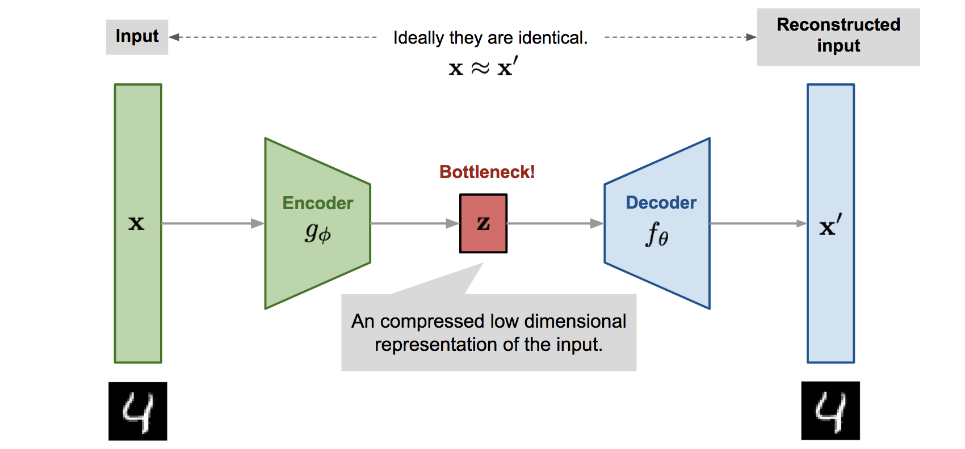
3. Task I - TVAE Model schema

Slide 11
3. Task I - the CTGAN Model
Generative Adversarial Network (GAN) models are a family of deep neural networks that can be used for the generation of synthetic data (especially used with images and textual data).
GANs can be also used to generate synthetic tabular data (CTGAN).
Generally, Adversarial Networks take a simple random variable as an input, and return, once trained, a random variable that follows the targeted distribution. Being this distribution potentially very complicated and unknown, we model the discriminator with another neural network which models a discriminative function.

Slide 12
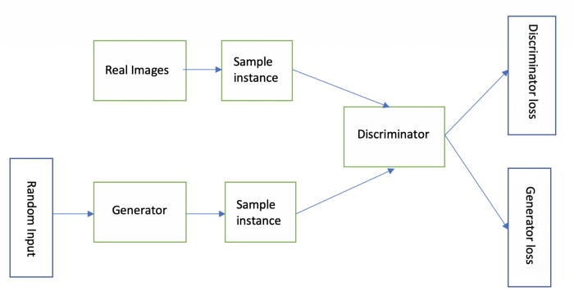
3. Task I - GAN Model schema

Slide 13
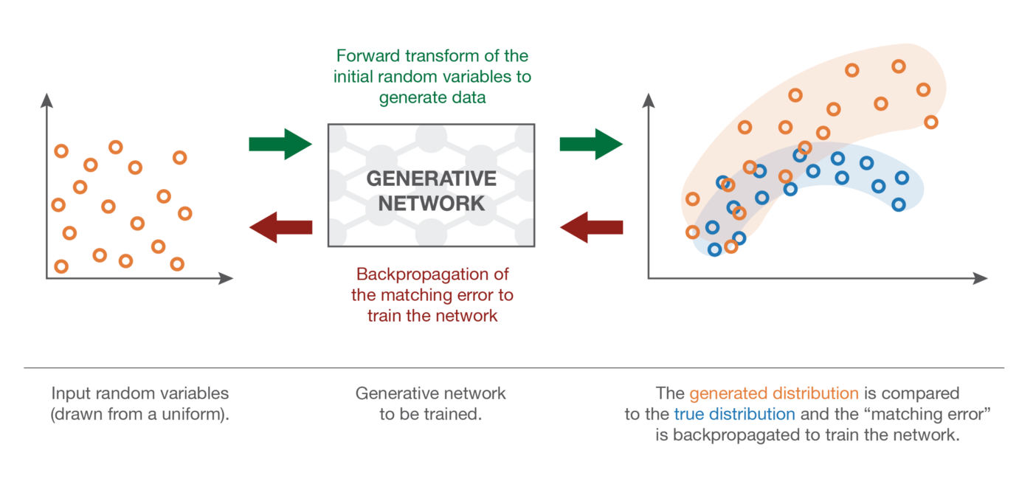
3. Task I - GAN Model schema
READY

Slide 14
3. Task I - our WE-GMM Model
READY
Gaussian Mixture models (GMM) are a family of clustering algorithms that can be employed to generate synthetic data. These models map an unknown target distribution to a combination of (well-known) multivariate normal distributions.
Firstly, we applied GMM directly on the cleaned original dataset, resulting in a poor synthetic data generation.
We then decided to encode the categorical variables contained in the dataset by applying a Word Embedding (WE) algorithm to project the data onto a latent space and then feeding the embedding to the Gaussian Mixture model, resulting in a very good synthetic data generation.
Notes:
That can be described through a mean vector and a covariance matrix.

Slide 15
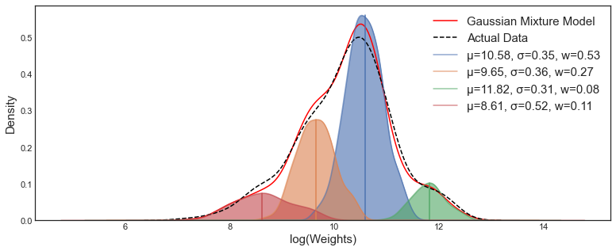
3. Task I - GMM schema
Notes:
That can be described through a mean vector and a covariance matrix.

Slide 16
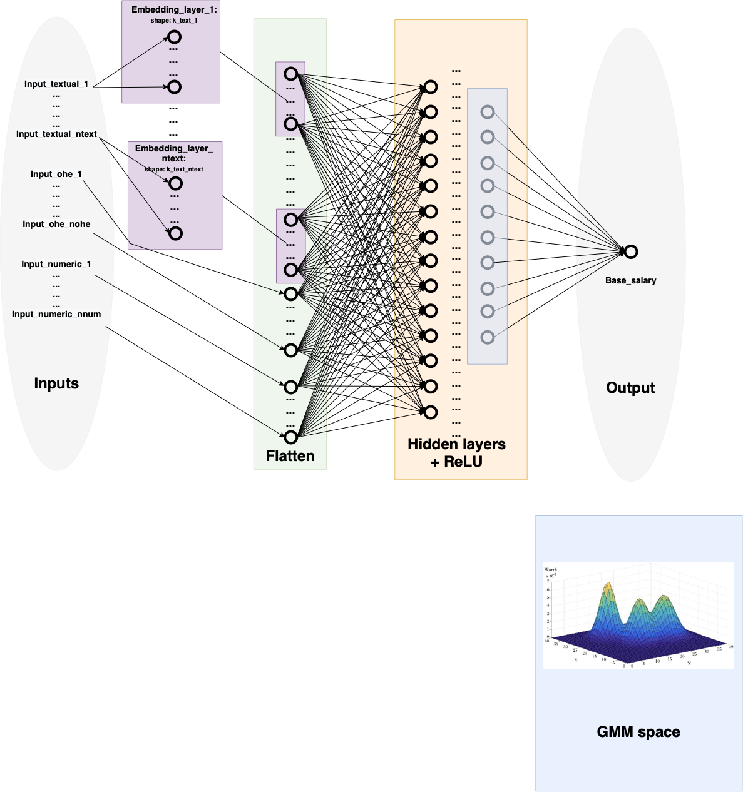
3. Task I - WE-GMM schema
Notes:
That can be described through a mean vector and a covariance matrix.

Slide 17



3. Task I - evaluating model results
 | Ranking | Privacy | Selected Model | RMSE
TVAE |  |  | Linear Regression | 30560.696
CTGAN |  |  | Linear Regression | 47567.203
WE-GMM |  |  | Random Forest | 20989.649
Notes:
That can be described through a mean vector and a covariance matrix.

Slide 18
4. Task II - effectiveness of our synthetic data
The SDV library includes privacy metrics to measure how anonymous is the synthetic data compared to the original data
Our selected model (WE-GMM), theoretically offers the best anonymization possible among the several models considered
For these reasons, we believe that it is not useful to evaluate this model based on privacy metrics
Notes:
These metrics can be used for numerical or categorical data types, but not mixed data types, which can make their use quite difficult + column structure has to be identical between the two datasets (original+synthetic)

Slide 19
4. Task II - limitations of synthetic data
Risk of re identification:
compromise between privacy and utility
the more a synthetic dataset mimics the real data, the more it may reveal about real people
Lack of clarity on other risks:
the data transference of generative models, which could allow other parties to generate synthetic data on their own, might bring further risks to privacy
Risk of membership inference attacks:
synthetic data seems to share the same caveats of other forms anonymisation regarding the risk of membership inference attacks
Notes:
Encoding the labels to 1 or 0

Slide 20
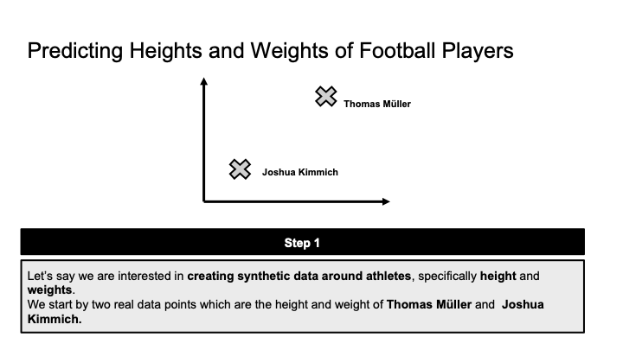
4. Task II - convincing a business client I
READY
Notes:
Encoding the labels to 1 or 0

Slide 21
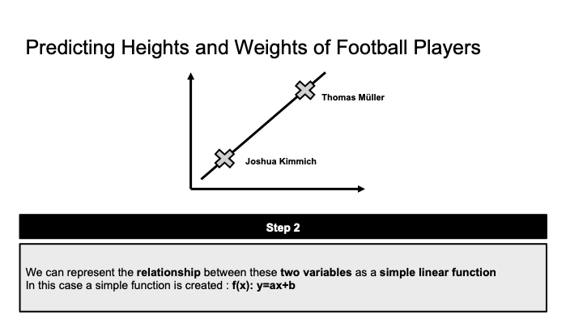
4. Task II - convincing a business client II
Notes:
Encoding the labels to 1 or 0

Slide 22
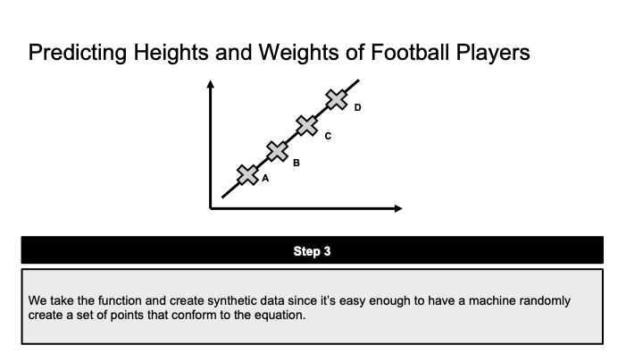
4. Task II - convincing a business client III
Notes:
Encoding the labels to 1 or 0

Slide 23
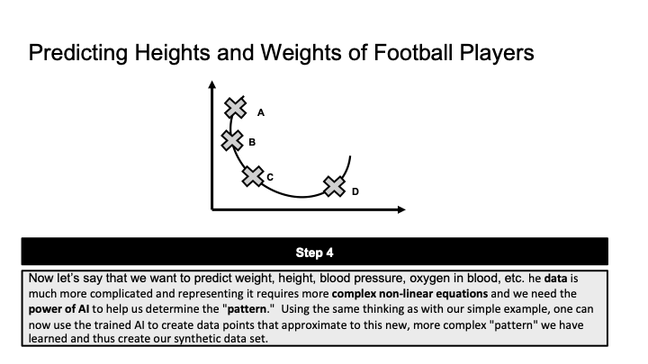
4. Task II - convincing a business client IV
Notes:
Encoding the labels to 1 or 0

Slide 24
4. Task II - the legal angle in the EU
A key element for the identification of the material scope of EU data protection rules, such as the General Data Protection Regulation, is the definition of personal data: the principles of data protection apply to any information concerning an identified or identifiable natural person.
Anonymous information: information which does not relate to an identified or identifiable natural person or to personal data rendered anonymous in such a manner that the individual is not or no longer identifiable
The Organisation for Economic Co-operation and Development (OECD) defines synthetic data as:
“An approach to confidentiality where instead of disseminating real data, synthetic data that have been generated from one or more population models are released.”
The current debate in the EU raises an important question: “what kind of threat scenarios should be considered to prevent these from harming individuals and what further measures and conditions are necessary to avoid re-identification and other privacy risks stemming from the use of synthetic data?”
The EDPS and the IPEN projects will therefore continue to follow the development of privacy engineering and the state of the art of synthetic data.
Source: https://edps.europa.eu/press-publications/press-news/blog/future-privacy-synthetic_en
Notes:
Encoding the labels to 1 or 0

Slide 25
5. Conclusions - results and overview
Takeaways:
The best performing model to generate synthetic data is the one combining Word Embedding and Gaussian Mixture
The model obtained a RMSE of 20989.649
High degree of anonymization
“Are synthetic data useful?”
“How much “anonymization” do synthetic data provide?”

Slide 26
UBS - Synthetic Data Hackathon
Thank You!
Group 8
Baptiste Bignaud
Clement Gauvin
Luca Giglioli
Tanguy Pichelot
Elissa Al Dalccache
Felix Hobeiche
Serena Abella
Edmond Irani
Sami Rizkallah
Hussein Rahal
Toufic Ziade

