Slide 1

AUTOMATIC CLASSIFICATION OF PLANKTON BY DEEP LEARNING
Anne LEGENDRE, Baptiste POUTHIER, Mathilde SCHNEIDER
Supervisors : Mr. Eric DEBREUVE, Mr Frédéric PRECIOSO

Slide 2
OVERVIEW
Introduction
CNN (Convolutional Neural Network)
Hierarchical architecture
Application
NEF

Slide 3
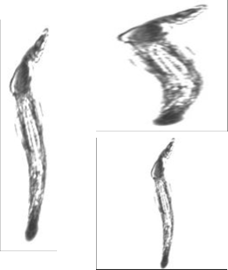
DATASET
Villefranche-Sur-Mer Oceanographic Laboratory
Overrepresented/underrepresented species
Resized images
Data Augmentation

Slide 4
CNN
- Filters sliding across the input Matrix
- Element-wise multiplication between filter values and input values at any position
- Generation of feature maps, stacked to get output matrix
Convolutional layers
More about filters
Activation function
Pooling
Dropout
Loss function & backpropagation

Slide 5
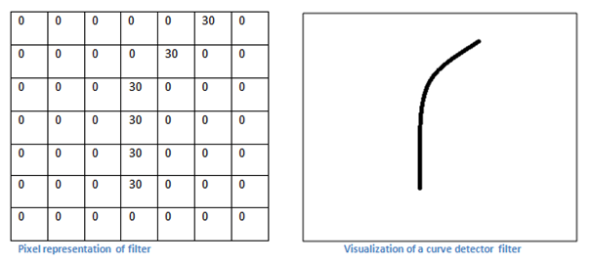
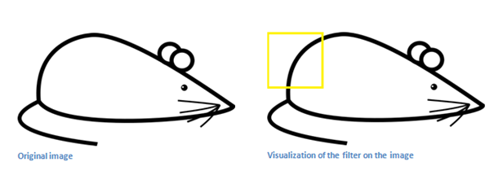
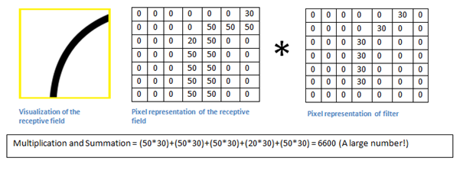
CNN
Convolutional layers
More about filters
Activation function
Pooling
Dropout
Loss function & backpropagation

Slide 6
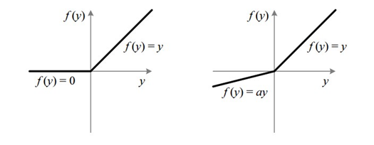
CNN
Convolutional layers
More about filters
Activation function
Pooling
Dropout
Loss function & backpropagation
ReLU: f(x) = max(0,x)
LeakyReLU: f(x) = x si x>0
f(x) = ax si x≤0

Slide 7
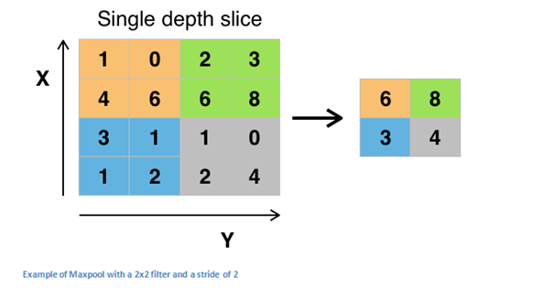
CNN
Convolutional layers
More about filters
Activation function
Pooling
Dropout
Loss function & backpropagation

Slide 8
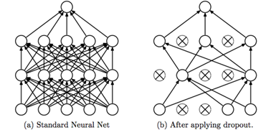
CNN
Convolutional layers
More about filters
Activation function
Pooling
Dropout
Loss function & backpropagation

Slide 9
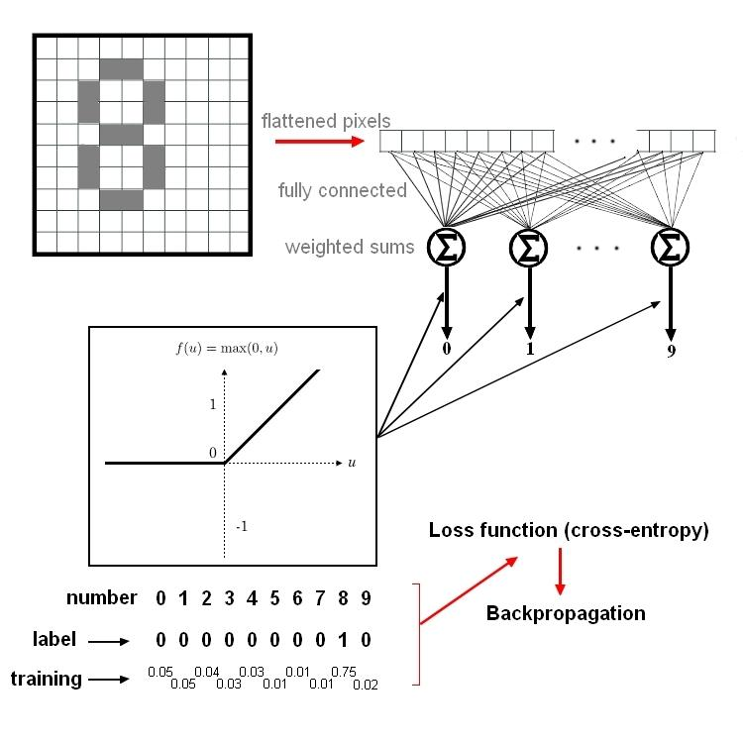
CNN - LOSS FUNCTION &
BACKPROPAGATION
Fully connected layer
Loss function
Backpropagation

Slide 10
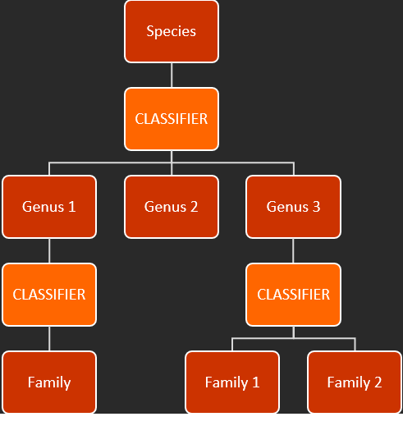
TREE-BASED HIERARCHY
Structure of taxonomy (classifies species by genetic traits)
Each classifier :
1 CNN-block ( extraction of features)
1 MLP-block (decisions)

Slide 11
ERROR-BASED CLASSIFIERS
Regroup classes with high classification errors
Create a new classifier only to differentiate them
Confusion matrix :
C[i,j] frequency of classifying a data in class j knowing that its real class is i
C[i,j] ⬅ 𝛂C[i,j]+𝛂C[j,i] : symmetric
Aim : creation of groups

Slide 12
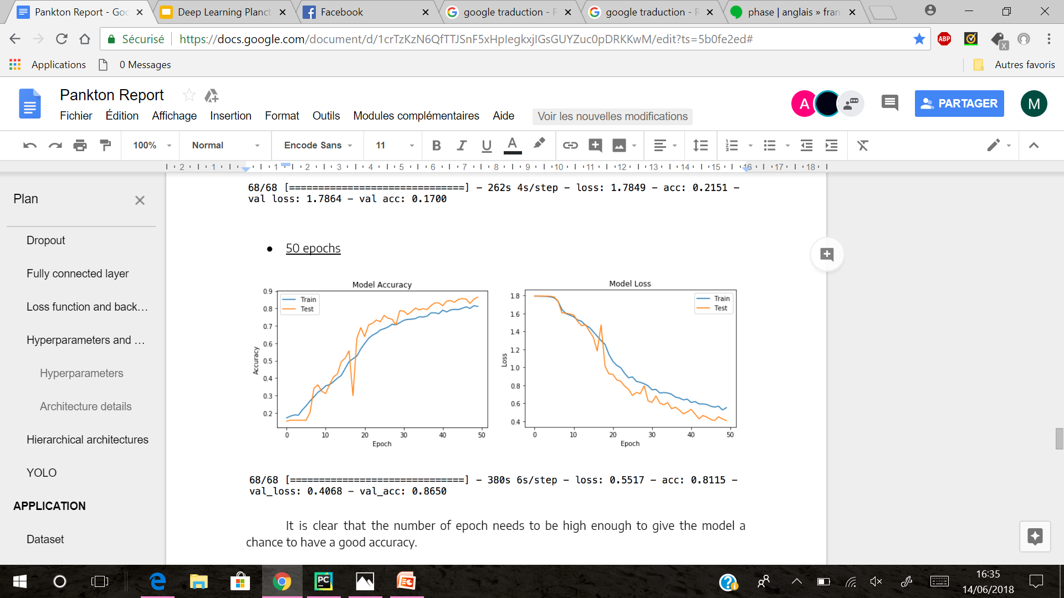
APPLICATION
Parameters :
Classes: 6
Images: 6000
Batch size: 70
Epochs: 50

Slide 13
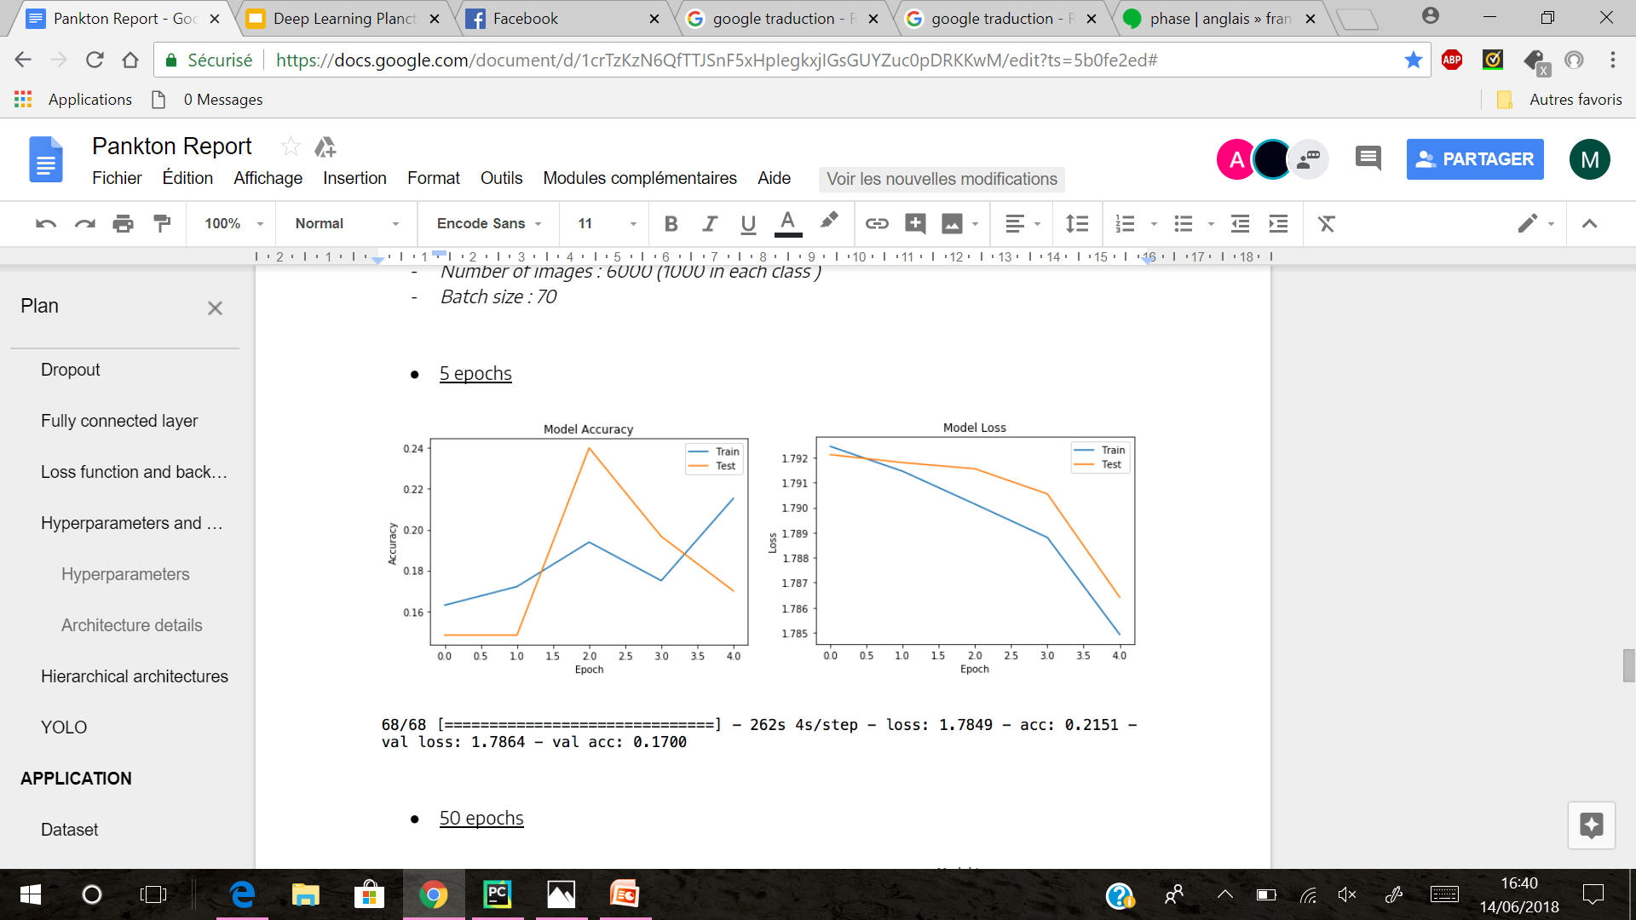
VARIATION OF EPOCHS
5
500

Slide 14
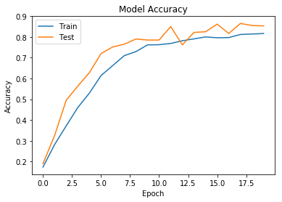
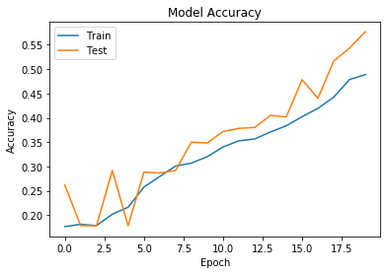


VARIATION OF BATCH SIZE
10 (20 epochs)
100 (20 epochs)

Slide 15
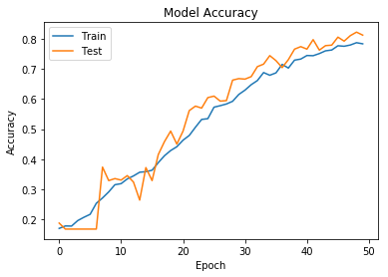
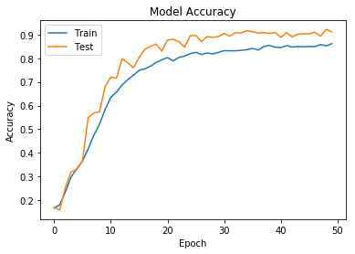
VARIATION OF BATCH SIZE
100 (50 epochs)
30 (50 epochs)

Slide 16
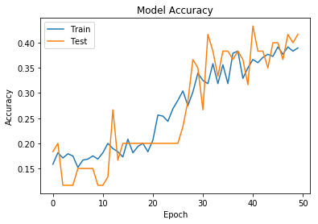
VARIATION OF THE NUMBER OF IMAGES
6000
600

Slide 17
NEF
INRIA computing cluster
oarsub -S ./start-naif.sh -t besteffort -p “gpu=’YES’ and host=’nefgpu09.inria.fr” -p ‘mem >150000’ -l /nodes=1, walltime=20:00:00

Slide 18
Thank you for your attention

