Slide 1

Sentiment Analysis Project
Revalida Group 5

Slide 2






Meet the Developers
John Adrian De Guzman
Machine Learning Engineer
Clan Porgalinas
Machine Learning Engineer
Jason Roberto
Data Engineer
Bernard Allen Villamil
Data Engineer

Slide 3

About the Project
Sentiment Analysis is the process of using natural language processing, text analysis, and computational linguistics to identify and extract subjective information from source materials.
We at SentiPy provide sentiment analysis predictions based on user inputs. We provide 2 services: single input and document input.

Slide 4
Definition of Terms
Corpus
: Collection of authentic text organized into datasets
TF-IDF
Word Embedding
Document Embedding
Contextual Embedding

Slide 5
Definition of Terms
Corpus
: Collection of authentic text organized into datasets
TF-IDF
Word Embedding
Document Embedding
Contextual Embedding

Slide 6


Definition of Terms
TF-IDF
Corpus
: Collection of authentic text organized into datasets
Definition:
Used to measure the importance of a word within a document. It is often used in NLP and information retrieval tasks, such as text classification, search, and summarization.
Process:
Involves calculating the frequency of a term in a document to obtain the score, which represents the importance of a term in the document.
Word Embedding
Document Embedding
Contextual Embedding

Slide 7
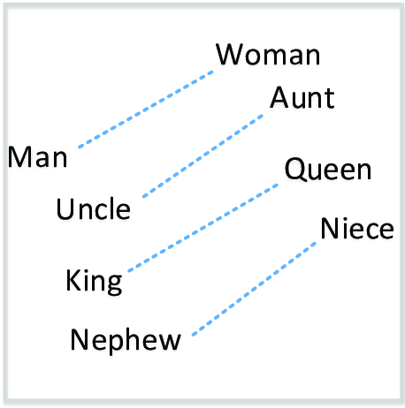
Definition of Terms
TF-IDF
Word Embedding
Corpus
: Collection of authentic text organized into datasets
Definition:
A way to represent words as dense vectors of numbers, where the position of the word in the vector space encodes information about the meaning of the word.
Process:
Training a model in a neural network to learn the relationship between words and produce a set of vectors that represent each word in the vocabulary.
Document Embedding
Contextual Embedding

Slide 8
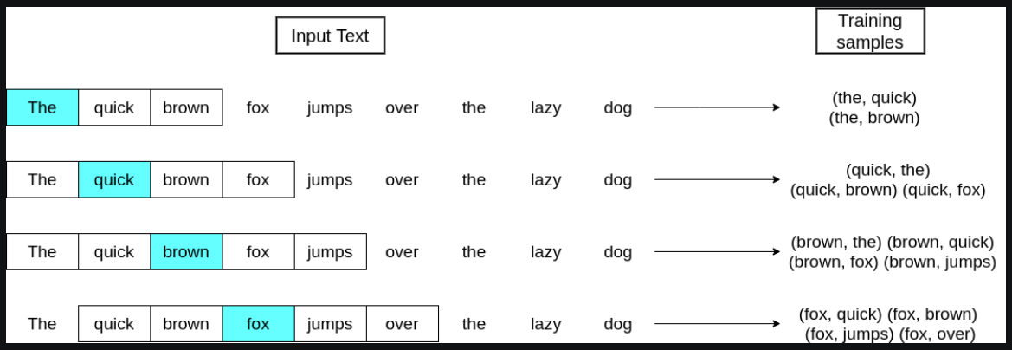
Definition of Terms
TF-IDF
Document Embedding
Word Embedding
Corpus
: Collection of authentic text organized into datasets
Definition:
A technique to represent text in a low-dimensional vector. This allows for text to be used as input for models, and also captures the relationship between words in the text.
Process:
Involves tokenizing the text, training the vectors using an unsupervised learning algorithm and then reducing the dimensionality of the vectors.
Contextual Embedding

Slide 9
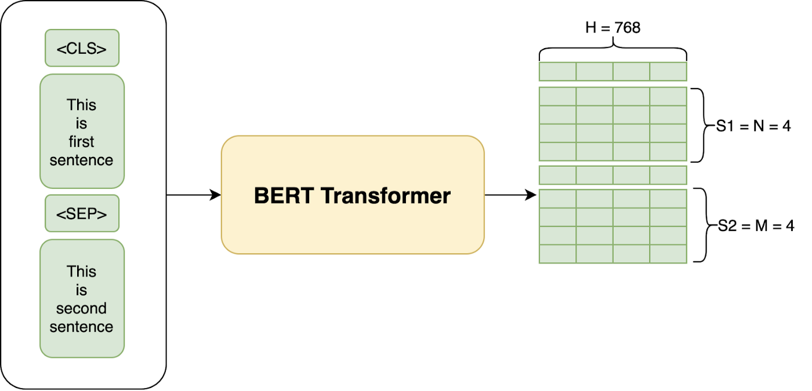
Definition of Terms
Document Embedding
TF-IDF
Contextual Embedding
Word Embedding
Corpus
: Collection of authentic text organized into datasets
Definition:
The process of creating a numerical output that takes into account the context in which it appears. Typically created using transformer-based architectures.
Process:
Includes tokenization, adding special tokens to the beginning and end of the input text. Padding the sequences and generating attention mask.

Slide 10


Dataset Used
We use a combination of 2 Twitter Datasets from Kaggle.
These provides us a more diverse approach on our Modeling
Narendra Modi Tweets
Twitter US Airline Sentiment
Sources:
https://www.kaggle.com/datasets/neelgajare/all-narendra-modi-tweets-2022-updated
https://www.kaggle.com/datasets/crowdflower/twitter-airline-sentiment

Slide 11
Deep Learning Model
For the vectorizer, we use:
TF-IDF Vectorizer
Architecture | Vectorizer | Model
TF-IDF | TF-IDF Vectorizer | Sequential (Dense)
Word Embedding | Glove | Sequential (LSTM)
Document Embedding | Word2Vec | Sequential (Simple RNN)
Contextual Embedding | DistilBertTokenizer | DistilBertForSequenceClassification

Slide 12
Deep Learning Model
For Final Model, we use:
Keras Sequential
Dense Layer

Slide 13
Here’s how works

Slide 14
Thank You!

