Slide 1
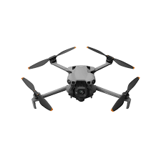
Inspection power line by using UAVs
Presenter: Lihang Shen
Supervisor: Vera Chung
Master of Computer Science

Slide 2
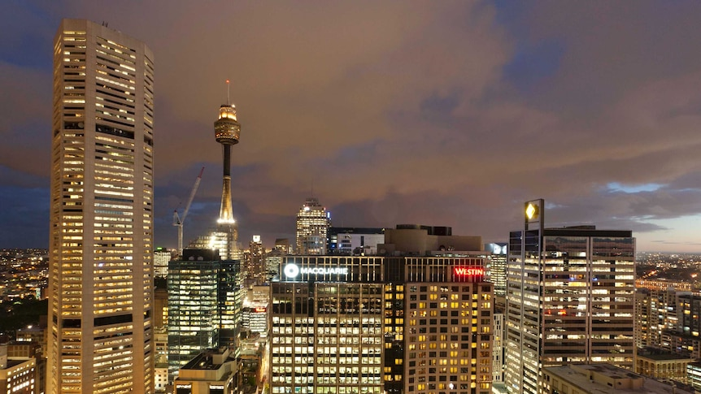
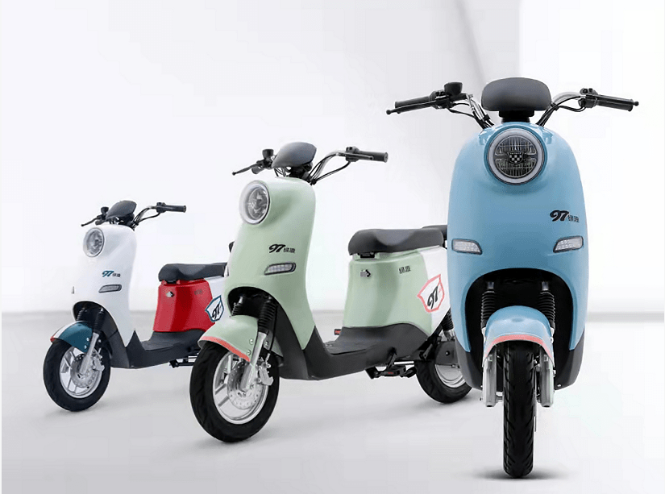
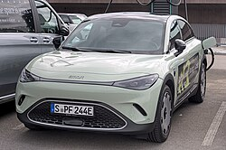
Background
Electricity Demand Increase
Electricity Car
Electricity Bicycle

Slide 3
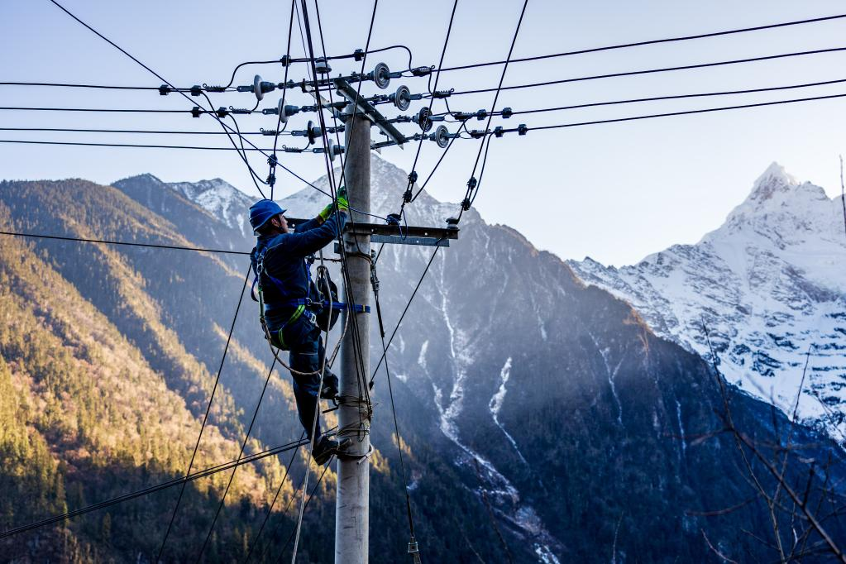
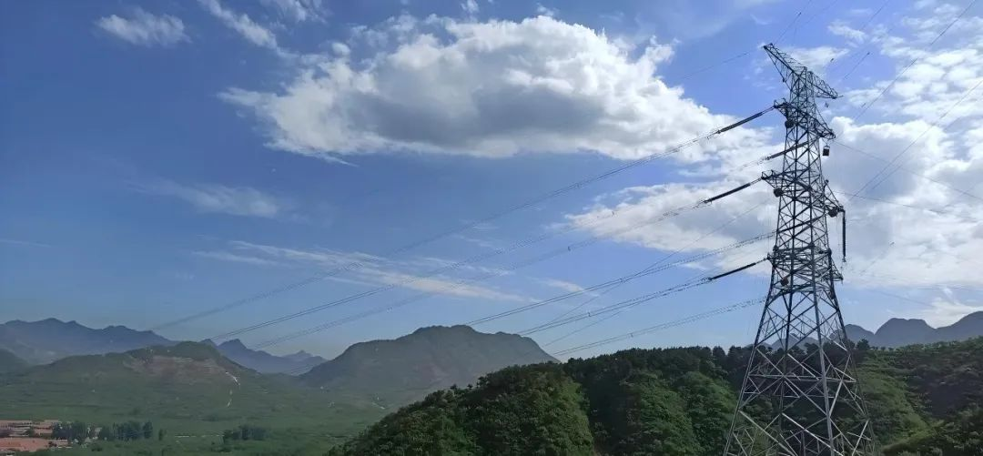
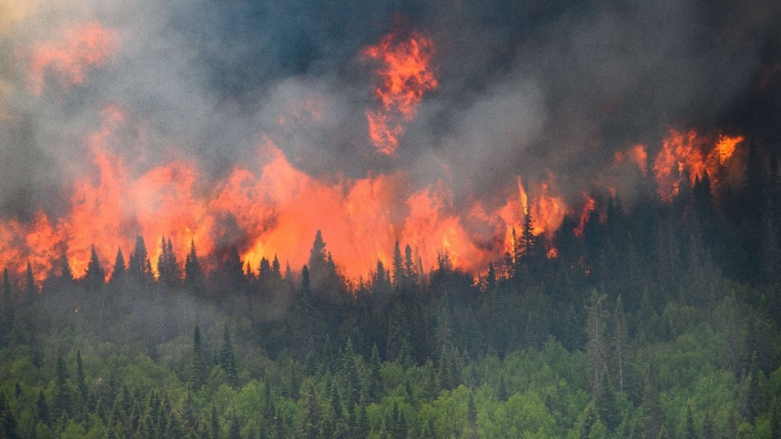
Motivation
For Safety
For Economic Efficiency

Slide 4
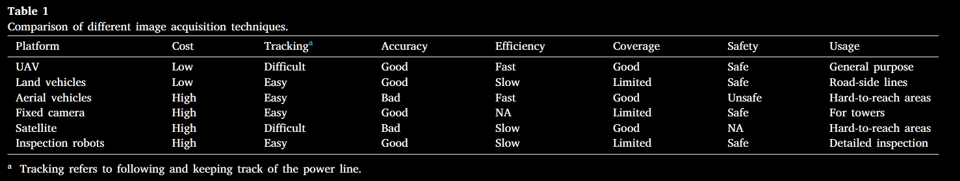
Comparison
UAVs are the most balanced option, as they are the only method that performs
best in 5 categories among all the compared approaches.
That’s why I choose UAVs not other methods!!!

Slide 5
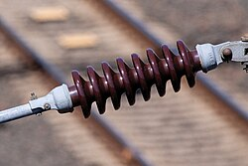
Research Domain (Literature Review)
Detection of Power Lines
blend into the background.
Detection of Power Towers
different in shape
Detection of Power Components
Small defects are hard to detect
Detection of Defects
Small defects are hard to detect

Slide 6
Gap of Defect Detection
RGB-only dependency & Surface-only detection
→ implies hidden defects may be missed
→ most methods ignore internal or subtle faults
Rare defect types
→ performance drops on uncommon defect types

Slide 7
Objectives
Research Question
“how to develop a robust, generalizable, and efficient UAV-based insulator defect detection framework that can reliably identify both common and rare defects under diverse operational and environmental conditions, while supporting real-time deployment and multi-sensor data fusion.”
Enhance existing datasets
Merge existing datasets
Develop a more robust model
Explore new YOLO variants with attention module

Slide 8
Research Method
Stage | Duration | Timeline | Key Focus
Stage 1: Dataset Preparation and Enhancement | 4 weeks | Dec 2025 – Jan 2026 | Dataset collection, enhancement, augmentation, rare defect balancing
Stage 2: Model Development and Optimization | 8 weeks | Feb – Mar 2026 | YOLO variant design, attention integration, ablation and tuning
Stage 3: Multi-Sensor Integration & Edge–Cloud Deployment | 4 weeks | Apr 2026 | Integrate multiple sensor data (e.g., infrared, LiDAR) with RGB images; test with GPU.
Stage 4: Evaluation and Validation | 4 weeks | May 2026 (Weeks 17–20) | Model robustness testing, efficiency evaluation, field validation
Stage 5: Report Writing and Submission | 2 weeks | Late May 2026 | Report compilation, proofreading, and final submission

Slide 9
References
Page 1
DJI, “DJI Consumer Drones Comparison,” DJI Official Website, September 3, 2025, https://www.dji.com/au/products/comparison-consumer-drones.
Page 2
ABC News, “悉尼中央商务区的办公楼缘何在夜间灯火通明？” Fri 17 Aug 2018 https://www.abc.net.au/chinese/2018-08-17/sydney-building-lights-left-on-energy-use-curious-sydney/10134002, accessed October 9, 2025.
Sohu, “I just found out: How practical are 48V, 60V, and 72V electric bikes in speed and range?”, May 6, 2022, https://www.sohu.com/a/544222324_120845368, accessed October 9, 2025.
Wikipedia contributors, “Electric car,” Wikipedia, The Free Encyclopedia, https://en.wikipedia.org/wiki/Electric_car, accessed October 9, 2025.
Page 3
Xinhua News Agency, “Lighting Up the Depths of Meili Snow Mountain,” January 13, 2023, http://www.news.cn/local/2023-01/13/c_1129282345.htm.
China Cable Network, “Far East Dual-Engine 'Smart' Manufacturing: Cables Embedded with 'Smart Nerves' & Ultra-Low Temperature Energy Storage Containers Make a Grand Appearance,” May 29, 2025, https://chinacable.com/news/details/9602.
Sohu News, “After the Canadian Wildfires Went Out of Control, No One Spoke Up: Some Suggested China Learn Firefighting from Canada,” September 3, 2023, https://www.sohu.com/a/717318011_121029100.
Page 4
M. A. A. Faisal, I. Mecheter, Y. Qiblawey, J. H. Fernandez, M. E. Chowdhury, and S. Kiranyaz, “Deep learning in automated power line inspection: A review,” Applied Energy, vol. 385, p. 125507, 2025.
Page 5
Wikipedia contributors, “Insulator (electricity),” Wikipedia, The Free Encyclopedia, last modified July 5, 2025, https://en.wikipedia.org/wiki/Insulator_%28electricity%29.

Slide 10
THANK YOU

