Slide 1
0. 数值方法简介
Yahui Wang, Jie Li, Yu Ma
Sino-French Institute of Nuclear Engineering & Technology, SYSU

Slide 2
Lesson info
Mathematics 80% + programming 20%
Teachers
王亚辉, wangyh296@mail.sysu.edu.cn
李捷, lijie287@mail.sysu.edu.cn
马宇, mayu9@mail.sysu.edu.cn
Text book
JH Mathews, Numerical methods Using Matlab, fourth edition
William H. Press, et al, Numerical recipes in C, the art of scientific computing. Cambridge university press, second edition
彭芳麟，计算物理基础，高等教育出版社
RY Rubinstein, Simulation and the Monte Carlo Method.

Slide 3
Scores & Exams
课堂作业会变化
Homework 30%. Lab-work class
assign in the lab-work class
sumit your work at the same day. Score would be halved if one day later
Attendance+Quiz. 10%+10%.
Exam 50%. Once in written test.
Requires
All work should be finished independently. Those found to have the same copy would get ZERO score.
Rewarded work would be assigned with the homework or project.
C/Matlab language programming

Slide 4
主要内容
数值方法角色 Role of numerical methods
数值方法内容 Contents for numerical methods
课程内容 Course contents
精度与误差 Accuracy & Error

Slide 5
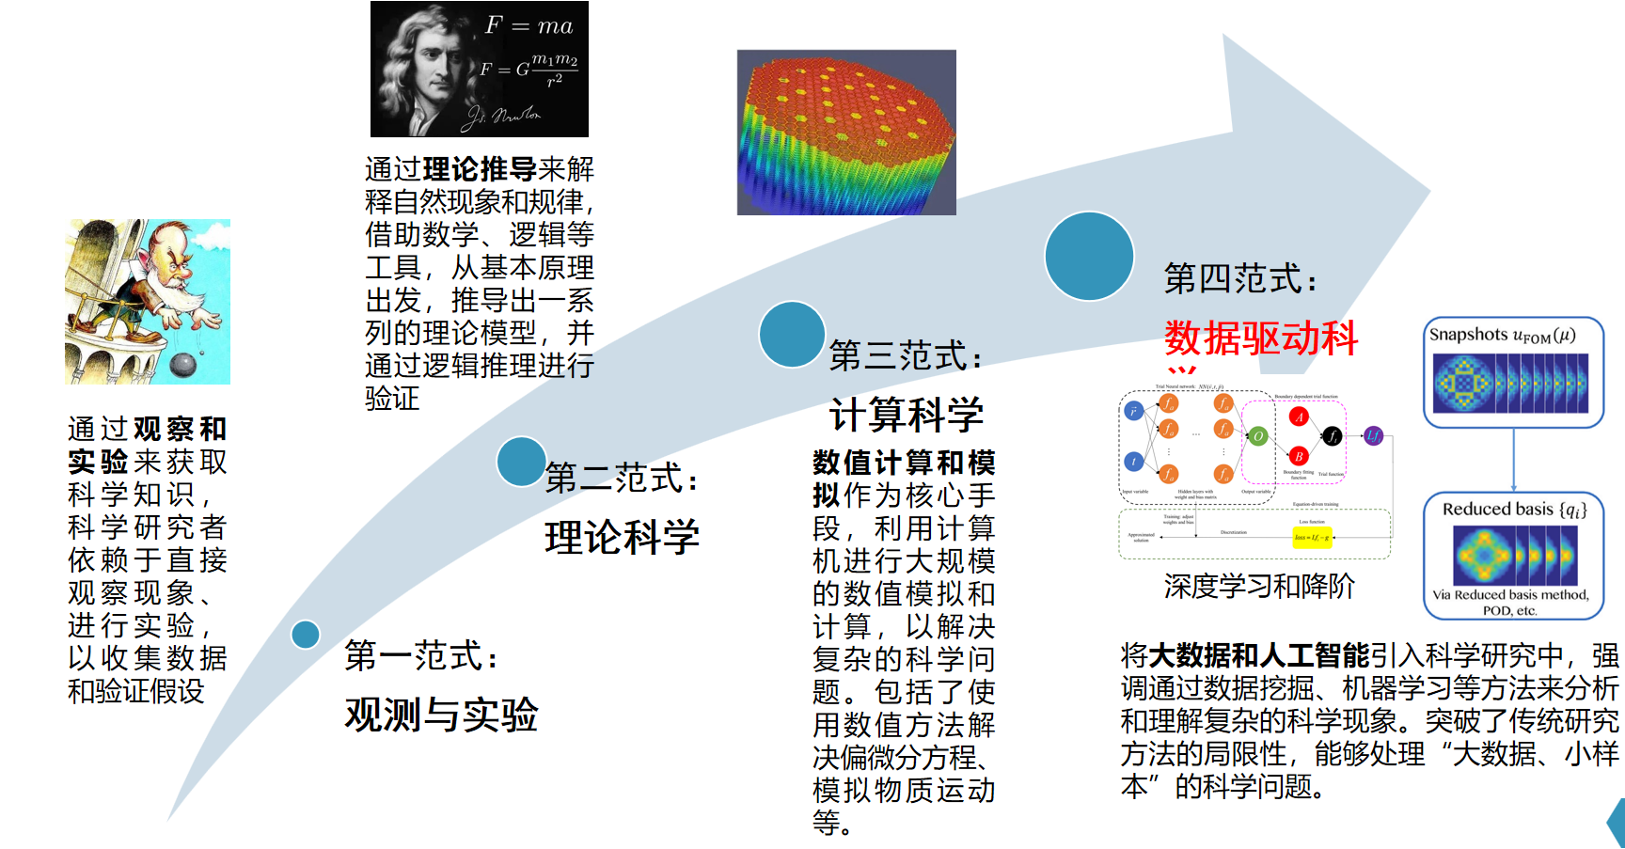
数值方法角色
现代科学/工程问题的研究方法(三大范式+第四范式)
物理问题
基本规律的数学方程描述
实验研究
理论分析
数值求解
现象形成原因
现象影响因素
模型的简化
解析求解
方程的数值求解
数据整理
真实
昂贵
更容易认识规律和本质！
复杂工程问题不存在解析求解！
容易获得复杂问题的结果！
可信度需要进一步分析！
发展中...
随着计算能力的提高和算法的改进，计算精度有重要的改善，数值求解越来越受重视及应用！

Slide 6
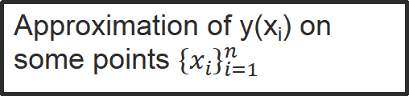
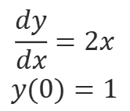
数值方法内容
What are numerical calculation methods used for?
Research object: Numerical problem
A clear and unambiguous description of the functional relationship between a finite number of input data (independent variables of the problem, raw data) and a finite number of output data (data to be solved)
Analytical expression: y=y(x)
Mathematical problem
$$\begin{matrix}\frac{dy}{dx}=2x \\ y(0)=1\end{matrix}$$
Approximation of y(x_{i}) on some points ${\left\{x_{i}\right\}}_{i=1}^{n}$
Numerical problem

Slide 7
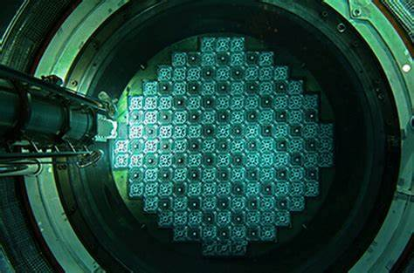
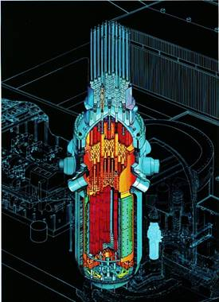
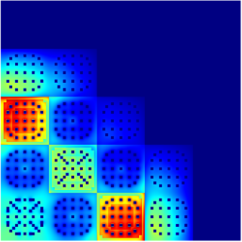
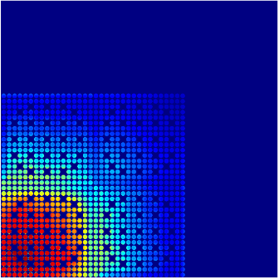
数值问题的来源及任务
数值问题
建立数学模型
实际问题
数值问题
重点讨论
求解
设计高效、可靠的数值方法
上机计算
程序设计
近似结果

Slide 8
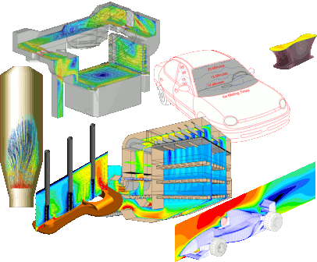
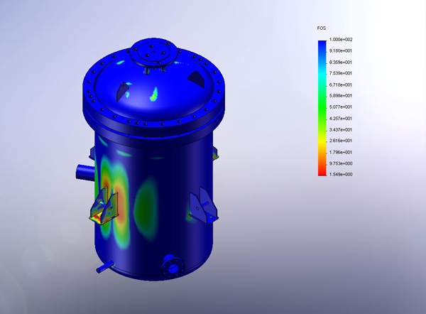
数值方法内容
Catalog
Computational Geometry
Computational Algebra
Computational Physics
Computational Mechanics
Computational Chemistry
......

Slide 9
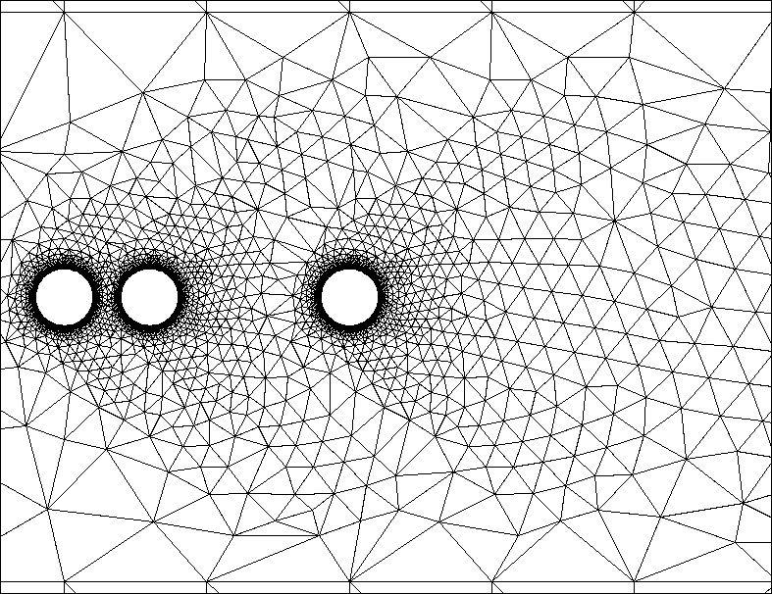
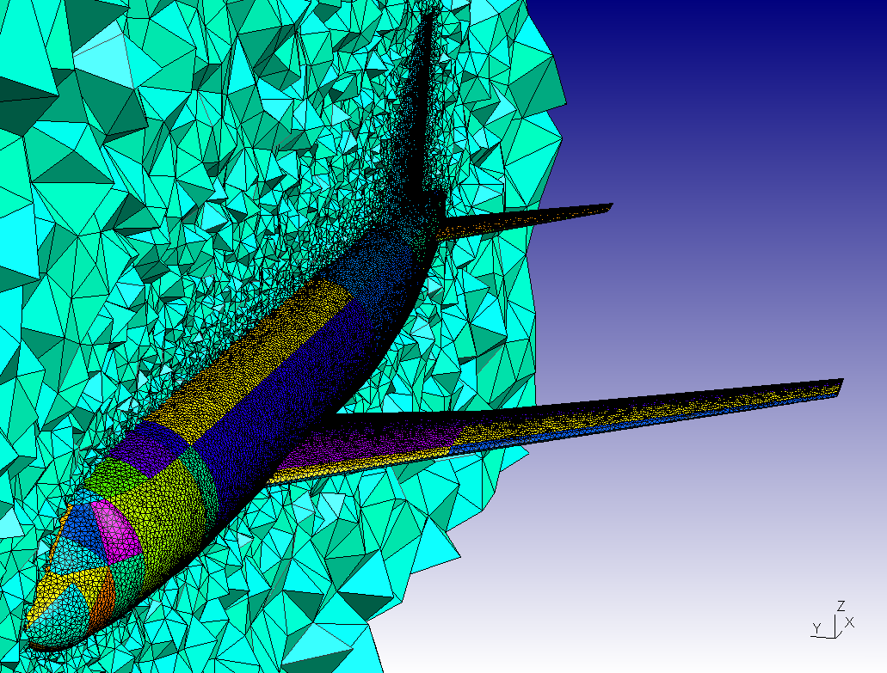
Modern numerical methods:
Spectral method, finite difference/element/volume, boundary element method, ……
Common characteristics:
Solutions are approximated using scattered points/cells
Governing equations are satisfied on the domain/control volume, ……

Slide 10
本课程内容
Lab work & Exams
Interpolation & Approximation
Lagrangian interpolation
Least-Squre fit
Numerical calculus
Differentiation
Integration
Roots finding of linear &nonlinear equations
Ordinary differential equs
Runge-Kutta methods
Shooting method
Partial differential equs
FD scheme for models
Convective-diffusion problems & application
Elliptic problems
… ?
Monte-Carlo Simulation
Cellular Automata and Lattice Boltzmann method

Slide 11
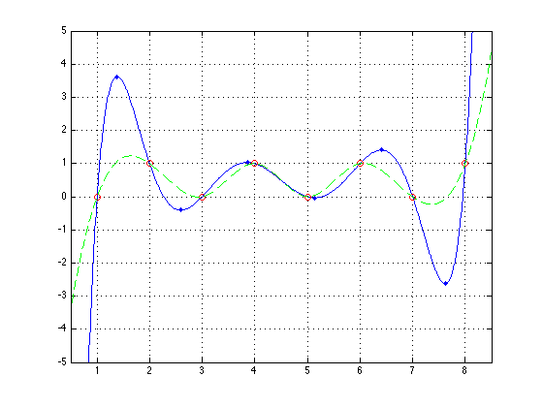
A rough introduction
Interpolation & Approximation
Given n points,
find a smooth function,
satisfying
How to construct？

Slide 12
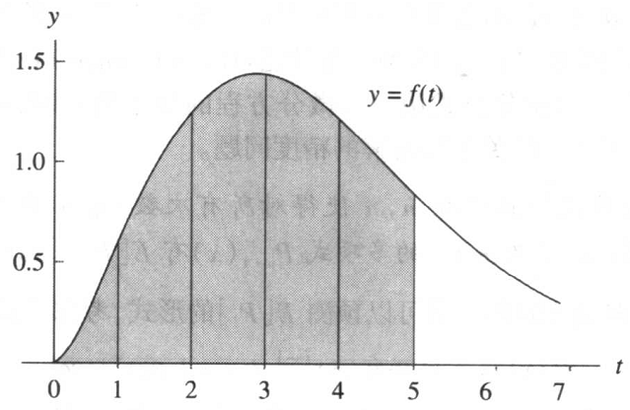
Numerical calculus
5th order
i-2 i-1 i i+1 i+2 i+3
x₀
x₁
x₂
x₃

Slide 13
Ordinary differential equs
Lotka-Volterra equation
In Matlab, ode23, ode45 can be used to solve.
What’s the algorithms for these functions ?

Slide 14
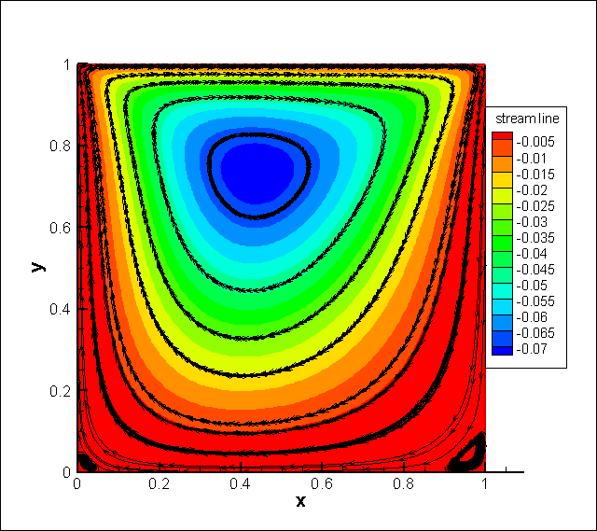
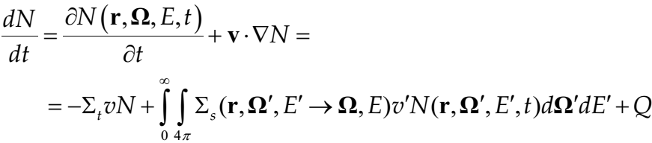
Partial differential equations
Wave equation
Heat transfer
2D incompressible flows, Navier-Stokes equations
Neutron transport equation

Slide 15
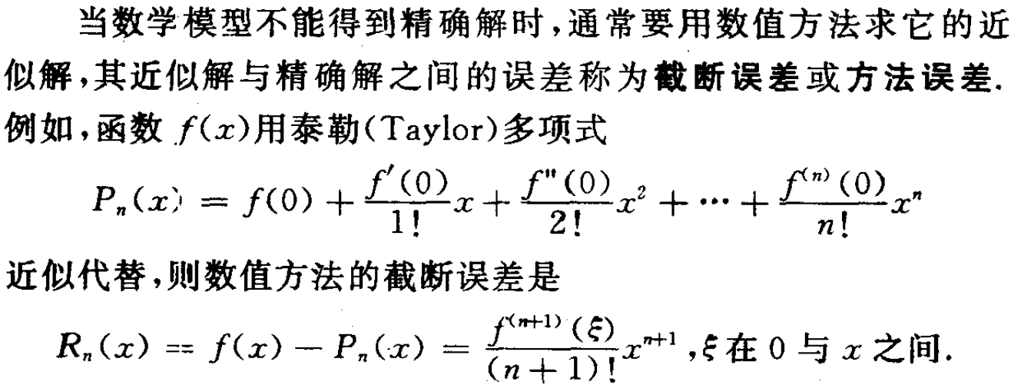
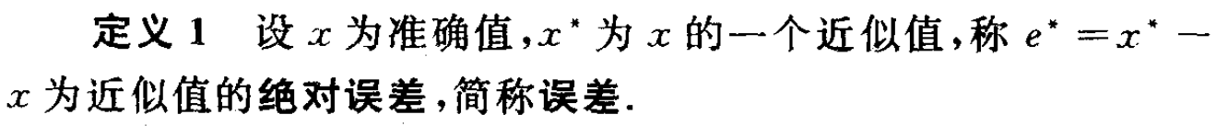
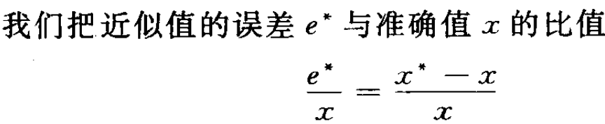
精度与误差

